Slide 1
Sub-Query

Slide 2
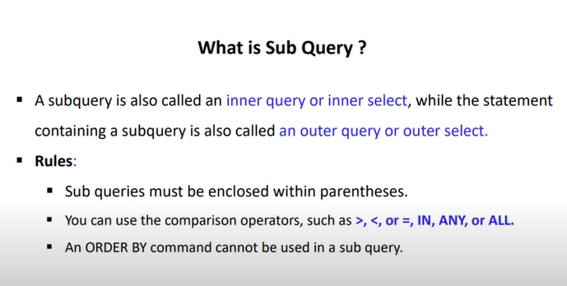

Slide 3
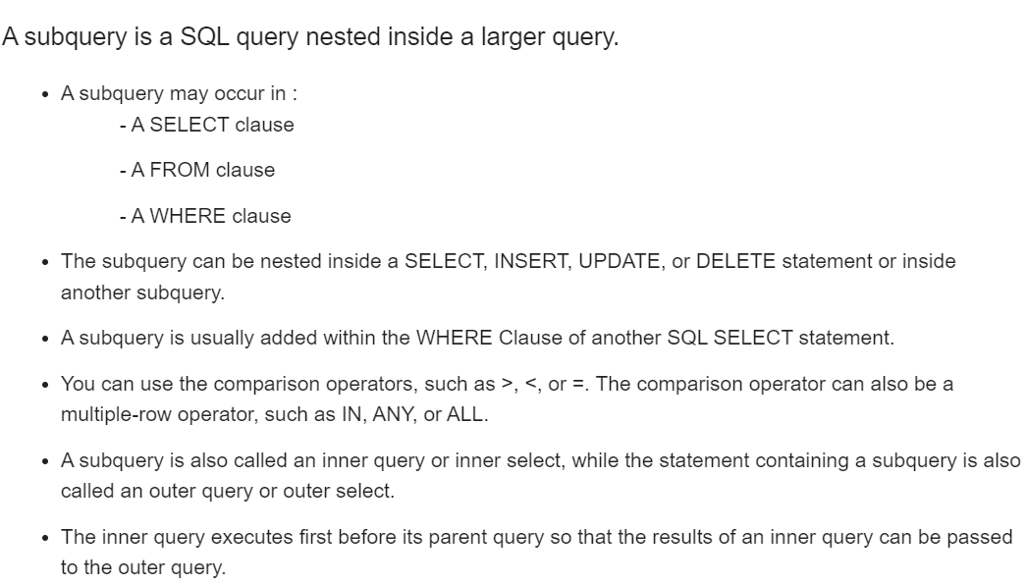

Slide 4
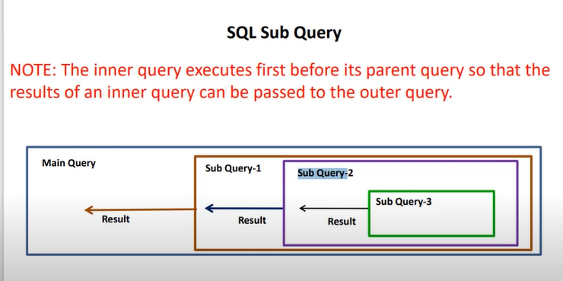

Slide 5
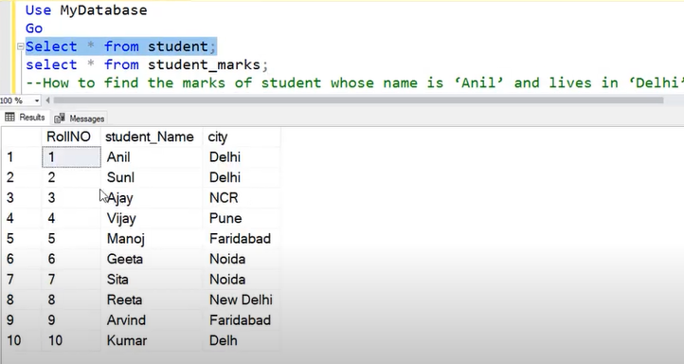

Slide 6
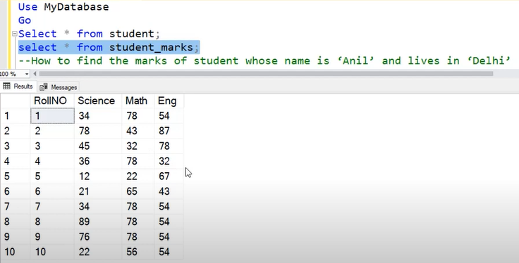

Slide 7
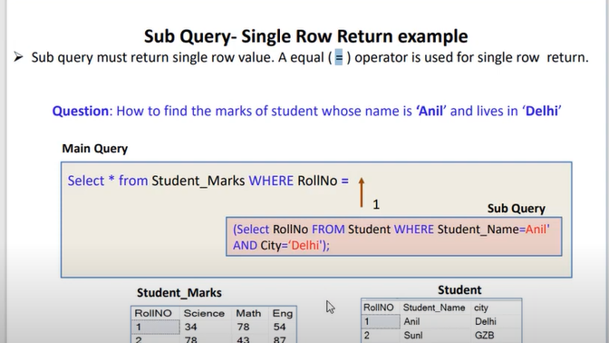

Slide 8
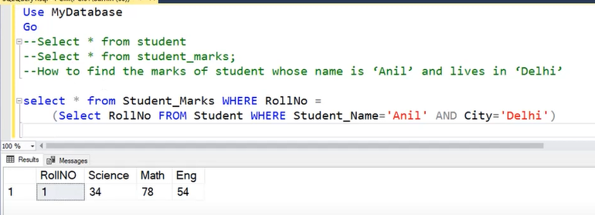

Slide 9
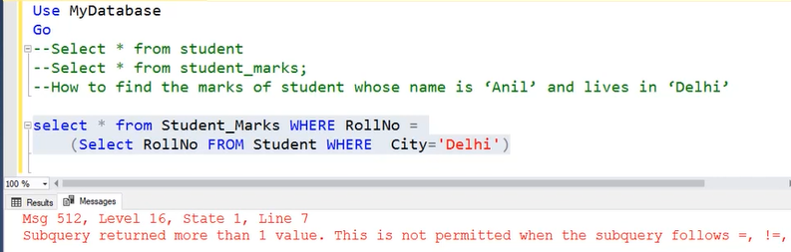

Slide 10
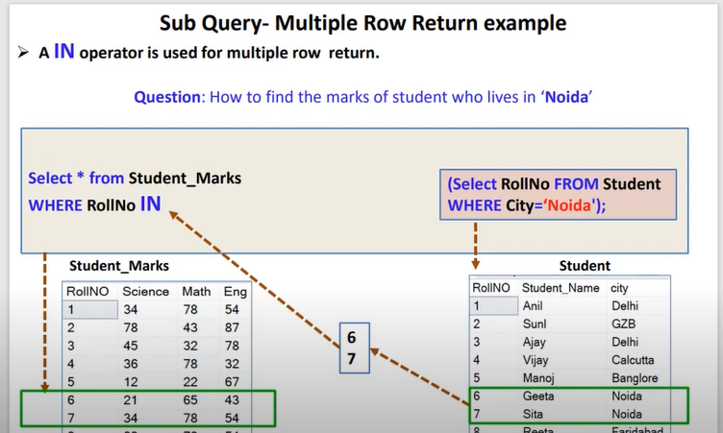

Slide 11
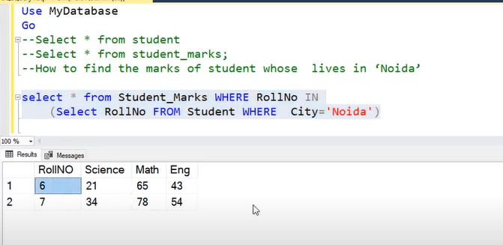

Slide 12
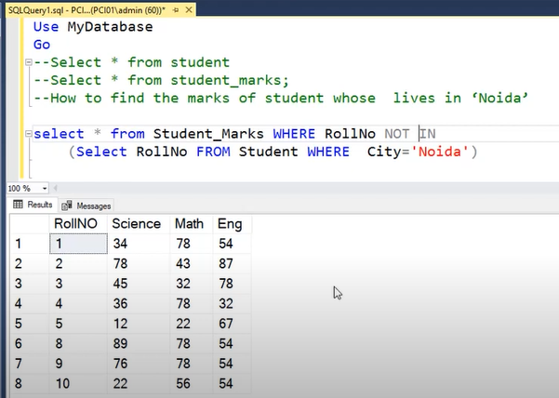

Slide 13
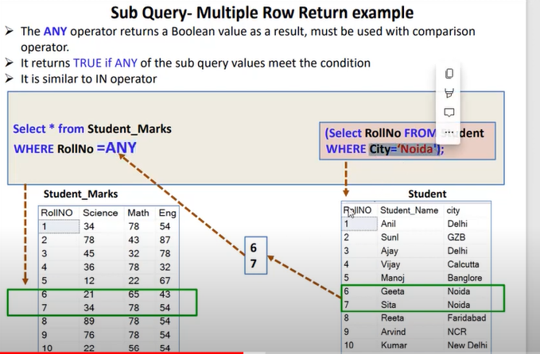

Slide 14
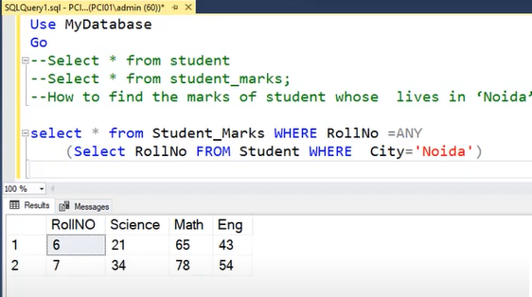

Slide 15
DELETE FROM table_name
WHERE column_name IN
( SELECT column_name FROM table_name WHERE column_name = ‘value’);
Example:
DELETE FROM student_marks
WHERE roll_no IN ( SELECT roll_no
FROM Student
WHERE city = 'delhi');
select * from student_ marks;

Slide 16
INSERT INTO table_1 SELECT * FROM table_2;
Example: insert into student select * from student_marks;

Slide 17
UPDATE table_name2 SET column_name=value
WHERE column_name IN ( SELECT column_name FROM table_name1
WHERE column_name IN (‘value1’,’value2’));
Example:
UPDATE student_marks
SET Science=900
WHERE roll_no IN ( SELECT roll_no
FROM Student
WHERE student_name IN ('geeta','sita'));
select * from mark;

