Slide 1
Introduction

Slide 2
DATA COMMUNICATIONS
The term telecommunication means communication at a distance. The word data refers to information presented in whatever form is agreed upon by the parties creating and using the data.
Data communications are the exchange of data between two devices via some form of transmission medium such as a wire cable or may be wireless.

Slide 3
Effectiveness of Data Communication
Four Fundamental Characteristics
Delivery
Accuracy
Timeliness - -real time
Jitter

Slide 4
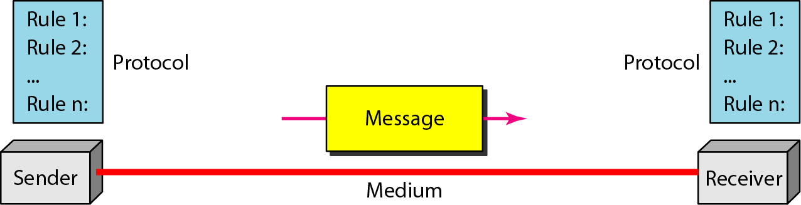
Components of a Data Communication System

Slide 5
Continue…
Five Components:
Message- Text, Number, Image, Audio, Video
Sender
Receiver
Transmission Medium
Protocol

Slide 6
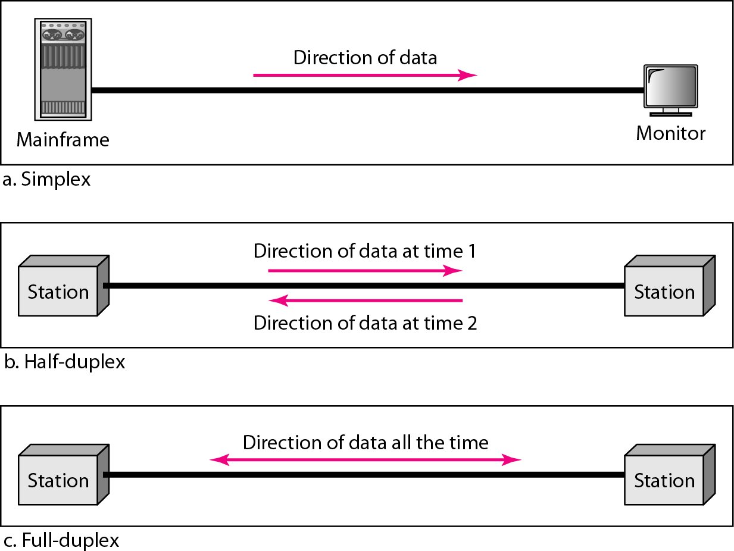
Data flow (Simplex, Half-duplex, and Full-duplex

Slide 7
NETWORKS
A network is a set of devices (often referred to as nodes) connected by communication links. A node can be a computer, printer, or any other device capable of sending and/or receiving data generated by other nodes on the network.
A link can be a cable, air, optical fiber, or any medium which can transport a signal carrying information.

Slide 8
Network Criteria
Performance
Depends on Network Elements- Transmit time, Response Time, Number of users, type of transmission medium, hardware, software.
Measured in terms of Delay and Throughput
Reliability
Failure rate of network components.
Time to recover from a failure.
Measured in terms of availability/robustness
Security
Data protection against corruption/loss of data due to:
Errors
Malicious users/ Unauthorized access.

Slide 9
Physical Structures
Type of Connection
Point to Point - single transmitter and receiver
Multipoint - multiple recipients of single transmission
Physical Topology
Connection of devices
Type of transmission - unicast, mulitcast, broadcast

Slide 10
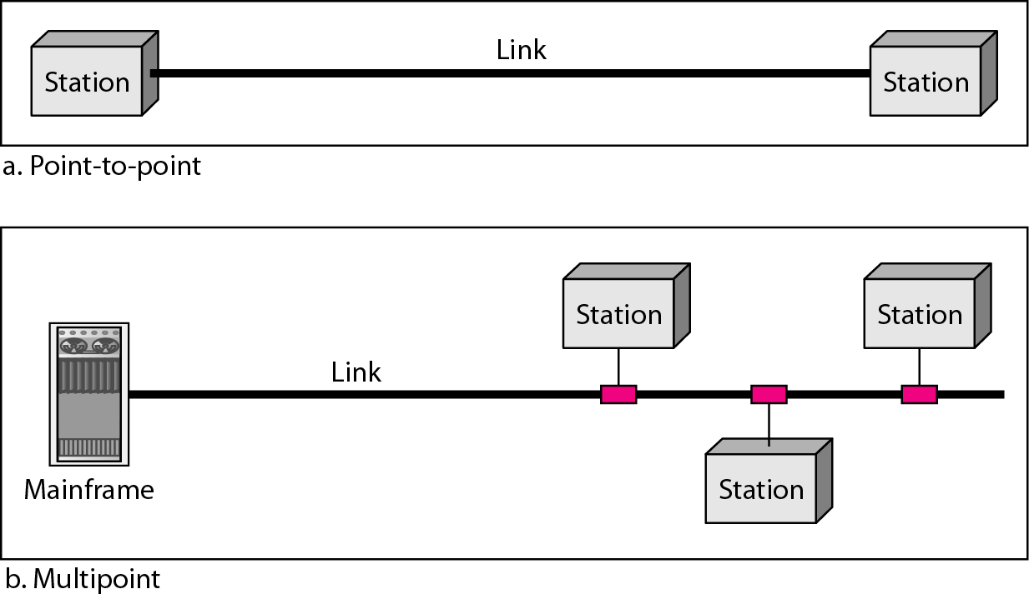
Types of connections: point-to-point and multipoint

Slide 11
Uses of Computer Network
Business Applications
Home Applications
Mobile Users
Social Issues

Slide 12
Business Applications
Resource sharing such as printers and storage devices
Exchange of information by means of e-Mails and FTP

Slide 13
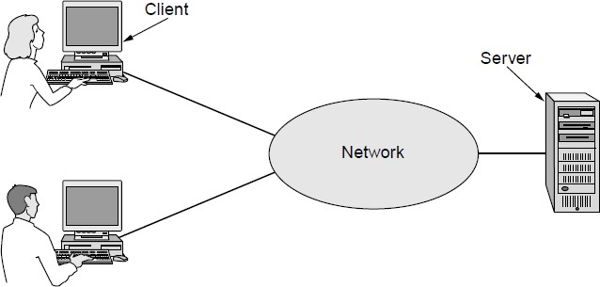
Business Applications (1)
A network with two clients and one server

Slide 14
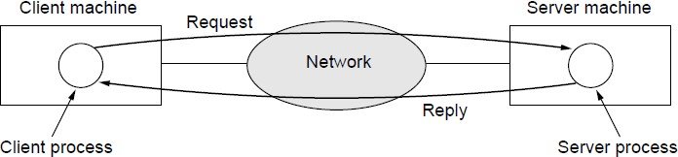
Business Applications (2)
The client-server model involves requests and replies

Slide 15
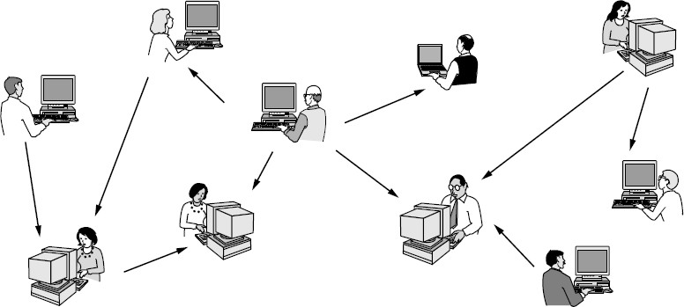
Home Applications (1)
In a peer-to-peer system there are no fixed clients and servers.

Slide 16
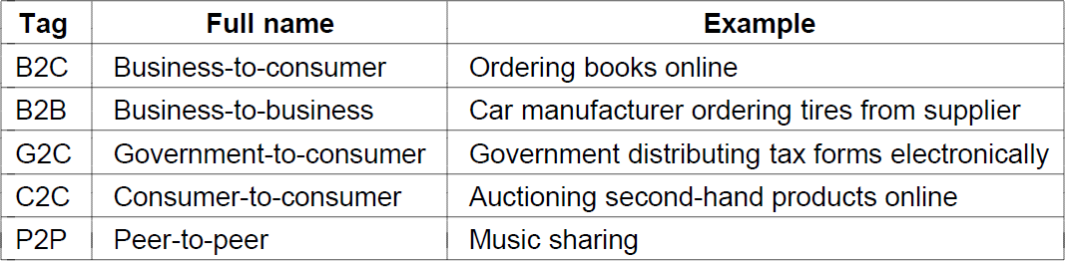
Home Applications (2)
Some forms of e-commerce

Slide 17
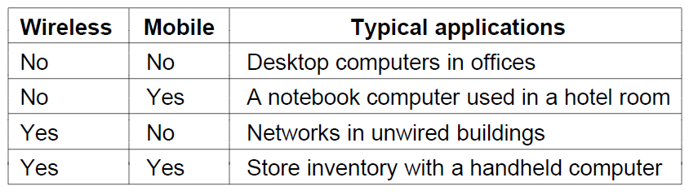
Mobile Users
Combinations of wireless networks and mobile
computing

Slide 18
Social Issues
Network neutrality
Digital Millennium Copyright Act
Profiling users
Phishing

Slide 19
PROTOCOLS
A protocol is synonymous with rule. It consists of a set of rules that govern data communications. It determines what is communicated, how it is communicated and when it is communicated.
The key elements of a protocol are
Syntax
Semantics
Timing

Slide 20
Elements of a Protocol
Syntax
Structure or format of the data
Indicates how to read the bits - field delineation
Semantics
Interprets the meaning of the bits
Knows which fields define what action
Timing
When data should be sent and what
Speed at which data should be sent or speed at which it is being received.

Slide 21
Types of Network
Wired Networks • Mobile Networks
high bandwidth
low bandwidth variability
can listen on wire
high power machines
high resource machines
low delay
connected operation
low bandwidth
high bandwidth variability
hidden terminal problem
low power machines
low resource machines
higher delay
disconnected operation
-No Mobility.
Mobility.

Slide 22

The End

