Slide 1
Chapter 16: Security

Slide 2
Chapter 15: Security
The Security Problem
Authentication
Program Threats
System Threats
Securing Systems
Intrusion Detection
Encryption
Windows NT

Slide 3
PROTECTION & SECURITY
Are implemented to prevent interference with the use of files.
Threats:- Protection & Security
Protection: is strictly internal problem. How do we provide controlled access to the programs and data stored in computer system.
Security: on the other hand, deals with the external threats.
includes firewalls, encryption techniques.
We say our system is secure if its resources are used and accessed as intended under all circumstances.
Computer resources must be guarded against unauthorized access, malicious destruction or alteration.
Total security can never be achieved.

Slide 4
The Security Problem
Security must consider external environment of the system, and protect it from:
  unauthorized access.
  malicious modification or destruction
  Data unavailability.
Security violation can be categorized as intentional or accidental.
Easier to protect against accidental than intentional misuse.

Slide 5
Some common Terms
Threat: is the potential to security violation.
Attack: attempt to break security.
Hacker:
A person with a strong interest in computers who enjoys learning and experimenting with them.
Cracker/Intruder:
Someone who breaks into computers.
Crackers should not be confused with hackers.
The term cracker is usually connected to computer criminals.
Some of their crimes include ID theft and session hijacking and intrusion in unauthorized areas.

Slide 6
Some security violations:
Breach of confidentiality: Unauthorized reading of data. Theft of information
Breach of integrity: Unauthorized modification of data.
Breach of availability: Unauthorized destruction of data/ website defacement: A website defacement is an attack on a website that changes the visual appearance of the site or a webpage. These are typically the work of system crackers, who break into a web server and replace the hosted website with one of their own. SQL injections.
Theft of service: unauthorized use of resources.
Denial of service: Send invalid data to applications or network services, which cause abnormal termination or behavior of the applications or services.
Flood a computer or the entire network with traffic until a shutdown occurs because of the overload.

Slide 7
Attackers use several standard methods in their attempts to breach security:
Masquerading: pretend to be someone else.
Replay attack: repeat of valid data transmission
Man in the middle attack: attacker sits in the data flow of communication. Masquerading as the sender to the receiver and vice versa.

Slide 8
To protect our system, we must take security measures at 4 levels:
Physical (site containing computer system must be physically secured).
Human(using authorization/authentication mechanisms)
Operating system(using firewalls)
Network(using encryption-decryption techniques)

Slide 9
Authentication
User identity most often established through passwords.
Passwords must be kept secret.
  Frequent change of passwords.
  Use of “non-guessable” passwords.
  Log all invalid access attempts.
Passwords may also either be encrypted or allowed to be used only once.

Slide 10
ACCESS MATRIX
Access Matrix is used to specify the resources a process may access.
Protection Domain-Domain can be user, process, procedure

Slide 11

Domain Structure
Access-right = <object-name, rights-set>
where rights-set is a subset of all valid operations that can be performed on the object
Domain = set of access-rights

Slide 12
Access Matrix
Used for the implementation of Protection Model.
Rows represent domains
Columns represent objects
Access(i, j) is the set of operations that a process executing in Domain_{i} can invoke on Object_{j}

Slide 13

Access Matrix

Slide 14
Types of Threats
Program Threats
When any prog.created by a user is used by another user then misuse of that prog.may occur.Examples:-Trojan Horses,Trap doors,stack buffer overflow.
Malware(malicious software): software that is specifically designed to disrupt, damage, or gain unauthorized access to a computer system Types of malware can include computer viruses, worms, Trojan horses and spyware.

Slide 15
Trojan horse
A Trojan horse, or Trojan, is software that appears to perform a desirable function for the user, but (perhaps in addition to the expected function) steals information or harms the system.
It is a program that sit ideally and transmits all user information to the attacker.
It is attached to your browser and when user fills his username or password for any website, it records everything and passes to attacker.

Slide 16
Spyware
Spyware is a type of malware that can be installed on computers, and which collects small pieces of information about users without their knowledge.
The presence of spyware is typically hidden from the user, and can be difficult to detect.
Sometimes, however, spywares such as key loggers are installed by the owner of a shared, corporate, or public computer on purpose in order to secretly monitor other users.
While the term spyware suggests software that secretly monitors the user's computing. Spyware programs can collect various types of personal information, such as Internet surfing habits and sites that have been visited, but can also interfere with user control of the computer in other ways, such as installing additional software and redirecting Web browser activity.
Spyware is known to change computer settings, resulting in slow connection speeds, different home pages, and/or loss of Internet connection or functionality of other programs.

Slide 17
System Threats-OS files/resources are misused
VIRUS: Vital Information Resource Under Seize or Very Important Resource Under Seize ..both are correct.
Small progs. Written to alter the way a computer operates.
designed to “infect” other programs.
Executes without user permission.
Can replicate itself.
Once a virus reaches a target machine, a program known as virus dropper inserts virus onto system..

Slide 18
Worms
Small programs that do -Self propagating or self duplicating.
Contains malicious code that cause major damage to OS files.
If a device gets infected, it sends the copies of itself onto the network to other devices.
Sometimes more dangerous, it might go into your email, find your contacts, sends copies of itself to all the contacts.

Slide 19
Threat Monitoring
Check for suspicious patterns of activity – i.e., several incorrect password attempts may signal password guessing.
Audit log – records the time, user, and type of all accesses to an object; useful for recovery from a violation and developing better security measures.
Scan the system periodically for security holes; done when the computer is relatively unused.

Slide 20
FireWall
A firewall is a device or set of devices designed to permit or deny network transmissions based upon a set of rules and is frequently used to protect networks from unauthorized access while permitting legitimate communications to pass.
A firewall is placed between trusted and untrusted hosts.
The firewall limits network access between these two security domains.

Slide 21
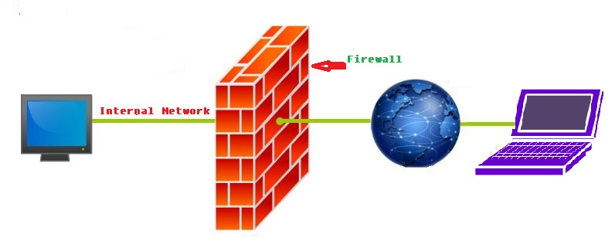

Slide 22
Encryption
Encrypt clear text into cipher text.
Substitution and transposition ciphers
Properties of good encryption technique:
  Relatively simple for authorized users to encrypt and decrypt data.
  Encryption scheme depends not on the secrecy of the algorithm but on a parameter of the algorithm called the encryption key.
  Extremely difficult for an intruder to determine the encryption key.
Data Encryption Standard substitutes characters and rearranges their order on the basis of an encryption key provided to authorized users via a secure mechanism. Scheme only as secure as the mechanism.

Slide 23
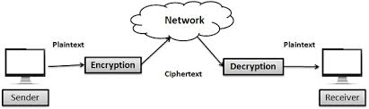

Slide 24
Encryption (Cont.)
Public-key cryptography refers to a cryptographic system requiring two separate keys, one to lock or encrypt the plaintext, and one to unlock or decrypt the cyphertext.
Neither key will do both functions.
One of these keys is published or public and the other is kept private.
Public key cryptography was invented in 1976 by Whitfield Diffie and Martin Hellman. For this reason, it is sometime called Diffie-Hellman encryption.
It is also called asymmetric encryption because it uses two keys instead of one key (symmetric encryption).

Slide 25
Private key encryption
Symmetric encryption (also called private-key encryption or secret-key encryption) involves using the same key for encryption and decryption.
Encryption involves applying an operation (an algorithm) to the data to be encrypted using the private key to make them unintelligible.

Slide 26
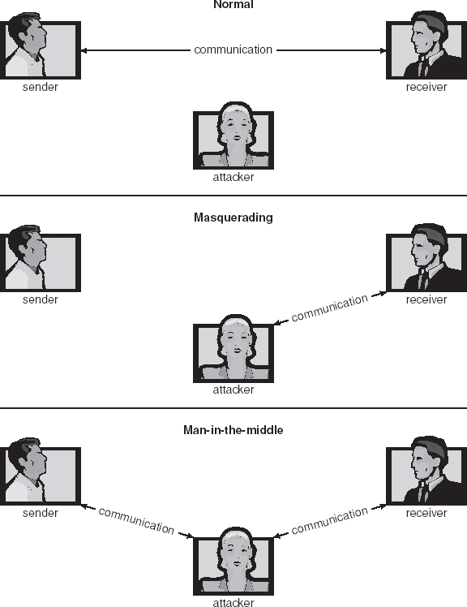
15.01

Slide 27
End of Chapter 15

