Slide 1
Chapter 8: Memory Management

Slide 2
Chapter 8: Memory Management
Background
Swapping
Contiguous Allocation
Paging
Segmentation
Segmentation with Paging

Slide 3
It is the functionality of an OS which manages primary memory(limited)& moves process back and forth b/w main memory and disk during execution.
Functions of memory management:-
Keep track of every memory location.
Track of whether memory is allocated or not?
Track of how much memory is allocated?
Takes the decision which process will get memory and when?
Updates the status of memory when it is allocated or freed.
Protection.(User may not enter into OS area from User area, implemented by FENCE address )

Slide 4

Memory Hierarchy
Size
Access Time
Per unit cost

Slide 5
Background
Memory consists of large array of words or bytes, each with its own address. CPU fetches instructions from the memory as per the value of program counter. These instructions may cause additional loading from or storing to the memory.
A typical instruction execution cycle, for example may be:
  fetch
  Decode and calculate effective address
  Fetch operands
  Execute operation
  Store result.

Slide 6
Basic hardware
Main memory and the registers built into the processor are the only storage that CPU can access directly.
There are machine instructions that take memory addresses or registers as operands. But none that takes disk addresses. Therefore any instruction in execution or any data being used by instruction must be in one of these direct access storage devices.
If is not in memory then firstly it must be moved there because can operate on it.

Slide 7
Base & Limit Registers
We first need to make sure that each process has a separate memory space.
To do this, we need the ability to determine the range of legal addresses that process may access and to ensure that the process can access only these legal addresses.
For that we use:
Base register: smallest legal physical memory address.
Limit register: Holds the size of the range.
Example:-Base=200 Limit=400 it means,
A process can access memory from 200 to 600(Base + Limit)

Slide 8
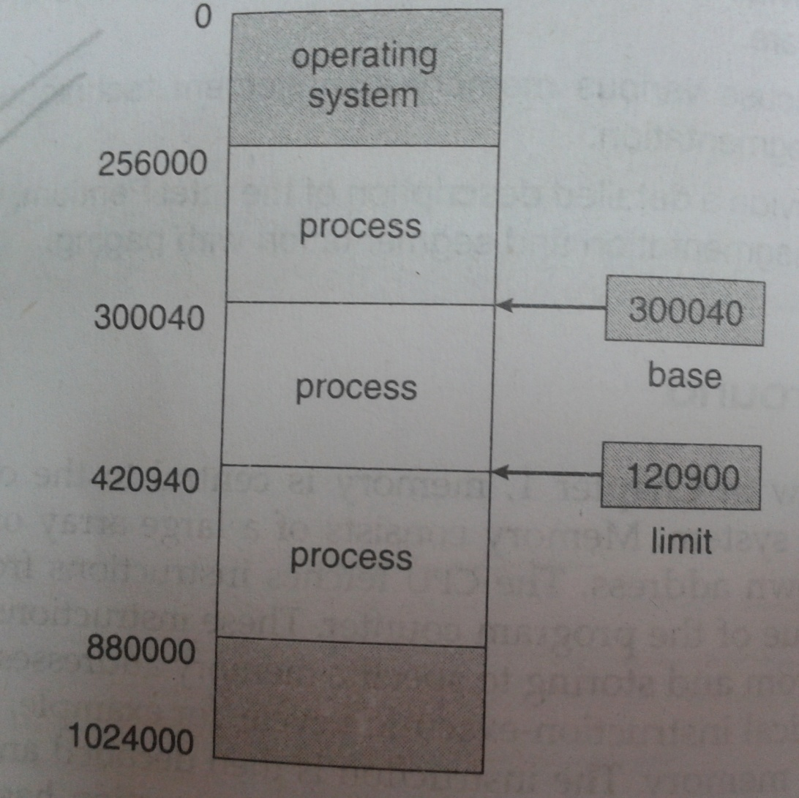
.. contd

Slide 9
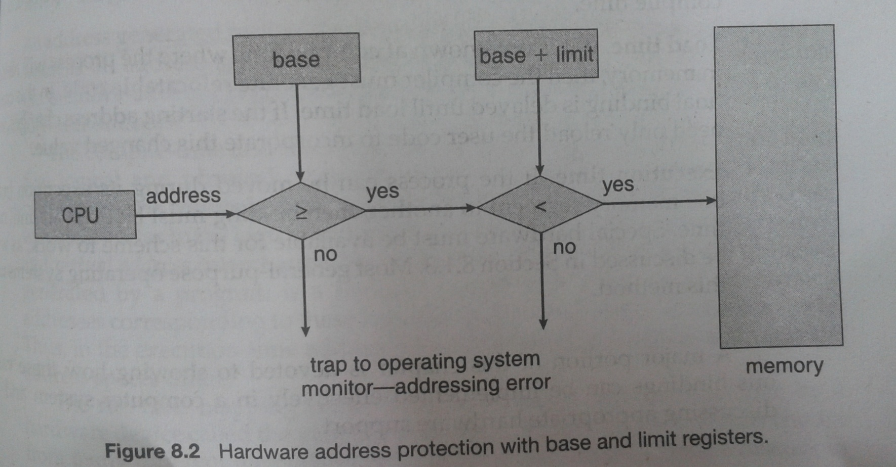
H/W Protection of memory address space

Slide 10
Address Binding of Instructions and Data to Memory
For the CPU to execute a process, the process must be loaded into the main memory.
There are two different types of address in the memory, logical address (generated by CPU) and physical address (address in the main memory).
User deals with only logical addresses, therefore address translation ( or address binding) from logical to physical address must be done to locate the process in the main memory.

Slide 11
Address binding of instructions and data to memory addresses Can happen at three different stages
Compile time: If memory location known at compile time, absolute code can be generated; must recompile code if starting location changes
Load time: Must generate relocatable code if memory location is not known at compile time. In this case final binding is delayed until load time.
Execution time: Binding delayed until run time if the process can be moved during its execution from one memory segment to another. Need hardware support for address maps (e.g., base and limit registers).

Slide 12

Multistep Processing of a User Program

Slide 13
Logical vs. Physical Address Space
The concept of a logical address space that is bound to a separate physical address space is central to proper memory management
  Logical address space(LAS) – generated by the CPU; also referred to as virtual address.
  Physical address space(PAS) – address seen by the memory management unit or the actual address of the physical memory (RAM)
  When process is executing, it generates the Logical address
  In compile time and load time memory address binding LAS & PAS are same.
  In execution time time memory address binding LAS & PAS are different.

Slide 14
Memory-Management Unit (MMU)
Hardware device that maps virtual/logical to physical address
In MMU scheme, the value in the relocation register is added to every address generated by a user process at the time it is sent to memory
The user program deals with logical addresses; it never sees the real physical addresses

Slide 15

Dynamic relocation using a relocation register

Slide 16
Dynamic Loading
Routine is not loaded until it is called
Better memory-space utilization; unused routine is never loaded
Main program is loaded into the memory and is executed. when a routine needs to call another routine, it is firstly checked that whether it is there in memory. If it is not then it is loaded.

Slide 17
Swapping
A process can be swapped temporarily out of memory to a backing store, and then brought back into memory for continued execution
Backing store – fast disk large enough to accommodate copies of all memory images for all users.
Roll out, roll in – swapping variant used for priority-based scheduling algorithms; lower-priority process is swapped out so higher-priority process can be loaded and executed
Major part of swap time is transfer time; total transfer time is directly proportional to the amount of memory swapped
Modified versions of swapping are found on many systems (i.e., UNIX, Linux, and Windows)

Slide 18

Schematic View of Swapping

Slide 19

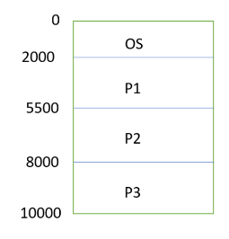
Contiguous memory allocation
Memory is divided into two partitions: one for resident OS one for user processes.
Each process is contained in a single contiguous section of memory.
One of the simplest methods for allocating memory is to divide memory into several fixed size partitions. each partition may contain exactly one process.

Slide 20
Two common methods for allocating memory in contiguous memory allocation are:
1. Fixed-Partition
2. Variable-Partition.

Slide 21
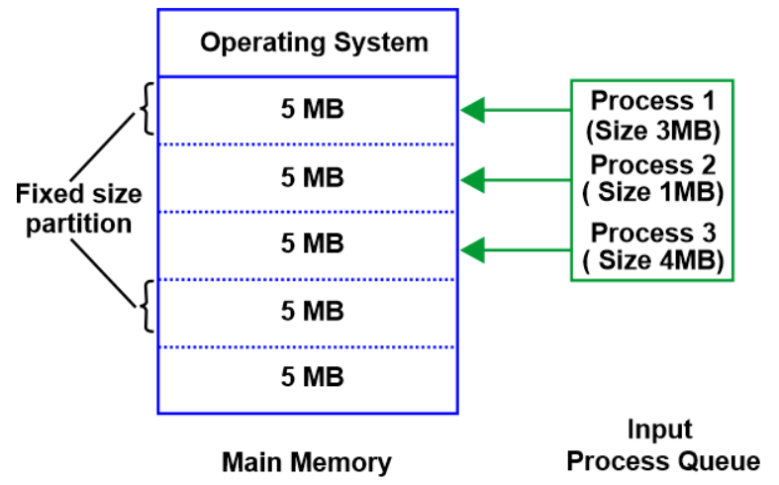
Fixed-Partition Method
In the fixed-partition method, memory is divided into several fixed-size partitions.
Each partition contains exactly one process.
In this case, the degree of multiprogramming is equal to the number of partitions.

Slide 22
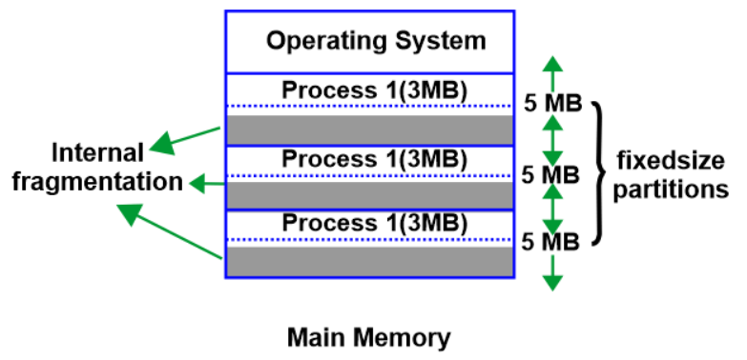
Drawback of Fixed-Partition Method
If there is some wastage inside the partition then it is termed Internal Fragmentation.

Slide 23
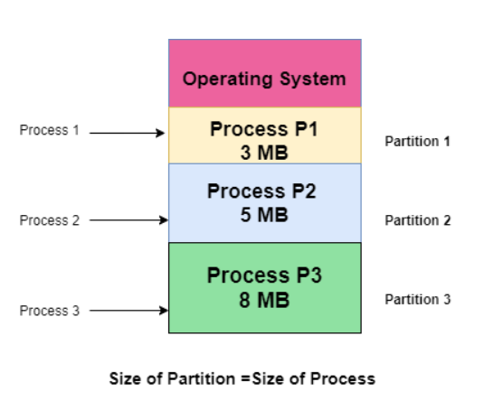
Variable-Partition Method
In the variable-partition method, the whole memory is a big hole. Initially, it is all empty.
Whenever a process arrives it is allocated memory from the hole.
The OS maintains a table indicating which part of the memory is free.

Slide 24
Contiguous Allocation
Multiple-partition allocation
  Hole – block of available memory; holes of various size are scattered throughout memory
  When a process arrives, it is allocated memory from a hole large enough to accommodate it
  Operating system maintains information about:
  a) allocated partitions b) free partitions (hole)
OS
OS
OS
OS
process 5
process 5
process 5
process 5
process 9
process 9
process 8
process 10
process 2
process 2
process 2
process 2

Slide 25
Dynamic Storage-Allocation
How to satisfy a request of size n from a list of free holes
First-fit: Allocate the first hole that is big enough
Best-fit: Allocate the smallest hole that is big enough; must search entire list, unless ordered by size. Produces the smallest leftover hole.
Worst-fit: Allocate the largest hole; must also search entire list. Produces the largest leftover hole.
First-fit and best-fit better than worst-fit in terms of speed and storage utilization

Slide 26
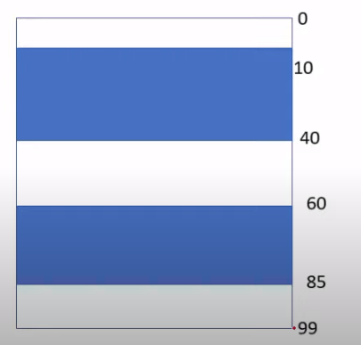
Example
Given three free memory partitions of 10 KB, 20 KB and 15 KB(in order), how would each of the first-fit, best-fit, and worst-fit algorithms place processes of 15 KB, 10 KB, 20 KB and 5 KB (in order)?

Slide 27
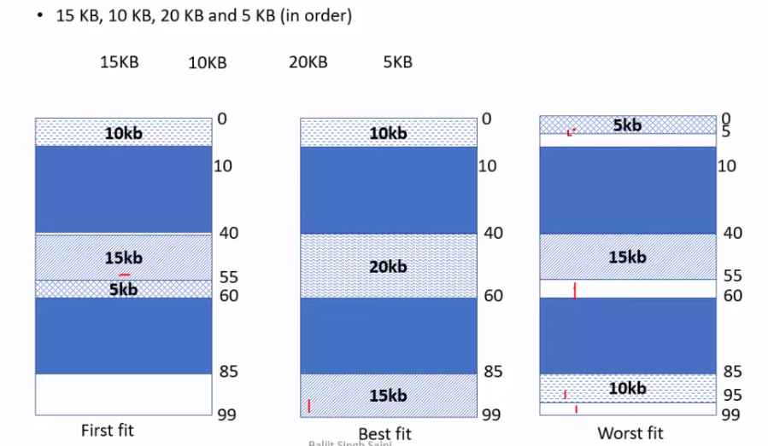

Slide 28
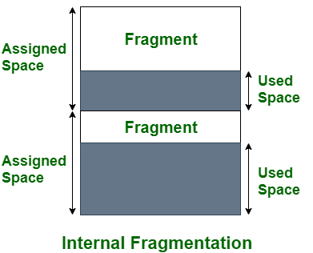
Fragmentation
External Fragmentation –Arises when unable to accommodate a process of size even we have sufficient size of memory but it is not contiguous.
Internal Fragmentation –Arises when a process of size smaller than allocated partition is placed in that partition, that leaves behind small amount of unused memory
Reduce external fragmentation by compaction(solution)
  Shuffle memory contents to place all free memory together in one large block to avoid External Fragmentation
  Compaction is possible only if relocation is dynamic, and is done at execution time

Slide 29
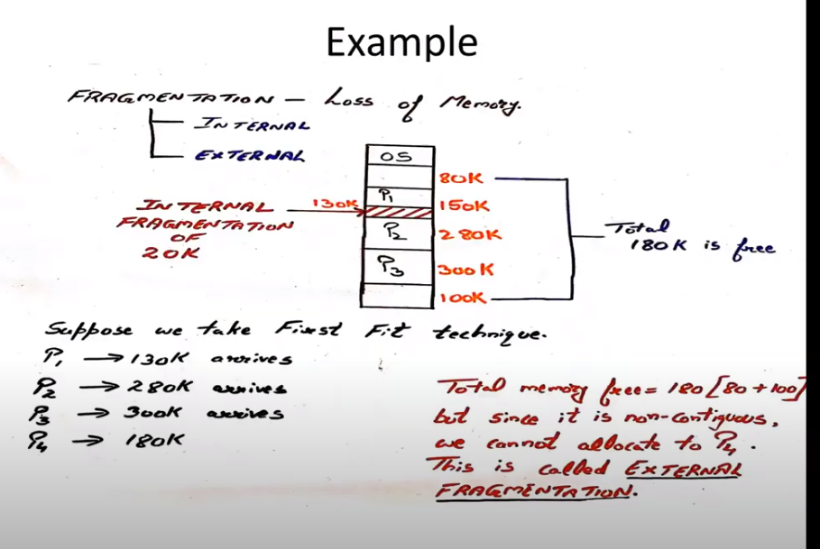

Slide 30
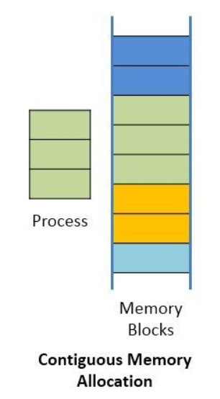
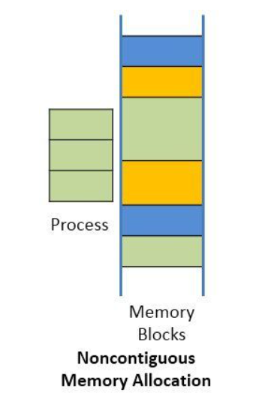
Non-Contiguous Memory Allocation
It allows to store parts of a single process in a non-contiguous fashion.
Thus, different parts of the same process can be stored at different places in the main memory.

Slide 31
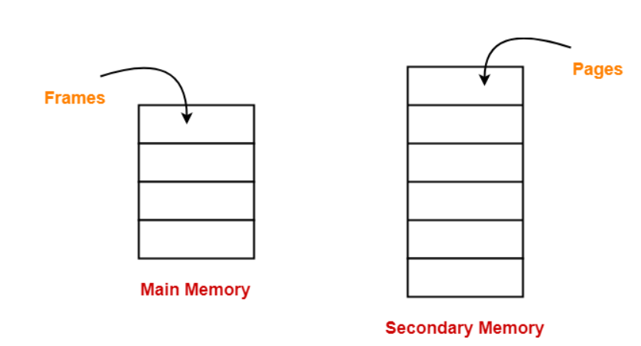
Paging
Paging is a fixed size partitioning scheme.
In paging, secondary memory and main memory are divided into equal fixed size partitions.
The partitions of secondary memory are called as pages.
The partitions of main memory are called as frames.
Each process is divided into parts where size of each part is same as page size.
The pages of process are stored in the frames of main memory depending upon their availability.

Slide 32
Address Translation Scheme
Logical Address generated by CPU is divided into:
  Page number (p) – Page Number specifies the specific page of the process from which CPU wants to read the data.
-- Page offset (d) – Page Offset specifies the specific word on the page that CPU wants to read.(Size of page)
For the page number generated by the CPU,
  Page Table provides the corresponding frame number (base address of the frame) where that page is stored in the main memory.
  The frame number combined with the page offset forms the required physical address.
Frame number specifies the specific frame where the required page is stored.
Page Offset specifies the specific word that has to be read from that page.

Slide 33
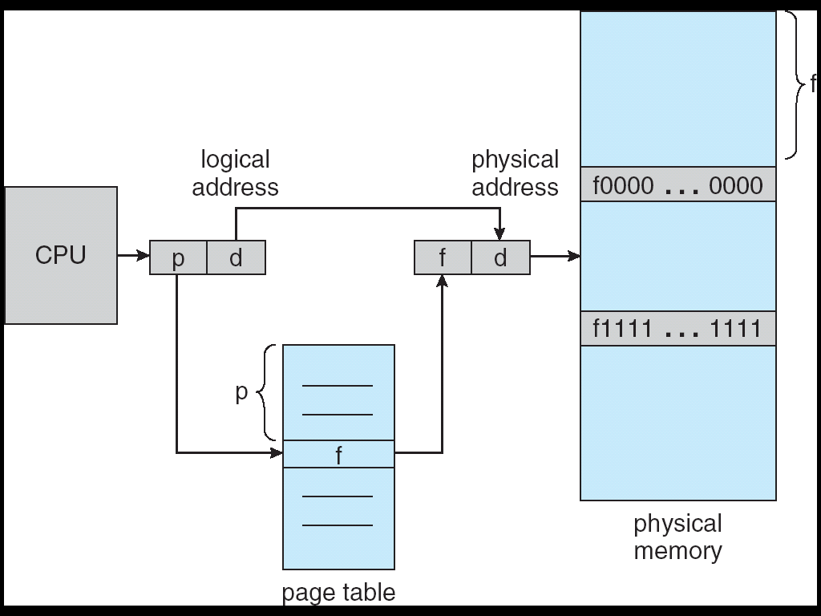
Address Translation Architecture

Slide 34

Paging Example

Slide 35

Paging Example

Slide 36

Free Frames
Before allocation
After allocation

Slide 37
How to break logical address into page number and page offset?
If address space size = 2^{m}
Page size = 2^{n}
Then
Page number = higher order (m-n) bits
Page offset = n low-order bits

Slide 38
Paging Example
Q. Using a page size of 4bytes and physical memory of 32 bytes, find the physical address if the logical address is
A.4
B.10
Solution:
a) Page size = 4bytes = 2² (i.e. n=2)
Address space = 32 = 2⁵ (i.e. m=5)
Logical address = 4
In binary = 00100
Page number=(higher)(m-n)bits=5-2=3 bits
i.e. 001 = 1
Offset = (lower)n bits = 2 bits i.e. 00 = 0
From page table, if page number = 1
Then frame = 6
Physical address = frame*page size + offset
= 6*4+0 = 24

Slide 39
Implementation of Page Table
Page table is kept in main memory
Page-table base register (PTBR) points to the page table
Page-table length register (PRLR) indicates size of the page table
In this scheme every data/instruction access requires two memory accesses. One for the page table and one for the data/instruction.
The two memory access problem can be solved by the use of a special fast-lookup hardware cache called associative memory or translation look-aside buffers (TLBs)

Slide 40
Memory Protection
Memory protection implemented by associating protection bit with each frame
Valid-invalid bit attached to each entry in the page table:
  “valid” indicates that the associated page is in the process’ logical address space, and is thus a legal page
  “invalid” indicates that the page is not in the process’ logical address space

Slide 41

Valid (v) or Invalid (i) Bit In A Page Table

Slide 42
Segmentation
Like Paging, Segmentation is another non-contiguous memory allocation technique.
In segmentation, process is not divided blindly into fixed size pages.
Rather, the process is divided into modules for better visualization.
Characteristics-
Segmentation is a variable size partitioning scheme.
In segmentation, secondary memory and main memory are divided into partitions of unequal size.
The size of partitions depend on the length of modules.
The partitions of secondary memory are called as segments.

Slide 43
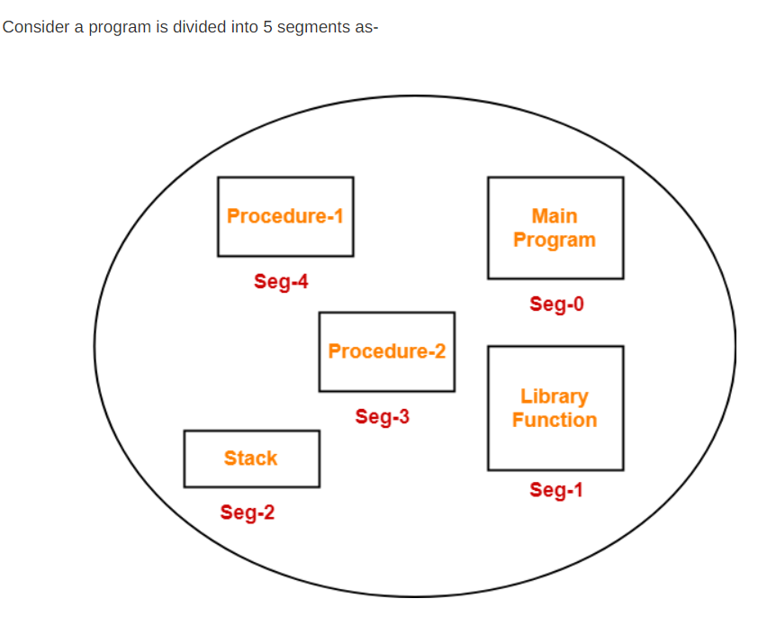
Example

Slide 44

User’s View of a Program

Slide 45
Logical View of Segmentation
1
1
4
2
3
4
2
3
user space
physical memory space

Slide 46
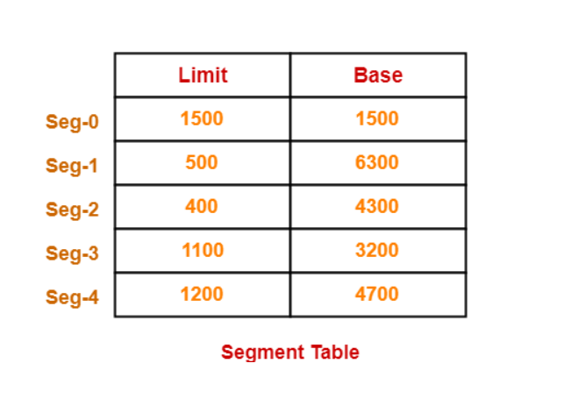
Segment Table
Segment table is a table that stores the information about each segment of the process.
It has two columns.
First column stores the size or length of the segment.
Second column stores the base address or starting address of the segment in the main memory.

Slide 47
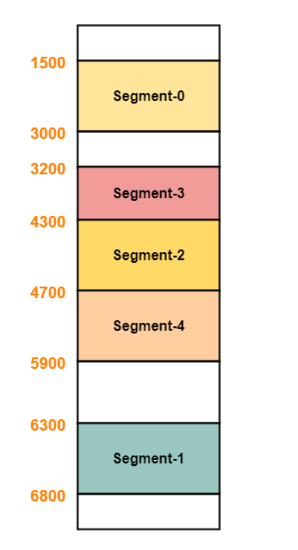
Segments are stored in the main memory as-

Slide 48
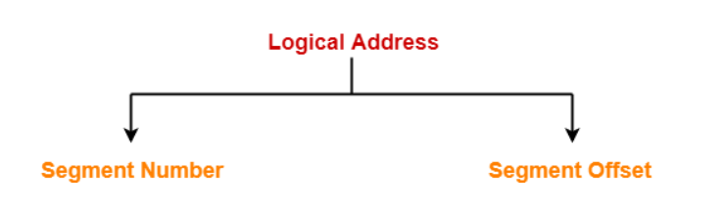
Translating Logical Address into Physical Address-
Step-01:
Segment Number specifies the specific segment of the process from which CPU wants to read the data.
Segment Offset specifies the specific word in the segment that CPU wants to read.

Slide 49
Translating Logical Address into Physical Address-
For the generated segment number, corresponding entry is located in the segment table.
Then, segment offset is compared with the limit (size) of the segment.
Now, two cases are possible-
Case-01: Segment Offset >= Limit
If segment offset is found to be greater than or equal to the limit, a trap is generated.
Case-02: Segment Offset < Limit
If segment offset is found to be smaller than the limit, then request is treated as a valid request.
Then, segment offset is added with the base address of the segment.
The result obtained after addition is the address of the memory location storing the required word.

Slide 50
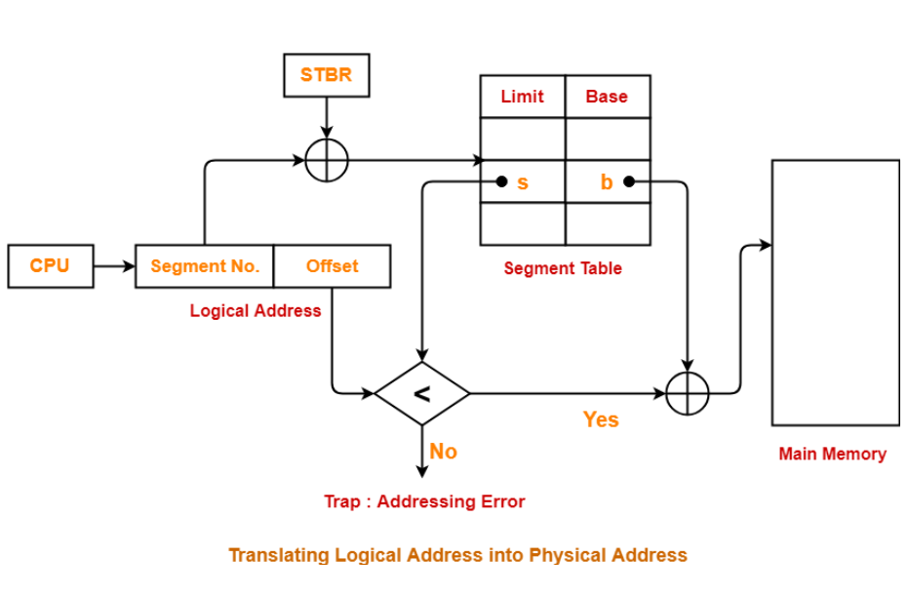

Slide 51
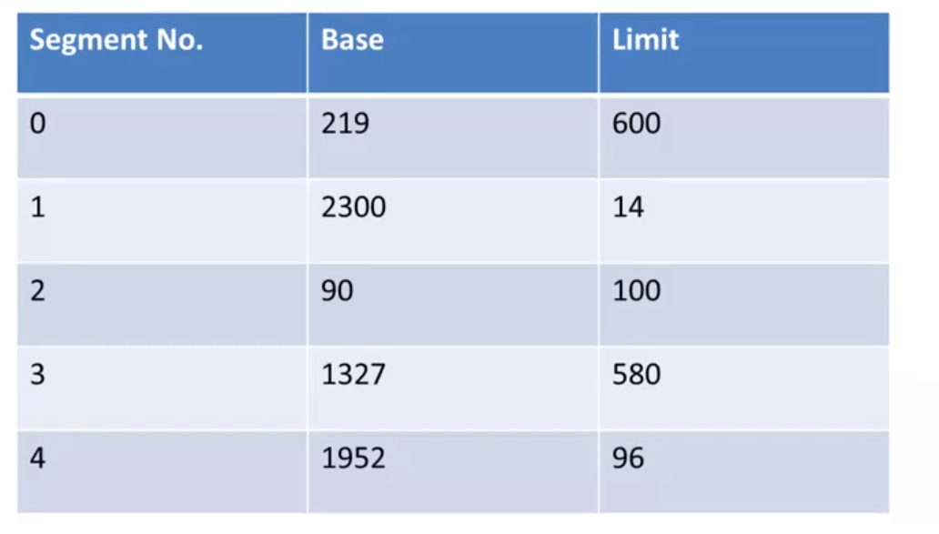
Example
Consider following segmentation table. What are the physical address for the following logical address.

Slide 52
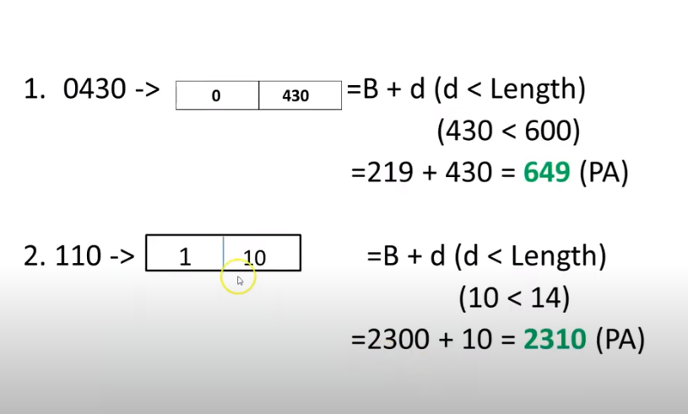

Slide 53
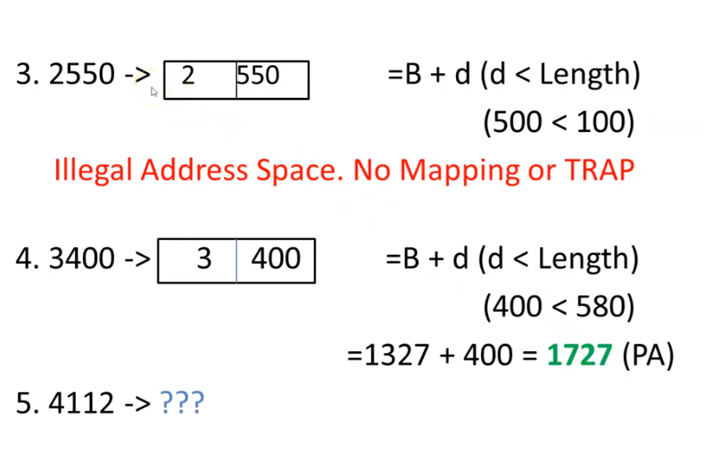

Slide 54
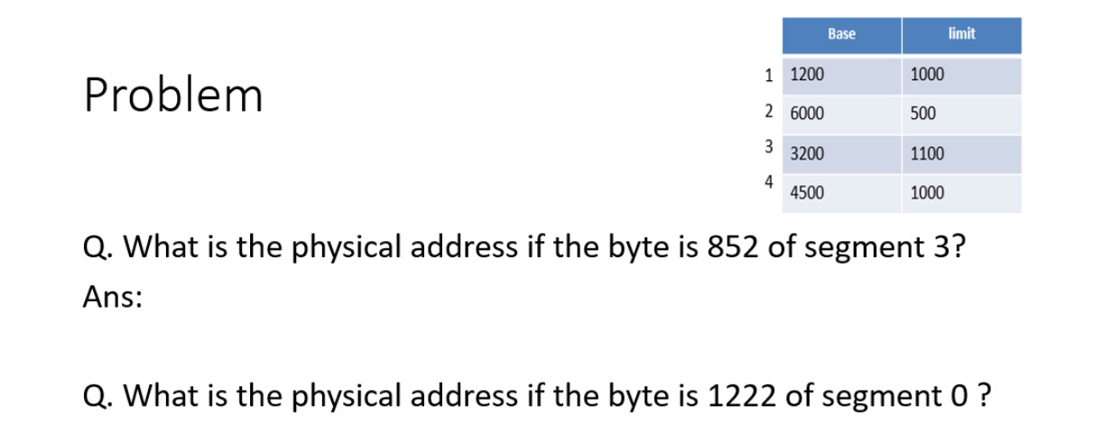

Slide 55
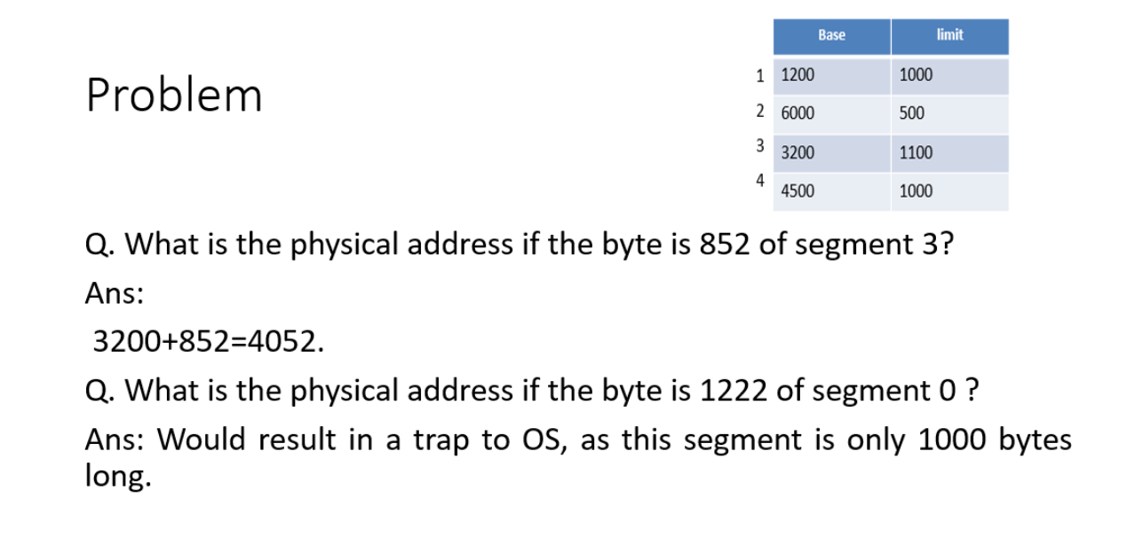

Slide 56
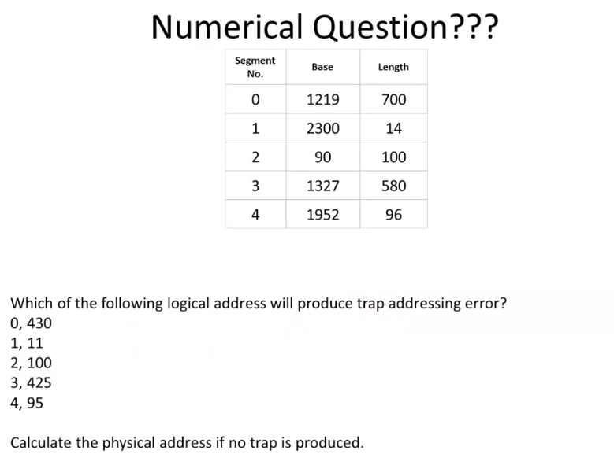

Slide 57
End of Chapter 8

