Slide 1
PostgreSQL

Slide 2
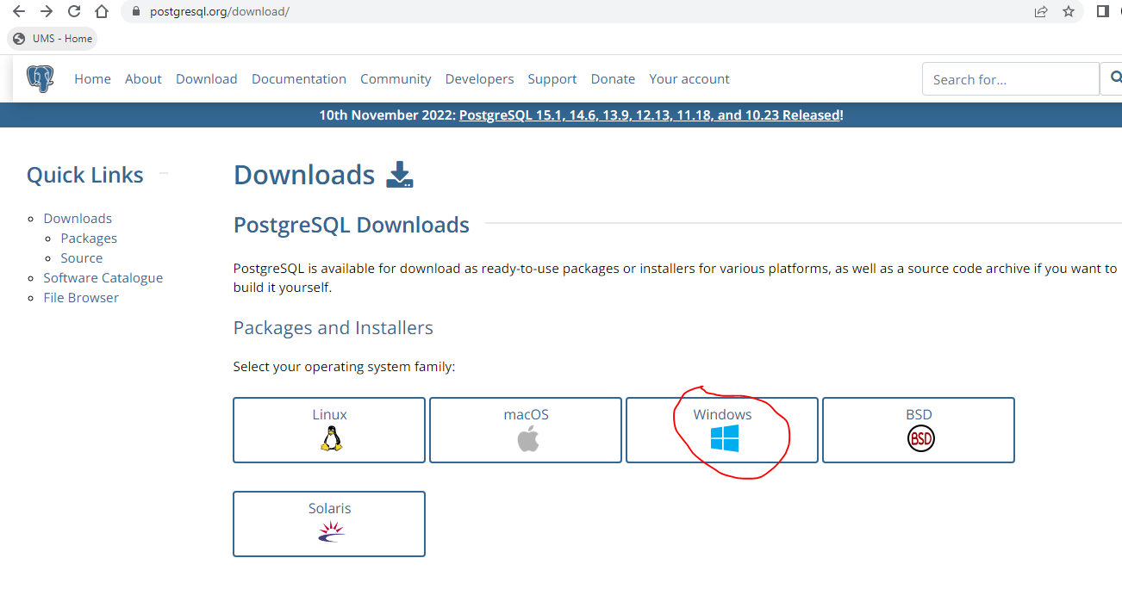
https://www.postgresql.org/download/

Slide 3
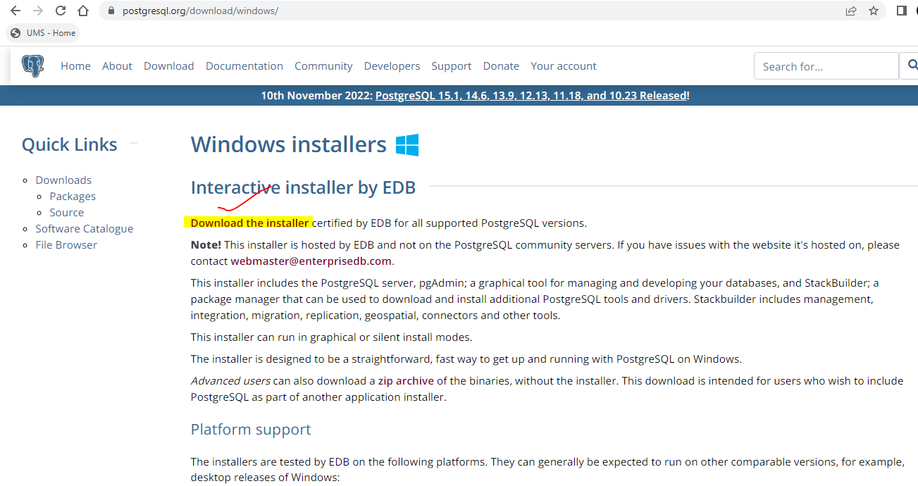

Slide 4
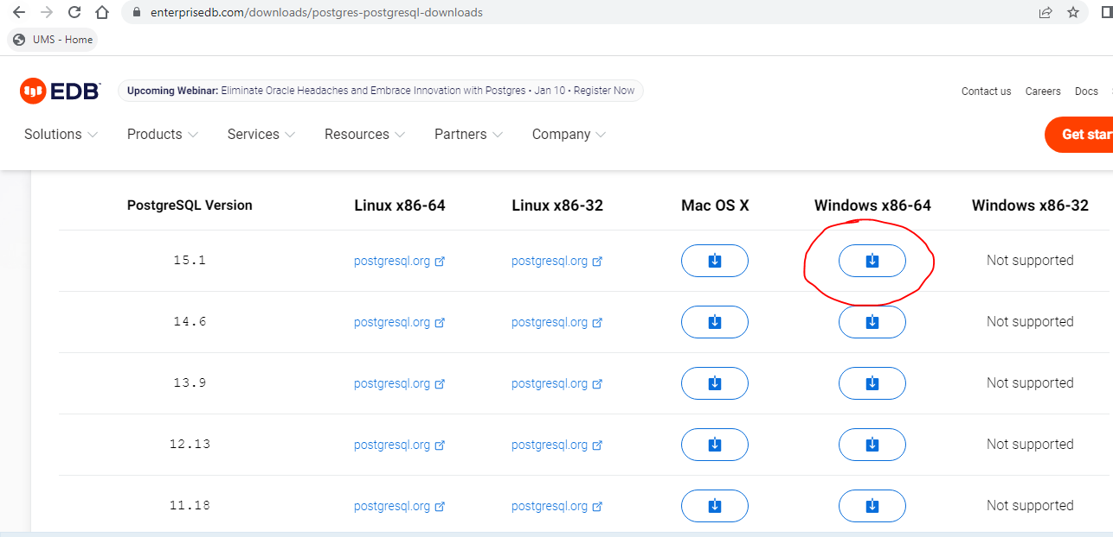

Slide 5
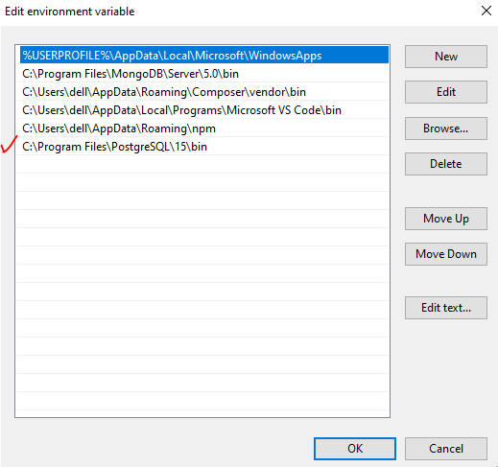
After installation set environment variables:
C:\Program Files\PostgreSQL\15\bin

Slide 6
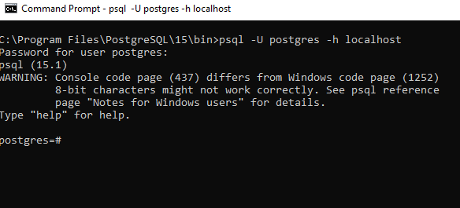
Open cmd
Command-> psql -U postgres -h localhost

Slide 7
List of commands
\q: Exit psql connection
\c: Connect to a new database
\dt: List all tables
\du: List all roles
\list: List databases

Slide 8
Create database
create database university;
List databases
\list
Create table
create table student(id int primary key not null, name text not null, address text, cgpa float);

Slide 9
Insert one row
insert into student(id, name, address, cgpa) values(1, 'Manoj', 'Delhi', 8.7);
Insert multiple rows
insert into student(id, name, address, cgpa) values(2, 'Rajneesh', 'Mumbai', 6.5), (3, 'Manoj', 'Noida', 7.2);
Select
Select * from student;

Slide 10
Sequelize
Sequelize is a Node. js-based Object Relational Mapper that makes it easy to work with MySQL, MariaDB, SQLite, PostgreSQL databases, and more.
An Object Relational Mapper performs functions like handling database records by representing the data as objects.
CRUD example using sequelize:
https://www.bezkoder.com/node-express-sequelize-postgresql/

