Slide 1


INT426 Generative AI
Lecture #0
Agenda, Roadmap & Expectations

Slide 2

Course details
LTP – 2 0 2
Credits – 3.0
Mode – Online with weekly supervision
Weekly Contact Hours: 1
Platform: Coursera
Course Focus: EMPLOYBILITY
Text Book: Not Applicable
Reference Book: Not Applicable
Software/Equipments/Databases: Python
Course Link: https://www.coursera.org/programs/int426-generative-ai-8n6df

Slide 3
Course Assessment Model
Marks break up*
Attendance 5
CA 25
4 Code Based Tests (Total 4 tasks, 3 best out of 4 to be considered)
MTE (MCQ) 20
ETE (MCQ) 50
Total 100

Slide 4
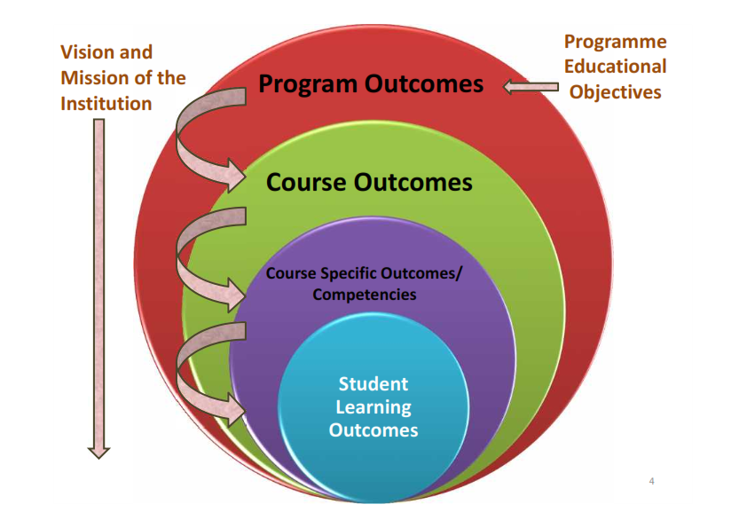
Program Outcomes
PO-1 Engineering knowledge::Apply the knowledge of mathematics, science, engineering fundamentals, and an engineering specialization to the solution of complex engineering problems.
PO-2 Problem analysis::Identify, formulate, research literature, and analyze complex engineering problems reaching substantiated conclusions using first principles of mathematics, natural sciences, and engineering sciences.

Slide 5
Program outcomes
PO-3 Design/development of solutions::Design solutions for complex engineering problems and design system components or processes that meet the specified needs with appropriate consideration for the public health and safety, and the cultural, societal, and environmental considerations.
PO-6 The engineer and society::Apply reasoning informed by the contextual knowledge to assess societal, health, safety, legal and cultural issues and the consequent responsibilities relevant to the professional engineering practice.
PO-12 Life-long learning::Recognize the need for, and have the preparation and ability to engage in independent and life-long learning in the broadest context of technological change.
PO-13 Competitive Skills::Ability to compete in national and international technical events and building the competitive spirit
5

Slide 6
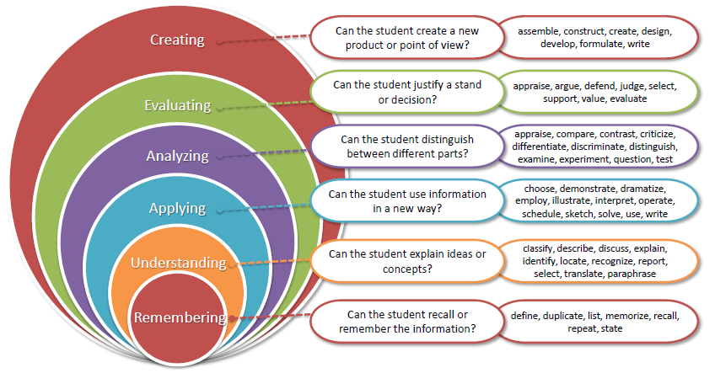
Revised Bloom’s taxonomy (RBT)
6

Slide 7
What are Cohorts
A group of students of a common programme who intend to attain similar characteristics by means of learning similar skills in order to target a particular career opportunity.

Slide 8
Purpose of Cohorts
Student shall be able to have a goal oriented approach for his/her career
Student identifies the goal in the very first year
Student shall be able to follow the stage wise career progression.
Early identification of skill set required for selected goal.

Slide 9
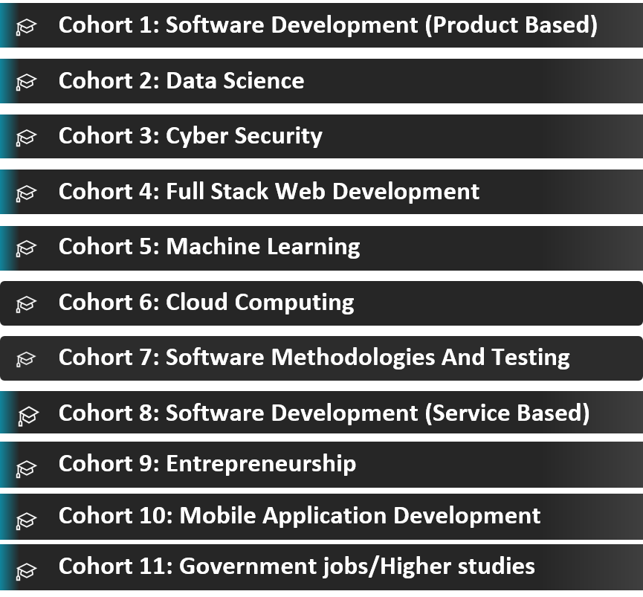
Cohort 8 and 5

Slide 10
Star Course
Hands-on Practice: A good course which include interactive coding exercises to help you apply what you've learned.
This course is a short bite-sized courses that help students develop foundational-level knowledge and skills in Python language. Although the course is packed with high quality content that helps students further with their learning and earn credits.

Slide 11
Course Outcomes
CO1 :: Understand the foundations and principles behind generative models.
CO2 :: Gain practical experience in crafting and refining prompts for language models through hands-on exercises and projects.
CO3 :: Apply prompt engineering skills to real-world scenarios, such as information retrieval, question-answering, or text generation.
CO4 :: Explore different architectures used in large language models, such as transformers, and understand their advantages and limitations.
CO5 :: Complete hands-on projects that involve coding and implementing generative models to solve specific problems or generate creative outputs.
CO6 :: Apply the learned skills and techniques through hands-on projects that involve a combination of ChatGPT, data analysis, visualization, and presentation creation.

Slide 12
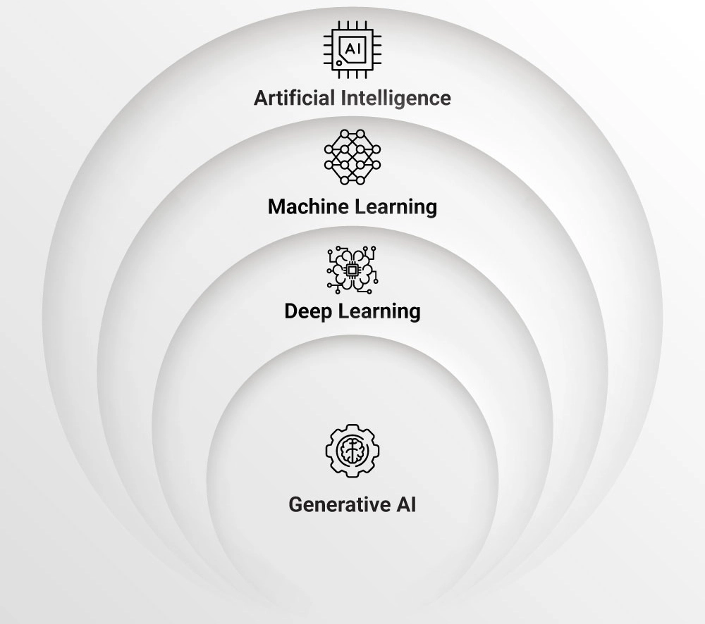
AI Hierarchy

Slide 13
What Is Artificial Intelligence (AI)?
AI is broadly defined as the ability of machines to mimic human behavior.
It encompasses a broad range of techniques and approaches aimed at enabling machines to perceive, reason, learn, and make decisions.
AI can be rule-based, statistical, or involve machine learning algorithms. Machine learning, Deep Learning, and Generative AI were born out of Artificial Intelligence.
Common Applications of AI are:
Virtual Assistants
Healthcare Diagnosis and Imaging
Virtual Reality and Augmented Reality
Game-playing AI

Slide 14
What Is Machine Learning (ML)?
Machine Learning algorithms leverage statistical techniques to automatically detect patterns and make predictions or decisions based on historical data that they are trained on.
Common Applications of ML are:
Time Series Forecasting
Credit Scoring
Text Classification
Recommender Systems

Slide 15
What Is Deep Learning (DL)?
DL utilizes deep neural networks with multiple layers to learn hierarchical representations of data.
It automatically extracts relevant features and eliminates manual feature engineering.
DL can handle complex tasks and large-scale datasets more effectively.
Common Applications of Deep Learning are:
Autonomous Vehicles
Facial Recognition

Slide 16
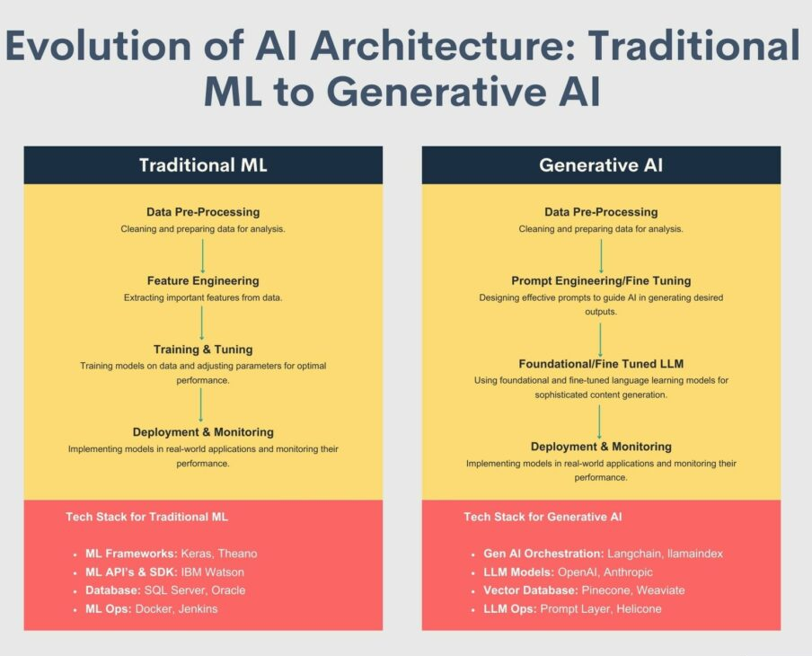

Slide 17
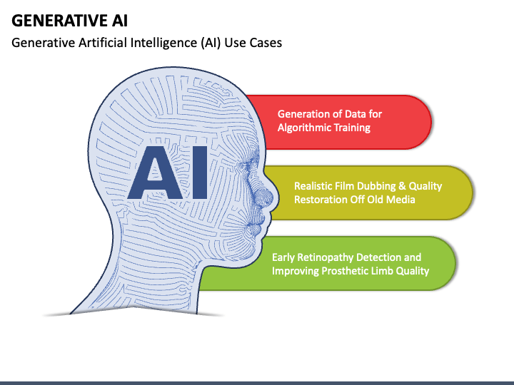

Slide 18
What Is Generative AI (GenAI)?
Generative AI, a branch of artificial intelligence and a subset of Deep Learning, focuses on creating models capable of generating new content that resemble existing data.
These models aim to generate content that is indistinguishable from what might be created by humans.
Generative Adversarial Networks (GANs) are popular examples of generative AI models that use deep neural networks to generate realistic content such as images, text, or even music.
Common applications of Generative AI are:
Image Generation
Video Synthesis
Social Media Content Generation

Slide 19
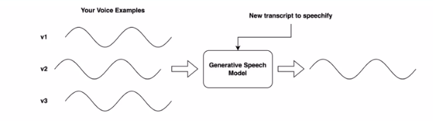
Generative AI

Slide 20
Common applications of Generative AI are:
Image Generation: Generative AI can learn from large sets of images and generate new unique images based on trained data. This tool can generate images with creativity based on prompts like human intelligence.
Video Synthesis: Generative models can create new content by learning from existing videos. This can include tasks such as video prediction, where the model generates future frames from a sequence of input frames. It can also perform video synthesis by creating entirely new videos.
Social Media Content Generation: Generative AI can be leveraged to automate content generation for social media platforms, enabling the creation of engaging and personalized posts, captions, and visuals.

Slide 21
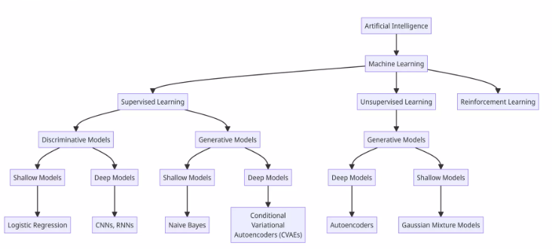

Slide 22
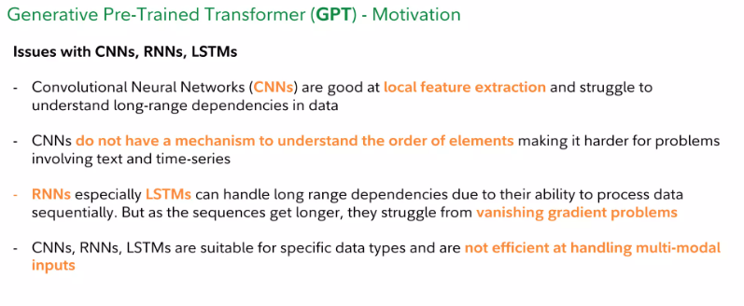

Slide 23
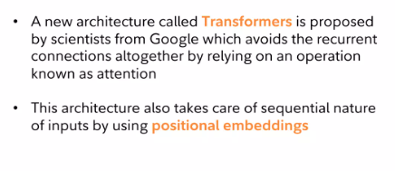

Slide 24
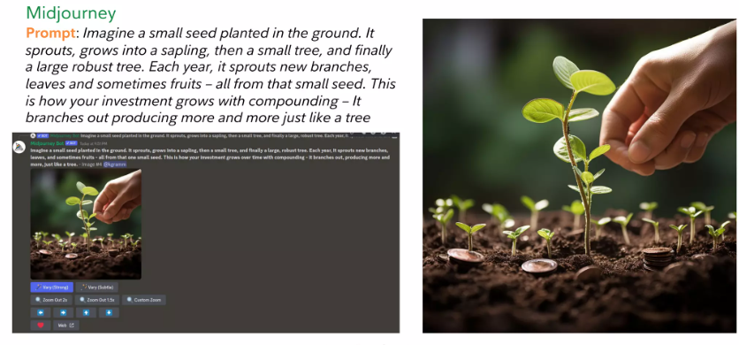
Applications

Slide 25
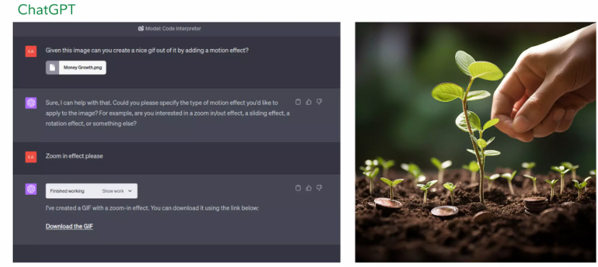

Slide 26
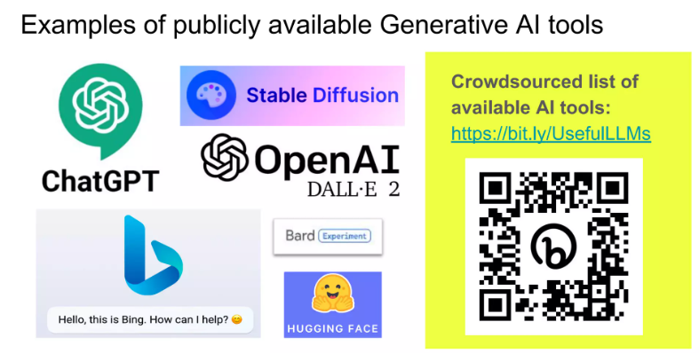

Slide 27
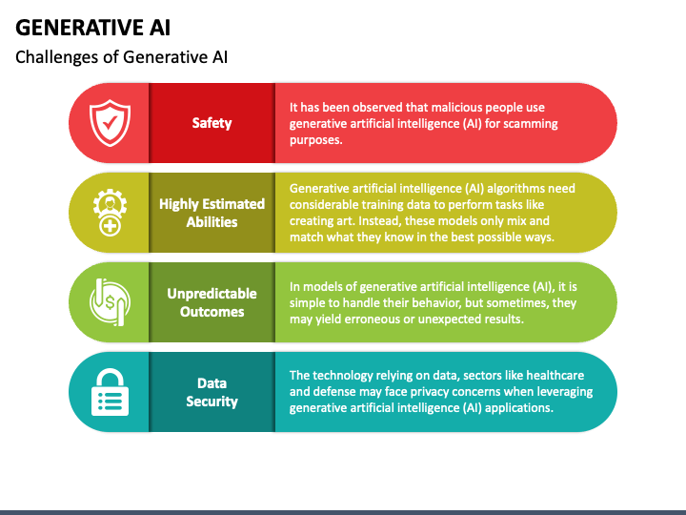

Slide 28
Unit Wise Content: Unit 1
Introduction to Generative AI
Fundamentals of Generative AI,
Generative AI model types,
Applications of Gen AI,
How Gen AI works,
Lifecycle of a Gen AI project,
Gen AI in software applications,
Gen AI in Business and Society,
Difference between GPTs and search engines,
Ethical and responsible AI

Slide 29
Unit 2
Prompt Engineering
Transforming computing,
The ACHIEVE framework,
Introduction to Large Language Models,
fundamentals of prompt,
prompt patterns,
prompt tuning
Prompt Pattern I
question refinement pattern,
cognitive verifier pattern,
audience persona pattern,
flipped interaction pattern

Slide 30
Unit 3
Prompt Pattern II
Game Play Pattern,
Template Pattern,
Meta Language Creation Pattern,
Recipe Pattern,
Alternate approaches pattern
Prompt Pattern III
Combining Patterns,
Expansion patterns,
Menu Action Patterns,
Check List Pattern,
Tail Generation Pattern,
Semantic Filter Pattern

Slide 31
Unit 4
Large Language Models
Generative AI and LLMs,
transformers architecture,
generating text with transformers,
Pre-training LLMs,
fine tuning and evaluating LLMs,
reinforcement learning and LLM-powered applications

Slide 32
Unit 5
Code with AI
Build web apps with AI,
Data Mastery with Excel and ChatGPT,
AI-driven chatbots,
Build a Movie App with GPT-3.5, and Dall-E,
Build a chatbot with ChatGPT -4,
Fine tune the chatbot with your own data

Slide 33
Unit 6
ChatGPT Advance Data Analysis
ChatGPT Advanced Data Analysis vs. ChatGPT,
Building Data Visualization and Creating a Presentation,
working with structured data,
working with media,
Zip files for automation,
working with small documents,
appropriate use of ChatGPT Advanced Data Analysis,
Human and AI Process planning,
Error identification techniques,
error handling

Slide 34
Thank You

