Slide 1
Cyberbullying
A silent killer of many young women’s career

Slide 2
cyberbullying
problematic
impacts
devastating impacts on mental health, self-esteem, and inter-personal relationships.
Cyberbullying is a pervasive issue in today’s digital age
Target
manifestations
individuals of all ages, particularly youth and women
-Harassment
-Shaming
-Spreading Rumors
consequences
Current solutions
severe emotional, psychological, and sometimes even physical harm
Completely disappearing from social media

Slide 3
Cyberbullying and mental health
59% of teenagers in the United States have experienced some form of cyberbullying
one in three young people worldwide have been bullied online
38% of online harrassement victims are women
59% of teenagers in the United States have experienced some form of cyberbullying
Recent Research data from January 2021

Slide 4
Solution ?
Protect Your Peace
: PYP
A platform to help young women escape cyberbullying while protecting their mental health

Slide 5
whats PYP ?
Avoid reading negative and harmfull comments and dms and have unlimited acces to block those comments while protecting your inner peace
Customize what you dont like to read and receive as comments and dms by manually apploading those data points in our platform

Slide 6
How to use “protect your peace”
login | You login with your prefered social meda account
Automatic research | Our server automatically starts searching for negative comments and bad language
Blocking people | Our platform now blocks bullies and restores your emotinal stability
Manual customisation | We give you freedom to add whatever language bothers you and the rest is on us

Slide 7
How did we do it?
scripting
We developed code using the Universal langage Python
AI
We use the help of LLMS to identify cyberabuse and online harrassement
Web
we utilized the Streamlit package to merge the front and back-end

Slide 8
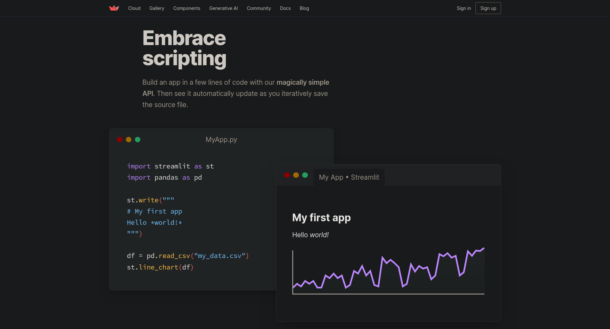
Streamlit
We achieved a coherant ,interactive,and accessible web page using the technology Streamlit
Using cloud hosting we ensured both portability and scallablility

Slide 9
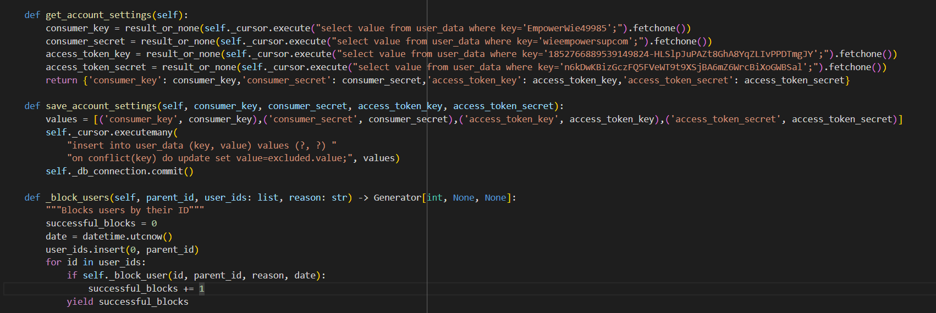

Slide 10
