Slide 1
PSC Run Timing Considerations 2022
M. Hague, S. Wong, C. Michielsens
Joint DFO-PSC Timing Discussion
May 2, 2022

Slide 2
Early Pre-Season Planning
The PSC provides historically-based estimates of migration behaviour (timing, spread, diversion rate)
Required for parameterizing the simulation model used for pre-season fisheries planning in April, prior to DFO forecasts being available
In June for the Fraser Panel meeting, many of the historically-derived inputs for the Planning Model are updated based on environmentally-based forecasts e.g. marine timing, diversion, management adjustments

Slide 3
April pre-season run timing analysis
PSC staff do:
Annual re-evaluation of stock-specific timing trends and cycle-line differences
Annual update of retrospective performance of alternative historical-median timing estimates
All years
Cycle-line specific
Odd/Even
Dominant/Sub-dominant
All years excluding 2020 cycle line/2020 cycle line

Slide 4
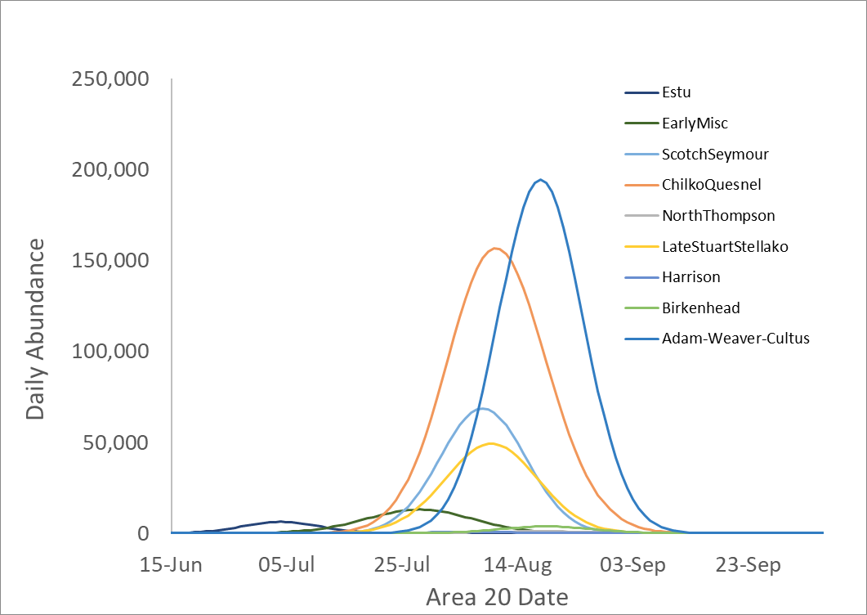
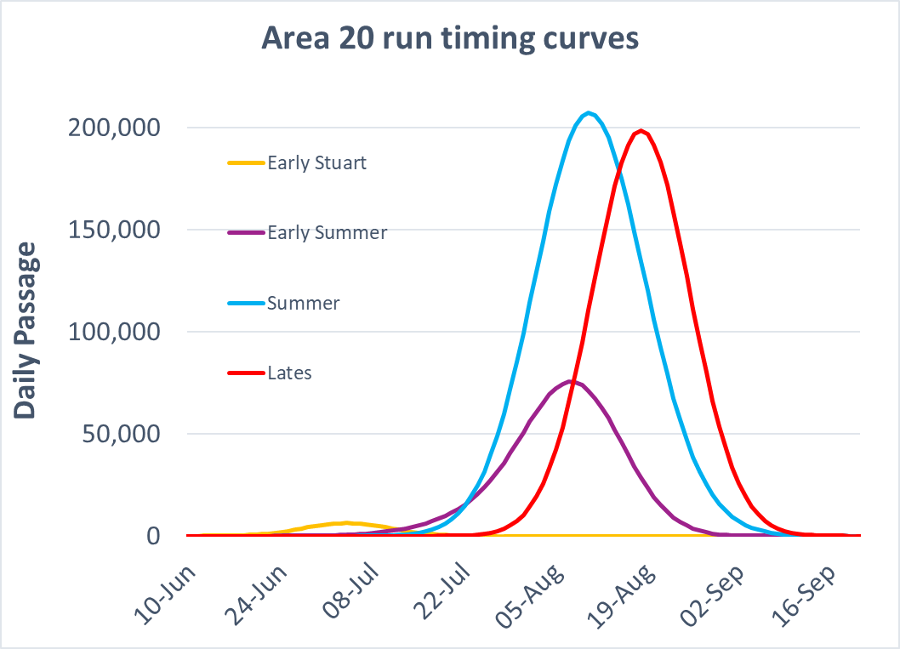
Pre-season run timing analysis
Timing and spread (i.e. standard deviations) estimates are derived for individual reconstructed stock groups
Daily abundances for each reconstruction group are assumed to follow normal distributions
Daily abundances for the overall management group is derived by summing across the curves for the individual components
The derived timing by management group is then compared to the historical distribution observations to ensure consistency

Slide 5
What this approach takes into consideration
Temporal changes in timing
e.g. using all-years or a more recent subset
Cycle-line specific differences
e.g. cycle-specific medians, or excluding a specific cycle line
Potential impact of co-migrating pink salmon
e.g. odd/even year subsets
Relative forecast abundances
e.g. timing of overall management group depends on both the timing and abundance of the individual reconstructed stocks
e.g. years with higher-than-average early timed Chilliwack abundance can push the overall timing of the Early Summer run earlier

Slide 6
What we do NOT consider
Influence of oceanographic considerations which may shift timing earlier/later than the historical median
Pre-season we consider each reconstructed stock group independently, but do not include covariation across groups as a predictor
In-season, when updated timing data is available for an earlier-timed component, we sometimes update our prediction of later-timed stocks based on the historical relationship

Slide 7
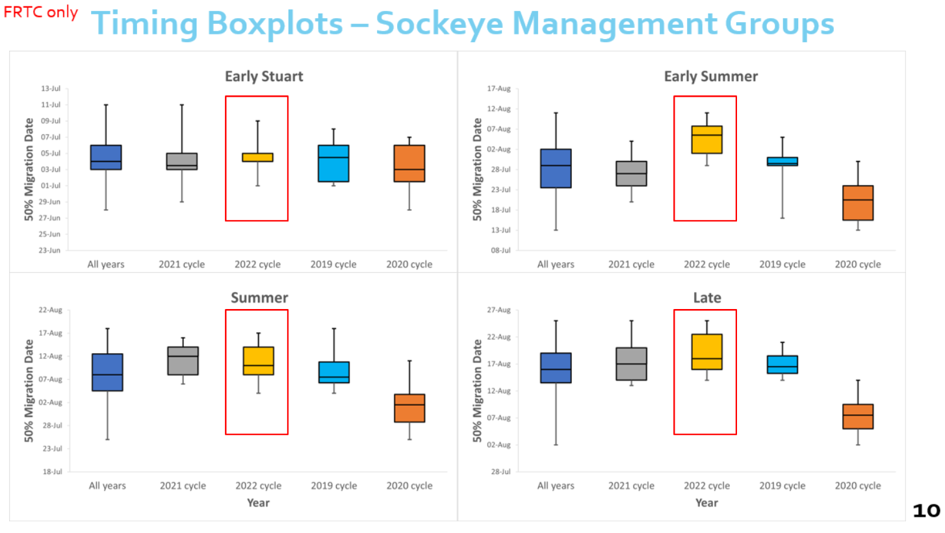
2022 Plan
Early Stuart timing does not appear to vary across cycle lines
Early Summer, Summer and Late-run management groups, the 2020 cycle line is often timed earlier than runs in other years
BUT the pattern across finer resolution stock groups within each MU can vary

Slide 8
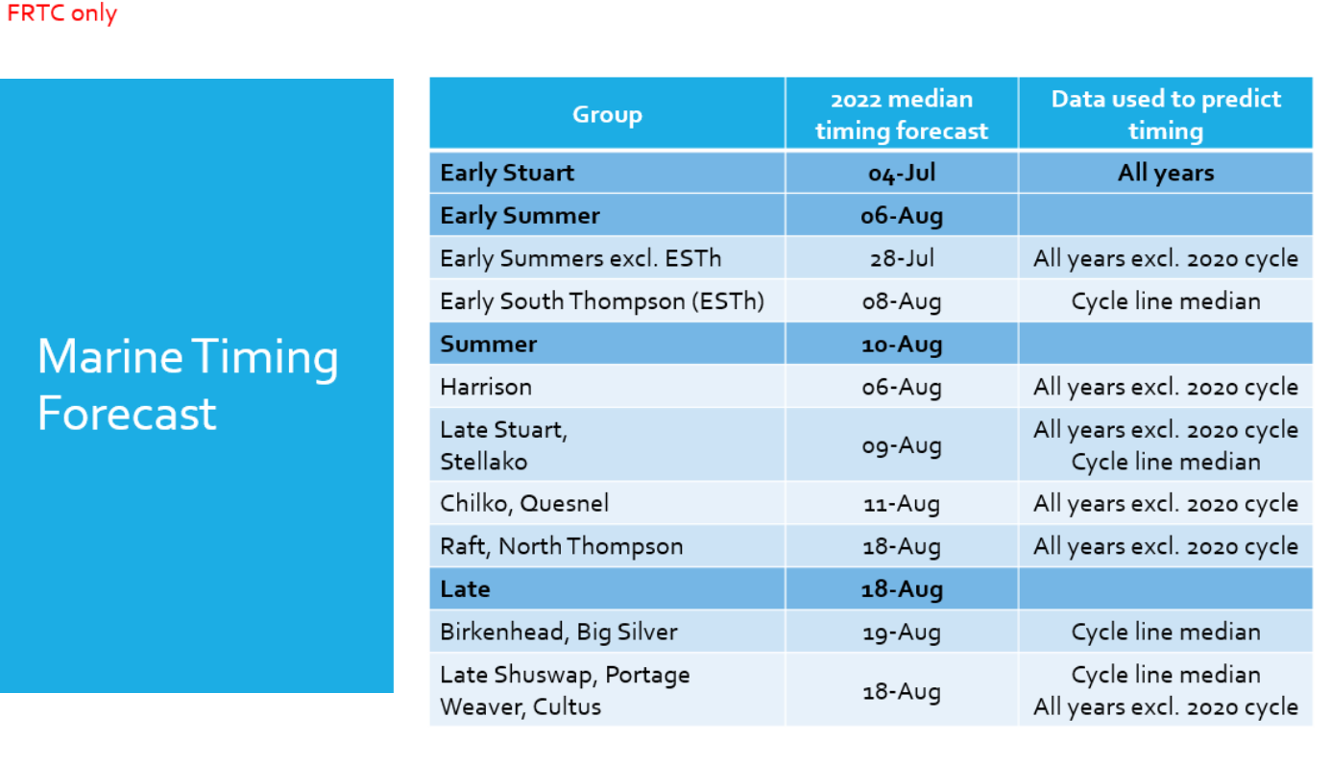
2022 Plan
Current assumptions

Slide 9
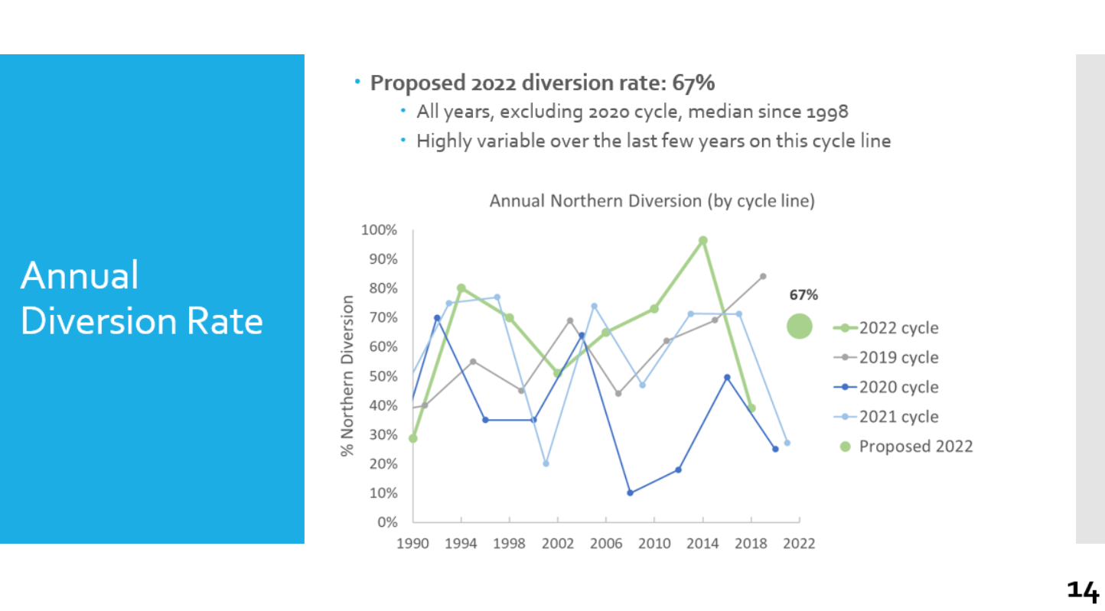
2022 Plan
A similar evaluation process is used for the northern diversion rate (for all stocks combined)

Slide 10
June Update Process
Early Stuart and Chilko median timing, and total northern diversion are replaced by DFO forecasts (at Panel discretion)
Timing of remaining stock-groups adjusted by the difference between the Chilko median and the updated Chilko forecast (timing offset between the median and the forecast)
Stock-specific diversion is a function of:
Total diversion forecast
Stock-specific timing
Historical cycle-specific daily patterns in diversion

Slide 11
Suggestions for 2022
Use the same subset of years for Chilko timing and total diversion forecast as applied by PSC based on historical evaluation
Clarify how much of the variability in timing is explained by cycle-line patterns vs. environmental data
Does the model structure also vary (i.e. is the underlying relationship different for different cycle-lines? Or on the 2020 cycle line, specifically?)

Slide 12
Next Steps: 2023 and beyond
Updated marine reconstruction files with improved timing and diversion rate estimates
PSC staff are currently populating a reconstruction database with improved post-season estimates of daily marine abundances from 2003-current at a finer stock resolution
Once complete, it might be useful to explore relationships for Early Shuswap and Late Shuswap timing groups on dominant years
Correlation between Chilko and Late Shuswap timing on dominant years is relatively weak; much stronger relationship for Early Shuswap and Late Shuswap.
Adding timing forecasts for these groups would be beneficial for Fraser River sockeye management

