Slide 1
MentorMind
AI Powered Personalized Study Plan Generator
Senior Project Presentation Leo Qin
Notes:
Hi everyone. MentorMind is an AI platform that builds personalized study plans for Chinese students. In 10 minutes I will show you how we diagnose knowledge gaps and generate adaptive learning paths, plus a quick live demo.

Slide 2
The Problem
46M+
$2K to 15K
50 to 1
Students in exam track education
Annual tutoring cost per family
Student to teacher ratio
Private tutoring is expensive but remains one size fits all
Teachers cannot diagnose individual gaps for 50 students
Students waste hours reviewing what they already know
2 / 10
Notes:
China has 46 million exam track students. Private tutoring costs families thousands per year but remains generic. A teacher with 50 students cannot deeply diagnose each one. Students end up restudying mastered topics while their real gaps go unaddressed.

Slide 3
How MentorMind works
1
Conversational diagnostic
AI chats with the student to uncover real knowledge gaps
2
Knowledge graph
Builds a per student map of concepts and their dependencies
3
Manager Critic AI
Generates study plans then evaluates quality before delivery
4
Active learning modes
Seminar debates, simulations, oral defense, memory challenges
3 / 10
Notes:
Four steps. First an AI chats with the student, adapting questions based on answers. Second we build a personal knowledge graph. Third a manager critic AI pair generates and checks study plans. Fourth the student engages through five active learning modes instead of passive reading.

Slide 4
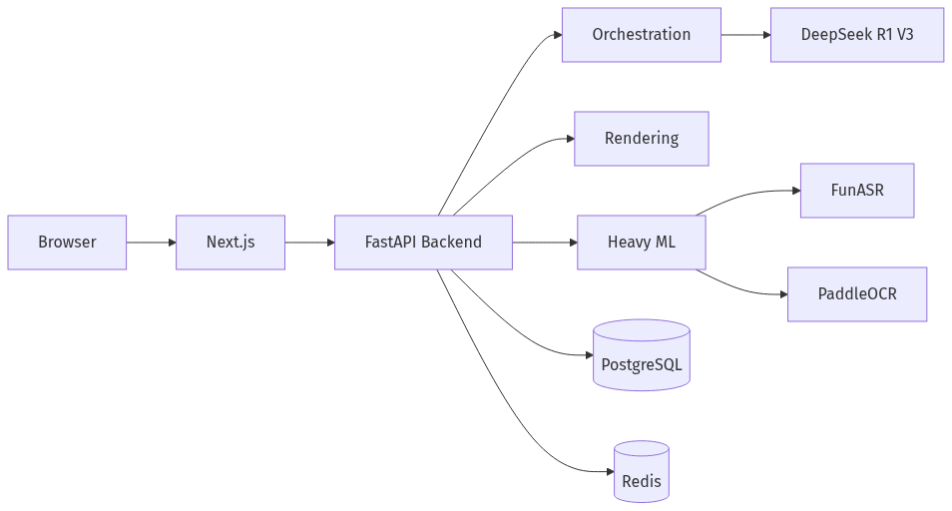
System Architecture
Next.js 14 frontend with Clerk authentication
FastAPI v2 backend serving ~90 endpoints
Three isolated Celery worker queues
PostgreSQL for all data, Redis for caching
SiliconFlow API with DeepSeek R1 and V3
FunASR for speech, PaddleOCR for image text
4 / 10
Notes:
Next.js frontend with Clerk auth. FastAPI backend with about 90 endpoints. Three Celery queues keep heavy tasks isolated. PostgreSQL stores everything including the knowledge graph. Redis handles caching and job orchestration. AI through SiliconFlow at under one cent per thousand tokens. FunASR and PaddleOCR handle Chinese speech and images.

Slide 5
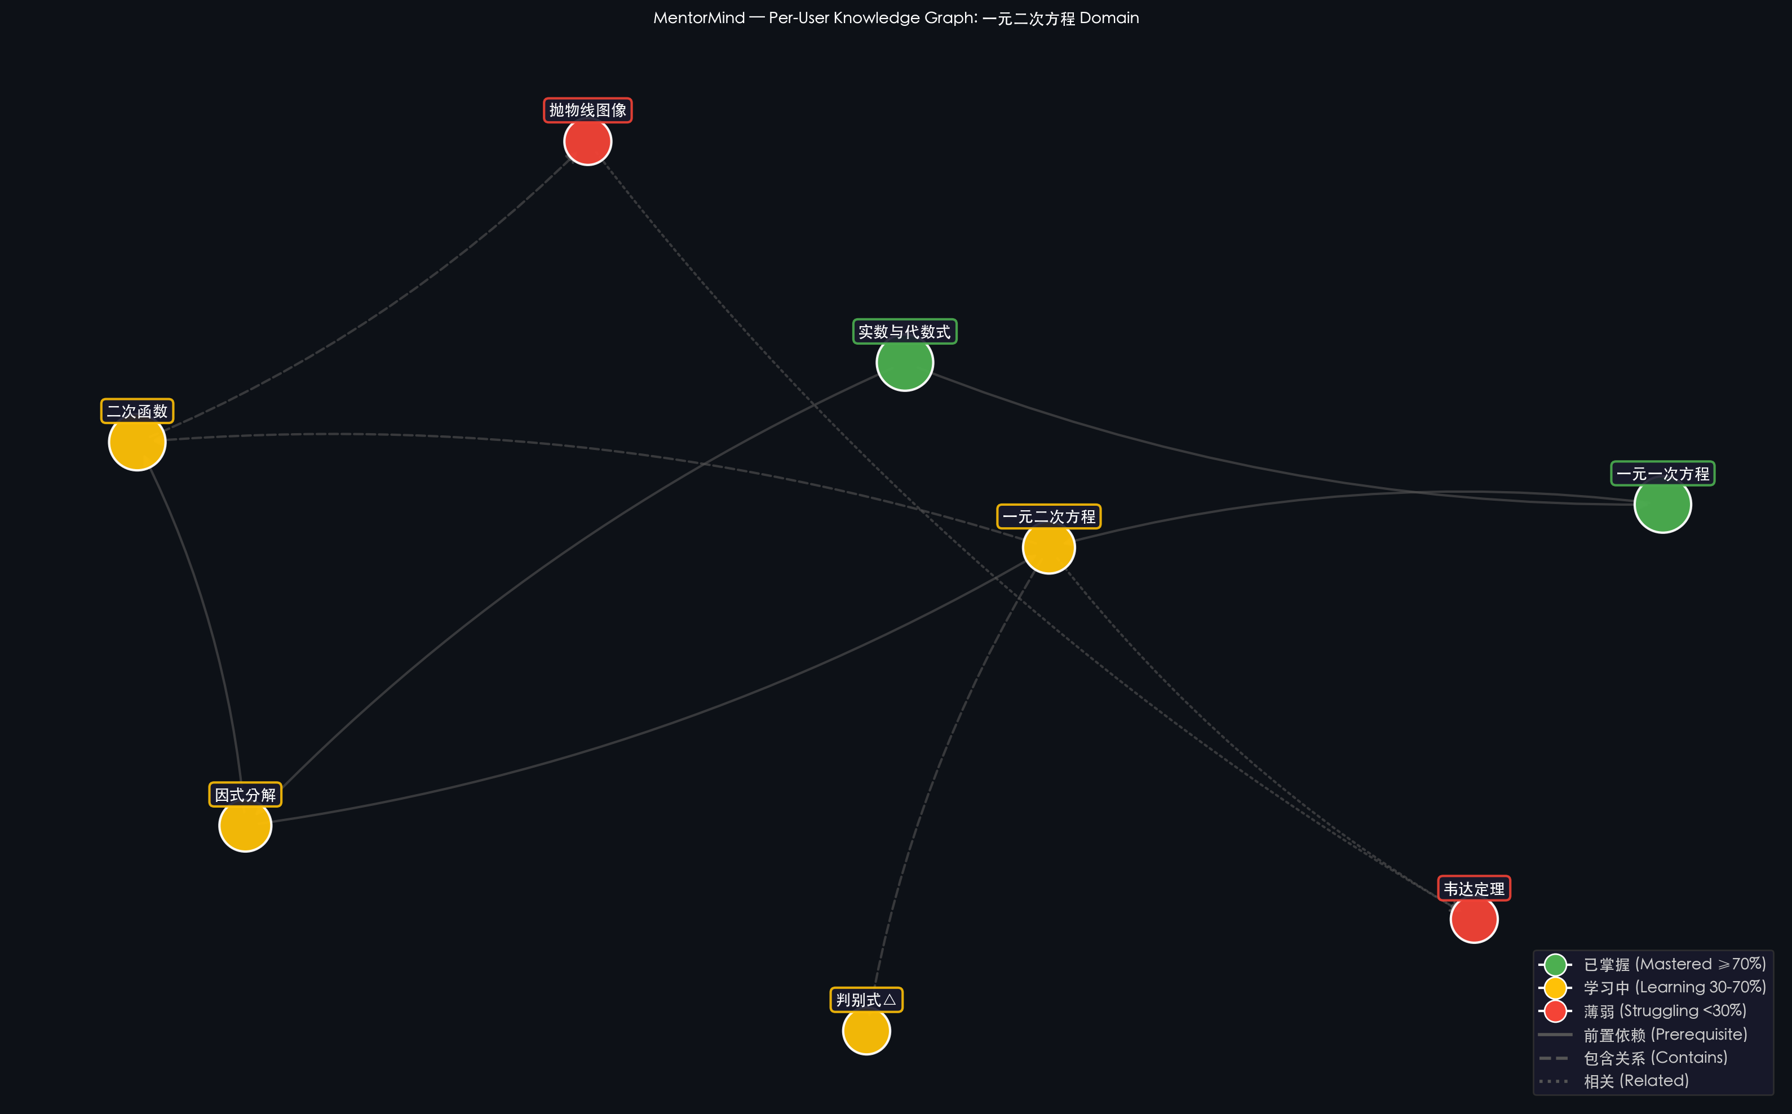
Personal Knowledge Graph
Audio uploads processed by FunASR
Image uploads processed by PaddleOCR
LLM extracts concepts and relationships
Graph stored per user in PostgreSQL
D3.js interactive force directed layout
Mastery colors: green, yellow, red
5 / 10
Notes:
Students upload audio or images. FunASR and PaddleOCR extract text. An LLM identifies concepts and their relationships such as prerequisites and containment. Everything is stored in a per user knowledge graph in PostgreSQL. The D3.js frontend colors nodes by mastery level. Red nodes become the study plan priority.

Slide 6
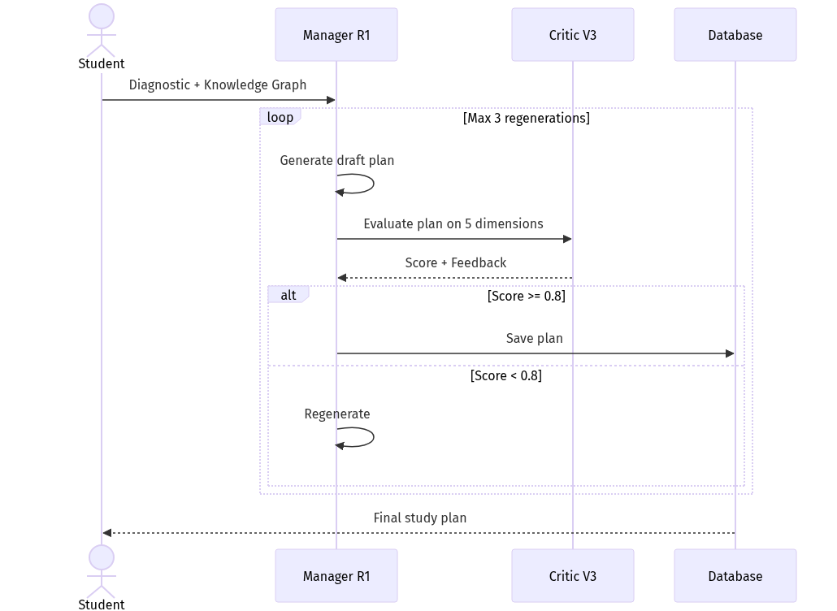
Manager Critic AI Planning Loop
DeepSeek R1 Manager generates the draft plan
DeepSeek V3 Critic evaluates on 5 dimensions
Clarity, accuracy, pedagogy, engagement, difficulty
Scored 0 to 1 with quality threshold at 0.8
Below threshold triggers regeneration up to 3 times
Four subagents produce quizzes and flashcards
6 / 10
Notes:
R1 acts as manager generating the study plan with units and objectives. V3 acts as critic evaluating on five dimensions including clarity, accuracy, pedagogical effectiveness, engagement, and difficulty. Threshold is 0.8. Below that the critic sends feedback and R1 regenerates up to three times. Plans that pass go to the student. Four subagents produce the actual content.

Slide 7
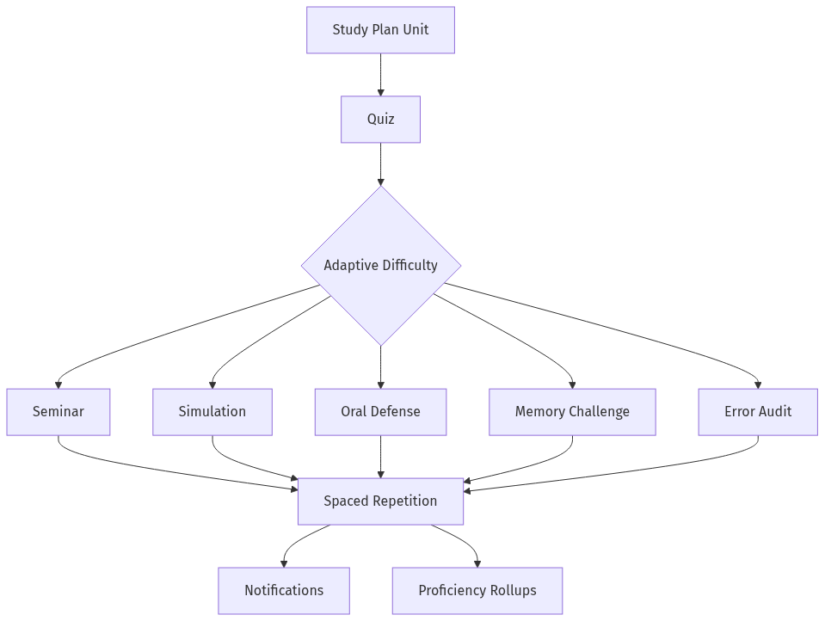
Learning by doing, not reading
Seminar: three AI roles debate, you evaluate
Simulation: decision scenarios with real concepts
Oral Defense: expert panel questions your reasoning
Memory Challenge: timed retrieval sprints
Error Audit: identify flaws in wrong answers
Backed by forgetting curve spaced repetition
7 / 10
Notes:
What sets MentorMind apart. Seminar has three AI personas debate and the student evaluates. Simulation presents real scenarios. Oral Defense fires questions from a panel of experts. Memory Challenge is a timed sprint. Error Audit finds flaws in a wrong answer. All backed by a forgetting curve scheduler with proactive review notifications.

Slide 8
The Pivot
Weeks 1 to 3: built a 5 stage AI video pipeline
Used Manim for math animations like 3Blue1Brown
CJK font rendering was inconsistent in production
User research showed students wanted personalization
Week 4: pivoted to study plan generation
Hid video UI, kept pipeline code intact
Built circuit breaker with multi provider fallback
Pivot unlocked the real user need for personalization
PIVOT
8 / 10
Notes:
We built a full video generation pipeline with Manim animations. It worked but CJK font rendering was inconsistent. User research showed students wanted personalization more than polished videos. We pivoted in week 4, hid the video UI, kept the pipeline intact, and redirected to study plans. We also built a circuit breaker with multi provider fallback for API resilience.

Slide 9
What I Shipped
~90
2
API endpoints across the full platform
Languages: Chinese English
$160 per month
90 days
Operating budget at under one cent per K tokens
Telemetry retention with daily proficiency rollups
Adaptive difficulty adjusts from a sliding window of three quiz scores
Gaokao exam prep system built and ready for our target market
9 / 10
Notes:
We shipped API v2 with about 90 endpoints across lessons, study plans, knowledge graphs, Gaokao prep, board lessons, billing, and analytics. Four languages. Operating cost around 160 dollars per month. Adaptive difficulty adjusts from three quiz scores. 90 day telemetry. And a Gaokao prep system directly relevant to our Chinese market.

Slide 10
Next Steps
Restore video generation once CJK font rendering is solved
Build a mobile app with offline study plan access
Integrate with school LMS platforms via LTI 1.3
Thank you.
10 / 10
Notes:
Three priorities: restore video generation once CJK fonts are solved, build a React Native mobile app for offline access, and integrate with school LMS platforms. Thank you. I am happy to take questions.

