Slide 1
Science
Fundamental Discovery:
  Advancing first-principles calculations of hadron spectroscopy, hadron structure, and nuclear structure to reveal how the strong force builds visible matter and to provide new pathways for discovering physics beyond the Standard Model.
Science and Technology Innovation:
  Developing scalable algorithms, portable software, AI-enabled analysis, and integrated workflows that turn leadership-class computing into sustained scientific capability.
National Scientific Capability:
  Providing essential theory support for major experimental programs, extending the scientific reach of DOE computing facilities, and training the next generation of computational nuclear scientists.

Slide 2
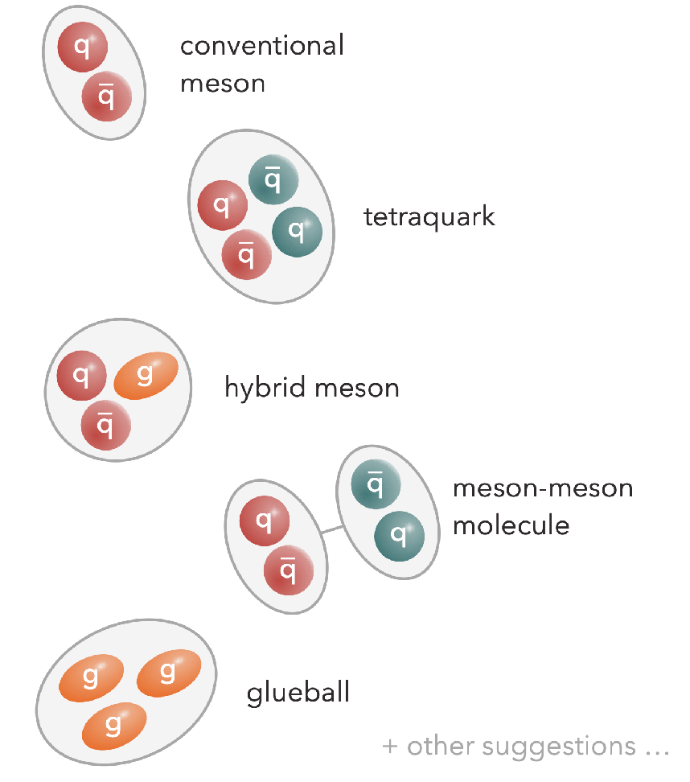
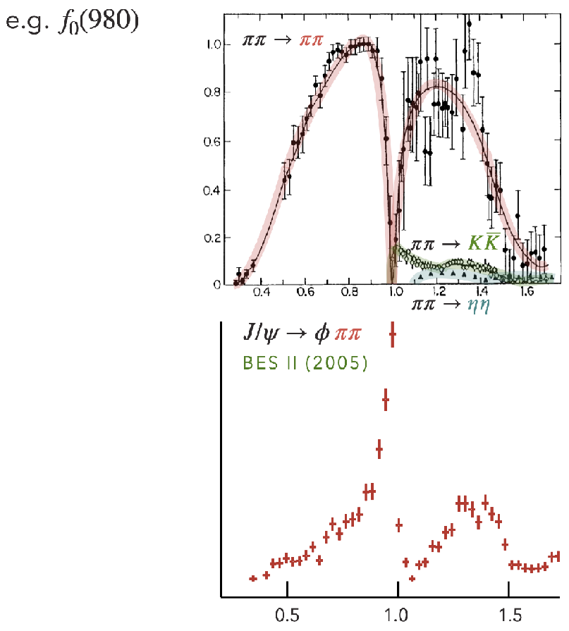
Meson spectroscopy
“pictures”
“reality”
Can we establish connection?
Realm of modeling
Measurements of stable hadrons
connection to QCD unclear
connection to QCD unclear

Slide 3
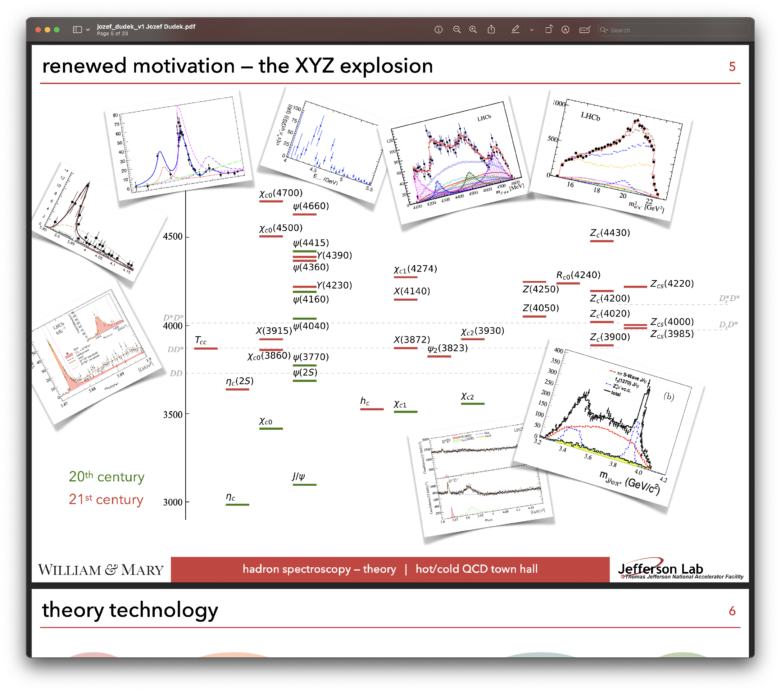
Renewed motivation - the XYZ explosion - tetraquarks?

Slide 4
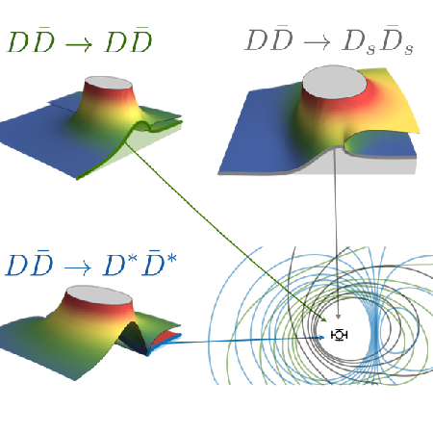


Charmonium resonances from coupled-channel QCD
First comprehensive calculation:
First LQCD determination of scalar and tensor charmonium resonances with all relevant coupled two-meson channels included.
A surprisingly simple spectrum
One scalar & one tensor resonance; no proliferation of extra states despite the many experimentally observed XYZ candidates.
Enabled by SciDAC
Automated graph evaluation developed with the SciDAC RAPIDS partnership, together with scalable correlation-function workflows, made the coupled-channel calculation possible.
Experimental impact:
Charmonium spectroscopy is an intense focus at experiments worldwide.
The experimental spectrum is crowded; the underlying QCD resonance content may be considerably simpler.
DOE highlight; Editor’s Suggestion
Phys.Rev.Lett. 132, 241901 (2024); Phys.Rev.D 109 (2024) 11, 114503;
arXiv:2602.09862

