Slide 1
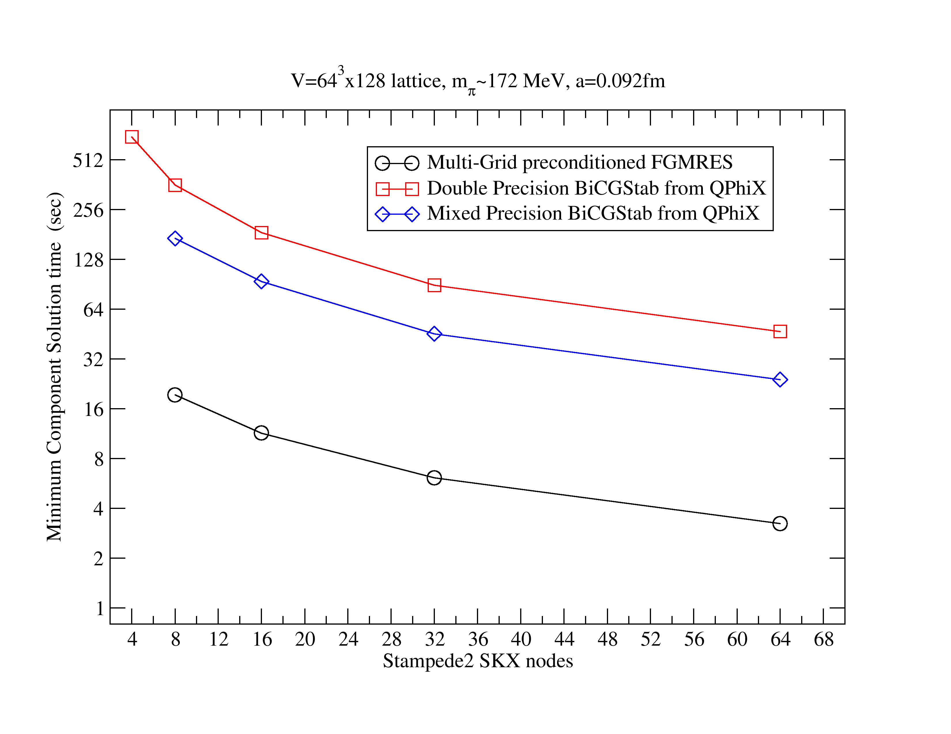
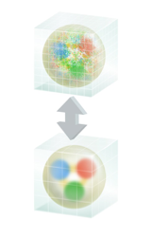
MG Proto: Multigrid LQCD Propagators for Multicore x86 systems
Objectives
Impact
Discovery of the properties of hadronic and nuclear matter through world leading Lattice Quantum Chromodynamics (LQCD) calculations
Extension of the state of the art in LQCD computational capability by the development and integration of advanced algorithms
Maximally exploiting advanced hardware capabilities of DOE systems such as Cori at NERSC and Theta at ALCF
Improvements increase the value of allocations on DOE systems such as Cori-KNL and ALCF Theta by a near order of magnitude, and (re)open other systems for our calculations (e.g. Stampede-2 & Frontera at TACC).
The solver development will enable more efficient gauge generation in the future, building on experience gained with similar work on GPU systems.
The MG Proto library serves as a spring-board for exploration of new programming models for LQCD such as Kokkos & SyCL for performance portability, e.g. targeting ALCF Aurora in the future.
Accomplishments
Implemented an Adaptive-Multigrid solver for Lattice QCD on x86 multi-core systems (Intel Knights Landing, Skylake) with OpenMP and AVX512 vectorization
The fine level of the Multigrid uses the optimized solvers from the QPhiX library
Investigated the potential for fine grained nested parallelism within OpenMP in collaboration with T. Kurth at NERSC (IXPUG-ISC 17 paper contribution)
Investigated Kokkos for Performance Portability in Wilson-Dslash kernel during a summer associate visit to NERSC as part of NESAP.
7-8x speedup achieved over previous Mixed Precision Iterative Refinement BiCGStab solvers from the QPhiX library for light quark masses
7.7x speedup
Image Credit: Joanna Griffin,
Jefferson Lab Public Affairs

