Slide 1
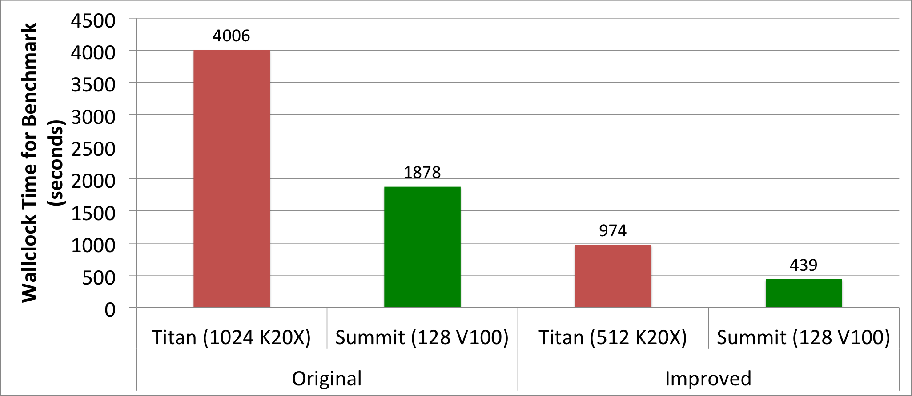
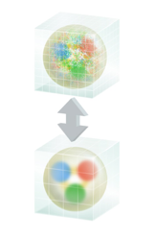
Accelerating QCD Gauge Generation on GPUs
Objectives
Impact
Discovery of the properties of hadronic and nuclear matter through world leading Lattice Quantum Chromodynamics (LQCD) calculations
Extension of the state of the art in LQCD computational capability by the development and integration of advanced algorithms
Maximally exploiting advanced leadership hardware capabilities such as GPUs in OLCF Titan and OLCF Summit
Nearly 2 orders of magnitude efficiency increase for gauge generation using OLCF Summit
Titan improvements bring nearly an order of magnitude increase in value from existing INCITE allocation for USQCD gauge generation program
Improvements fundamentally shift the balance of costs between gauge generation and gauge field analysis, allowing previously unaffordable calculations
Accomplishments
4.1x faster
on 2x fewer
GPUs
~8x gain
9.1x faster
on 8x fewer
GPUs
~73x gain
~9x wallclock speed-up on Summit using 8x fewer GPUs than Titan: ~73x improvement in computational efficiency
Moved Multi-grid set-up phase in QUDA library entirely to GPUs allowing its use in gauge generation, and added extra optimizations (K. Clark, NVIDIA)
Multi-grid solver integrated into Gauge Generation code (B. Joo, JLab)
Developed Force-Gradient Time-stepper for Chroma (B. Yoon, LANL)
Re-tuned Hamiltonian splitting and multi-level integration scheme enabled by these advances (B. Joo, JLab)
Image Credit: Joanna Griffin,
Jefferson Lab Public Affairs

