Slide 1
EC500 C1 Group 2 Face Detection
Presented by:

Slide 2
Eugene - 2min - trello + sprinting + team work

Slide 4
Xiangchao - 3min - setting up environment

Slide 6
Yida - 2min - face detection algo

Slide 8
Lan - 2-3 min - code explain
Code
import cv2
import sys
# Get user supplied values
imagePath = sys.argv[1]
cascPath = sys.argv[2]
# Create the haar cascade
faceCascade = cv2.CascadeClassifier(cascPath)
# Read the image
image = cv2.imread(imagePath)
gray = cv2.cvtColor(image, cv2.COLOR_BGR2GRAY)

Slide 9
Code
# Detect faces in the image
faces = faceCascade.detectMultiScale(
gray,
scaleFactor=1.55,
minNeighbors=3,
minSize=(30, 30),
flags = cv2.CASCADE_SCALE_IMAGE
)

Slide 10
Code
print "Found {0} faces!".format(len(faces))
# Draw a rectangle around the faces
for (x, y, w, h) in faces:
cv2.rectangle(image, (x, y), (x+w, y+h), (0, 255, 0), 2)
cv2.imshow("Faces found", image)
cv2.waitKey(0)

Slide 11
Parameter tuning
“scaleFactor”: decreasing the size of the rectangles used for object detection each loop. 1.05 means reducing size by 5 %.
“minNeighbors”: how many neighbour rectangles each candidate rectangle should have before object found statement become valid.
“miniSize” and “maxSize”: minimum and maximum size of rectangles are used to detect object.
Tuning sequence: miniSize -> scaleFactor -> minNeighbors -> sacleFactor -> minNeighbors -> maxSize
Notes:
Your model has a fixed size defined during training. This means that this size of face is detected in the image if occurring. However, by rescaling the input image, you can resize a larger face towards a smaller one, making it detectable for the algorithm.
Using a small step for resizing, for example 1.05 which means you reduce size by 5 %, you increase the chance of a matching size with the model for detection is found. 1.10 means that each time you downscale the image by 10%. This continues starting from the input image resolution until you reach the model dimension in X or Y.
You may increase it to as much as 1.4 for faster detection, with the risk of missing some faces altogether.
Parameter specifying how many neighbours each candidate rectangle should makes up an object. This parameter will affect the quality of the detected faces. Higher value results in less detections but with higher quality.
Minneighbors is 0, the function does not any grouping at all and returns all the detected candidate rectangles
Minimum possible object size. Objects smaller than that are ignored
Maximum possible object size. Objects bigger than this are ignored.
These two parameter related to picture resolution.

Slide 12
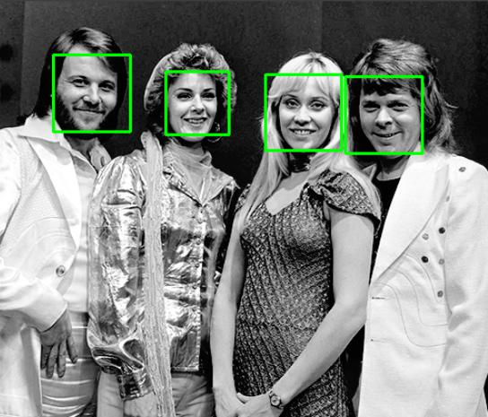
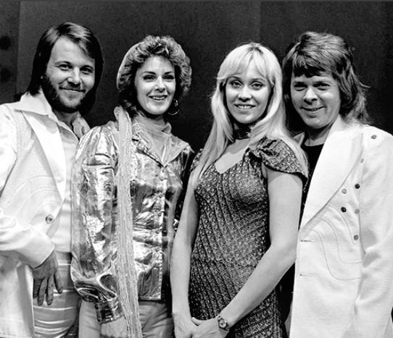
minSize tuning:
Notes:
Scalefactor is 1.3
Minneighbors is 3
Maxsize disabled
First pic minsize is 30 30
Second is 200 200

Slide 13
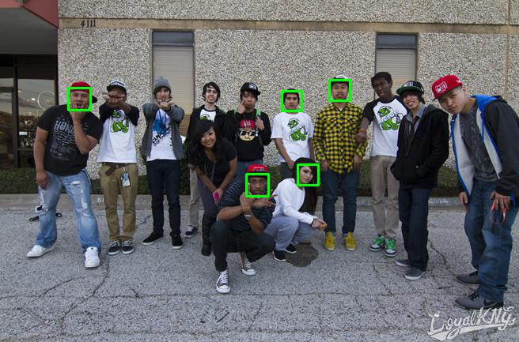
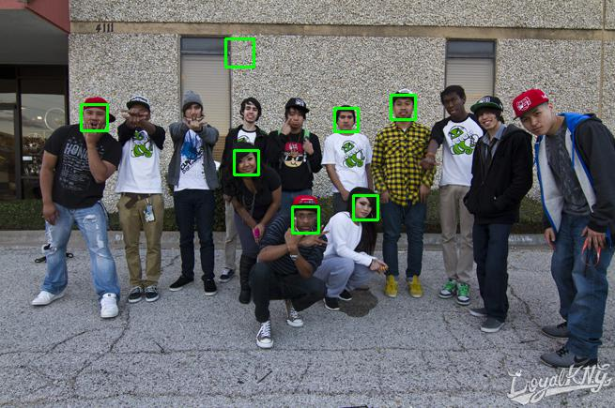
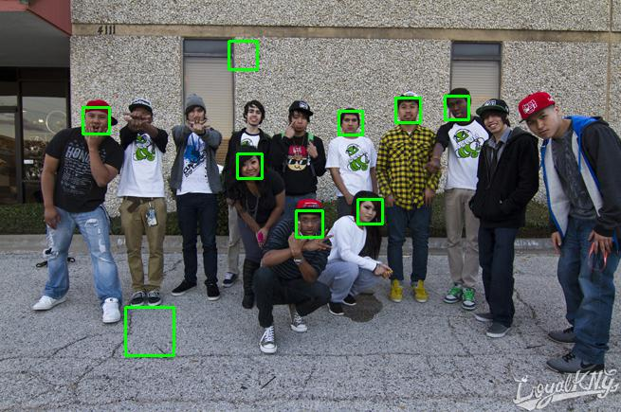
minNeighbors
Notes:
Scalefactor is 1.1
Minisize is 1515
Maxsize disabled
First minneighbors is 3, second is 2, third is 1

Slide 14
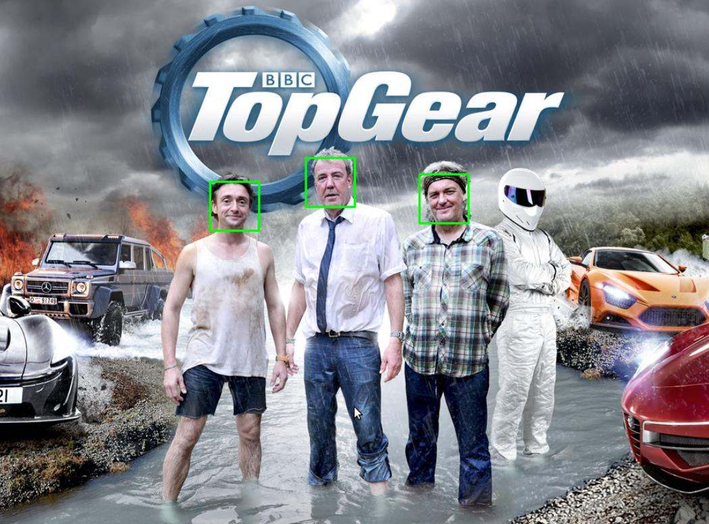
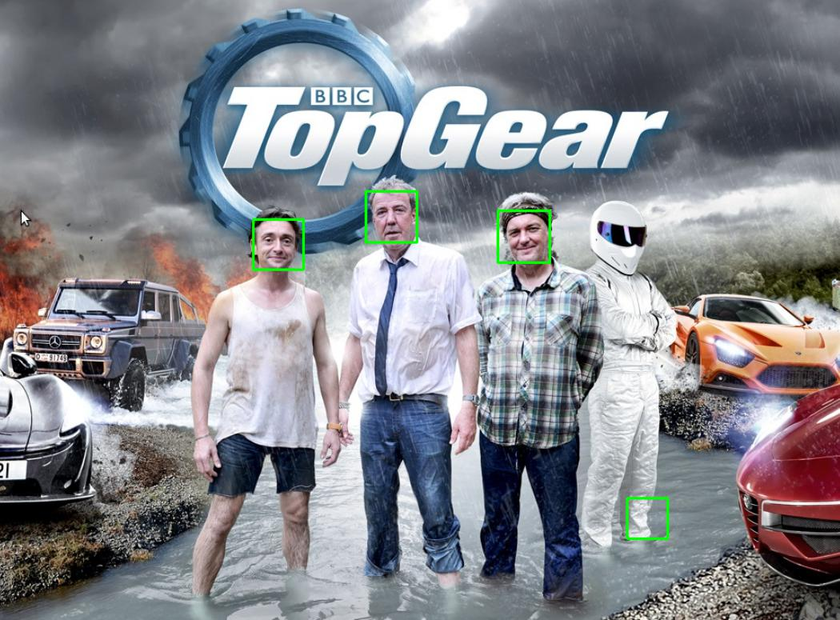

scaleFactor

Slide 15
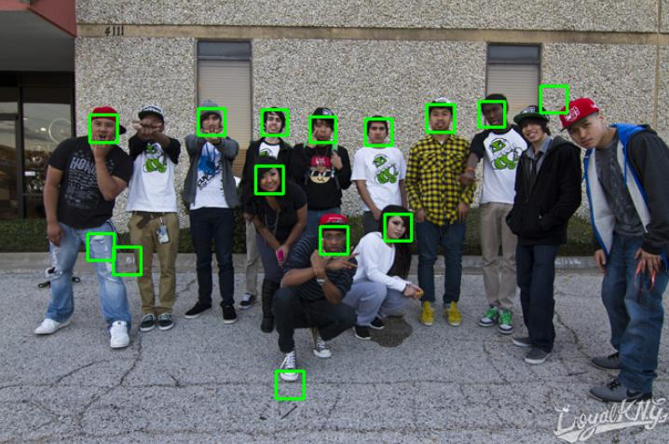
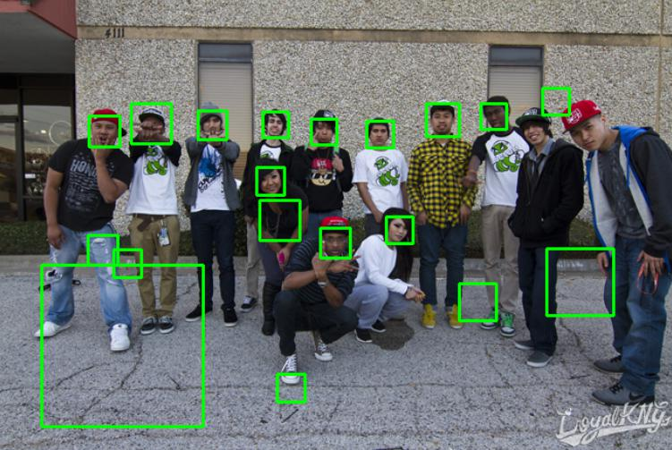
maxSize
Notes:
Scalefactor changed from 1.1 to 1.01
Then maxsize 3030 is applied

Slide 16
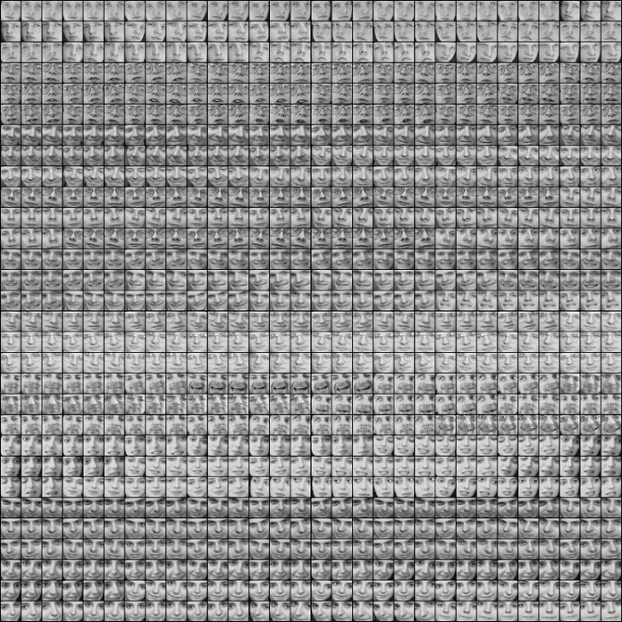
Notes:
Trypophobia please turn away
Start with default setting
Scale 1.3 minnei 3 minisize 3030 no face found each face is smaller than 3030

Slide 17
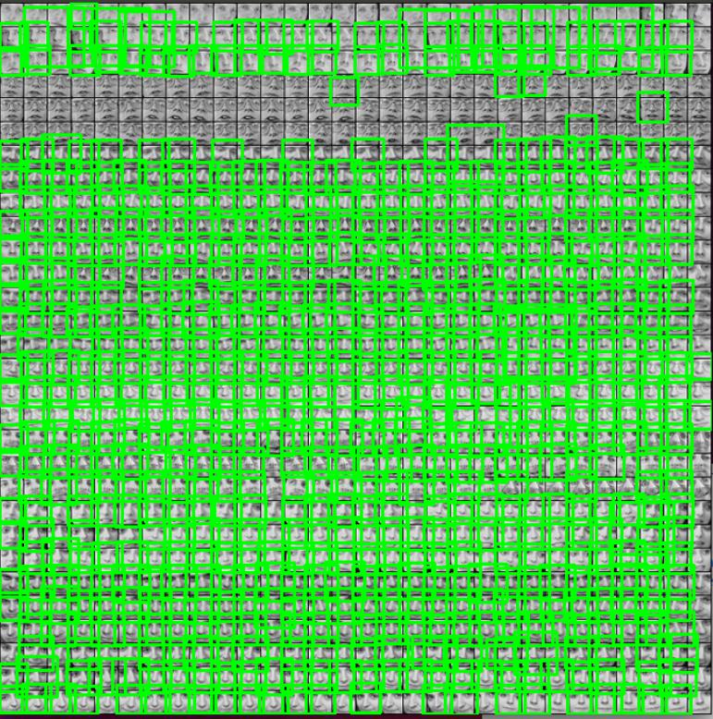
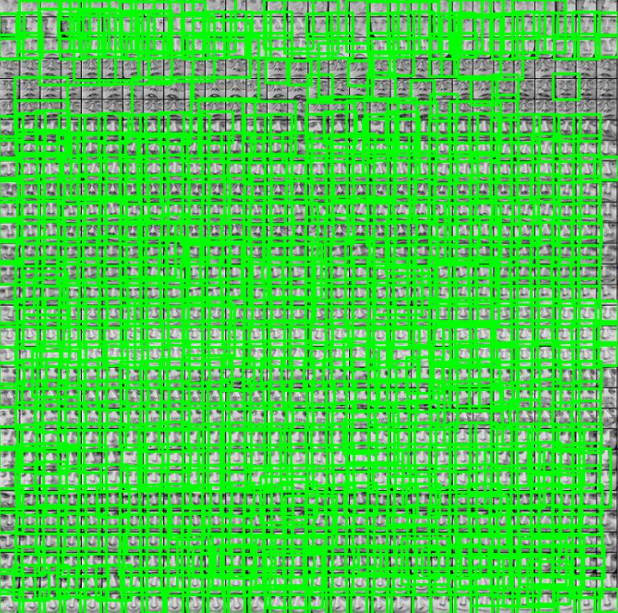
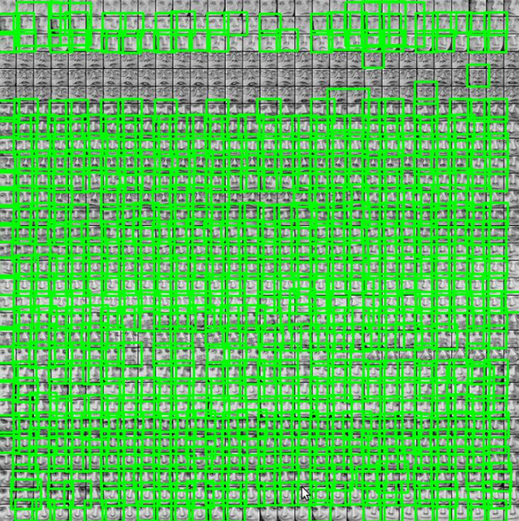
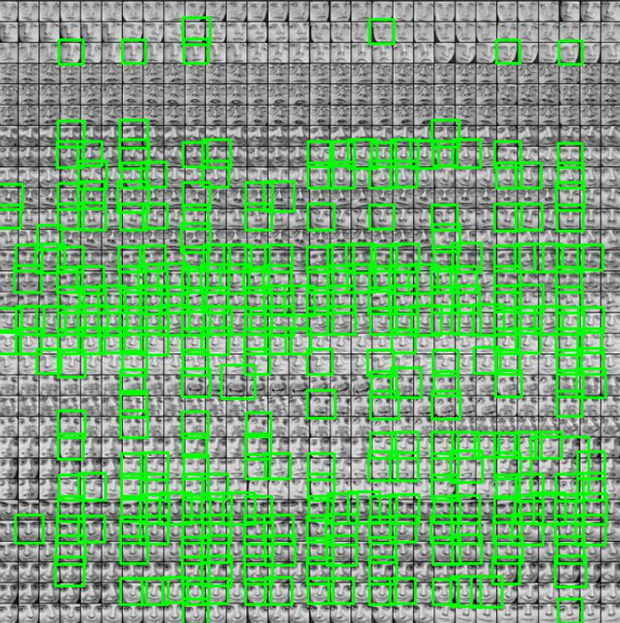
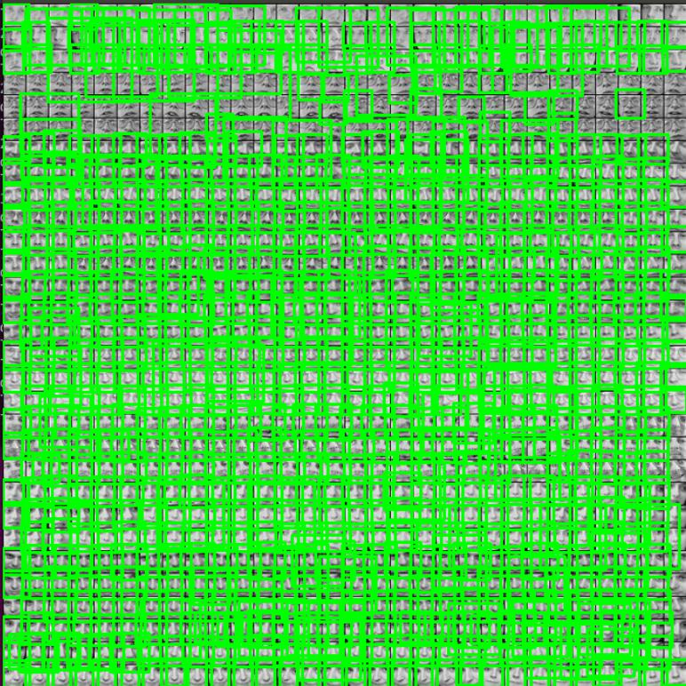
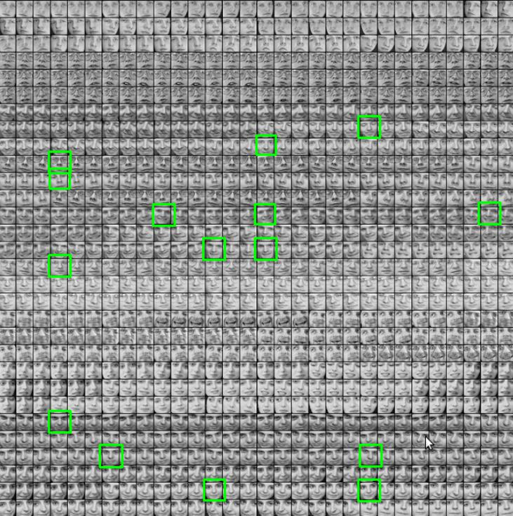
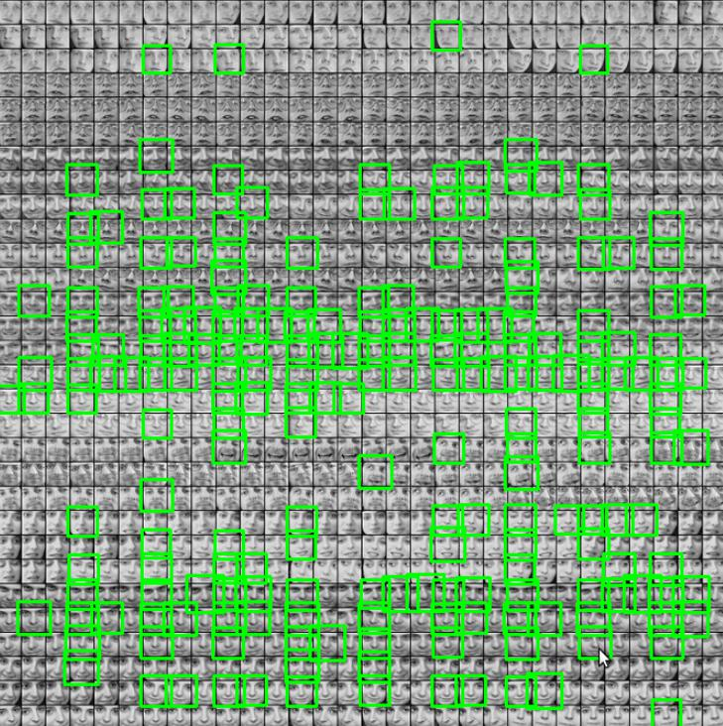
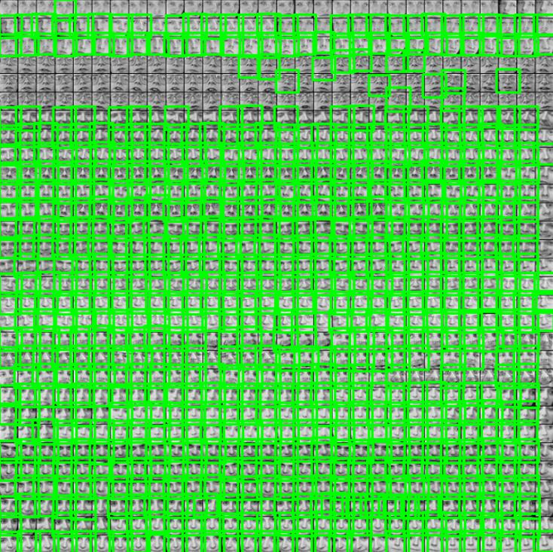
Notes:
Minisize reduced to 1515, 15 faces found
Scalefactor reduced to 1.1, 212 faces found
Minneig reduced to 2, 309 faces
Scale factor 1.01, 670 faces, errors start to occur
Minneig to 1, 707 faces
Scale to 1.001, 857 faces, takes very long time, error prone
Minneig to 2, 840 faces
Applying maxsize 3030, 742 face found, almost no errors

