Slide 1
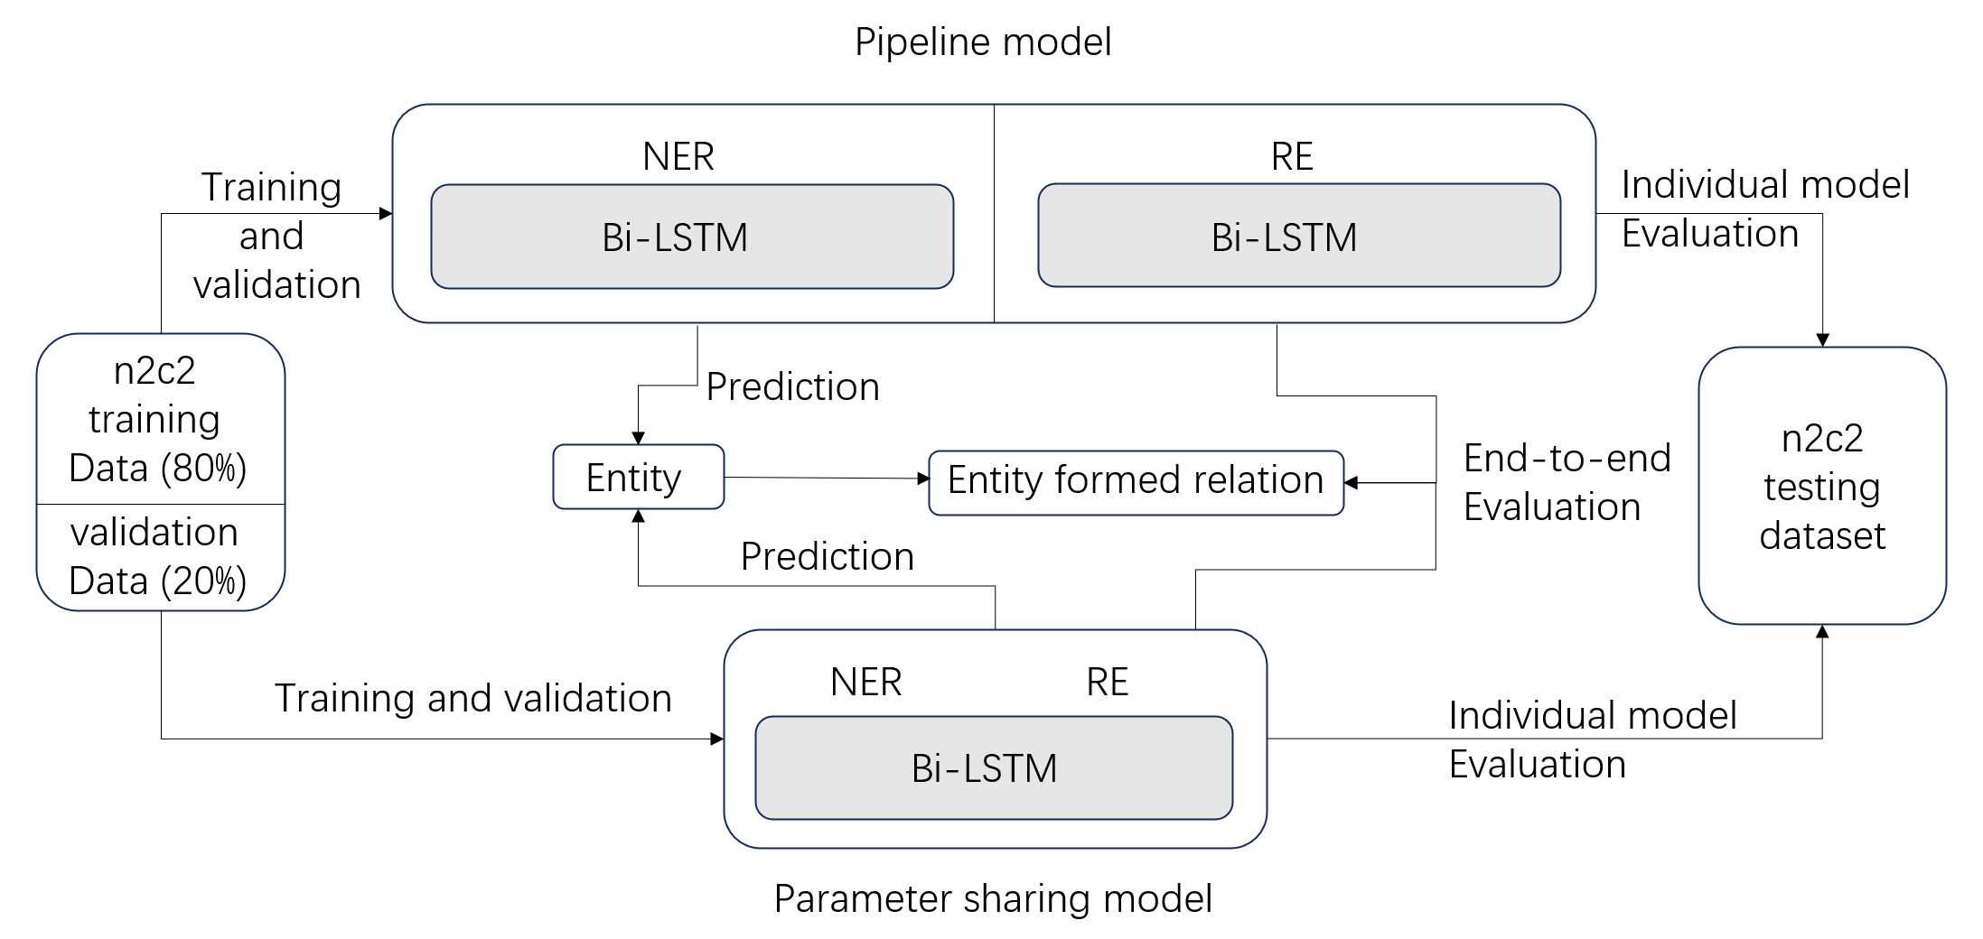
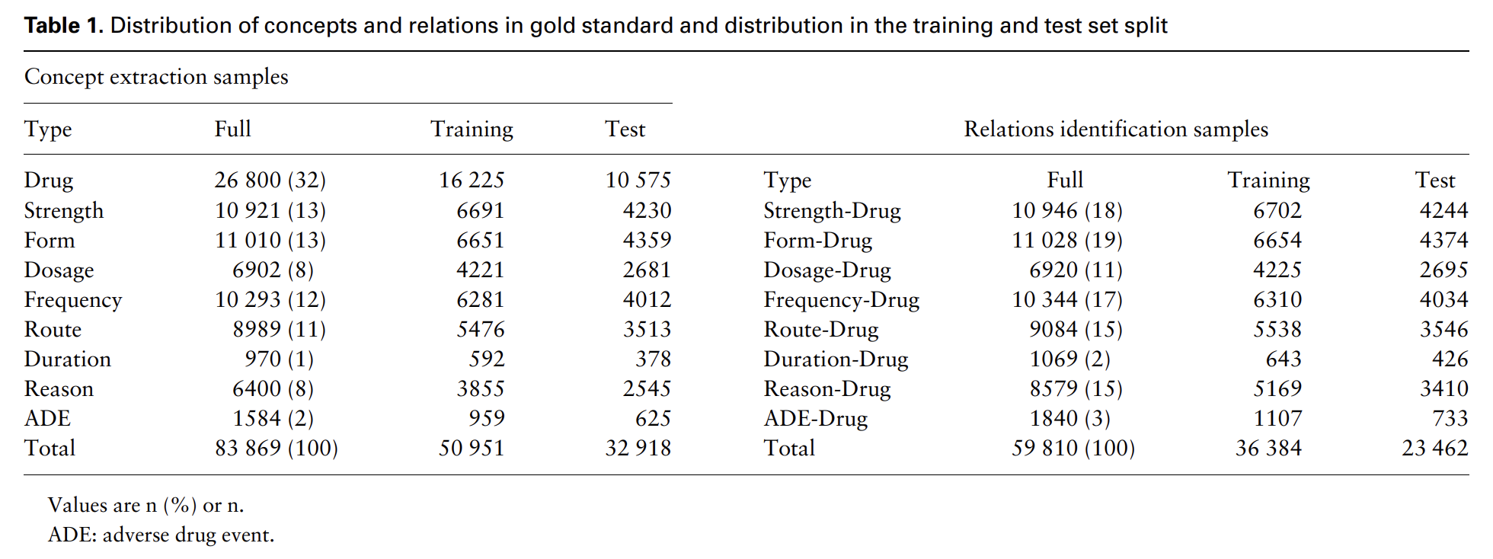
Does parameter sharing between named entity recognition and relations extraction models improve model performance for n2c2 medical concept and relation extraction?
Author: Qingzhou Li, Department of Biostatistics and Health Informatics, Kings College London.
Supervisors: Dr Angus Roberts, Leo Xinyue Zhang
Introduction
Extracting meaningful information from clinical texts plays a crucial role in healthcare decision-making, research, and knowledge representation.
Named Entity Recognition (NER) and Relation Extraction (RE) are pivotal tasks for medical information extraction (IE).
The National NLP Clinical Challenges (n2c2) is a collection of challenges for IE. n2c2 2018 Track 2 focused on extraction of adverse drug events (ADE) from clinical records and evaluated 3 tasks: concept extraction, relation classification, and end-to-end systems. [1]
Joint learning between NER and RE can help capturing context and dependencies in the text effectively. [2]
Aim: Build two individual named entity recognition and relation extraction model and a parameter sharing model.
Identify if parameter sharing between named entity recognition and relation extraction models help improve model performance for n2c2 medical concept and relation extraction.
Figure 1. Project Overview and workflow
Methodology
Data source
The data used for this project consisted of 505 discharge summaries drawn from the MIMIC-III (Medical Information Mart for Intensive Care-III) clinical care database.[3] Data distribution are shown in Table 1. [1]
Data Preprocessing
For NER task, we are using the Inside–outside–beginning (IOB) tagging format to tag the entities in each sentence. [4] For RE task, we are given with the gold standard relations, we just need to indicate the index position where the head and tail entity are. For parameter sharing model, we combine the both inputs.
For training process, the training data was partitioned into a training set (80%) and a validation set (20%).
Model Architecture design
We use PyTorch framework to build Bidirectional Long Short-Term Memory (BiLSTM) models. Parameter sharing model uses a shared word embedding that contains the contextual information. We tuned four hyperparameters (optimizer, learning rate, hidden dimension and tolerance in early stopping) to get the optimum feature values.
Table 1: Distribution of named entity and relation types in gold standard and distribution in training and test set split [1]
Discussion
Strength: We evaluate the impact of parameter sharing, result shows joint learning did improve the result for RE and end-to-end system, Li et al. [5] used similar approach on extract ADEs and proved that joint learning can significantly improve the performance of ADE-related Information Extraction.
Limitations: Compare our model with the current state-of-art models [1], we have a close f1-score measure to the top 10 groups’ result, our model could be improved by implementing with CRF layer or Attention mechanism. [6]
We used a different end-to-end performance measure approach, which overestimates the real model performance, this is due to lack of negative example in training phase. If we could add a ‘No relation’ to relations, our negative relations can be correctly identified and produce a more reliable result.
Results
After training, we compare the Precision, Recall and strict f1-score measure of each individual model with the parameter sharing model, and we evaluate the end-to-end performance by comparing the RE result of the pipeline model and joint model. From Table 2 we can see that the parameter sharing model has improved relation extraction and end-to-end performance, but not significant in NER prediction.
Model Pre diction | Individual and pipeline model (Precision/Recall/F1) |  |  | Parameter sharing model (Precision/Recall/F1) |  |  | Absolute Difference (%)
NER | 0.79 | 0.80 | 0.793 | 0.79 | 0.80 | 0.793 | 0.0 | 0.0 | 0.0
RE | 0.94 | 0.94 | 0.942 | 0.95 | 0.95 | 0.952 | 1.0 | 1.0 | 1.0
End-to-end | 0.99 | 0.99 | 0.985 | 1.00 | 1.00 | 0.997 | 1.0 | 1.0 | 1.2
References
[1] Henry, S., Buchan, K., Filannino, M., Stubbs, A., & Uzuner, O. (2020). 2018 n2c2 shared task on adverse drug events and medication extraction in electronic health records. Journal of the American Medical Informatics Association, 27(1), 3-12.
[2] Liu, X., He, P., Chen, W., & Gao, J. (2019). Multi-task deep neural networks for natural language understanding. arXiv preprint arXiv:1901.11504.
[3] Johnson, A. E., Pollard, T. J., Shen, L., Lehman, L. W. H., Feng, M., & Mark, R. G. (2016). MIMIC-III, a freely accessible critical care database. Scientific data, 3(1), 1-9.
[4] Ramshaw, L. A., & Marcus, M. P. (1999). Text chunking using transformation-based learning. In Natural language processing using very large corpora (pp. 157-176). Dordrecht: Springer Netherlands.
[5] Li, F., Liu, W., & Yu, H. (2018). Extraction of information related to adverse drug events from electronic health record notes: design of an end-to-end model based on deep learning. JMIR medical informatics, 6(4), e12159.
[6] Huang, Z., Xu, W., & Yu, K. (2015). Bidirectional LSTM-CRF models for sequence tagging. arXiv 2015. arXiv preprint arXiv:1508.01991.
Table 2: Performance measure of three tasks. NER: named entity recognition. RE: relation extraction

