Slide 1
Searching with BigQuery
Adam Stine

Slide 2
Overview
What is BigQuery?
Pinning Data in the Console
Search SRA Metadata
Taxonomy Searches of SRA

Slide 3
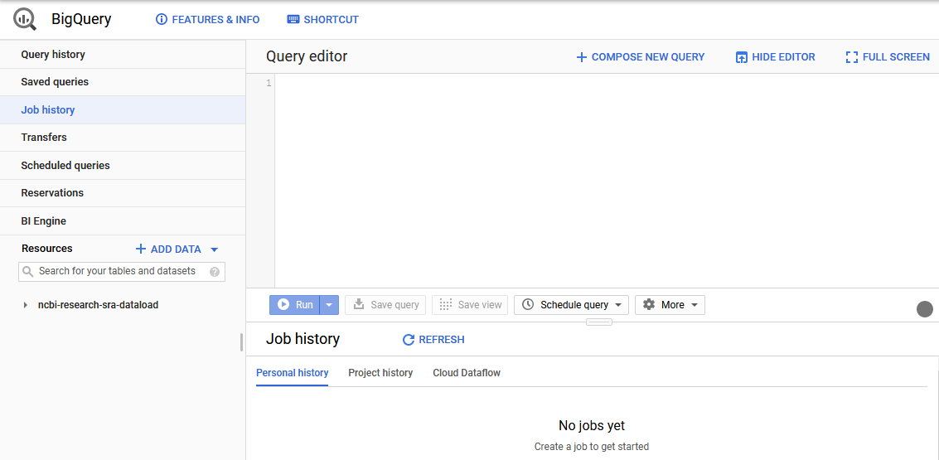
What is BigQuery?
BigQuery is the Google Cloud Data Warehouse product.
It supports features like queries, access control, and data management.
The Sequence Read Archive (SRA) maintains a copy of the sequence metadata from submissions in BigQuery
This allows SQL queries to search the metadata in ways that are hard or impossible with the NCBI Entrez search engine.
https://cloud.google.com/bigquery/docs/how-to

Slide 4
Intro to BigQuery
Like bucket creation you can either use a client from Google in a vm (bq) or the GCP console in a web browser.
For this demo we will only be using the browser console.

Slide 5
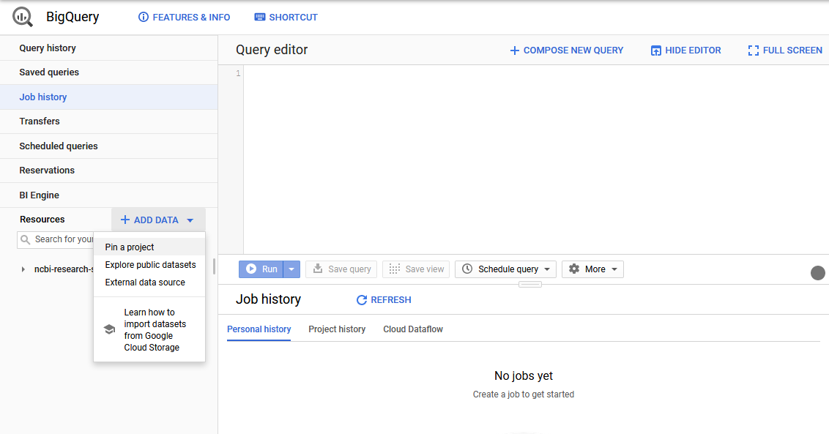
Adding Data
We will add the public SRA data set to our BigQuery project.
Click + ADD DATA on the left side of the console.
In the menu that appears click Pin a project.

Slide 6
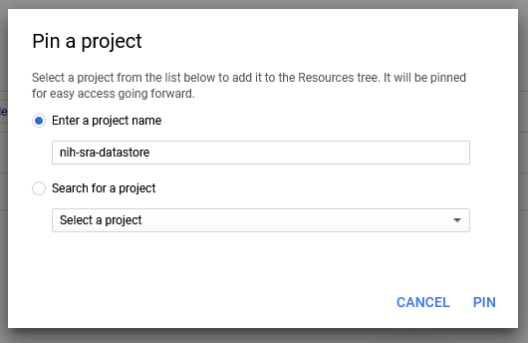
Adding Data
Enter nih-sra-datastore in the project name box.
Click PIN.
This will pin the public metadata datastore to your BigQuery console.

Slide 7
Yes/No Question
I feel comfortable writing basic queries in SQL.

Slide 8
Simple SQL Queries
A very basic overview of SQL queries.
SELECT – command to extract data from a table.
FROM – specify which tables to extract data from
WHERE – filters the data
ORDER BY – order the results by specified column(s)
https://cloud.google.com/bigquery/docs/reference/standard-sql/query-syntax

Slide 9
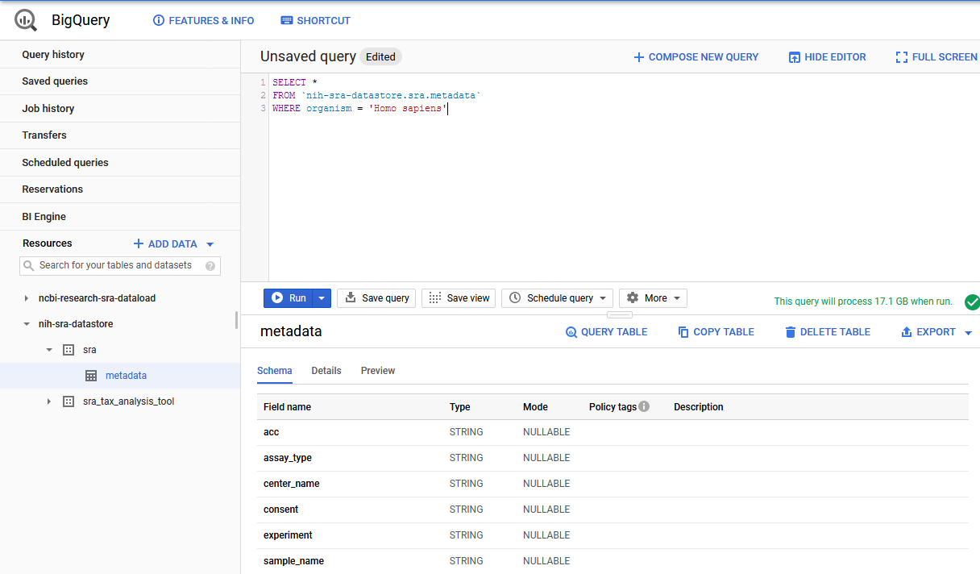
Searching in BigQuery
Here is an example search for the SRA Data.
SELECT * FROM `nih-sra-datastore.sra.metadata` WHERE organism = ‘Homo sapiens’
This query will search in the metadata table that is part of the SRA dataset contained in the nih-sra-datastore project.
The query will look for all (Select *) records with ‘Homo sapiens’ in the organism column.

Slide 10
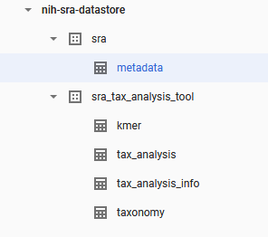
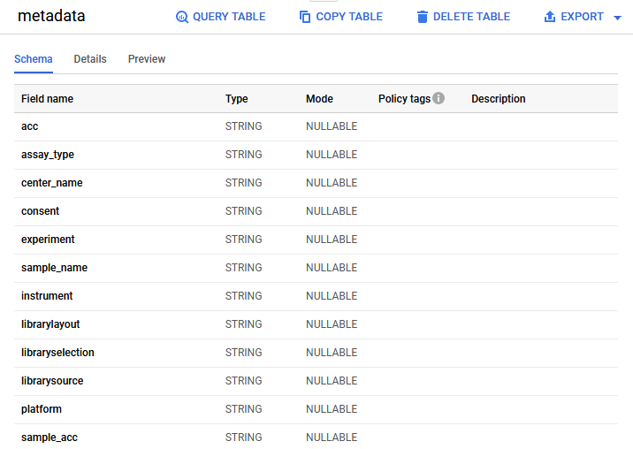
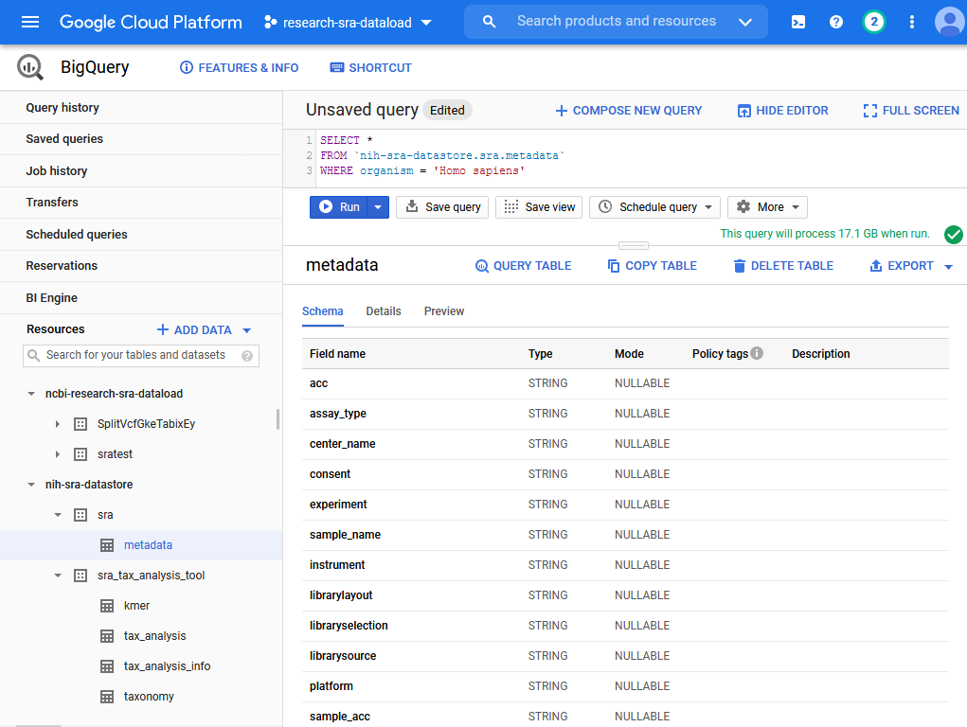
Console Previews and Info
The console has some very useful features we can explore.
We can look through the tables available to query in the pinned dataset.
By clicking on a single table we can view the columns and data type of those columns.

Slide 11
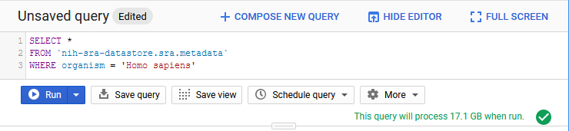
BigQuery Charges
We also get a preview of how much data will be searched.
Our example query will look through 17.1 GB of data to get a result.
This is one of the ways you generate cost in BigQuery
https://cloud.google.com/bigquery/pricing
Our example is an on-demand query which currently costs $5.00 per TB searched.
This query would be ~$0.10 to run
The first 1 TB each month is free.

Slide 12

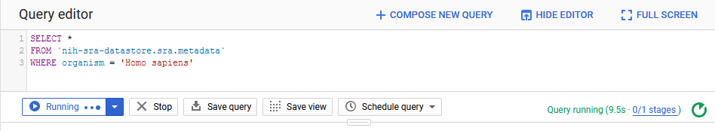
Running a Query
Click RUN to run the query.
While the query is running the console will show live updates on the status of the query.
Once the query finishes the results will display in the lower right portion of the console.

Slide 13
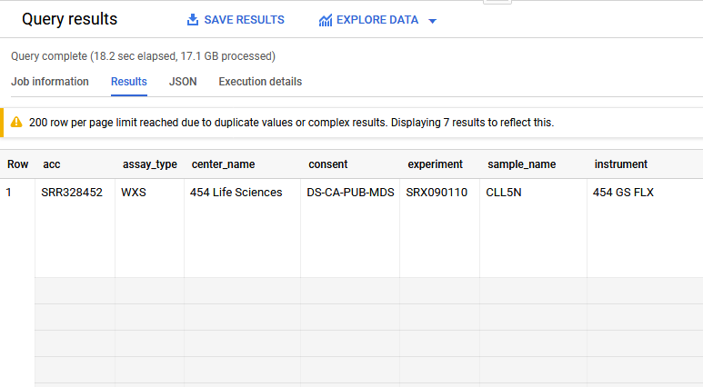
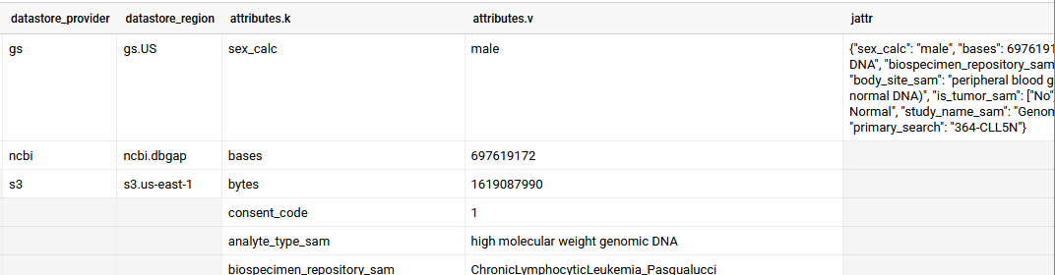
BigQuery Arrays
You might expect to see one record per row on the results but BigQuery supports an array feature for multi-value fields.
Scrolling to the right on this record we can find several columns that have multiple lines for this one record.
We won’t go into depth on the data structure in these columns but it is an important feature of BigQuery

Slide 14
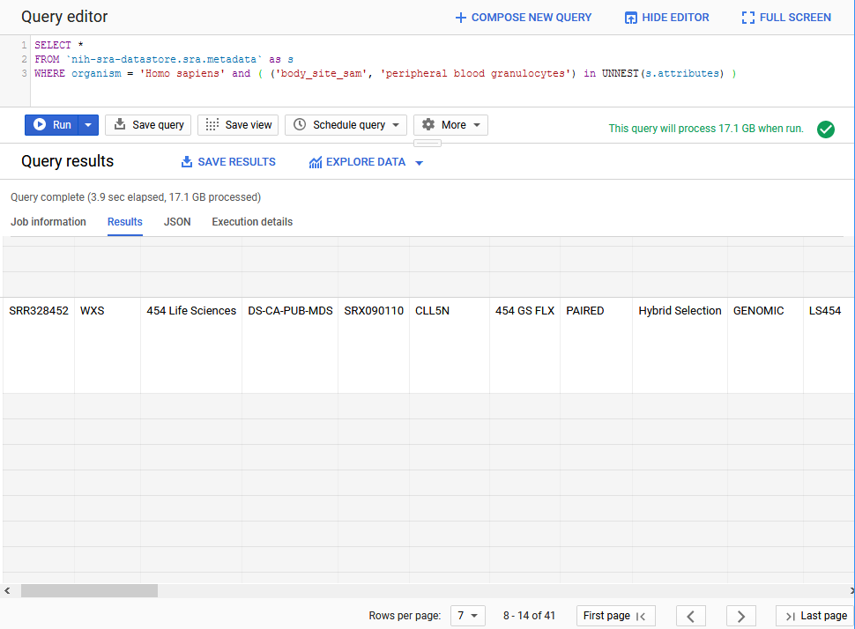
Unnesting Arrays
Here is an example search that will filter for a value in one of those columns.
SELECT *
FROM `nih-sra-datastore.sra.metadata` as s
WHERE organism = 'Homo sapiens' and ( ('body_site_sam', 'peripheral blood granulocytes') in UNNEST(s.attributes) )
The unnest function is allowing us to search the key ‘body_side_sam’ and find only records with the value ‘peripheral blood granulocytes’

Slide 15
Taxonomy Data
In addition to metadata from the SRA database, there is also the sra_tax_analysis_tool dataset.
There are four tables in this dataset:
tax_analysis_info: a summary table for the results of the STAT tool
tax_analysis: use the taxonomy analysis table to locate any number of runs based on kmer hits to a particular organism or branch in a taxonomic tree.
taxonomy: NCBI Taxonomy database where you can locate the taxid based on organism names.
kmer: contains kmers mapped to a particular organism and allows you to continue exploring organismal content further. You can use kmer tables in your downstream analysis by building custom kmer libraries.

Slide 16
Searching in BigQuery
We can join the metadata and the taxonomy data and to search for sequence data in SRA that is from the coronaviridae family.
SELECT m.bioproject, m.biosample, m.acc, m.collection_date_sam, m.geo_loc_name_sam,
(select v from unnest(m.attributes) where k = 'collected_by_sam') as collected_by,
(select v from unnest(m.attributes) where k = 'host_sam') as host
FROM `nih-sra-datastore.sra.metadata` m , `nih-sra-datastore.sra_tax_analysis_tool.tax_analysis` tax
WHERE m.acc = tax.acc
and tax.name = 'Coronaviridae'

Slide 17
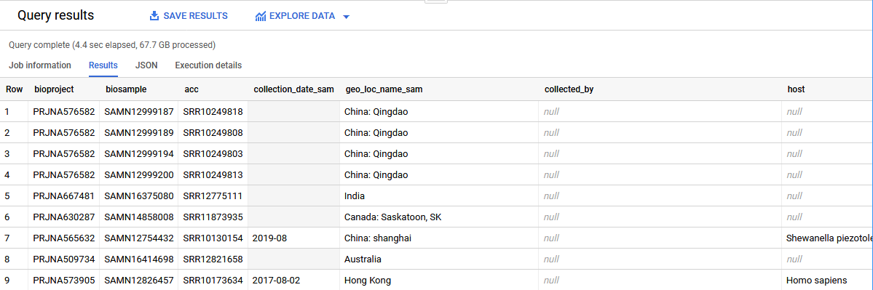
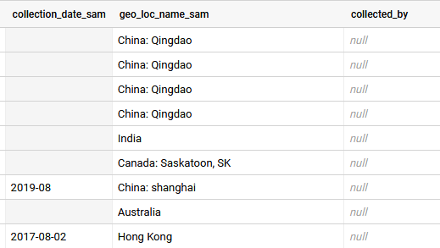
Searching in BigQuery
This query includes the project, sample, and run accessions for all the data we found. It also shows submitter supplied metadata for date, location, host, and collected by fields.
Note that some of this metadata might not have been provided by the submitter so the presence of certain metadata on one record does not imply it will be present on all records.
Keep that in mind when writing queries.

Slide 18
Searching in BigQuery
The last query was part of this NCBI Minute webinar on using BigQuery
https://www.youtube.com/watch?v=DkNz-RCCm-M
The NCBI YouTube channel has additional videos on many topics that range in length from a few minutes to over an hour long.
https://www.youtube.com/channel/UCvJHVo5xGSKejBbBj0A5AyQ

Slide 19
Review
BigQuery allows for SQL searches of large data sets quickly.
BigQuery can be used to search the publicly accessible SRA metadata using SQL searches.
SRA has generated taxonomy data using the SRA Taxonomy Analysis Tool (STAT) that can be used to find the organism content of runs in SRA.

Slide 20
Additional Resources
STAT Description https://www.ncbi.nlm.nih.gov/sra/docs/sra-taxonomy-analysis-tool/
Additional Examples for SRA Searches in BigQuery https://www.ncbi.nlm.nih.gov/sra/docs/sra-bigquery-examples/
Google Quickstart for BigQuery https://cloud.google.com/bigquery/docs/quickstarts/quickstart-web-ui
A video from Google that looks at nested data in BigQuery https://www.youtube.com/watch?v=STo98QUKDS8

Slide 21
Thank you.
This research was supported by the Intramural Research Program of the NIH, National Library of Medicine.
Lydia Fleischmann
Carl Leubsdorf
Brad Plecs
Thomas Doak
Kate Mortensen
Layla Freeborn
Sheri Sanders
Rodney Brister
Ryan Connor
Ravinder Eskandary
Allie McDougall
Rana Morris
Daniel Soren
Louise To
Tom Madden
Chistiam Camacho
Françoise Thibaud-Nissen
Dave Arndt
Rick Lapoint
Chris O’Sullivan
Yuriy Skripchenko
Jon Trow
Steve Sherry

