Slide 1
Starting a Google Compute Engine Instance
Adam Stine

Slide 2
Overview
What is Google’s Compute Engine?
Creating a new Compute Engine Virtual Machine.
Installing the SRA Toolkit on a VM

Slide 3
What is Compute Engine?
GCP Compute Engine provides on demand virtual machines.
These can be launched with basic operating systems or custom images.
Users can scale both the power of single machines or the number of VMs to fit their workflow.

Slide 4
Multiple Choice Question
What percentage of your informatics work is done with a command line terminal? (less than 10%, 10-50%, more than 50%)

Slide 5
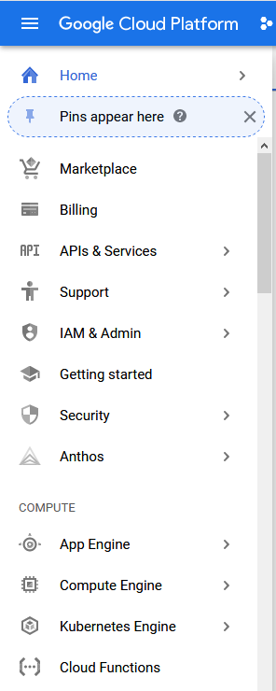
New Compute Engine
To create a Compute Engine VM start at the GCP console
https://console.cloud.google.com/
click "Compute Engine" in the menu on the left of the screen.

Slide 6
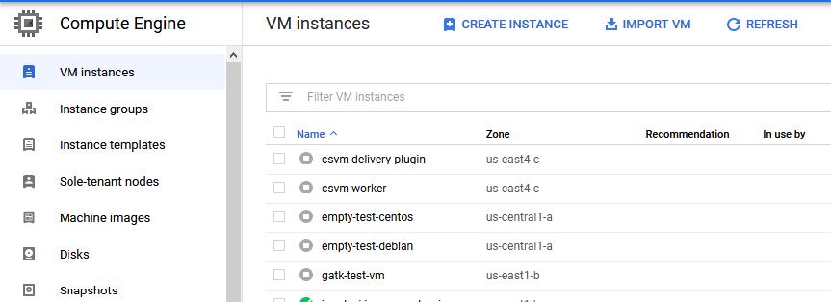
New Compute Engine
Click the Create Instance button in the center of the screen.

Slide 7
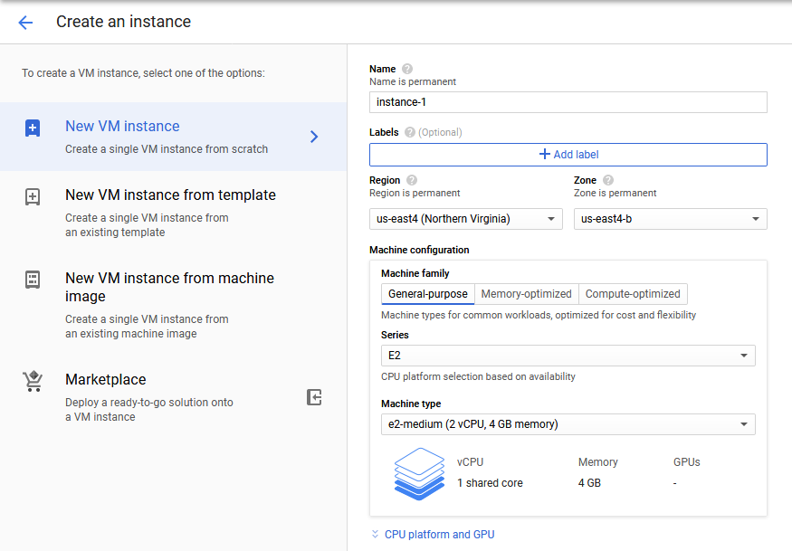
New Compute Engine
Select a permanent name for the instance.
Select a Region : us-east4 (Northern Virginia)
Regions determine the location of the data center running the compute instance. NCBI archive data is typically available to any US region.
Your own stored results or data may be limited in access to a smaller geographic area. We'll talk about this more when discussing buckets and storage.
More info on regions and zones here:
https://cloud.google.com/docs/overview#global_regional_and_zonal_resources

Slide 8
New Compute Engine
Select a Zone to run the instance in.
Zones are a further layer of localization. For our workshop we should be able to avoid issues by picking a zone and region we will work in and staying consistent with that. More information about zones and regions can be found here.
https://cloud.google.com/compute/docs/regions-zones

Slide 9
New Compute Engine
Select General-purpose E2 Series machine.
Select the e2-medium Machine type from the Shared core list. This has access to 2 virtual cores and 4GB of memory.
Choosing the correct size of CPU can have a big impact on the expense of compute costs. For this example we will be using low powered (and therefore lower cost per time) CPUs.
For tasks that will take more memory resources or are very compute intensive, a larger machine may be necessary and may also be less expensive because it will be able to finish the task substantially faster. Detailed pricing of the resources can be found here.
https://cloud.google.com/compute/all-pricing

Slide 10
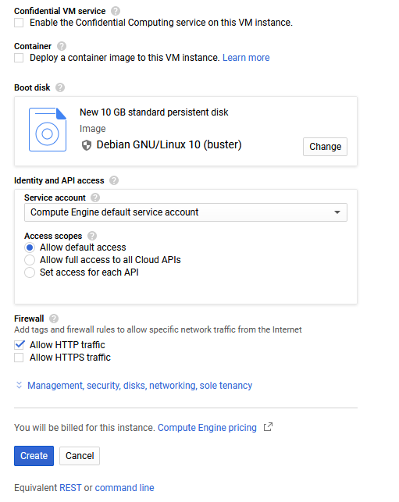
New Compute Engine
Select the 10 GB standard disk with Debian GNU/Linux 10 (buster)
Allow full access to all Cloud APIs
Allow HTTP traffic (this opens port 80)
Click Create to begin launching the VM

Slide 11
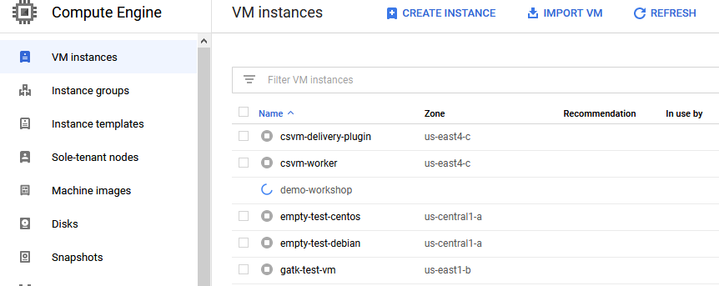
New Compute Engine
You will be automatically taken to a page showing the running VM instances in GCP.
Once a green circle with a check inside of it appears next to your new instance, it is ready for you to connect to it.

Slide 12
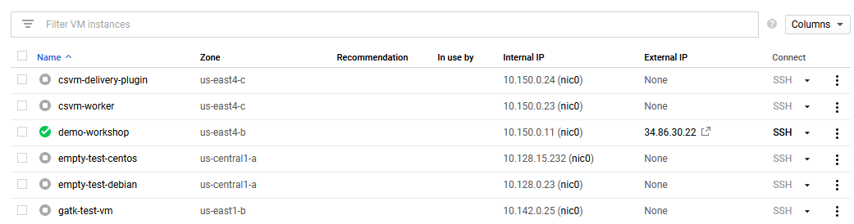
New Compute Engine
Once a green circle with a check appears next to your new instance, it is ready for you to connect to it.
There are multiple ways to connect to a GCP instance. You can use any ssh client you prefer to connect to the instance using an External IP.
To connect in a browser window find the Connect column menu for your instance and click the text SSH for your instance.

Slide 13
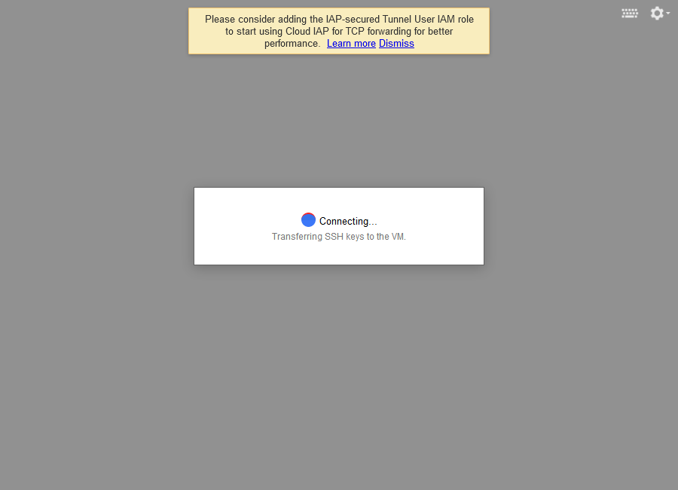
New Compute Engine
A new browser will open and begin connecting to your instance.
You may need to tell your browser to allow GCP to open new windows.
When we connect we will be presented with a command prompt for our compute instance.

Slide 14
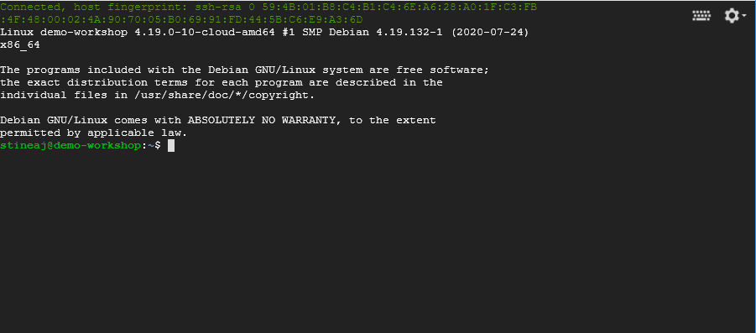
New Compute Engine
This VM will have very few programs installed. Frequent users of cloud services will typically go through the process of installing all the software they want on their instances and saving that as an image or container that can be launched from the Compute Engine.
Now we’ll install the SRA Toolkit from NCBI.

Slide 15
Yes/No Question
Have you used the SRA Toolkit before?

Slide 16
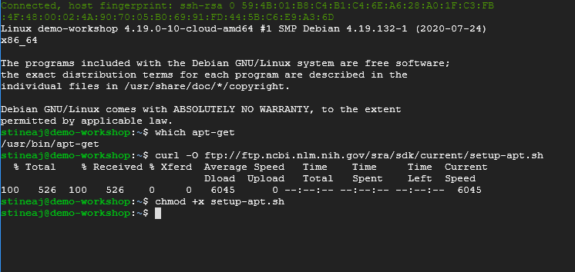
Install SRA Toolkit
The current version of the SRA Toolkit is distributed from the NCBI FTP here. ftp://ftp.ncbi.nlm.nih.gov/sra/sdk/current/
Our instance should have apt-get installed. We can verify this by typing 'which apt-get' in the console and making sure a location is returned.
The install script we need to run for the SRA Toolkit is here: ftp://ftp.ncbi.nlm.nih.gov/sra/sdk/current/setup-apt.sh
We can use curl to copy the script to our VM instance with the following command.
curl -O ftp://ftp.ncbi.nlm.nih.gov/sra/sdk/current/setup-apt.sh
Finally use chmod +x to make the shell script executable

Slide 17
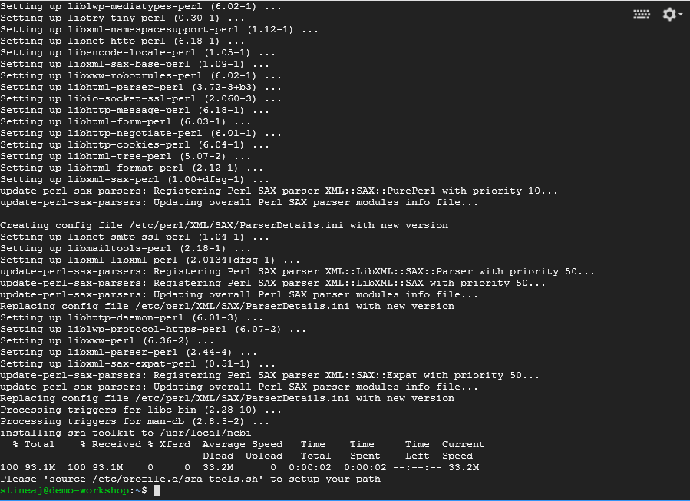
Install SRA Toolkit
We'll run the install script using sudo so that it has sufficient permissions to install necessary libraries and packages.
sudo ./setup-apt.sh
This will install several packages and libraries on our instance that are used by the SRA Toolkit
The last message in the install process wil tell us to source a shell script included with the toolkit. This will add the newly installed toolkit programs to our path.
source /etc/profile.d/sra-tools.sh

Slide 18
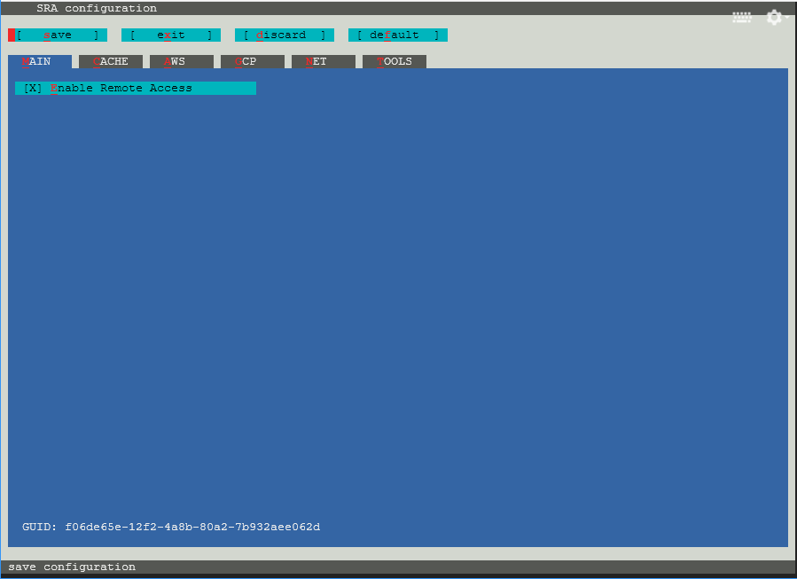
Install SRA Toolkit
The final step to getting the toolkit installed will be to run vdb-config program to configure our toolkit install.
vdb-config -i
This will open a graphical user interface (GUI) to set some required parameters.
We can navigate the menus by typing the letter highlighted in red on the screen to move between the menus and set options.

Slide 19
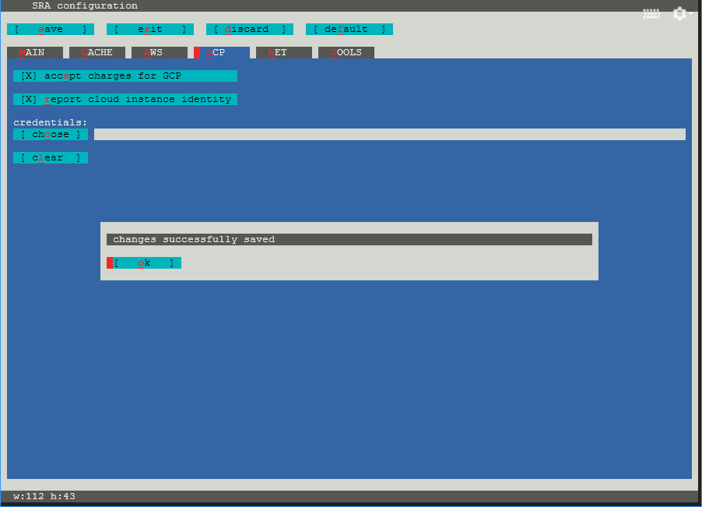
Install SRA Toolkit
Type g in the window to select the GCP menu.
Type e to accept charges for GCP so that we as the users agree to pay costs for egress of data to different storage regions or access to user owned buckets. In this seminar we do not expect to generate any charges from this type of usage.
Type r to report the cloud instance identity to the toolkit. The information provided with this is the cloud provider and region.
Type o and select the JSON credentials file saved from the Service Accounts console.
Type s to save the configuration. Type o to confirm.
Type x to exit the configuration.
We have finished configuring the SRA Toolkit for accessing data on a GCP VM.

Slide 20
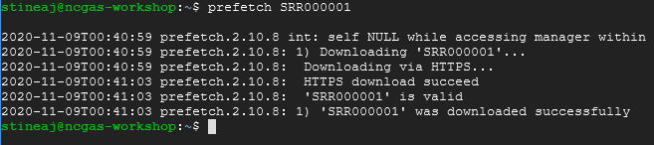
Pull In Data with SRA Toolkit
To test our configuration, we’ll try accessing a sequencing data run from SRA.
prefetch SRR000001
We should see several lines of information appear on the screen with the last line telling us we have downloaded the data successfully.
If we list the directory SRR000001 we will see the downloaded data file in the directory.
ls SRR000001

Slide 21
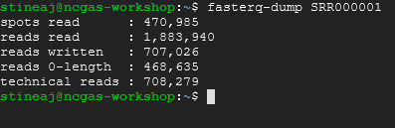
Output FASTQ with SRA Toolkit
We can also use the SRA Toolkit to convert the data we downloaded into other formats, like fastq.
We will use the fasterq-dump program to produce fastq data. This program has many options but if we run with the default choices it will output a fastq file for each read in a paired data set.
If there are unmated reads in the run it will output a third file with just the unmated reads.
fasterq-dump SRR000001

Slide 22
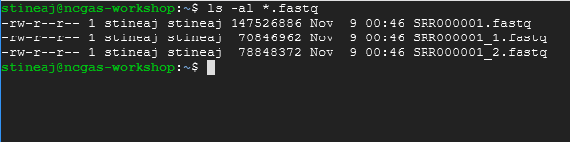
SRA Toolkit FASTQ Output
There were three files produced from this operation
SRR000001.fastq SRR000001_1.fastq SRR000001_2.fastq
The first file is the unmated reads while the files with the _1 and _2 are the mated reads.

Slide 23
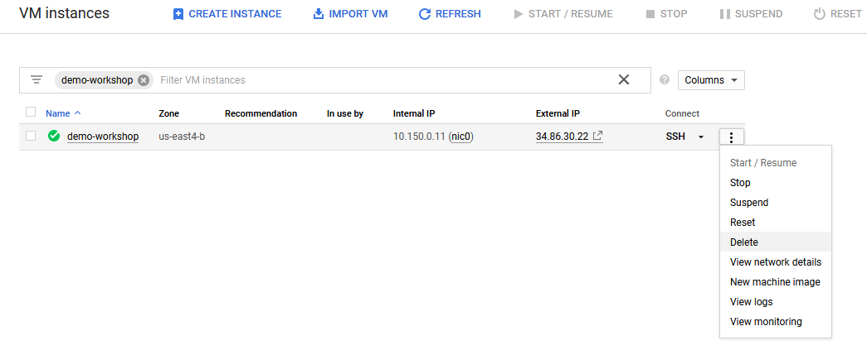
Delete an Instance
This VM has accomplished all we need to do with it right now. For later work we will be starting our VM from an image that has more software installed for us. To close the terminal window type the following command
exit
This closes the browser window for our instance but our VM is still running.
Our instances can be found by going to the Compute Engine page of the console and selecting VM instances from the menu on the left of the screen.

Slide 24
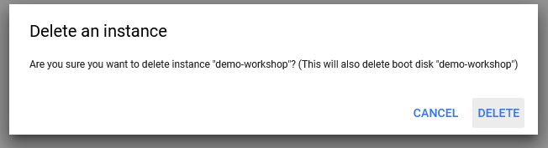
Delete an Instance
This is the page we launched our client window to access the VM earlier.
We can perform several important actions by clicking the three dots to the right for our instance.
We can stop or suspend instances that we will return to later but are not using currently. Or we can delete instances we do not plan to use again.
Click Delete to stop and delete our instance. The data we downloaded will be deleted as well.
More information about instance states can be found here. https://cloud.google.com/compute/docs/instances/instance-life-cycle

Slide 25
Review
We created a VM with the Google Compute Engine.
We installed a program (SRA Toolkit) as well as additional packages it required to run.
We downloaded data from SRA using the SRA Toolkit.
We converted the downloaded data to FASTQ format.
And we deleted our instance to stop generating charges on our GCP account.

Slide 26
Additional Resources
Google Cloud Next Introduction to Virtual Machines video https://www.youtube.com/watch?v=3aNDcgoJ-_8
Google Docs for VM Instances https://cloud.google.com/compute/docs/instances
SRA Toolkit Software Docs https://github.com/ncbi/sra-tools/wiki

