Slide 1
Welcome!
We are excited you will be joining us for the workshop starting Monday, November 16th at 10:00AM EST.
Please follow this guide to prepare for the workshop.
Test that WebEx works with your computer and internet connection.
Test access to Google Cloud Platform using the email provided in registration.
Please email stineaj@ncbi.nlm.nih.gov with a description of any problems.
NCGAS Hosts NCBI in the Cloud

Slide 2
WebEx Test
If you have not already accepted the WebEx invite sent this week, please do that as soon as possible. Make sure to check spam folders.
WebEx will be used for presentations and communication at the workshop. Please try to join a test meeting at this link. https://www.webex.com/test-meeting.html
Unix/Ubuntu users have experienced problems using WebEx and we recommend using a Windows, OSX, or ChromeOS computer if possible.
WebEx supported browsers and operating systems. https://help.webex.com/en-us/9ehuwu/Webex-Meetings-Web-App-Supported-Operating-Systems-and-Browsers

Slide 3
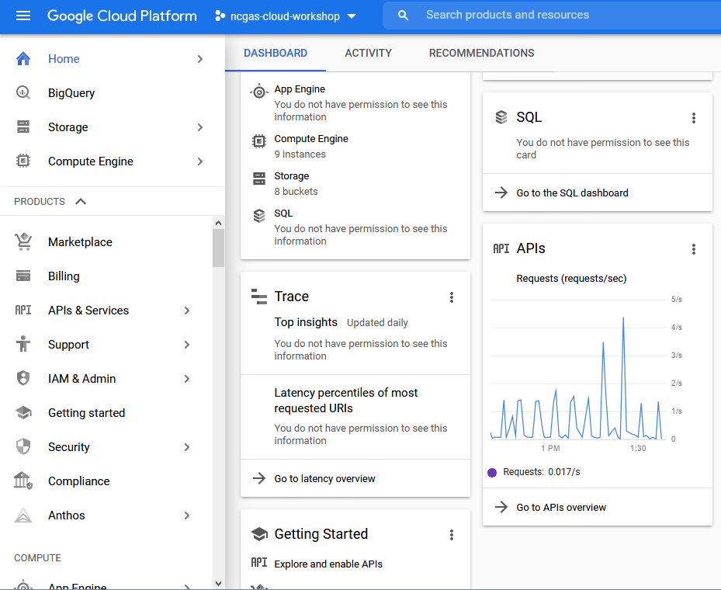
Google Cloud Platform Login
Please try connecting to https://console.cloud.google.com/ using the email address you provided when registering for the workshop.
You will need to log in to your google account first.
In the blue bar, look to the right of Google Cloud Platform and select the ‘ncgas-cloud-workshop’ project.
You may need to search for the ‘ncgas-cloud-workshop’ project.

Slide 4
Google Cloud Platform Console
You can explore the Google Cloud Platform console if you want but please do not generate charges on this Google project until the workshop starts.
There will be plenty of time in the workshop to experiment!
Now you are ready for the workshop.

Slide 5
Schedule
Monday
10:00 AM Opening Remarks
10:15 AM Intro to Cloud
11:00 AM Break
11:15 AM Intro to Cloud II
Noon Lunch Break
12:45 PM RAPT/PGAP Intro
1:30 PM ElasticBLAST
2:15 PM Break
2:30 PM Hands-On Time
4:00 PM Q & A and Wrap-up
5:00 PM Workshop Day 1 concludes
NCGAS Workshop
Nov 16th-17th 2020

Slide 6
Schedule
Tuesday
10:00 AM Workshop Day 2 begins
Participants continue hands-on activity, breakout rooms open
Noon Lunch Break
12:45 PM Office Hours
3:00 PM Breakout rooms close
3:30 PM Wrap-up Discussion
5:00 PM Cloud Access Closes

Slide 7
GitHub Repository
Documents and slides will be available on this GitHub repository.
https://github.com/NCBI-Codeathons/NCGAS-cloud-workshop

