Slide 1
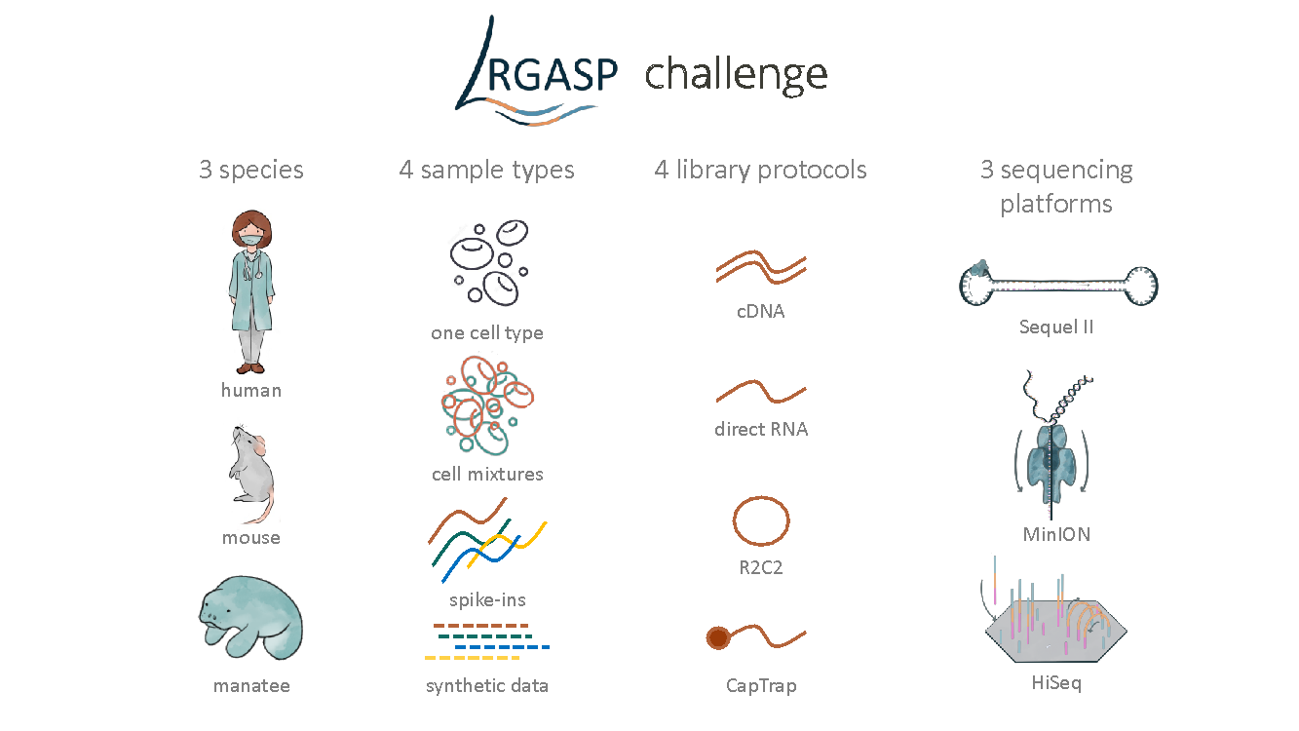
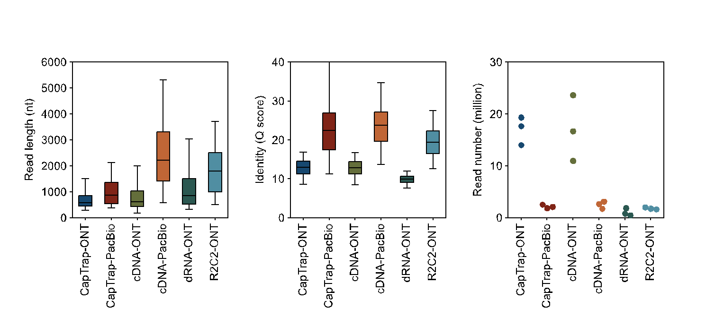
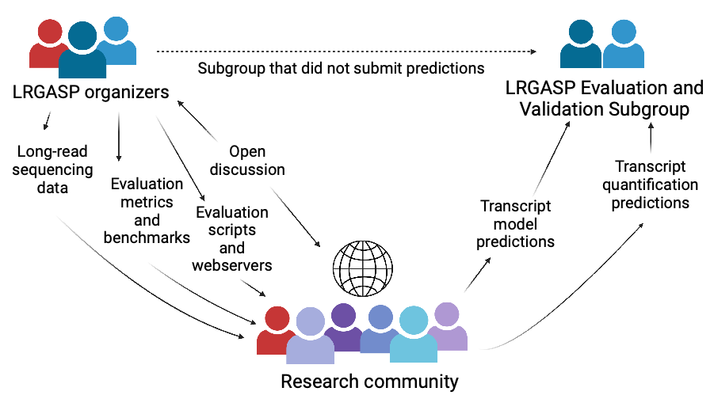
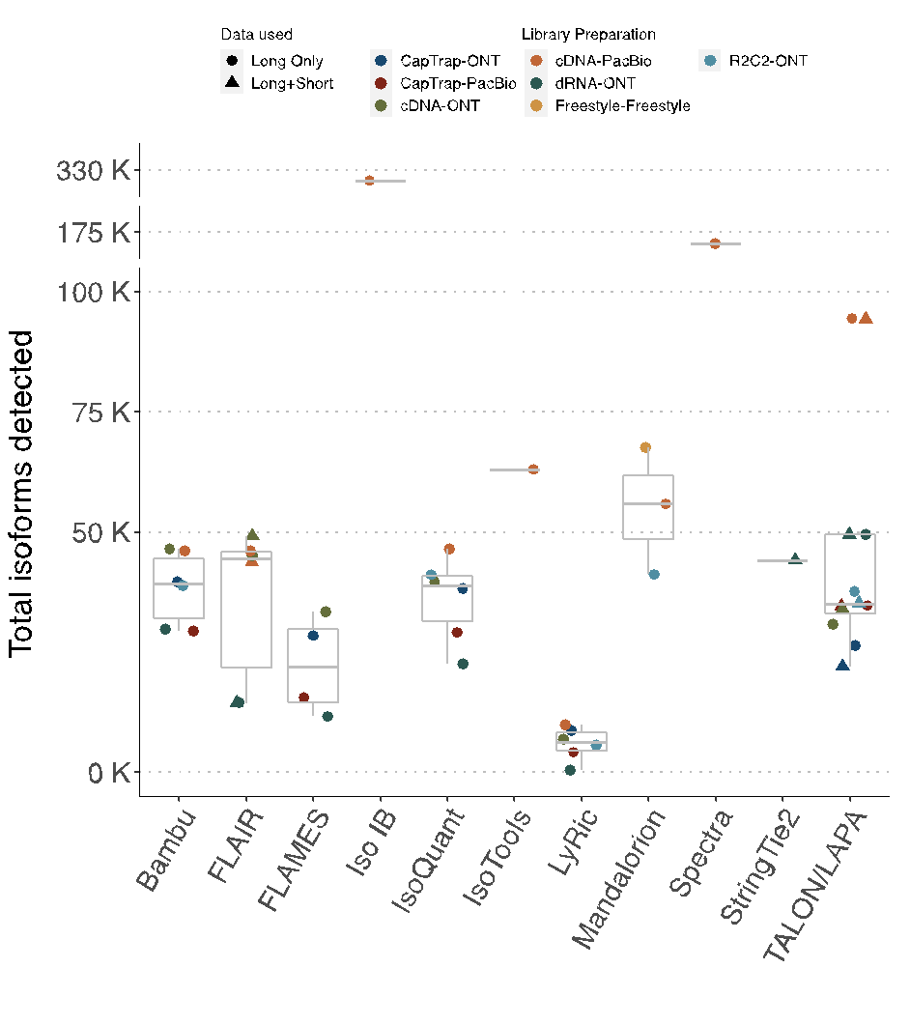
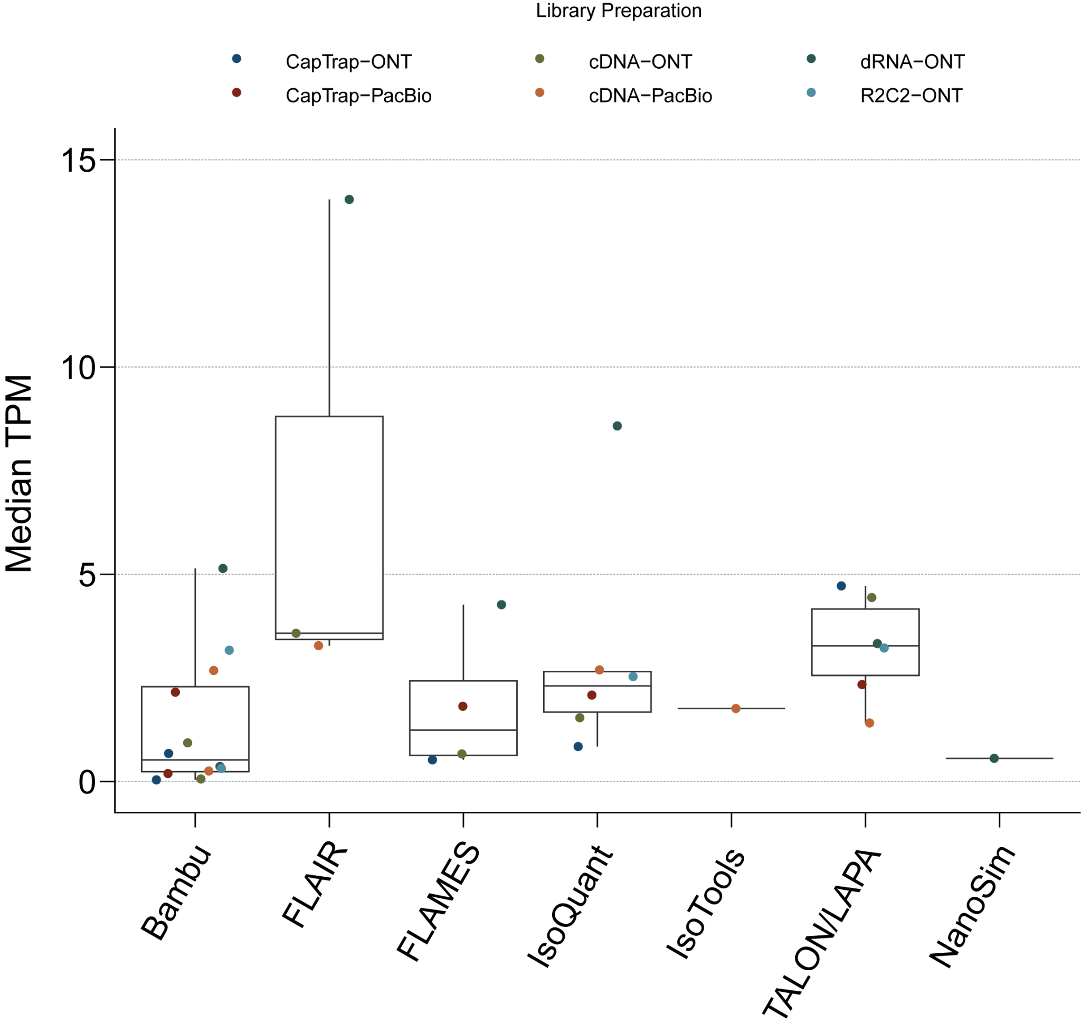
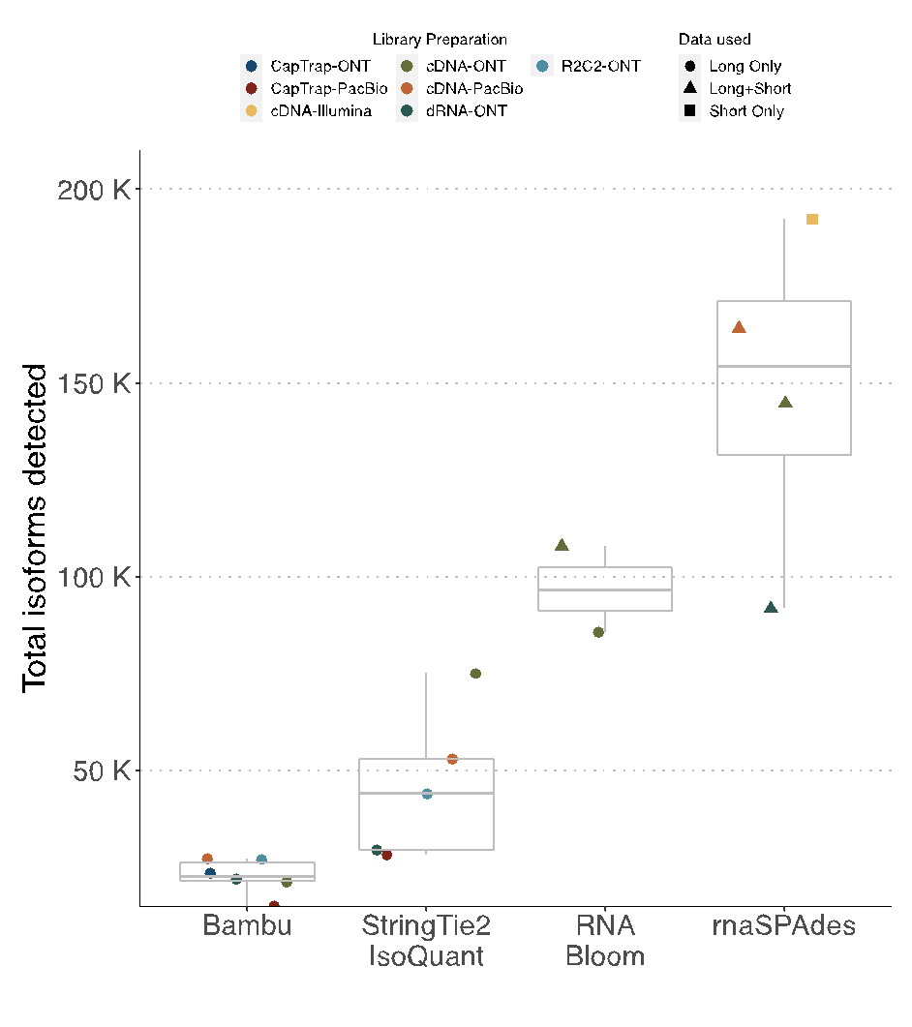
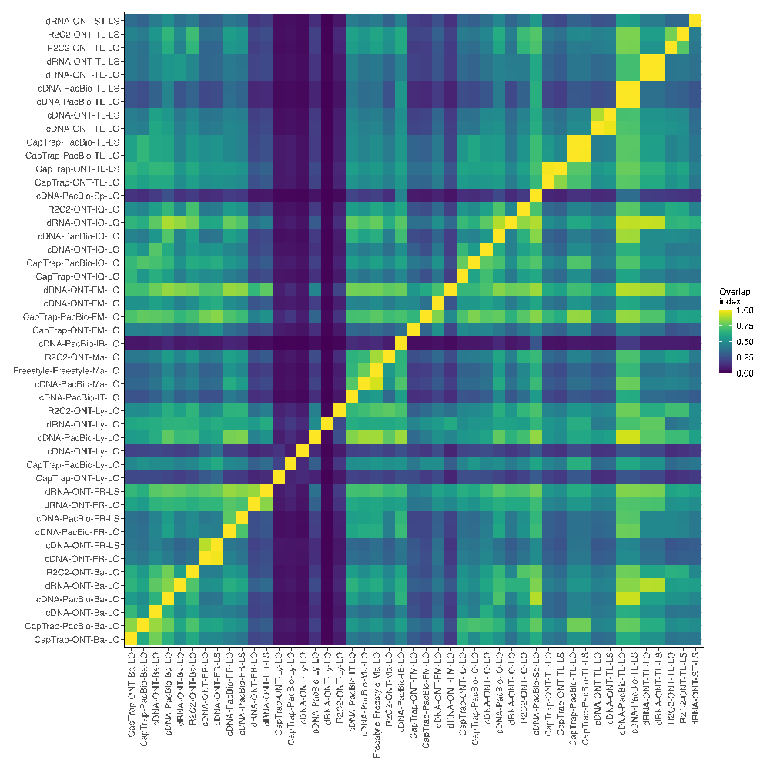
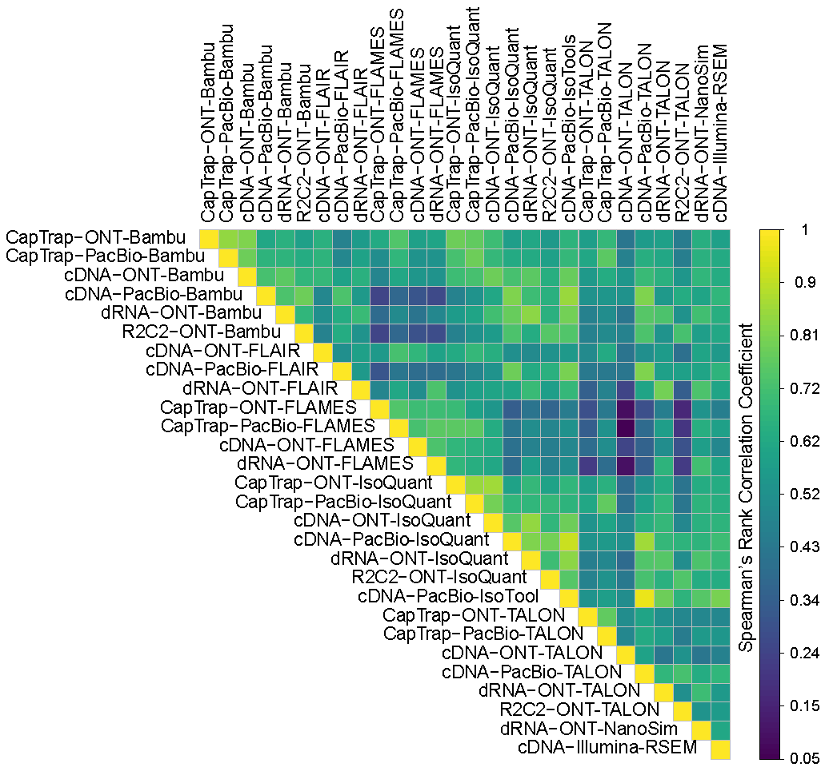
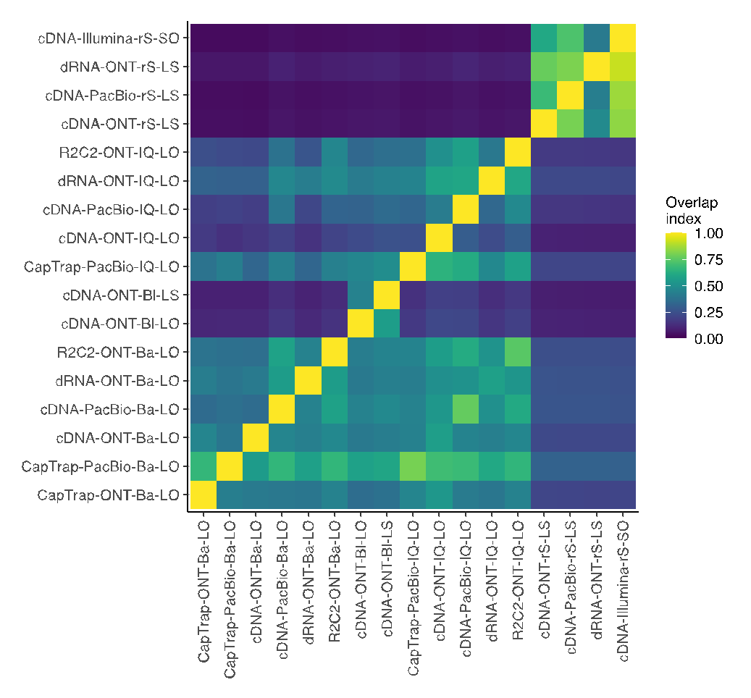
a
b
c
d
e
f
g
h
i

Slide 2
Fig. 1. Overview of the Long-read RNA-seq Genome Annotation Assessment Project (LRGASP). a, Data produced for LRGASP consists of multiple species, multiple sample types, multiple library protocols, and multiple sequencing platforms for comparison. b, Distribution of read lengths, identify Q score, and sequencing depth (per biological replicate) for the WTC11 sample. c, LRGASP as an open research community effort for benchmarking and evaluating long-read RNA-seq approaches. d, Number of isoforms reported by each tool on different data types for the human WTC11 sample for Challenge 1. e, Median TPM value reported by each tool on different data types for the human WTC11 sample for Challenge 2. f, Number of isoforms reported by each tool on different data types for the mouse ES data for Challenge 3. g, Pairwise relative overlap of unique junction chains (UJCs) reported by each submission. The UJCs reported by a submission is used as a reference set for each row. The fraction of overlap of UJCs from the column submission is shown as a heatmap. For example, a submission that has a small, subset of many other UJCs from other submissions will have a high fraction shown in the rows, but low fraction by column for that submission. Data only shown for WTC11 submissions. h, Spearman correlation of TPM values between submissions to Challenge 2. i, Pairwise relative overlap of UJCs reported by each submission. The UJCs reported by a submission is used as a reference set for each row. The fraction of overlap of UJCs from the column submission is shown as a heatmap.

