Slide 1
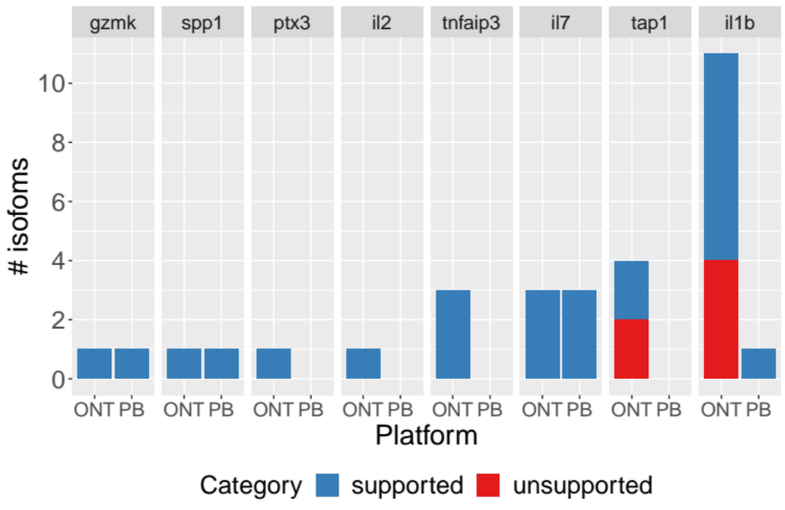
Extended Data Fig. 70. PCR validation results for manatee isoforms for seven target genes (data shown in Figure 5l) broken down by the platform (ONT or PacBio) underlying the pipelines that led to the identification of the isoform.

