Slide 1
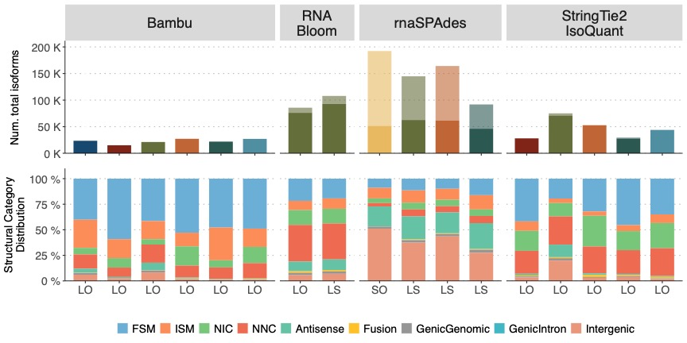
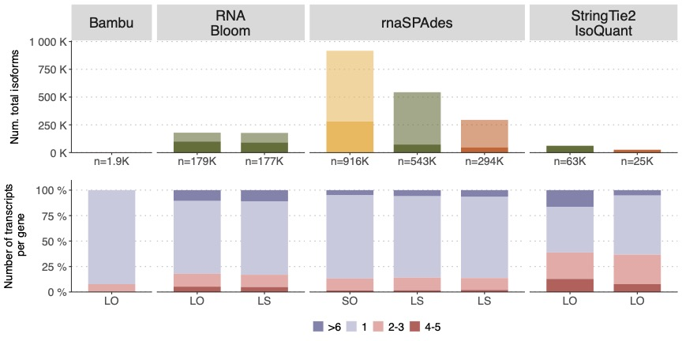
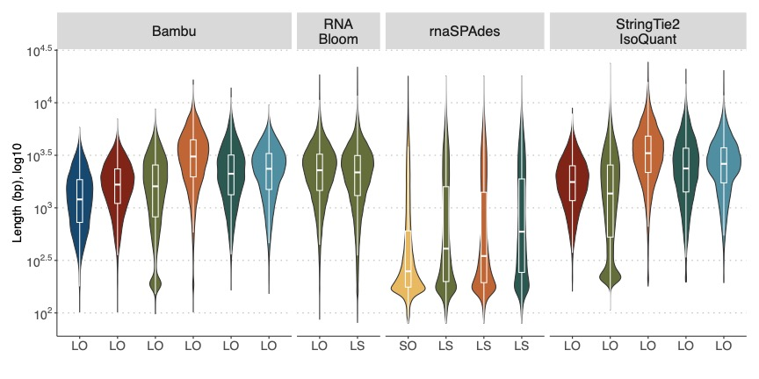
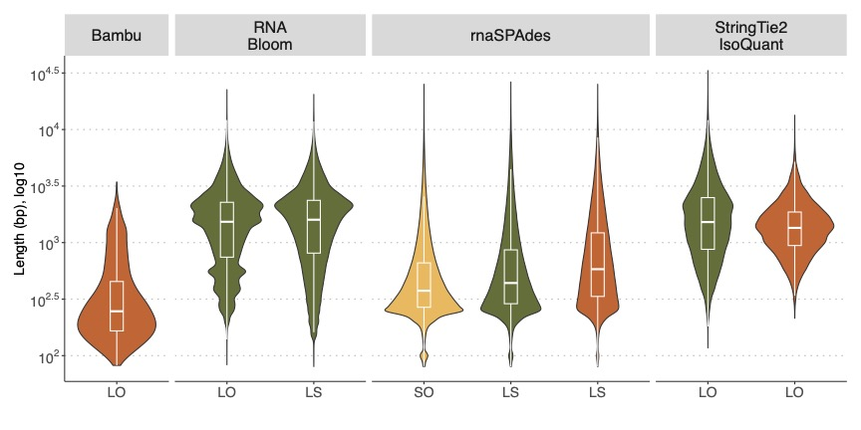
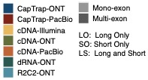
a
b
c
d
e
f
g
Mouse ES
Manatee
Figure 4. Evaluation of Challenge 3: transcript identification without a reference annotation. a) Number of detected transcripts and distribution of SQANTI structural categories, Mouse ES sample. b) Number of detected transcripts and distribution of transcripts per loci, Manatee sample. c) Length distribution of Mouse ES transcripts predictions . d) Length distribution of Manatee transcripts predictions. e) Support by orthogonal data. f) BUSCO metrics. g) Performance metrics based on SIRVs. Sen: Sensitivity, PDR: Positive Detection Rate, Pre: Precision, nrPred: non-redundant Precision, FDR: False Discovery Rate, 1/Red: Inverse of Redundancy.

