Slide 1
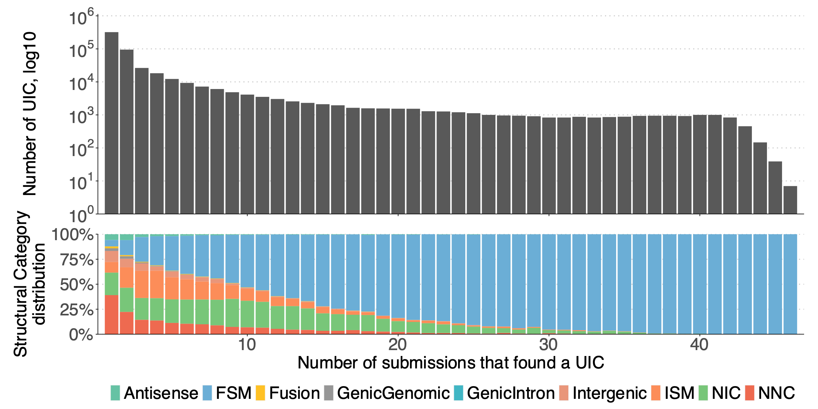
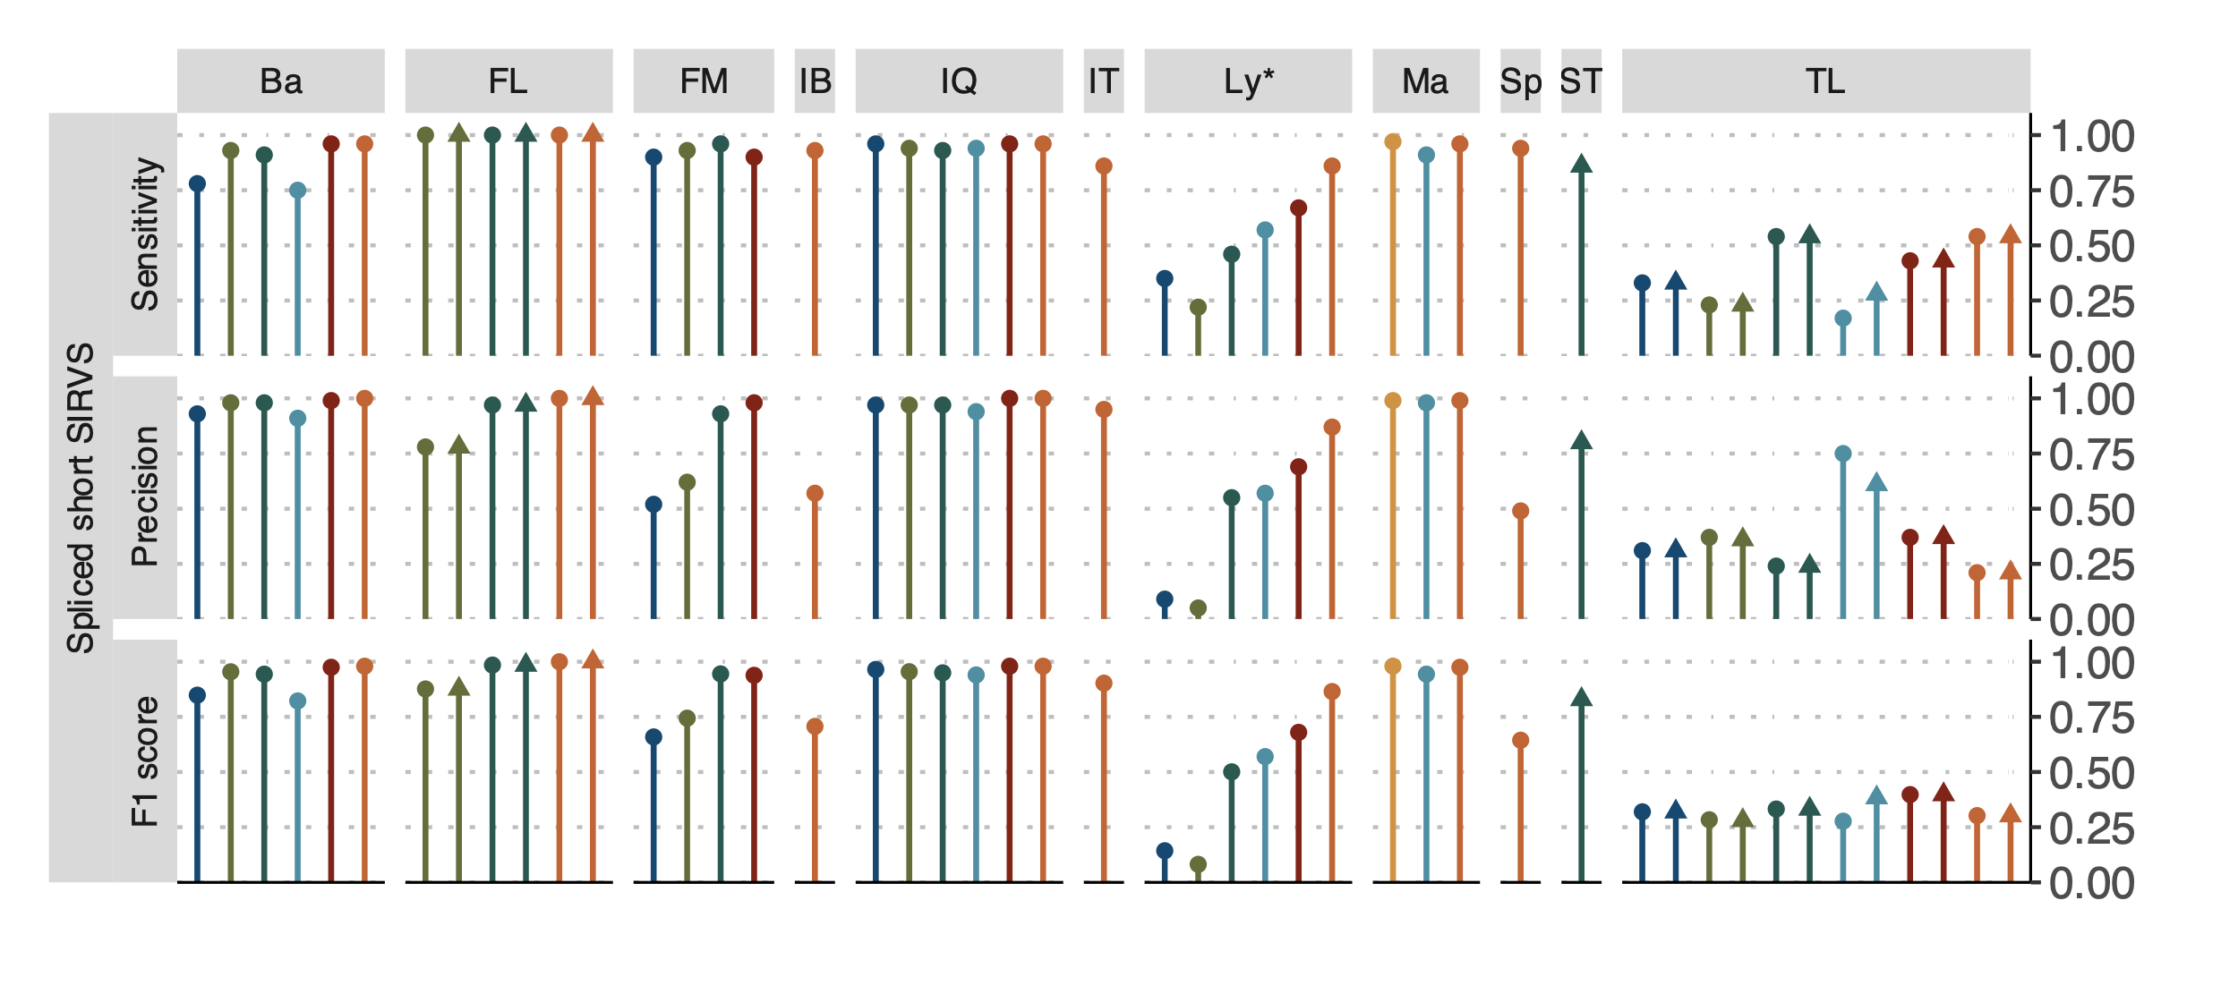
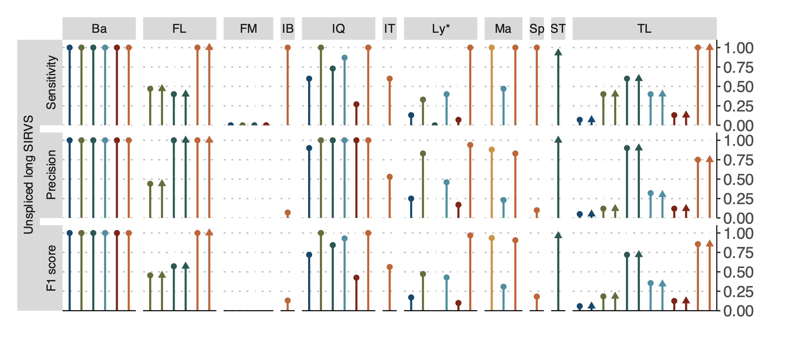
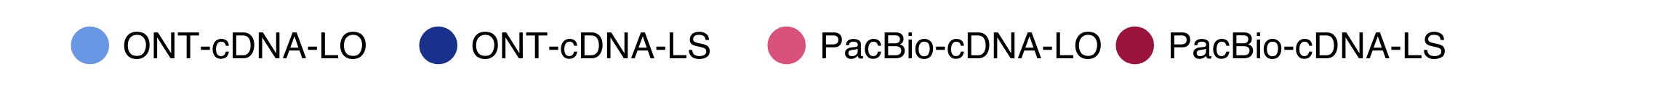
a
b
c
d
e
Figure 2: Overview of evaluation for Challenge 1: transcript identification with a reference annotation. a) Number of genes and transcripts per submission. Abundance of the main structural categories and support by external data. b) Agreement in transcript detection as a function the number of detecting pipelines. c) Performance based on for spliced-short and unspliced-long SIRVs. d) Performance based on simulated data. e) Performance for known and novel transcripts based on 50 manually-annotated genes by GENCODE. Ba: Bambu, FM: Flames, FR: FLAIR, IQ: IsoQuant, IT: IsoTools, IB: Iso_IB, Ly: LyRic, Ma: Mandalorion, TL: TALON-LAPA, Sp: Spectra, ST: StringTie2.

