Slide 1
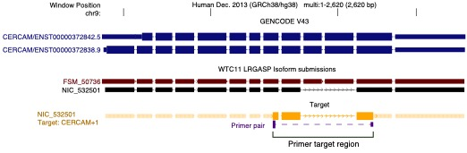
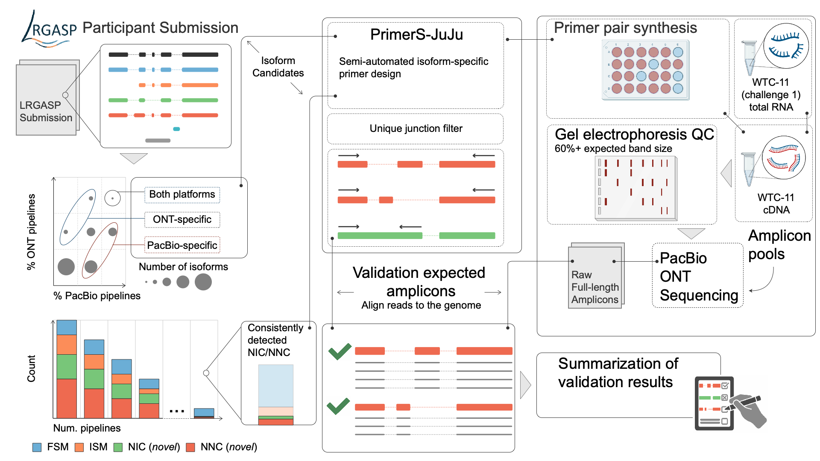
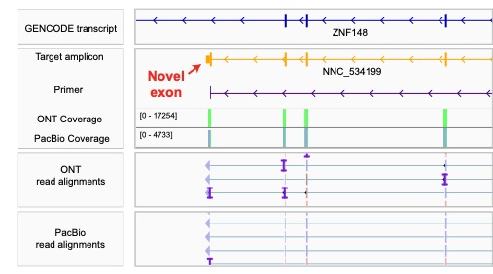
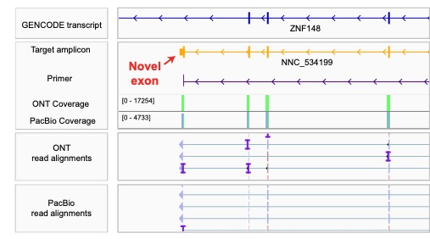
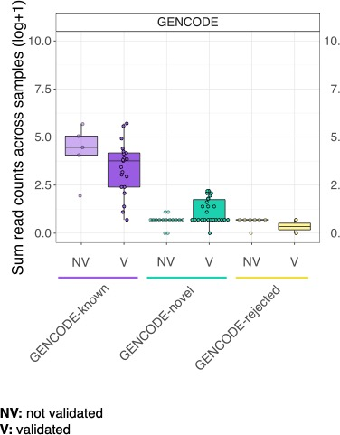
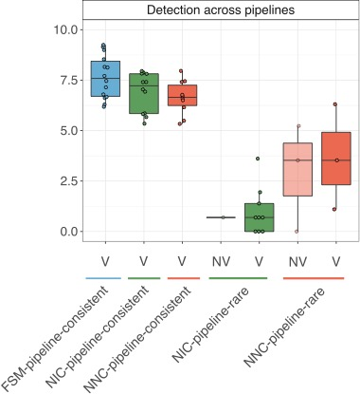
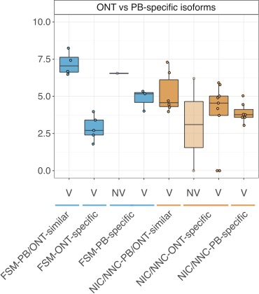
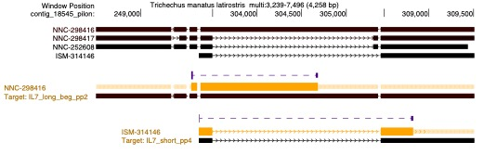
a
b
c
d
e
f
g
h
i
j
k
l

Slide 2
Figure 5. Experimental validation of known and novel isoforms. a) Schematic for the experimental validation pipeline. b) Example of a consistently detected NIC isoform (detected in over half of all LRGASP pipeline submissions) which was successfully validated by targeted PCR. The primer set amplifies a novel event of exon skipping (NIC). Only transcripts above ~5 CPM and and part of the GENCODE Basic annotation are shown. c) Example of a successfully validated novel terminal exon, with ONT amplicon reads shown in the IGV track (PacBio produce similar results). d) Recovery rates for GENCODE annotated isoforms that are reference-matched (known), novel, and rejected. e) Recovery rates for consistently versus rarely detected isoforms, for known and novel isoforms. f) Recovery rates between isoforms that are more frequently identified in ONT versus PacBio pipelines. g-i) Relationship between estimated transcript abundances (calculated as the sum of reads across all WTC11 sequencing samples) and validation success for GENCODE (g), consistent versus rare (h), and platform-preferential (i) isoforms. j) Fraction of validated transcripts as a function of the number of WTC11 samples in which supportive reads were observed. k) Example of two de novo isoforms in Manatee validated through isoform-specific PCR amplification, blue corresponds to supported transcripts and red to unsupported transcripts. l) PCR validation results for manatee isoforms for seven target genes.

