Slide 1
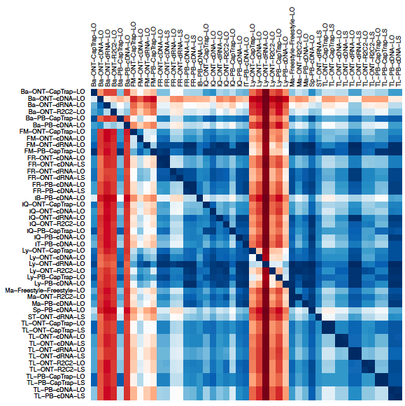
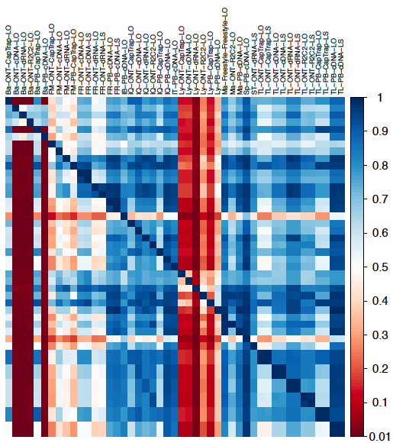
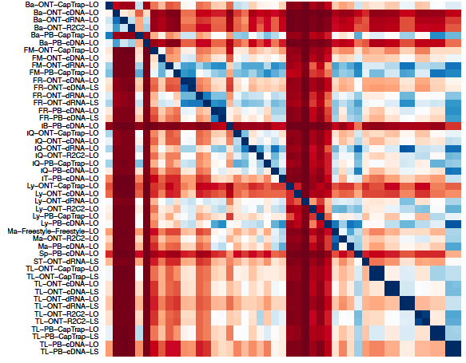
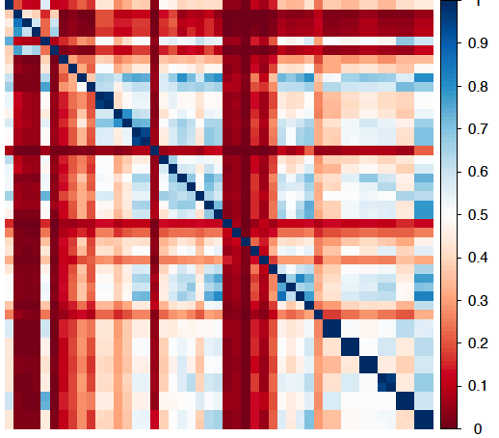
a)
Genes
b)
Splice Junctions
c)
UIC
d)
Dominant UIC
a
Extended Data Fig. 28. Pair-wise overlap in the detection of features between pipelines; H1-mix sample. Each value represents the feature intersection between column and row pipelines divided by the number of detections in the row pipeline. a) Genes, b) Splice junctions, c) Unique Intron Chains (UIC), c) Top UIC accounting for at least 50% of the gene expression.

