Slide 1
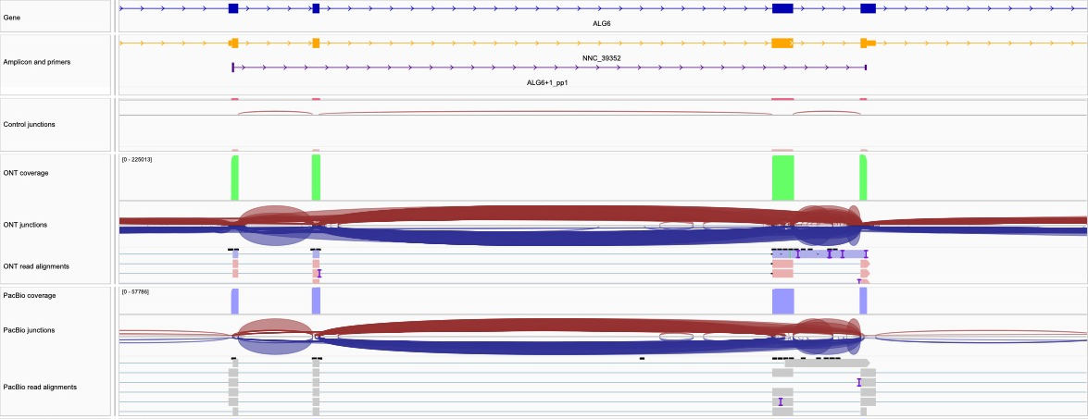
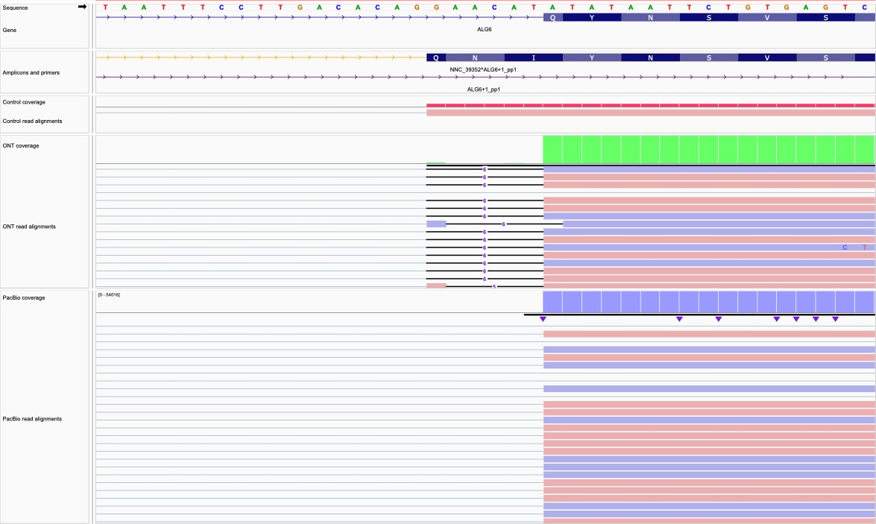
a
chr1:63,405,342-63,413,931
b
chr1:63,411,123-63,411,162
Extended Data Fig. 71. Validation of ALG6 U12 Intron with WTC11 Reads. In panel (a), a novel transcript model, NCC_39352 (blue arrow), appears to corroborate the exon within the ALG6 GENCODE annotation. The mapped amplicon in the control junction tracks provides evidence of the preceding intron. The green arrow indicates the ONT and PacBio read alignment coverage over the exon, but the junction tracks shows a lack of support for the splice junction at the exon's 5' end. In panel (b), GENCODE's annotation of a rare U12 GT-AT intron (purple arrow), which is unsupported by minimap2. Instead, minimap2 forces a GT-AG intron by reporting a six-base deletion in the reference genome (red arrow). As all pipelines relied on minimap2, correct annotation of this transcript was unattainable, illustrating the challenges difficult-to-align regions can pose to annotation with long-read transcripts.

