Slide 1
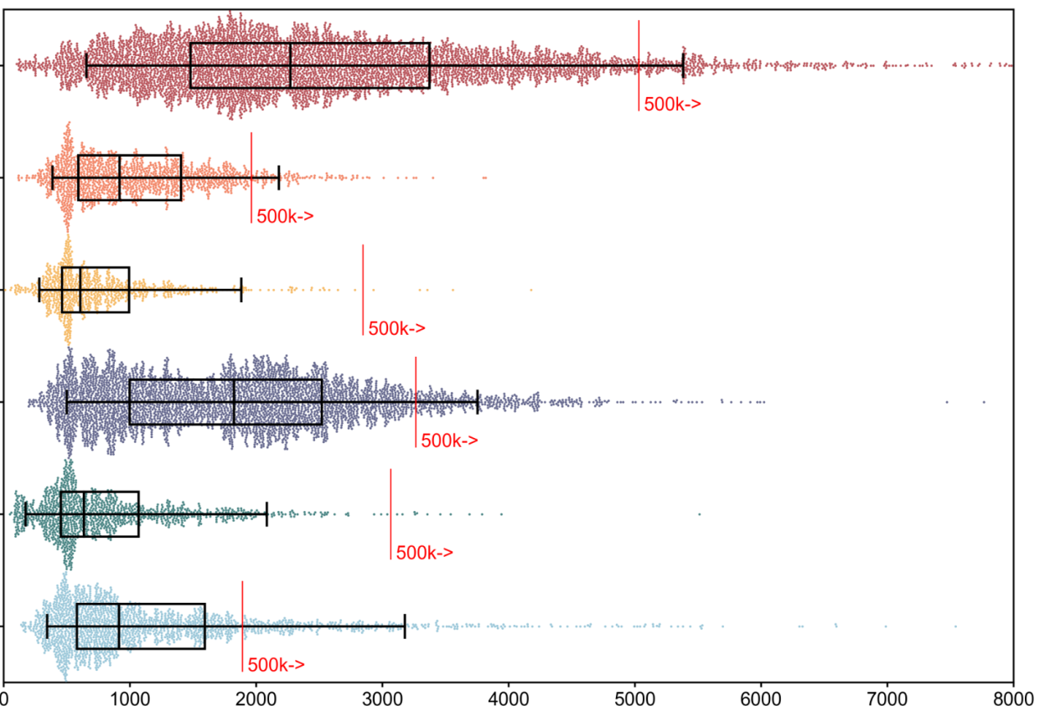
cDNA-PacBio
CapTrap-PacBio
CapTrap-ONT
R2C2-ONT
cDNA-ONT
dRNA-ONT
Read length (nt)

