Slide 1
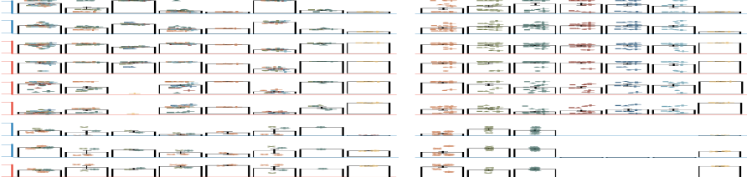
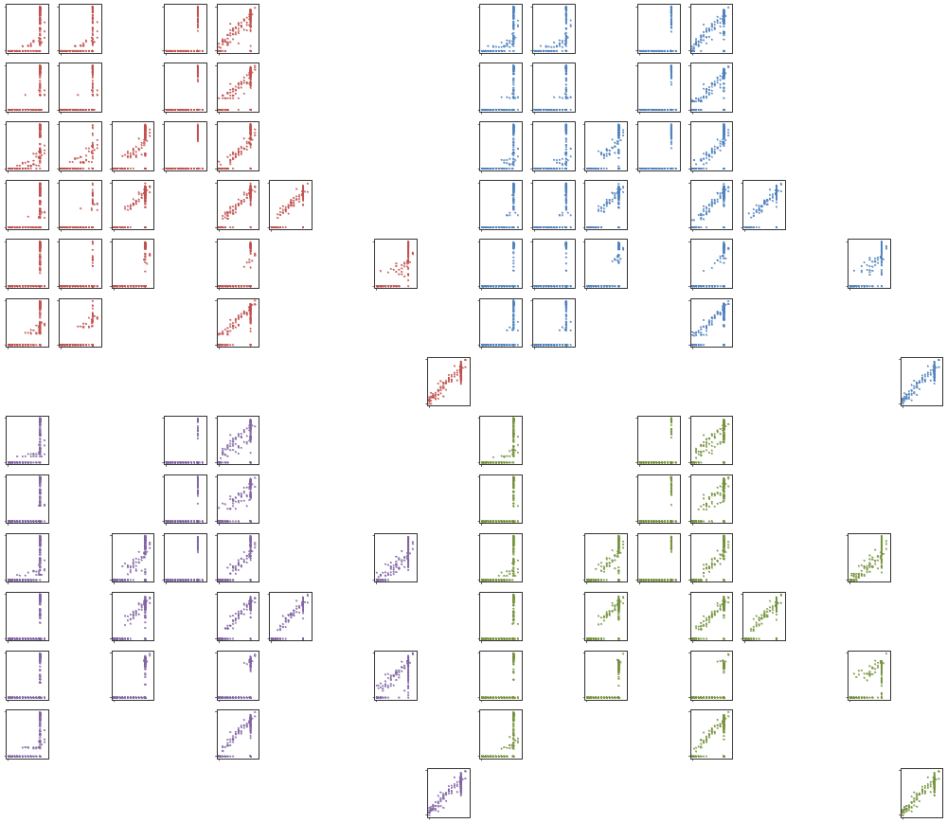
a
Quantification tools
Protocols-Platforms
1.0
Protocols-Platforms
Samples
cDNA-PacBio
H1-mix
H1-hESC
H1-DE
WTC11
NRMSE
cDNA-ONT
dRNA-ONT
0
CapTrap-PacBio
CapTrap-ONT
Bambu
FLAIR
FLAMES
R2C2-ONT
IsoQuant
IsoTools
TALON
NanoSim
RSEM
cDNA-PacBio
cDNA-Illumina
cDNA-ONT
dRNA-ONT
CapTrap-ONT
R2C2-ONT
CapTrap-PacBio
cDNA-Ilumina
b
Bambu-merge
Bambu-LR
FLAIR
FLAMES
IsoQuant
IsoTools
TALON
NanoSim
RSEM
Bambu_LR
FLAIR
FLAMES
IsoQuant
IsoTools
TALON
NanoSim
Bambu
RSEM
CapTrap-ONT
H1-mix
CapTrap-PacBio
WTC11
H1-hESC
cDNA-ONT
H1-DE
cDNA-PacBio
15
dRNA-ONT
Log2(Estimated TPM-1)
0
0 15
R2C2-ONT
Log2(True TPM-1)
cDNA-Illumina
CapTrap-ONT
CapTrap-PacBio
cDNA-ONT
cDNA-PacBio
dRNA-ONT
R2C2-ONT
cDNA-Illumina

