Slide 1
Internet
What is it – How does it work

Slide 2
Networking
The problem to solve

Slide 3
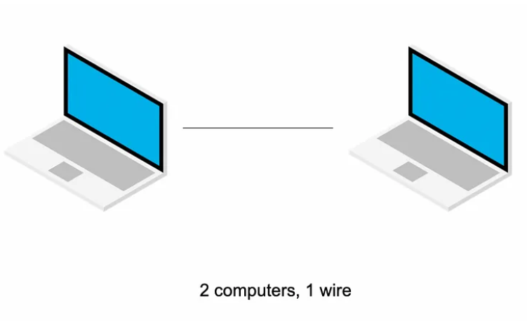
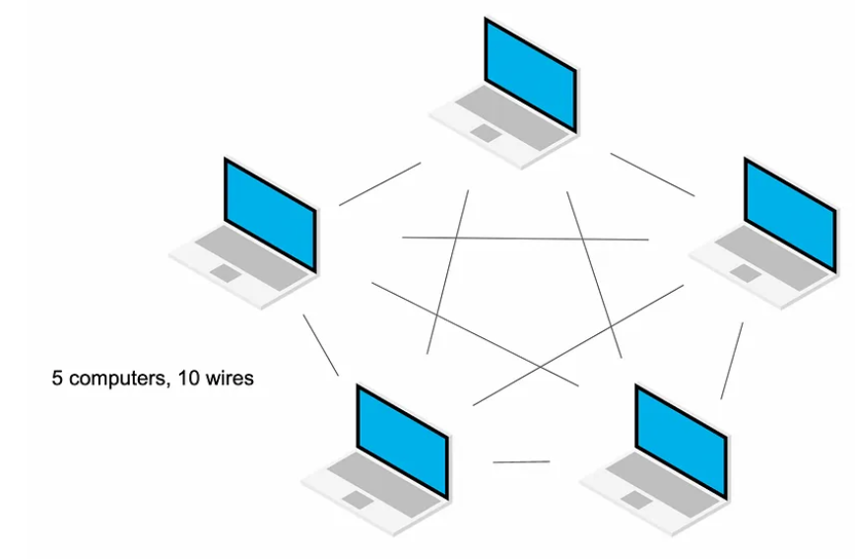
To connect computers to each other :
Unsustainable
Schema from Bennett Garner : https://www.youtube.com/watch?v=BBBOPAU0FuQ

Slide 4
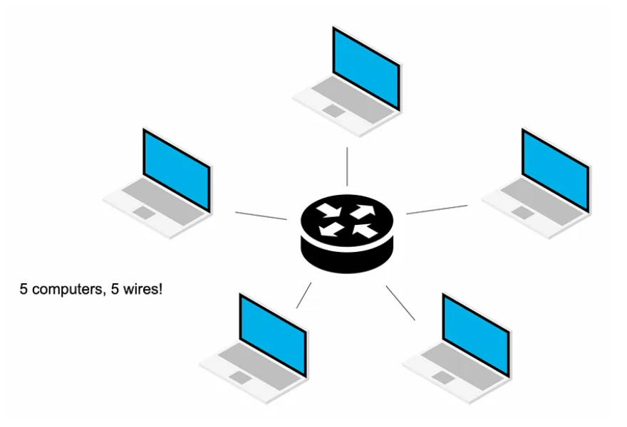
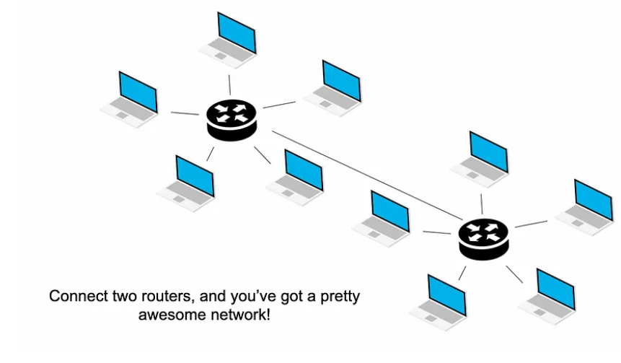
Router whose job is to route traffic
Routers can be connected to talk between networks
Schema from Bennett Garner : https://www.youtube.com/watch?v=BBBOPAU0FuQ

Slide 5
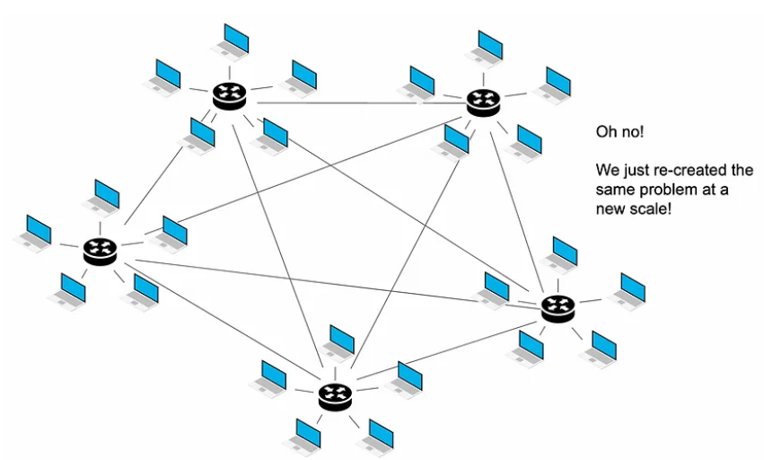
But soon :
And means a lot of infrastructure : cables between houses, businesses, …
Schema from Bennett Garner : https://www.youtube.com/watch?v=BBBOPAU0FuQ

Slide 6
Infrastructure
Internet Service Providers

Slide 7
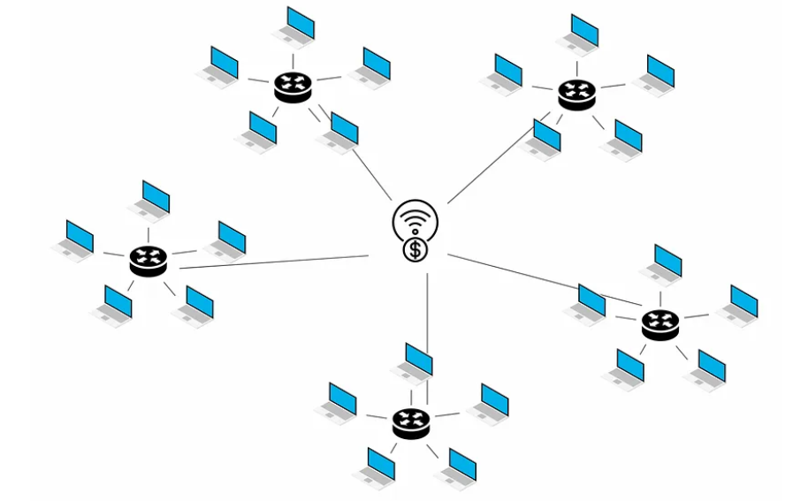
Need a company to install, maintain, and operate the cables between all our routers => Internet Service Provider (ISP)
Schema from Bennett Garner : https://www.youtube.com/watch?v=BBBOPAU0FuQ

Slide 8
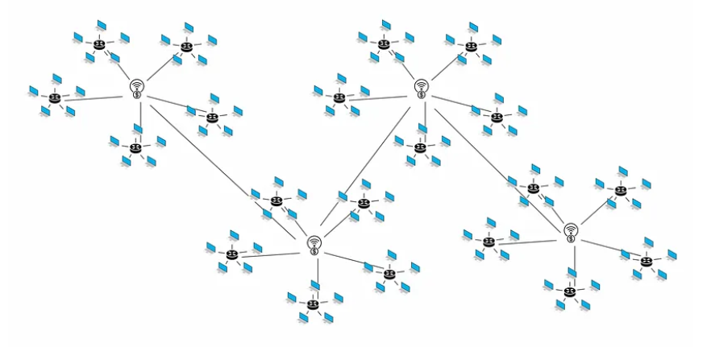
They also can talk to each others
Schema from Bennett Garner : https://www.youtube.com/watch?v=BBBOPAU0FuQ

Slide 9
Internet = network of cables connecting the globe (copper wires, fiber optic cables, …)
ISPs : maintain this infrastructure.
Larger ISPs (backbone Internet providers)
=> provide the largest parts of the Internet infrastructure.
=> such as the Atlantic Internet sea cables.
Smaller ISPs
=> Buy access to the networks of the larger ISPs
=> sell Internet access to organizations and home users.

Slide 10
Communication
Protocols And Standards

Slide 11
INTERNET ADDRESSES
ip address (internet protocol address)
- When computer connects to internet, receives an Internet Protocol address
- allows to identify computer on the internet
- EG: ip address of becode.org is 34.253.116.158
domain name system
- becode.org easier to remember
- allows computer to look up becode.org and get the correct ip address

Slide 12
How are computers able to talk to each other across this big network of networks?
=> By using a set of rules defined for communicating across the internet
The internet =
The infrastructure + the protocols

Slide 13
Internet protocol suite
= Set of network protocols
Nickname : TCP/IP - Transmission Control Protocol/Internet Protocol
Structured as a series of layers - protocol stack with
Each protocol on a different layer

Slide 14
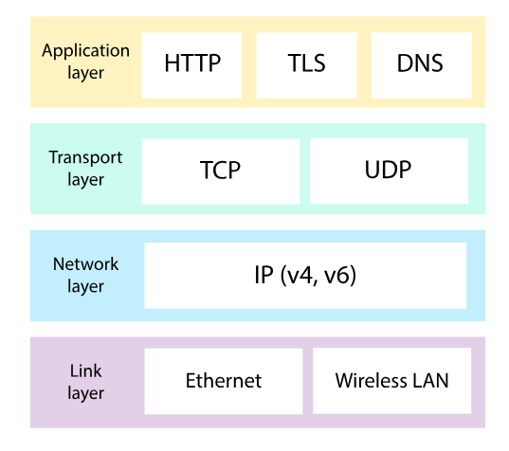
Message sent through the Internet :
- doesn't use every protocol in the suite
- BUT does use at least one protocol from every layer.
Schema from Khan Academy : https://www.khanacademy.org/computing/computers-and-internet/xcae6f4a7ff015e7d:the-internet/xcae6f4a7ff015e7d:the-internet-protocol-suite/a/the-internet-protocols

Slide 15
Link layer
need a physical mechanism to send digital data
electromagnetic signals sent over a wired or wireless connection.
Network layer
need to uniquely identify the sender and receiver => IP addresses
data pass from router to router => Internet Routing Protocol
Transport Layer
data broken into packets and reassemble at destination;
Transmission Control Protocol ensure the transport of the packet (or UDP but less reliable)

Slide 16
Application Layer
visible part of the computer network.
provides the interfaces and protocols needed by the users.
includes interactive programs we use over the internet (web app, email.,…).
Hyper Text Transfer Protocol : foundation of data communication for the World Wide Web
Transport Layer Security protocol (TLS) : when private info need to be transported securely
…

Slide 17
World wide web

Slide 18
WWW = organizational system for information accessible by using the internet.
billions of connected digital documents
Internet = a library // Web = books, magazines, newspapers, dvds, …
Internet can be used without the web (email, VoIP, File Transfer Protocol)
Web CANNOT be used without internet; www is a service on top of the internet

Slide 19
conclusion

Slide 20
The internet = Infrastructure + Internet Protocol suite
Infrastructure is managed by ISPs
Internet Protocol Suite can be represented in layers
When message is sent, a protocol of each layer is always used
WWW is not the internet
Web is a service on top of the internet

Slide 21
RESOURCES
https://en.wikipedia.org/wiki/Internet_protocol_suite
https://medium.com/@IP_Address/the-difference-between-internet-protocol-and-ip-addresses-13ca6a1f05c4
https://www.arelion.com/knowledge-hub/what-is-guides/what-is-the-internet-backbone
https://thilakshids.medium.com/the-tcp-ip-protocol-architecture-5e2064ce1504
https://docs.oracle.com/cd/E19455-01/806-0916/6ja85398m/index.html
https://www.khanacademy.org/computing/computers-and-internet/xcae6f4a7ff015e7d:the-internet/xcae6f4a7ff015e7d:the-internet-protocol-suite/a/the-internet-protocols
https://goteleport.com/learn/what-is-tcp-ip-protocol-suite/
https://www.whatismyisp.com/articles/what-is-an-isp

Slide 22
https://medium.com/@gmtechbyhabib.com/who-owns-the-internet-c5631d43f609
https://www.cloudflare.com/learning/network-layer/how-does-the-internet-work/
https://en.wikipedia.org/wiki/Internet#
https://medium.com/@ankurdhamija83/day-0-web-development-basics-what-is-the-internet-and-how-it-works-9714e6f82181
https://www.theguardian.com/technology/2018/oct/22/what-is-the-internet-13-key-questions-answered
https://javascript.plainenglish.io/what-every-new-software-developer-needs-to-know-about-the-internet-da5d5c7ed84c
https://bennettgarner.medium.com/
https://javascript.plainenglish.io/software-developers-how-does-your-computer-connect-to-the-internet-e6cb96f46922
https://www.youtube.com/watch?v=BBBOPAU0FuQ
https://developer.mozilla.org/en-US/docs/Learn/Common_questions/Web_mechanics/How_does_the_Internet_work

Slide 23
https://dev.to/codewithtee/how-does-the-internet-work-32d6
https://www.lenovo.com/in/en/glossary/what-is-internet/?orgRef=https%253A%252F%252Fwww.google.com%252F#
https://cs.fyi/guide/how-does-internet-work#introduction-to-the-internet
https://www.vox.com/2014/6/16/18076282/the-internet
https://www.youtube.com/watch?v=zN8YNNHcaZc&list=PLWKjhJtqVAbmMuZ3saqRIBimAKIMYkt0E&index=22
https://www.youtube.com/watch?v=7_LPdttKXPc
https://www.youtube.com/watch?v=x3c1ih2NJEg&list=PLuUdFsbOK_8pWzW7KJjbiJ8Ow0cdHlApV&index=3
https://www.makeuseof.com/difference-between-internet-world-wide-web/
https://www.geeksforgeeks.org/difference-between-internet-and-www/
https://www.lifewire.com/difference-between-the-internet-and-the-web-2483335

