Slide 1
OAuth

Slide 2
Access Control - Authentication And Authorization

Slide 3
Authentication
Identifying users that request access to a system, network, or device
Who I Am - verifies that the users are who they say they are
Prerequisite to authorization
Lot of methods :
password-based (something the user knows)
certificate-based (something you have)
Biometric (something you are)
token-based (something you have)
Best practice : multifactor-authentication

Slide 4
Authorization
Process which determines if
a user is allowed to access certain resources/data
and to perform certain actions
What I Can Do - Verify that user receives correct access / permissions .
Types :
RBAC (roles-based access control) - E.G. : viewer, editor and admin
ABAC (Attribute-Based Access Control) - E.G.: access to users who are type=employees and have department=HR can access the HR/Payroll system AND only during business hours
…

Slide 5
Authentication VS Authorization
Who I Am >< What I Can Do
Secure Solution : Must have both authentication and authorization, on each and every request/action
Authentication and Authorization work together

Slide 6
Oauth – Definition and Flow

Slide 7
What is OAuth
OAuth 2.0 is the industry-standard protocol for authorization
Allows
Delegating and centralizing authorization outside of the app
passing authorization from one service to another without sharing the user credentials
Before OAuth : applications requesting usernames and passwords when accessing user-specific data at other services
With OAuth : log into one platform and use tokens generated by that platform to grant access to data and perform actions in one or more other applications
OAuth is a specification : no info about how it should be implemented

Slide 8
What Oauth isn’t
Is not an authentication protocol => OAuth says nothing about the user
Often misunderstood because OAuth is used inside of authentication protocols
the specifications don’t cover authentication => in practice this is a core piece of Oauth and authentication must happen in the authorization end-point
Exist a standard for user authentication using OAuth: OpenID Connect

Slide 9
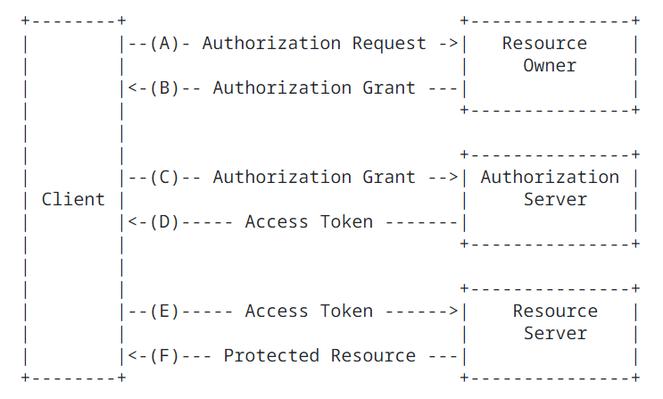
Abstract OAuth Flow
Resource owner = often, the end-user
Client = app making protected resource requests on behalf of the resource owner
Resource Server : server hosting the protected resources
Authorization server : server issuing access tokens to the client after successfully authenticating the resource owner and obtaining authorization.

Slide 10
Oauth Modes or Uses Cases
Register and log users into your application
you own both the OAuth server and the application
usually feels like the user is signing up or logging directly into your application
But login/registration is delegated to an OAuth server rather than implemented from scratch
Used a third-party login and registration
“login with …” – avoid storing credentials
Login in app through another account (i.e. Facebook or Google)
the user must grant permissions to the app
the third-party service shows the user a screen that asks for certain permissions

Slide 11
Oauth – Grants

Slide 12
encapsulates the resource owner's authorization (to access its protected resources)
used by the client to obtain an access token
Different types of grants
Authorization Code
PKCE
Client Credentials
Device Code
Refresh Token
Legacy
Implicit Flow (legacy)
Password Grant (legacy)

Slide 13
Authorization Code Flow
the most common OAuth grant flow
the most secure when a user is involved
Steps for obtaining the authorization code
Client redirects user to the OAuth server (= authorization point)
Authentication is performed *
OAuth server provides an authorization code (random string of printable ASCII characters)
Redirect back to client with the code
* NB : as stated before, OAuth doesn’t specify anything about this.

Slide 14
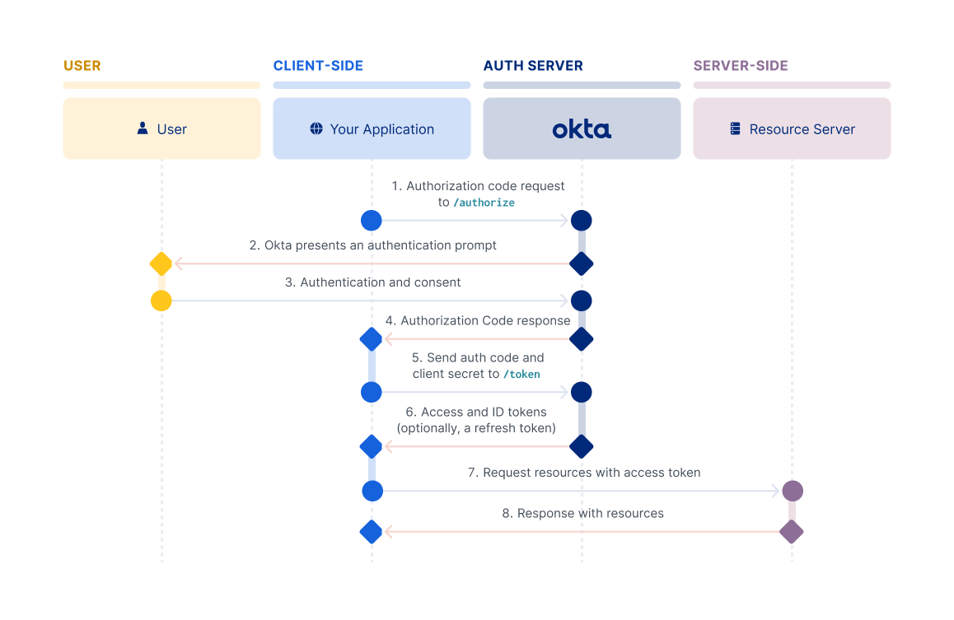
From https://developer.okta.com

Slide 15
Oauth – Tokens

Slide 16
credentials used to access protected resources
string representing an authorization issued by authorization server
Specific/limited scopes and durations of access
single token understood by the resource server
No need for resource server to understand several authentication methods

Slide 17
From https://developer.okta.com

Slide 18
Conclusion

Slide 19
Authentication = Who I am >< Authorization = What I Can Do - strongly tied together
OAuth is about
delegation of the users’ authorization (but authentication must happen in the flow)
Avoid communicating credentials across several services/app
OAuth = specifications ; not a tool nor a techno and no implementation details
Flow :
After authentication
Oauth server gives grant to the client
Oauth server exchange this grant with a token
The client can request the protected resource with the token

Slide 20
Resources
https://www.oauth.com/
https://oauth.net/getting-started/
https://frontegg.com/blog/authentication#Types-of-Authentication
https://www.idrnd.ai/5-authentication-methods-that-can-prevent-the-next-breach/
https://www.microsoft.com/en-us/security/business/security-101/what-is-authentication
https://www.sailpoint.com/identity-library/authentication-methods-used-for-network-security/
https://www.techtarget.com/searchsecurity/tip/Use-these-6-user-authentication-types-to-secure-networks
https://www.strongdm.com/authentication
https://www.toptal.com/designers/ui-ux/user-authentication-system-design
https://dev.to/ma7moud3bas/how-to-secure-the-web-a-comprehensive-guide-to-authentication-strategies-for-developers-48od
https://oauth.net/2/access-tokens/
https://datatracker.ietf.org/doc/html/rfc6749#page-4
https://en.wikipedia.org/wiki/OAuth
https://developers.google.com/identity/protocols/oauth2
https://www.youtube.com/watch?v=ZV5yTm4pT8g
https://www.youtube.com/watch?v=ZDuRmhLSLOY

Slide 21
https://www.varonis.com/blog/what-is-oauth
https://www.digitalocean.com/community/tutorials/an-introduction-to-oauth-2
https://fusionauth.io/articles/oauth/modern-guide-to-oauth
https://developers.google.com/identity/protocols/oauth2/javascript-implicit-flow
https://www.cloudflare.com/learning/access-management/what-is-oauth/
https://blog.identityautomation.com/rbac-vs-abac-access-control-models-iam-explained
https://www.aserto.com/blog/rbac-vs-abac-authorization-models
https://en.wikipedia.org/wiki/Attribute-based_access_control
https://amazic.com/6-types-of-authorizations-and-how-to-choose-the-best-one-for-your-company/
https://www.linkedin.com/pulse/comprehensive-overview-access-control-models-rbac-abac-jay-
https://auth0.com/intro-to-iam/what-is-authorization
https://www.osohq.com/post/ten-types-of-authorization
https://frontegg.com/blog/authentication-vs-authorization
https://www.cloudflare.com/learning/access-management/what-is-oauth/
https://developer.okta.com/docs/guides/implement-grant-type/authcode/main/

