Slide 1
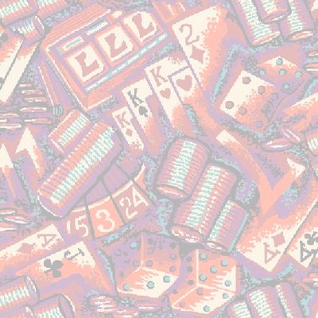
Worm Algorithms
Jian-Sheng Wang
National University of Singapore

Slide 2
Outline of the Talk
Introducing Prokofev-Svistunov worm algorithm
A worm algorithm for 2D spin-glass
Heat capacity, domain wall free energy, and worm cluster fractional dimension

Slide 3
Worm Algorithms
Worm algorithms were first proposed for quantum systems and classical ferromagnetic systems:
  Prokof’ev and Svistunov, PRL 87 (2001) 160601
  Alet and Sørensen, PRE 67 (2003) 015701

Slide 4
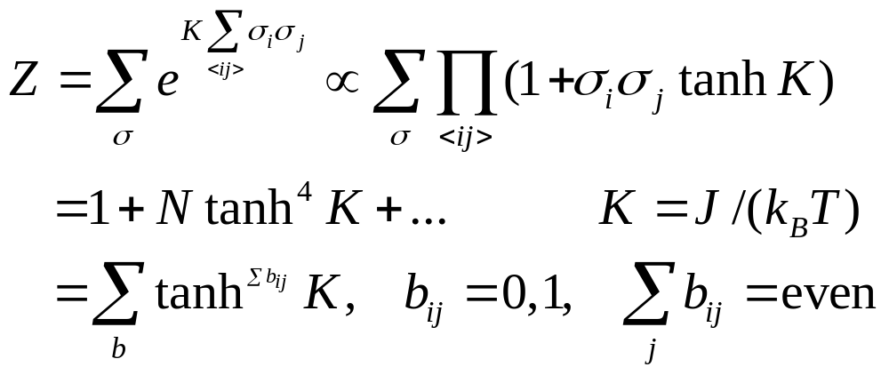
High-Temperature Expansion of the Ising Model
The set of new variables b_{ij} on each bond are not independent, but constrained to form closed polygons by those of b_{ij}=1.

Slide 5
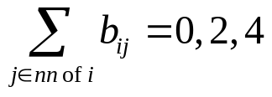
A High-Temperature Expansion Configuration
The bonds in 2D Ising model high-temperature expansion. The weight of each bond is tanhK. Only an even number of bonds can meet at the site of the lattice.

Slide 6
Worm Algorithm (Prokof’ev & Svistunov, 2001)
Pick a site i₀ at random. Set i = i₀
Pick a nearest neighbor j with equal probability, move it there with probability (tanhK)^{1-b}_{ij}. If accepted, flip the bond variable b_{ij} (1 to 0, 0 to 1). i = j.
Increment: ++G(i-i₀)
If i = i₀ , exit loop, else go to step 2.
The ratio G(i-i₀)/G(0) gives the two-point correlation function
Notes:
Energy and specific heat can be calculated by average number bonds and its fluctuations.

Slide 7
The Loop
b=1
b=1
b=0
b=0
i₀
i₀
Erase a bond with probability 1, create a bond with probability tanh[J/(kT)]. The worm with i ≠ i₀ has the weight of the two-point correlation function g(i₀, i).

Slide 8
Statistics, Critical Slowing Down
Direct sampling of the two-point correlation function <σ_{i}σ_{j}> in every step
The total number of bonds and its fluctuations (when a closed loop form) are related to average energy and specific heat.
Much reduced critical slowing down (τ ≈ log L) for a number of models, such as 2D, 3D Ising, and XY models

Slide 9
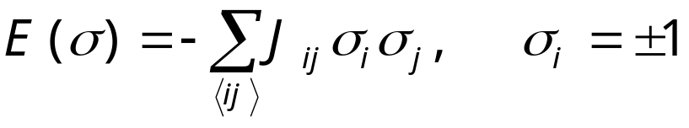
Spin Glass Model
+
-
-
+
-
+
-
-
+
-
+
+
-
-
+
+
+
+
-
+
-
A random interacting Ising model - two types of random, but fixed coupling constants (ferro J_{ij} > 0, anti-ferro J_{ij} < 0). The model was proposed in 1975 by Edwards and Anderson.
-
+
-
+
+
-
+
+
-
-
+
-
-
-
-
+
+
-
-
+
+
+
+
-
+
-
-
-
blue J_{ij}=-J, green J_{ij}=+J
High-temperature worm algorithm does not work as the weight tanh(J_{ij}K) change signs.
Notes:
See K. Binder and A. P. Young, Rev Mod Phys 58 (1986) 801, for a review.

Slide 10
Spin-Glass, Still a Problem?
2D Ising spin-glass T_{c} = 0
3D Ising spin-glass T_{c} > 0
LowT phase, droplet picture vs replica symmetry breaking picture, still controversial
Relevant to biology, neutral network, optimization, etc

Slide 11
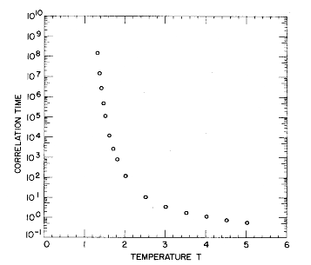
Slow Dynamics in
Spin Glass
Correlation time in single spin flip dynamics for 3D spin glass. τ ∝ |T-T_{c}|⁶.
From Ogielski, Phys Rev B 32 (1985) 7384.

Slide 12
Advanced Algorithms for Spin-Glasses (3D)
Simulated Tempering (Marinari & Parisi, 1992)
Parallel Tempering, also known as replica exchange Monte Carlo (Hukushima & Nemoto, 1996)

Slide 13
Special 2D Algorithms
Replica Monte Carlo, Swendsen & Wang 1986
Cluster algorithm, Liang 1992
Houdayer, 2001

Slide 14
Replica Monte Carlo
A collection of M systems at different temperatures is simulated in parallel, allowing exchange of information among the systems.
β₁
β₂
β₃
. . .
β_{M}
Parallel Tempering: exchange configurations
Notes:
Replica Monte Carlo [R. H. Swendsen and J.-S. Wang, Phys Rev Lett 57 (1986) 2607] is one of the earliest idea that simulates many systems in parallel for efficiency. Hukushima and Nemoto, J Phys Soc Jpn 65 (1996) 1604, proposed parallel tempering or replica exchange.

Slide 15
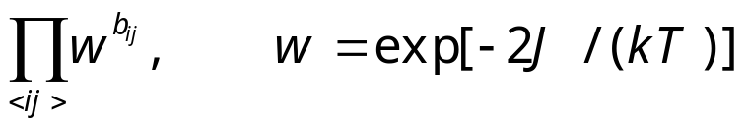
Strings/Domain Walls in 2D Spin-Glass
The bonds, or strings, or domain walls on the dual lattice uniquely specify the energy of the system, as well as the spin configurations modulo a global sign change.
The weight of the bond configuration is
[a low temperature expansion]
+
-
-
-
-
antiferro
+
+
-
+
-
+
+
-
-
ferro
-
-
+
+
+
+
+
-
+
-
+
+
-
+
+
-
-
+
-
-
-
-
+
+
-
-
+
+
+
+
-
+
-
-
-
bond
b=0 no bond for satisfied interaction, b=1 have bond

Slide 16
Constraints on Bonds
An even number of bonds on unfrustrated plaquette
An odd number of bonds on frustrated plaquette
-
+
Blue: ferro
Red: antiferro
+
-
+
-
+
-

Slide 17
Peierls’ Contour
-
-
+
+
+
-
The bonds in ferromagnetic Ising model is nothing but the Peierls’ contours separating + spin domains from – spin domains.
The bonds live on dual lattice.
-
-
-
+
+
-
+
+
-
-
-
-
+
-
+
+
+
-
+
+
-
-
-
-
+
+
-
-
+
-

Slide 18

Worm Algorithm for
2D Spin-Glass
Pick a site i₀ at random. Set i = i₀
Pick a nearest neighbor j with equal probability, move it there with probability w^{1-b}_{ij}. If accepted, flip the bond variable b_{ij} (1 to 0, 0 to 1). i = j.
If i = i₀ and winding numbers are even, exit, else go to step 2.
See J-S Wang, PRE 72 (2005) 036706.

Slide 19
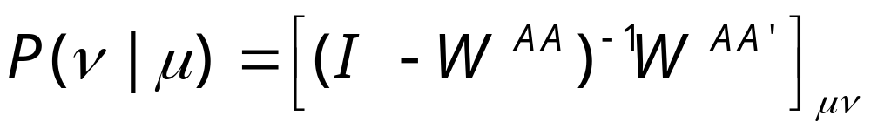
N-fold Way Acceleration
Sample an n-step move with exit probability:
where A is a set of states reachable in n-1 steps of move. A’ is complement of A. W is associated transition matrix.

Slide 20
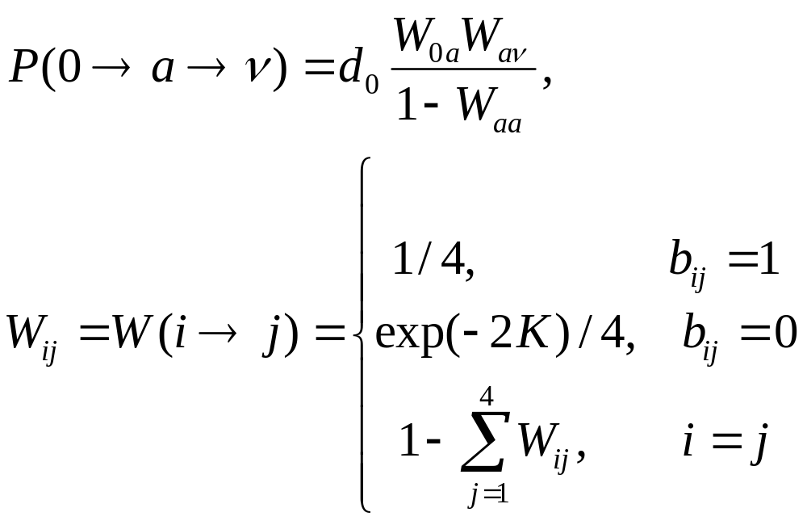
Two-Step Probabilities
a
0
ν
d₀ is fixed by normalization

Slide 21
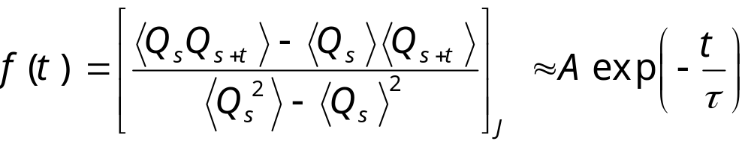
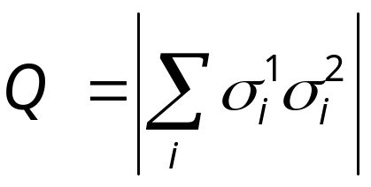
Time-Dependent Correlation Function and Spin-Glass Order Parameter
We define
where
Notes:
Some people define the second term, ∑_{t=1}∞ f(t) as the integrated correlation time. We can call τ_{int} de-correlation time, as it is the number of steps needed to generate effectively independent sample. We can interpret the average < … > as over the history of a Markov chain (which requires the joint distribution of the chain from time s to s+t), or can be estimated from a simulation as average over time, i.e.,
<Q_{s}Q_{s+t}> ≈ (1/N) ∑_{s=1}^{N} Q_{s}Q_{s+t}.
What is τ_{int} for completely uncorrelated sample?

Slide 22
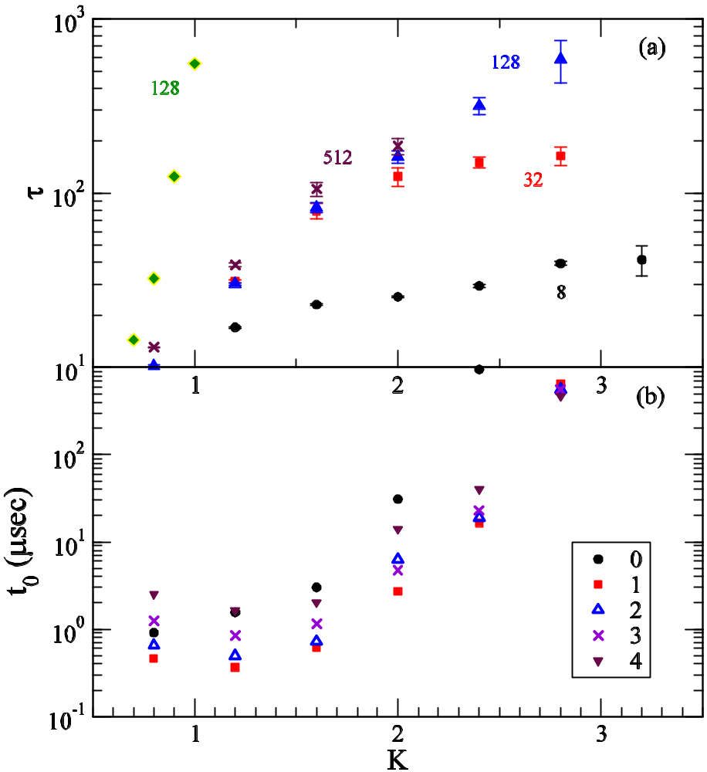
Correlation Times
Exponential relaxation times in units of loop trials of the worm algorithm.
CPU times per loop trial per lattice site (32x32 system). Different symbols correspond to 0 to 4 step N-fold way acceleration.
single spin flip

Slide 23
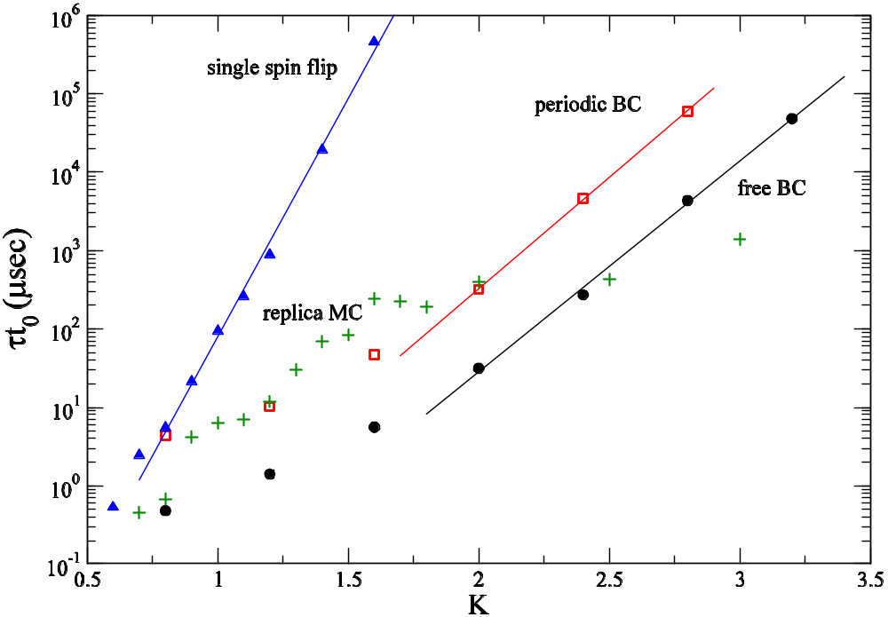
Correlation Times
L = 128

Slide 24
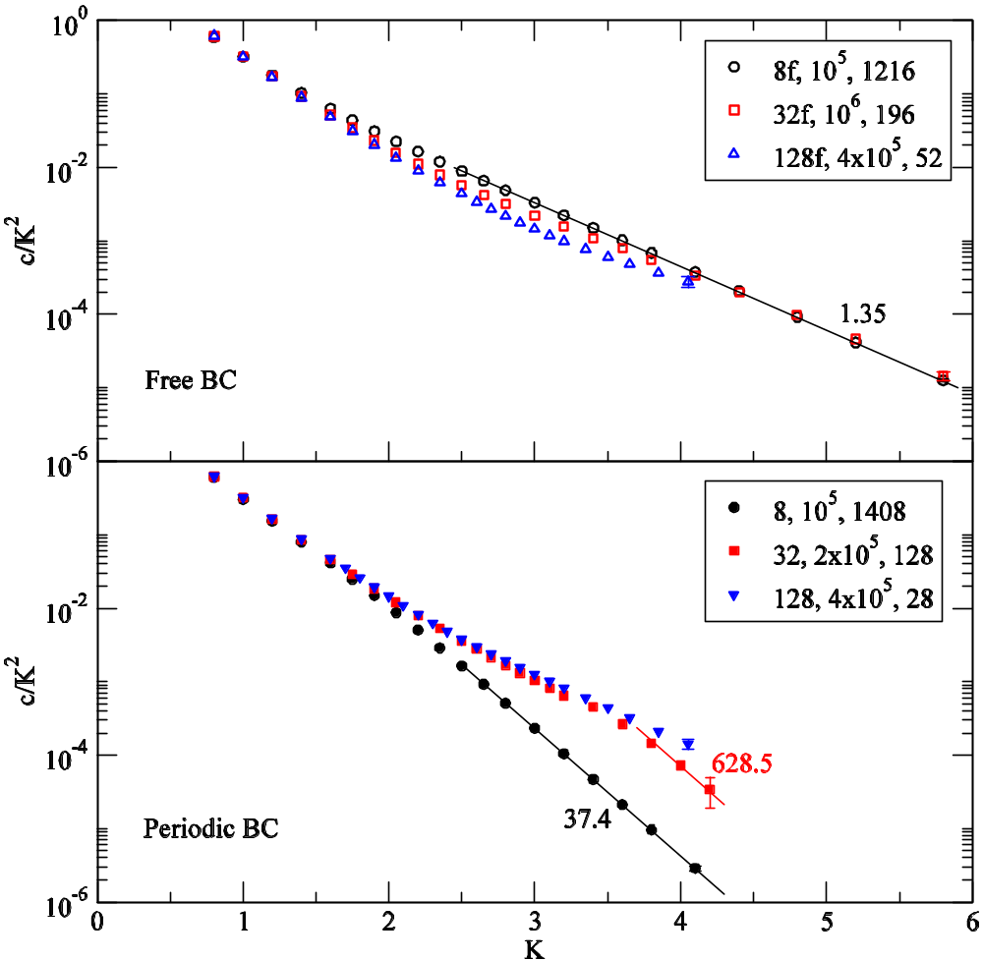
Specific Heat when T -> 0
Free boundary condition: c/K² ≈ exp(-2K).
Periodic BC: c/K² ≈ exp(-2K) in thermodynamic limit ( L -> ∞ first). For finite system it is exp(-4K). K = J/(kT)
See also H G Katzgraber, et al, cond-mat/0510668.

Slide 25
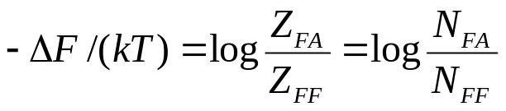
Free Energy Difference
N_{FF}, N_{FA}, etc, number of times the system is in a specific winding number state, when the worm’s head meets the tail. Red line denotes anti-periodic boundary condition.
FF
Winding number x even, y even
FA
Winding number x odd, y even
y
x
AF
Winding number x even, y odd
AA
Winding number x odd, y odd

Slide 26
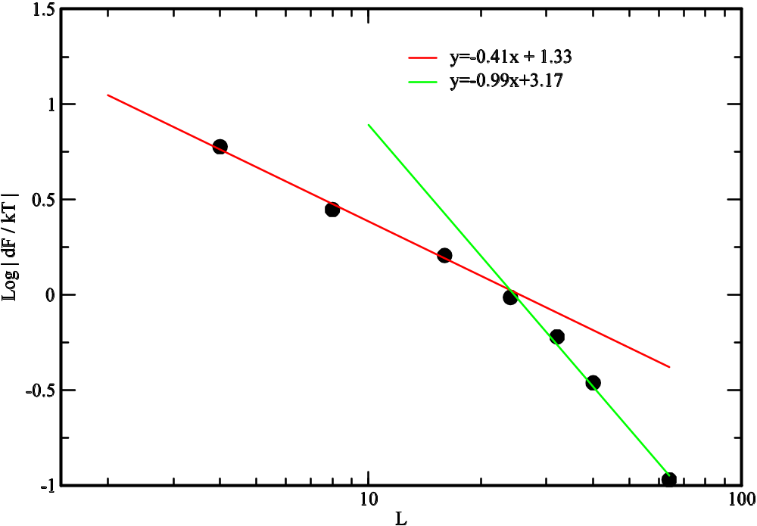
Free energy difference at T = 0.5
Difference of free energy between periodic BC (FF) and periodic/anti-periodic BC (FA), averaged over 10³ samples. ΔF ≈ L^{θ},
θ≈−0.4
J Luo & J-S Wang, unpublished
Correlation length ξ≈24

Slide 27
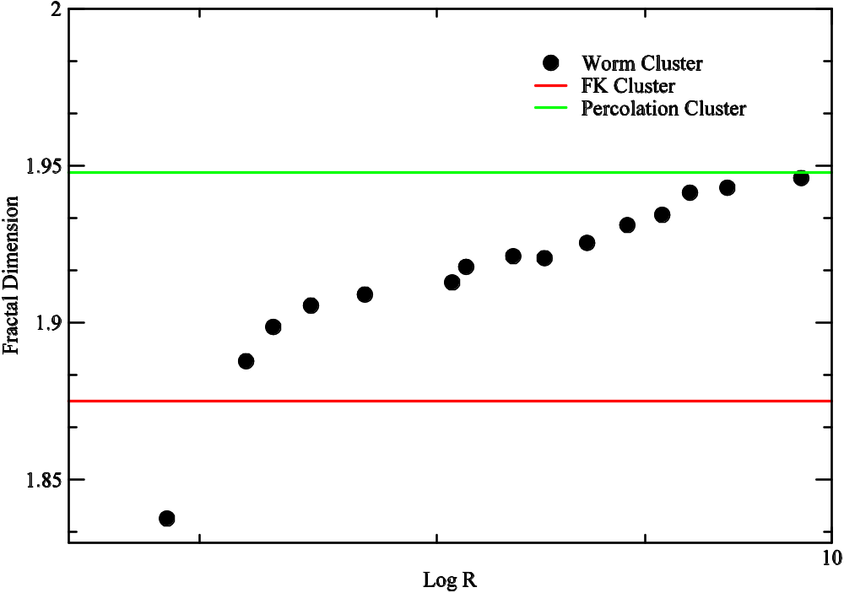
Clusters in Ferromagnetic Ising Model
Fractal dimension D defined by S=R^{D}, where R is radius of gyration. S is the cluster size. Cluster is defined as the difference in the spins before and after the a loop move.
J Luo & J-S Wang, unpublished

Slide 28
Summary Remarks
Worm algorithm for 2D ±J spin-glass is efficient down toT ≈ 0.5
A single system is simulated
Domain wall free energy difference can be calculated in a single run
Slides available at http://web.cz3.nus.edu.sg/~wangjs under talks

Slide 29
Postdoctorial Research Fellow Position Available
Work with J-S Wang in areas of computational statistical physics, or nano-thermal transport.
Send CV to wangjs@cz3.nus.edu.sg

