Slide 1
Automatic Machine Knitting of 3D Meshes
Presentation of “Automatic Machine Knitting of 3D Meshes” by Narayan, Albaugh, Hodgins, Coros and McCann
Published in ACM Transactions on Graphics (TOG), 08/2018, Volume 37, Issue 3
Summary for class CS536, by Joseph Heenan

Slide 2
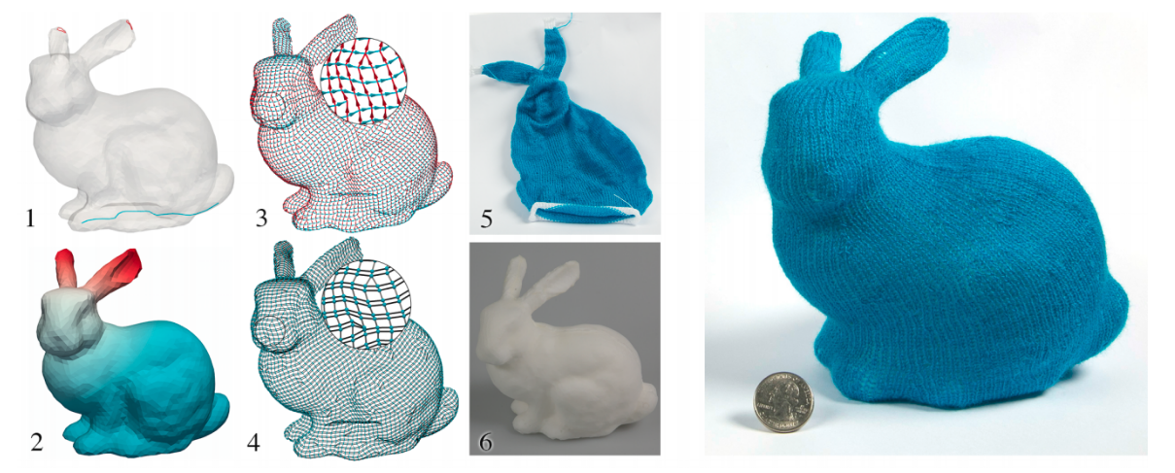
What is automatic machine knitting?
Automatic machine knitting per Narayan et al allows a 3D object in .obj format to be transformed to a knit structure via a 5-step process that closely matches a foam replica (6)

Slide 3
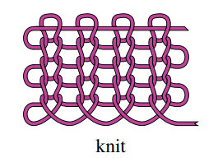
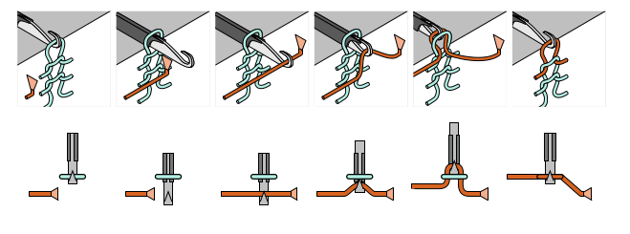
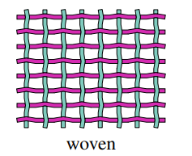
How do knitting machines work?
Images from: McCann, Albaugh, Narayanan, Grow, Matusik, Mankoff, and Hodgins. A Compiler for 3D Machine Knitting. ACM Trans. Graph. 35, 4, Article 49 (July 2016), 49:1–49:11 pages.

Slide 4
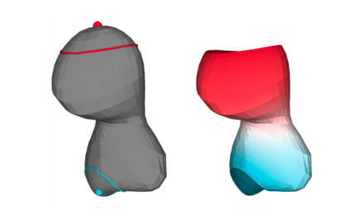
Details of Method – Step 1 - Define Start/End Vertices
First step:
Users select beginning and ending vertices; Laplacian interpolation used to contruct time score from early (blue) to late (red) for each vertex:

Slide 5
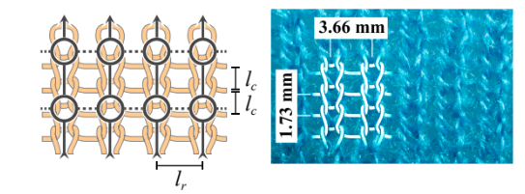
Details of Method – Step 2 – Construct Knit Graph
Second step:
A knit graph is constructed, here showing nodes with circles, and taking the edge width and heights from pattern specifications:
Algorithm ensures limited degree for nodes, and no helices in graph, to ensure it can be machine-knit

Slide 6
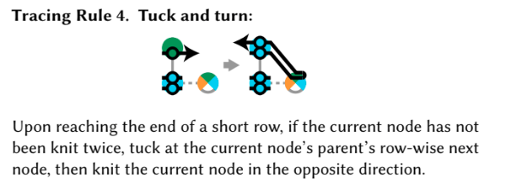
Details of Method – Step 3 – Apply Trace Rules
Tracing associates nodes with timings – later column edges should be knit at a later time, and adjacent rows should be knit at similar times
Rules handle movement between rows and columns, e.g.:

Slide 7
Details of Method – Step 4 - Scheduling
Having computed a desired series of tucks, loops, etc, the algorithm takes information about the capacity of the current machine (e.g., how many needles are present) to assign each operating to a different needle. At this point, the garment can be fabricated on the machine

Slide 8
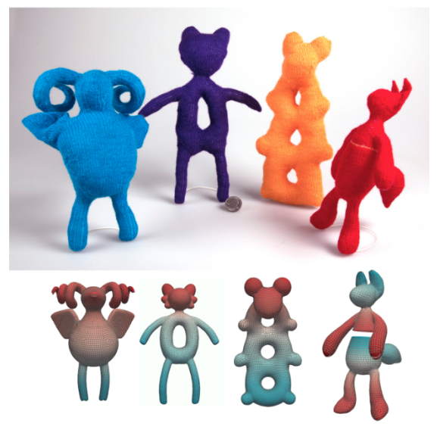
Example Garments/Toys Produced
The paper demonstrates a strong ability to machine-knit complex 3D shapes

Slide 9
Overview of Implementation
Source code is provided on GitHub at: https://github.com/textiles-lab/autoknit
OpenGL and GLM are used for visualization of .obj files that are later machine-knitted
Users can specify beginning and ending vertices in software program
RowColGraph struct represents listed of nodes with neighbor information

Slide 10
Overview of Implementation (continued)
Struct Parameters specifies width of desired stitch
A struct Stitch represents one stitch around the tube surface of a garment, e.g. around the level set of an intersecting plane
trim_model removes any chains that cross on themselves as opposed to ending at a starting vertix
Software is itself only partially documented, but represents great potential.

Slide 11
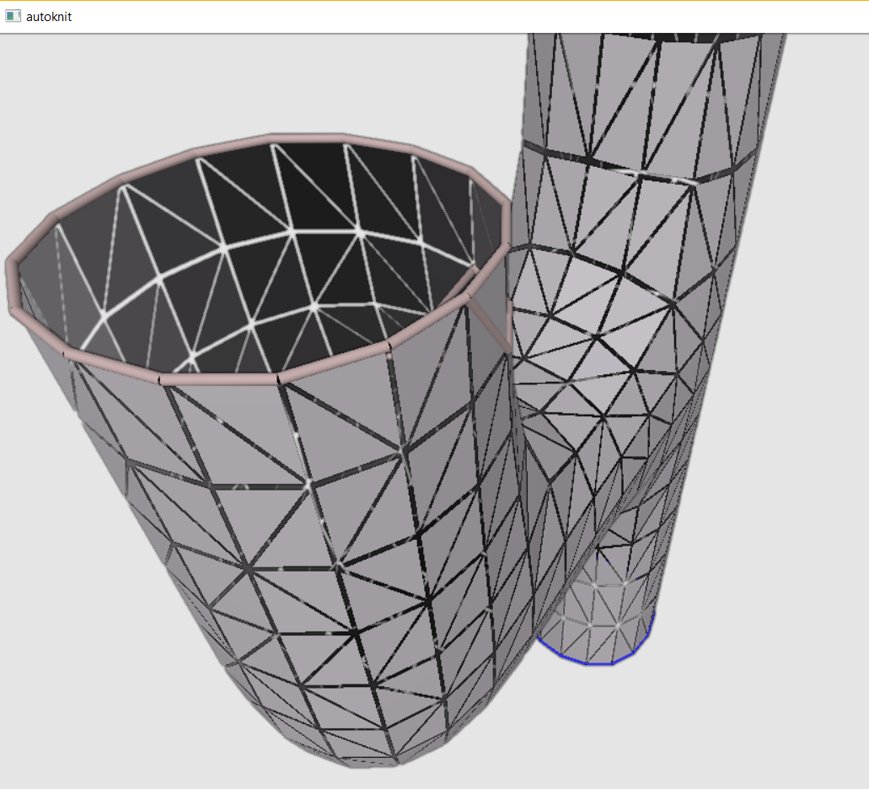
Walkthru of Software – Timing Nodes
The autoknit executable allows a user to visualize to constructed knit graph and select start and stop vertices. Note: I could not compile the scheduler so only tested knit graph construction

Slide 12
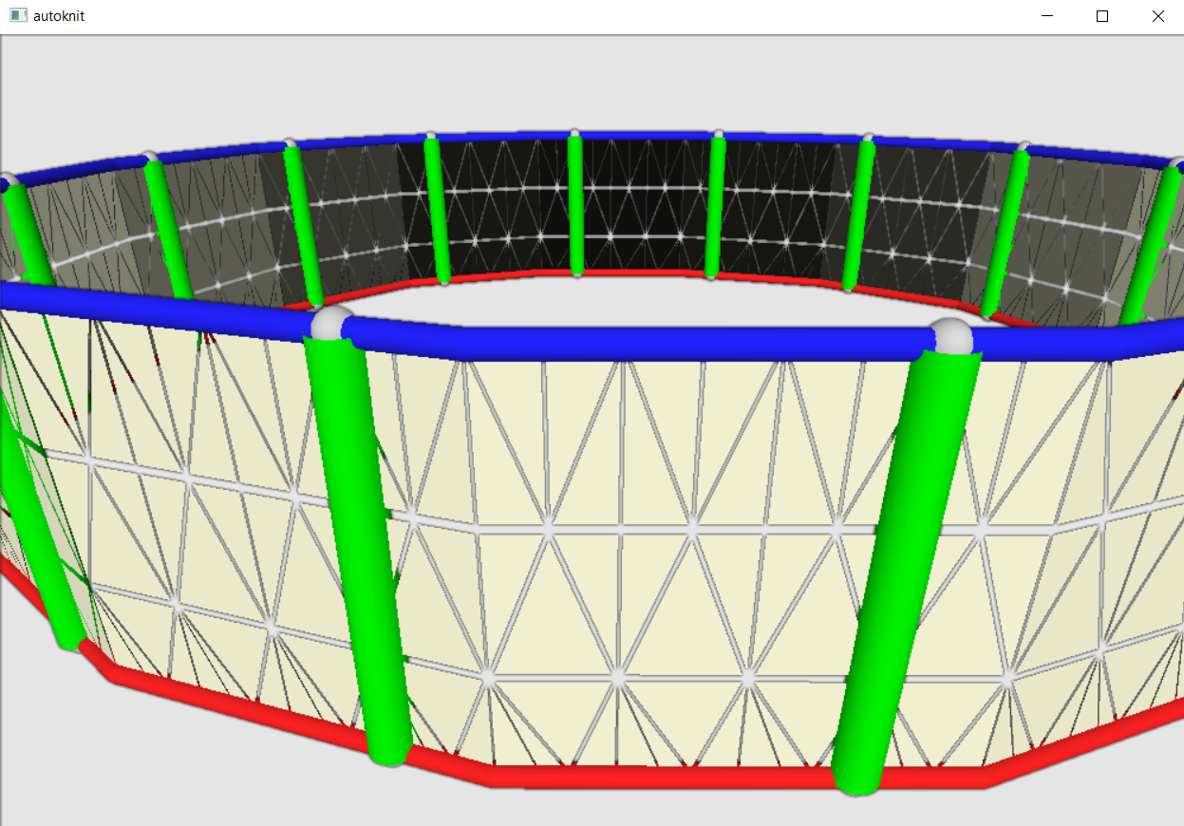
Walkthru of Software – Knit Graph
The knit graph is constructed automatically, slice by slice, from the bottom starting node that was selected in blue

Slide 13
Conclusions
This paper shows a potential to make 3D knitting accessible to a wide range of designers and modelers
The construction of a “knit graph” appears to facilitate the creation of even complex objects
The provided autoknit code, while not fully documented, is a promising starting point for further research. Authors note the code could in theory be ported to other (non Seiko) knitting machines.

