Slide 1
Barehanded Music: Real-time Hand Interaction for Virtual Piano
SIGGRAPH i3D 2016
Authored BY Hui Liang, Jin Wang, Quan Sun, Yong-Jin Liu, Junson YUAN, Jun LUO, Ying He
Presented BY JOSEPH HEENAN

Slide 2
Paper Citation
Title: Barehanded Music: Real-time Hand Interaction for Virtual Piano
Presented: 20th ACM SIGGRAPH Symposium on Interactive 3D Graphics and Games (I3D '16)
Published: February 2016, I3D '16 Proceedings of the 20th ACM SIGGRAPH Symposium on Interactive 3D Graphics and Games
Hui Liang, Jin Wang, Qian Sun, Yong-Jin Liu, Junsong Yuan, Jun Luo, and Ying He. 2016. Barehanded music: real-time hand interaction for virtual piano. In Proceedings of the 20th ACM SIGGRAPH Symposium on Interactive 3D Graphics and Games (I3D '16). ACM, New York, NY, USA, 87-94. DOI: https://doi-org.ezproxy2.library.drexel.edu/10.1145/2856400.2856411

Slide 3
Introduction
Goal
Allow a user (who may not have a physical piano) to learn to play a virtual piano
Solution useful for
Distance music education
Music therapy in partially disabled populations (e.g., stroke victims)

Slide 4
Challenges
The algorithm must be able to process input and render a tap event to a virtual piano in real-time
A training/test dataset must be compiled to evaluate accuracy of the algorithm
The algorithm must be robust to a variety of hand sizes and colors
It must be comfortable for a user to interact with the virtual piano

Slide 5
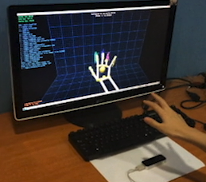
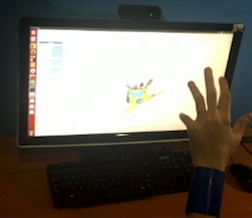
Related Work: Hand Tracking in Free Space with Leap Motion
Examples here include systems incorporating the Leap Motion on left [Han and Gold 2014], a recent start-up product that offers a hand-tracker as a UI input tool, and an example from the SGP ‘15 Conference called “Robust Articulated-ICP for Real-Time Hand Tracking” on the right. Images from Article

Slide 6
Related Work: Hand Tracking in Free Space with Depth Camera
[Tagliasacchi and Schroeder 201515] presented a system based on a depth camera called “Robust Articulated-ICP for Real-Time Hand Tracking” on the right.

Slide 7
Limitations of Related Work
All prior systems the authors could find performed detection in free space, that is, with hands in the air and not resting on any surfaces. However this position is not comfortable to long-lasting interations such as learning to play piano.
Furthermore it is difficult for a user to orient their hand positions in free space for playing an instrument where absolution positioning (vs just gesture detection) is important, such as the piano. Placing hands on a rigid surface such as a desk helps with this.

Slide 8
Contributions
Algorithm for hand segmentation against a planar surface
Estimation model for finger position and tap up/down detection
Rendering and Feedback of Detected Movements on a Virtual Piano
An end-to-end software pipeline enabling the virtual piano playing experience

Slide 9
Solution Overview
Solution allows a user to simulate playing a virtual piano without discomfort of holding hands in the air
On a dataset of 7.2k annotated images, a random forest model is used to predict 3D hand joint positions for online (live) position detection
Tapping is detected based on relative heights of each of the fingers after positions are estimated
The entire algorithm runs in less than 20ms allowing for real-time performance

Slide 10
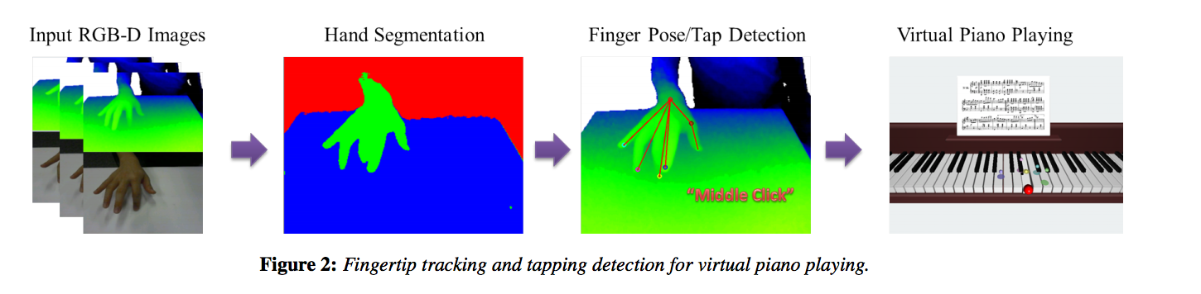
Software Pipeline
The following images show each stage of operation of the software routine:

Slide 11
Hardware Used Part 1 - RGB-D Cameras
The authors attempt to build a system that allows a user to rest their hands on a desk and play a “virtual piano” by tapping fingers on the desk. Major problems to solve are tap detection that is robust against self-occlusion (in this context self-occlusion refers to parts of the hand may be hidden from view of the camera)
For this they used an “RBG-D” camera that can capture Red, Green and Blue color values in addition to depth information. The authors used the DS-325 camera, however the manufacturer (SoftKinetic) has replaced that at the current time with a DS-525 camera

Slide 12
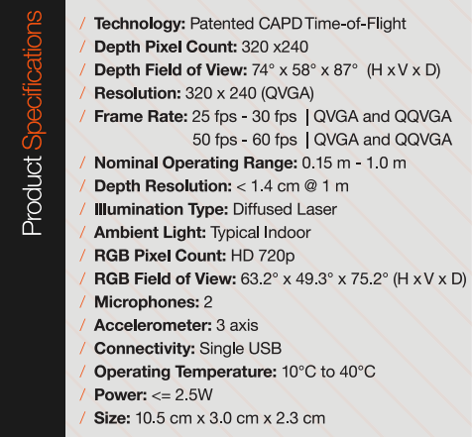
Hardware Used Part 2 - What is a DepthSense camera capable of?
The model used in this study, the DS-325, combines laser illumination with an optical lens to capture color and depth information at a resolution of 320 by 240

Slide 13
Algorithm Building Blocks – Part 1
The normal vector centered on the desk is taken as the the origin used to render the virtual piano at
The RANSAC algorithm helps estimate positions in 3D space, ensuring that the impact of outlier results is minimal via an iterative method (this is in contract to least squares pegression parameter estimation, where both inlier and outlier datapoints are given equal importance in the global error count)
A random regression forest [Girshick et al 2011] is additionally used to estimate joint positions.

Slide 14
Algorithm Building Blocks – Part 2
The following high-level libraries are used to implement the algorithms in part 1:
OpenCV – For segmentation of the hand in the image
OpenGL – For rendering of the virtual piano centered on the desk

Slide 15
Robustness
After 4-fold cross validation (this means reserving 4 times a random 25% of the total dataset for testing, not seen during training) the authors report that the ”average error between the ground truth hand joint positions and the predicted positions is 1.3cm”.
For tapping down, the authors report tapping down detection exhibits the following performance:
Finger | Precision | Recall
Thumb | 88.99% | 97.00%
Index | 100.00% | 95.00%
Middle | 96.77% | 90.00%
Ring | 85.34% | 99.00%
Pinky | 100.00% | 87.00%

Slide 16
Limitations
Due to limited training dataset size, the prediction accuracy drops when size of player’s hand differs significantly from sizes in training dataset
Current algorithm is not efficient or accurate enough to detect the tapping event in a fast playing tempo

Slide 17
Future Directions
Hand normalization algorithm for players with varying hand sizes
Integration with head-mounted VR display which may provide a more immersive experience
Creation of larger training dataset including player faster (allegro) rhythms

