Slide 1

Task Management System
A collaborative web-based platform for organizing teams, projects, and employee work — built with modern software engineering practices for enterprise environments.
Лъчезар Рашков
Георги Стоянов
Даниел Костадинов
Product owner
Scrum
QA
Румен Първанов
Ивелин Войнов
Александър Лалев
Front End
Designer
Back End
Антон Кабаков
Георги Георгиев
Back End
Front End

Slide 2
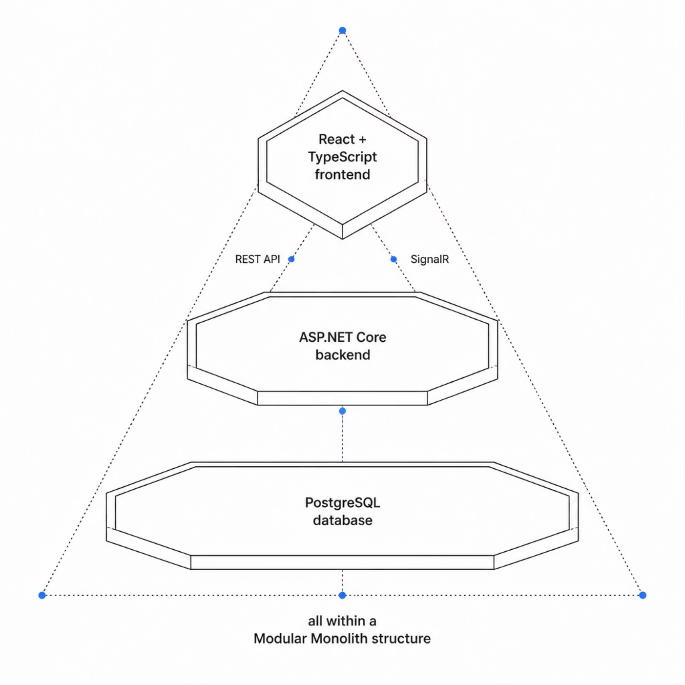

Technologies & Architecture
Tech Stack
Backend
C# · ASP.NET Core Web API ·
Entity Framework Core · SignalR · JWT Auth
Frontend
React · TypeScript
Database & DevOps
PostgreSQL· Git & GitHub
The system follows a Modular Monolith architecture
— a React frontend communicates with an ASP.NET
Core REST API backed by PostgreSQL, enabling
clean separation of concerns and future scalability.

Slide 3

Roles & Main Functionalities
Administrator
Manager
Employee
Full system access, user
management, and global
configuration.
Assigns tasks, monitors
team workload,
and reviews analytics.
Receives tasks, updates progress,
and manages personal workload.
JWT Auth
Comments & @Mentions
Personal Tasks
Team Management
Task Management
Workload Validation
Real-time Notifications
Real-time Notifications
Real-time Notifications
Activity Logs
Analytics Dashboard

Slide 4
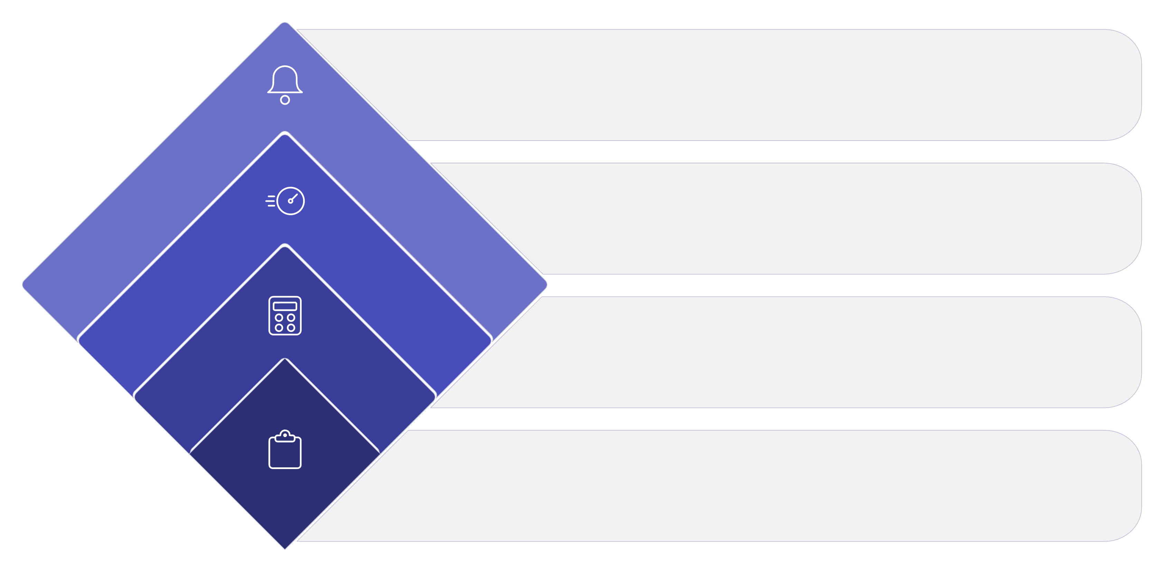
Business Logic & Core Features
Assignment Outcome
Assign or reject with notice
Capacity Check
Compare against employee limit
Calculate Load
System converts hours to days
Create Task
Manager enters task and hours
The system enforces intelligent workload validation before every task assignment, protecting employees from over-allocation.
Workload Calculation
Real-time Notifications
Each task carries estimated working hours. The system computes available capacity as 8 hours × working days until deadline.
SignalR pushes instant alerts for task assignments, new comments, and @mentions — keeping every team member in sync.

Slide 5

Conclusion
A production-grade, full-stack application demonstrating end-to-end software engineering — from database design to real-time UI.
Clean Architecture
Modular, maintainable, and built for long-term growth.
REST + Real-time
ASP.NET Core REST API paired with SignalR for live collaboration.
Scalable by Design
PostgreSQL backend with EF Core, ready for enterprise workloads.
Future-Ready
Architecture supports new modules, roles, and integrations without rework.

