Slide 1


Slide 2
Introduction to Molecular Modelling and Computational Chemistry on HPC Systems at LRZ
Leibniz Computing Centre
Garching, Germany
November 2025
Author: Dr.-Ing. Elmira Birang

Slide 3
Outline
Introduction to LAMMPS features
LAMMPS packages
Input script – case study: dynamic crack propagation
Output files – case study: dynamic crack propagation
KOKKOS on LAMMPS

Slide 4
OVERVIEW OF LAMMPS
LAMMPS: Large-scale Atomic/Molecular Massively Parallel Simulator
Classical molecular dynamics open-source modular C++ code; compiler requirement: min version C++11.
It models particles in liquid, solid and gaseous state.
It models 2D or 3D systems ranging from a few particles up to trillions.
It models atomic, polymeric, biological, solid-state, granular, coarse-grained or macroscopic systems with various force fields and potentials.
Credit to: https://docs.lammps.org/Intro_features.html

Slide 5
LAMMPS Features
LAMMPS can be run in serial and any parallel machine that supports Message Passing Interface (MPI).
Runs from an input script
Syntax for defining and using variables and formulas.
Intergartion with Python for various tasks such as time integration, force computation.
Run one or multiple simulations simultaneously from one job script.
Source code can be extended with new features.
https://github.com/lammps/lammps

Slide 6
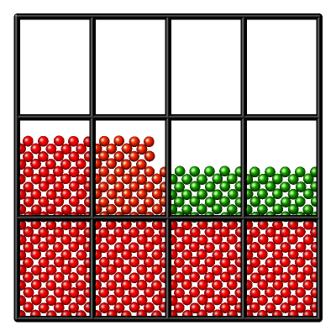
LAMMPS Features
Particle decomposition. One atom=one gpu thread
Spatial decomposition of simulation domain for MPI parallelism. Figure shows tiled or brick decomposition.
Particle decompostion inside spatial decompostion GPU parallelism.
Comm_style style.
Style is brick (default) or tiled (customizable).
Note: comm_style only presents kind of decomposition and pattern of communication.
Spatial Decomposition
One subdomian = One MPI rank
Picture credit: LAMMPS documentation

Slide 7
Workflow of runing a Molceular Mechanics simulation
Define lattice, assign positions and velocities, create neighbor list
Calculate forces on each atom/particle
Integartion of equation of motion, energy minimization
Compute physical quantities
Apply boundry conditions - set simulation parameters

Slide 8
Workflow of running simulations in LAMMPS
Software installation w required packages. Provide executable (lmp)
Input file user_script.in. Required: Potentials & Atoms topology
Output files
Post processinging - visualization tools

Slide 9
LAMMPS PACKAGES
LAMMPS is modular and has several optional packages.
During installation activate any package using;
-D PKG_packageName=yes in CMAKE or
make yes-packagename in traditional make.
See LAMMPS documentation for detailed information.
Input/Output | H5MD | Interaction | MANYBODY REAXFF MOLECULAR
Chemistry | CLASS2 ELECTRODE | Acceleration | OPENMP KOKKOS GPU INTEL OPT

Slide 10
Structure of LAMMPS input script
Input script is text file containing commands
To learn commands read lammps documentation

Slide 11
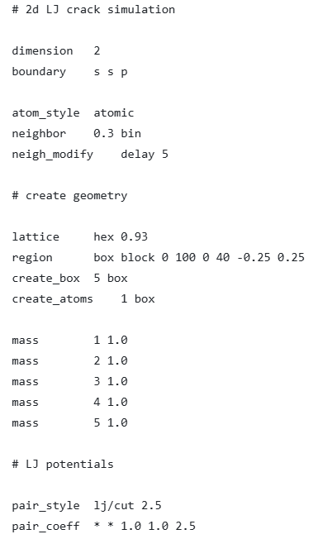
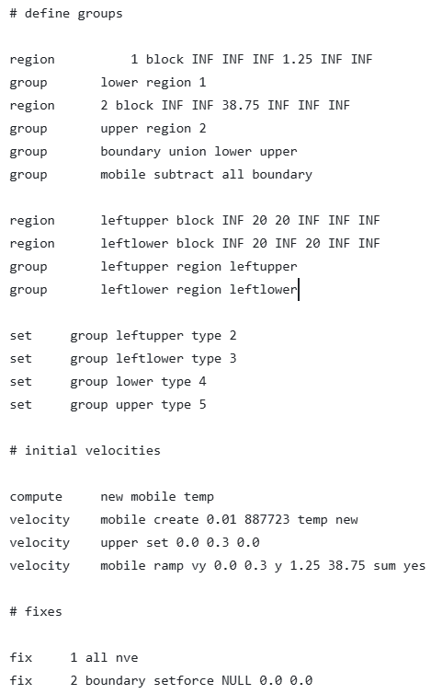
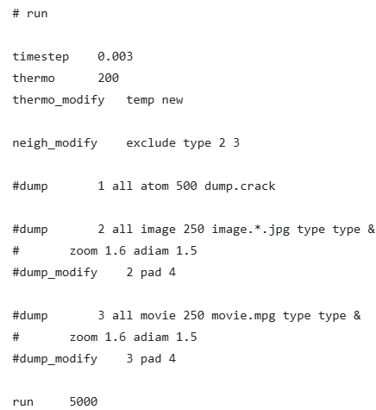

Slide 12
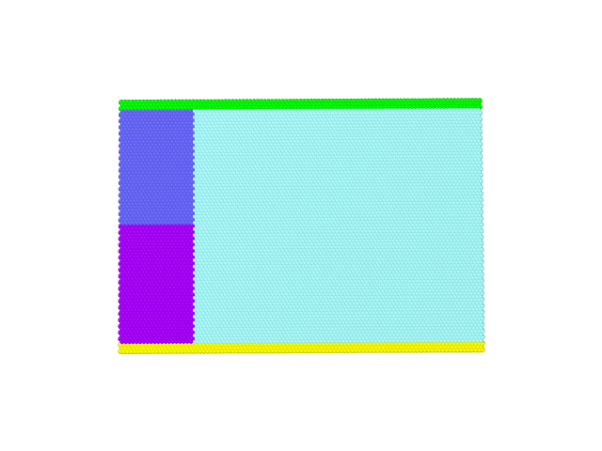
upper
left upper
mobile
left lower
lower

Slide 13
Global settings:
Units, dimension, atom_style, boundary commands
Simulation box and atoms :
region, create_box, create_atoms, lattice
read_data, read_restart, read_molecule
dimension 2
boundary s s p
atom_style atomic
neighbor 0.3 bin
neigh_modify delay 5
lattice hex 0.93
region box block 0 100 0 40 -0.25 0.25
create_box 5 box
create_atoms 1 box

Slide 14
group of atoms can be specified
set atoms attribute
specify interaction style
bond_style, pair_style, angle_style, dihedral_style, kspace_style, …
Define diagnostics (quanities) that should be computed
group upper region 2
group boundary union lower upper
group mobile subtract all boundary
set group leftupper type 2
set group leftlower type 3
pair_style lj/cut 2.5
pair_coeff * * 1.0 1.0 2.5
compute new mobile temp

Slide 15
fix commands applies any operation to the system during time stepping or minimization
output commands
run and minimize
Applies fixes and computes at each (pseudo-) time step, writes output at each step
fix 1 all nve
fix 2 boundary setforce NULL 0.0 0.0
thermo 200
dump 1 all atom 500 dump.crack
timestep 0.003
run 5000

Slide 16
Command-line options
At run time several options can be used on command-line to determine any package or output
mpirun –np 8 lmp –sf kk –k on g 8 –pk kokkos gpu/aware on -l log.lmp_kk –i in.myscript
-i: specify the input script file | -k: enable or disable kokkos support | -nb: turn off buffering for output file and commit output immediately, useful for debuging
-e: output to screen, log file or both | -pk: invoke accelerator packages | -p: invoke multi-partition mode to run multi-replica simulations
-l:specify the log file to write information | -sf: along with –pk, it invokes accelerator packages | -mpicolor: to launch more than one executable

Slide 17
LAMMPS OUTPUT
Log file
Screen output
Export of data in different format for post-processing, *.vtk, *.h5md, lammps dump, ...

Slide 18
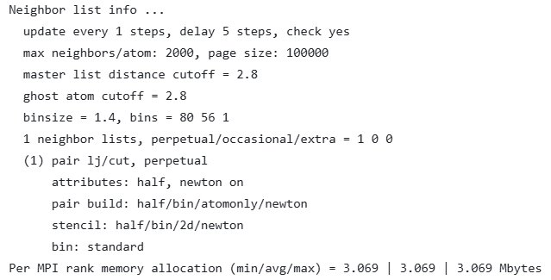
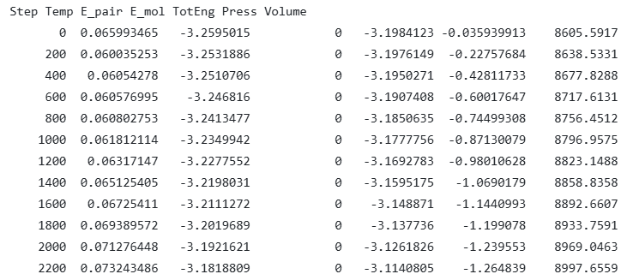
Log.lammps
Substitution of variables with values
Returns warnings and errors
Pre-run info: Information on neighbor list and memory usage.
Columns of thermodynamic quantities that are defined via thermo_modify out at every times

Slide 19
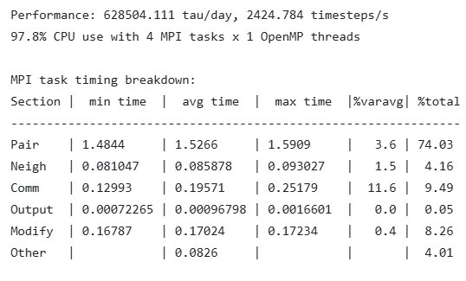
Post-run info: performance, CPU usage and timing.
Use performance output for benchmarking or calculation of resources (CPU-hour). Using this data you know how long a simulation will take.
CPU usage percentage per MPI task, lower percentage corresponds to delay because of I/O and insufficient thread utilization.
GPU offload leads to less percentage of CPU usage.
Use timing breakdown to identify computation bottlenecks.
Pair: non-bonded force computations
Neigh: neighbor list construction
Comm: inter-processor communcation of atoms and their propertieses
Output: output of thermodynamic info and dump files
Modify: fixes and computes

Slide 20
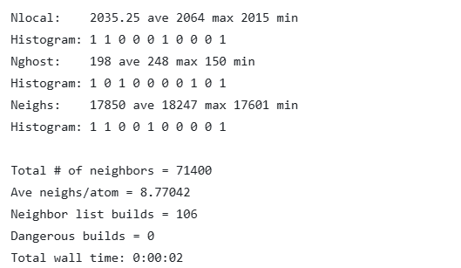
Nlocal: number of atoms owned by each MPI rank. Closer min and max means better the load balance.
Histogram: distribution of atoms counts across ranks in 10 equal bins
Nghost : number of ghost atoms per rank
Neighs: number of neighbor pairs per rank. This is directly related to computational cost

Slide 21
Kokkos on LAMMPS
Kokkos is a templated library developed in C++ and compatible with C++ standard.
Kokkos provides offloading of computation Kernels on various hardware (vendor-agnostic) with an acceptable performance.
After installation of LAMMPS, the styles that has Kokkos support can be checked using lmp –h kokkos
It supports GPU, shared-memory and distributed memory.

Slide 22
How to invoke Kokkos on run command
neigh: half for GPU. Determines how a neighbor list is built
newton: off for GPU. Set Newton flags for pairwise and bonded interactions.
binsize: set the size of bins used to bin atoms in neighbor list.
comm: no, host, device. It determines packing and unpacking of data that should be perfromed by CPU or GPU when communicating per-atom data. For GPUs device is faster when all style are Kokkos-enabled.
gpu/aware: on. This allows GPU buffers to be sent directly to MPI sender/reciever. Check the availability of gpu-aware mpi on your system.
mpirun –np 4 –sf kk –k on g 4 –pk kokkos newton off neigh half comm device gpu/aware on –in in.your_script

