Slide 1


Slide 2
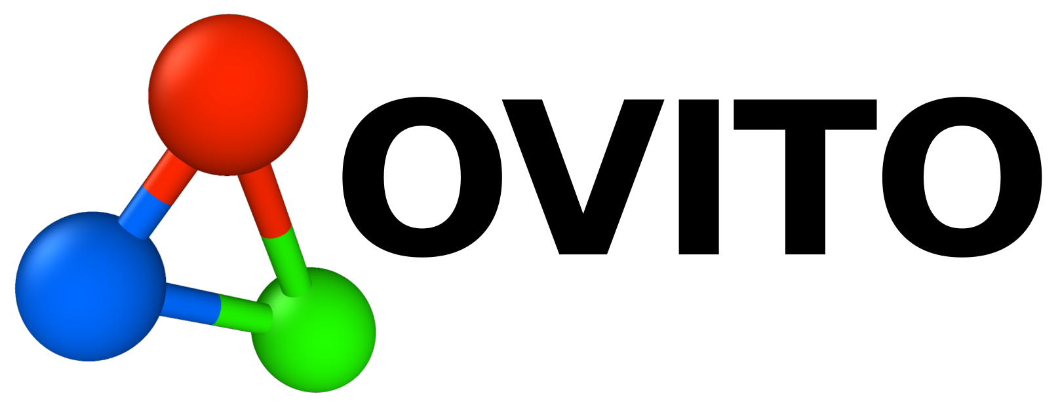
Introduction to Molecular Modelling and Computational Chemistry on HPC Systems at LRZ Leibniz Computing Centre, Garching, Germany. November 2025 Dr.-Ing. Elmira birang
LAMMPS – MD Simulation
Dump file
Visualization by Ovito
https://www.ovito.org/

Slide 3
Main features
Visualize and explore particle simulations of any kind and size. From ab initio to large-scale models with 100M+ atoms or particles.
Many features are available free of charge under an open source license.
Additional analysis, visualization, and automation functions are available on OVITO Pro version.
https://www.ovito.org/ is the home- page of software, it includes user-friendly installation steps.

Slide 4
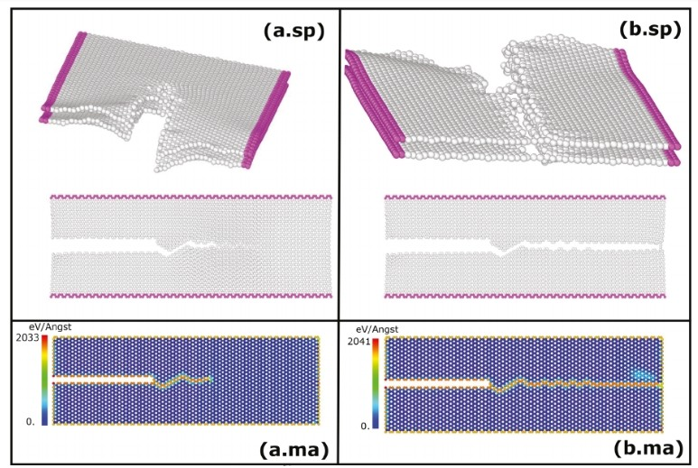
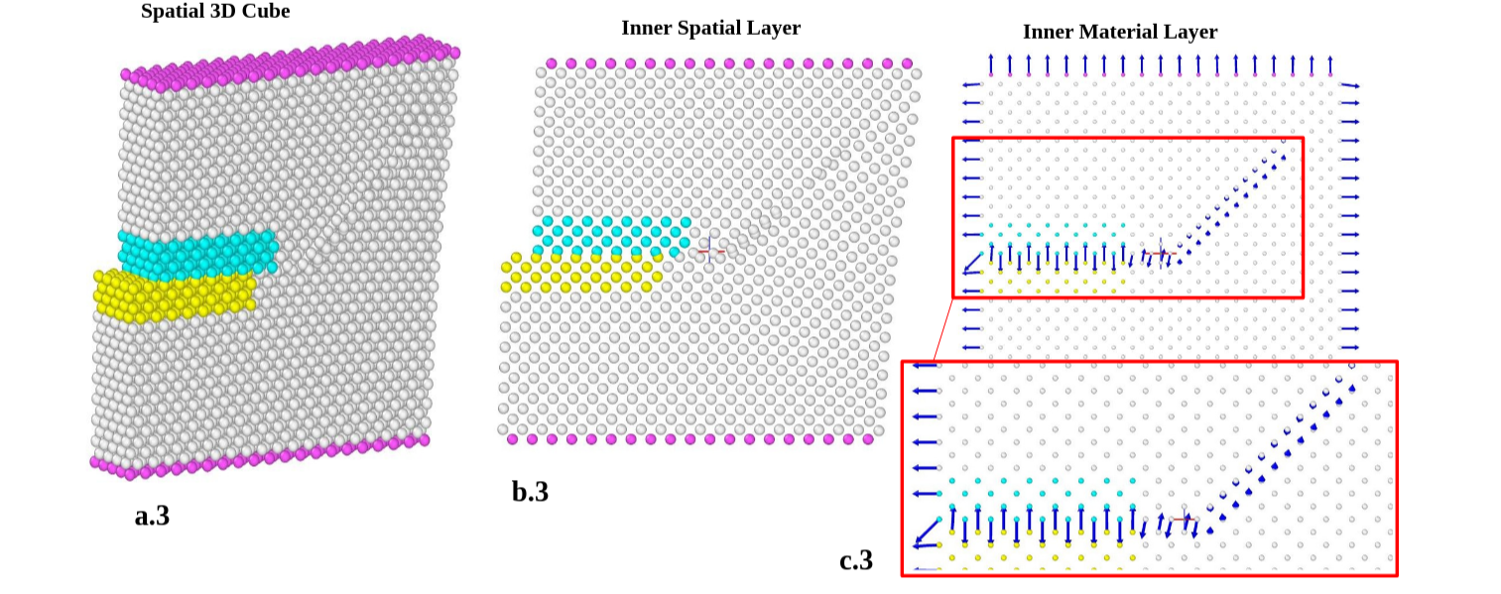

Slide 5
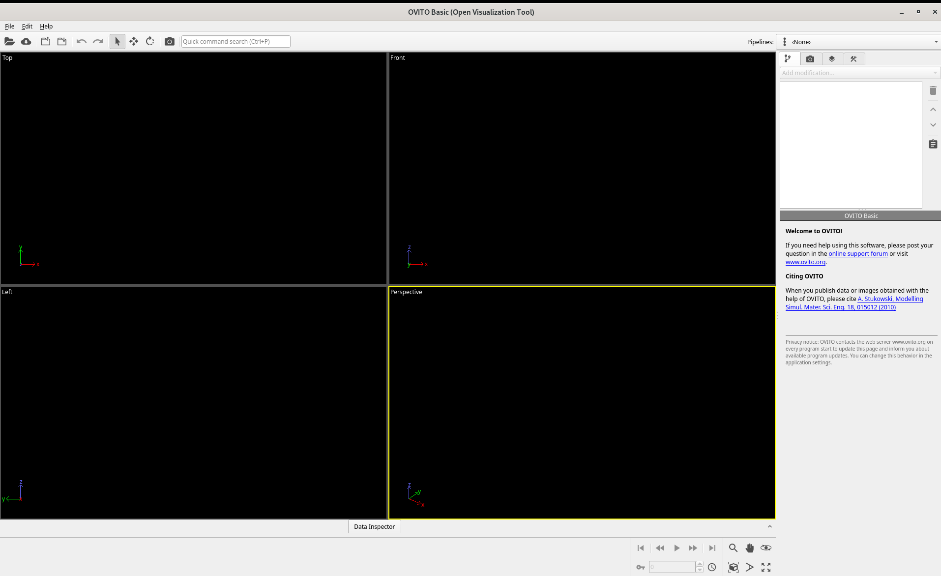
Introduction to GUI

Slide 6
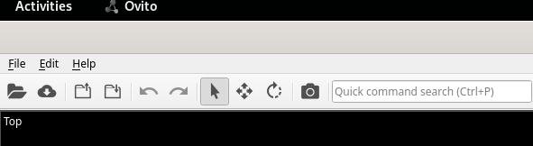
Data Input/Output
Supported input file formats
XYZ (basic and extended variants)
NetCDF (written with ‘dump netcdf’ command)
CFG, GSD/HOOMD, IMD, PDB, GALAMOST, DL_POLY
Ab initio codes: POSCAR, FHI-aims, QE, CASTE
Volumetric: XSF, Cube, CHGCAR
Geometry: OBJ, STL, VTK
1
2
3
4
5
6
7
8
Load a file from local machine
Load a file from remote machine using OpenSSH
Save the current session
Load the saved session
5. Make mouse left-click button to Select
6. Make mouse left-click button to Move
7. Make mouse left-click buttoon to Rotate
8. Render active view-point

Slide 7

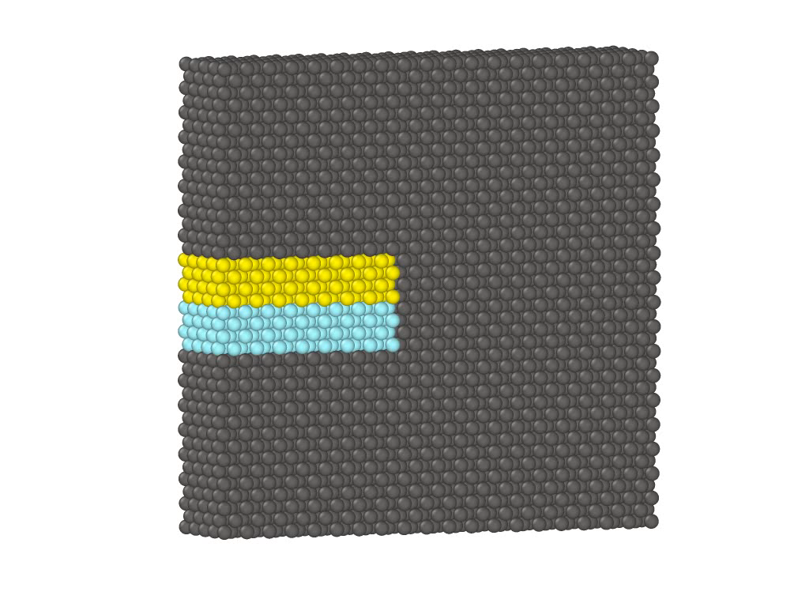
Movie and Zoom
2
Enter frame number
Play all frames as multiple files can be loaded at once and make a movie from it
Fit view
Adjust zoom
See one view-panel, re-click to exit
1
3
4
5

Slide 8
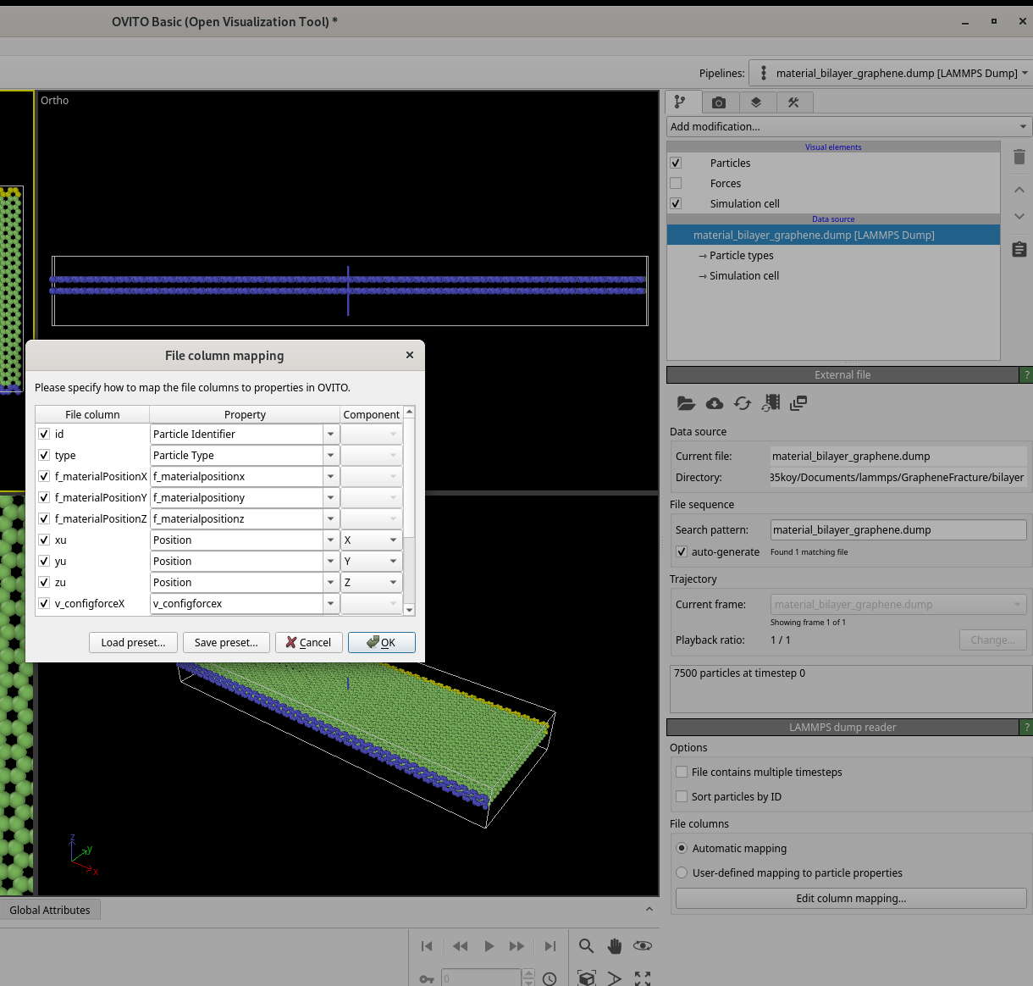
Customized file mapping

Slide 9
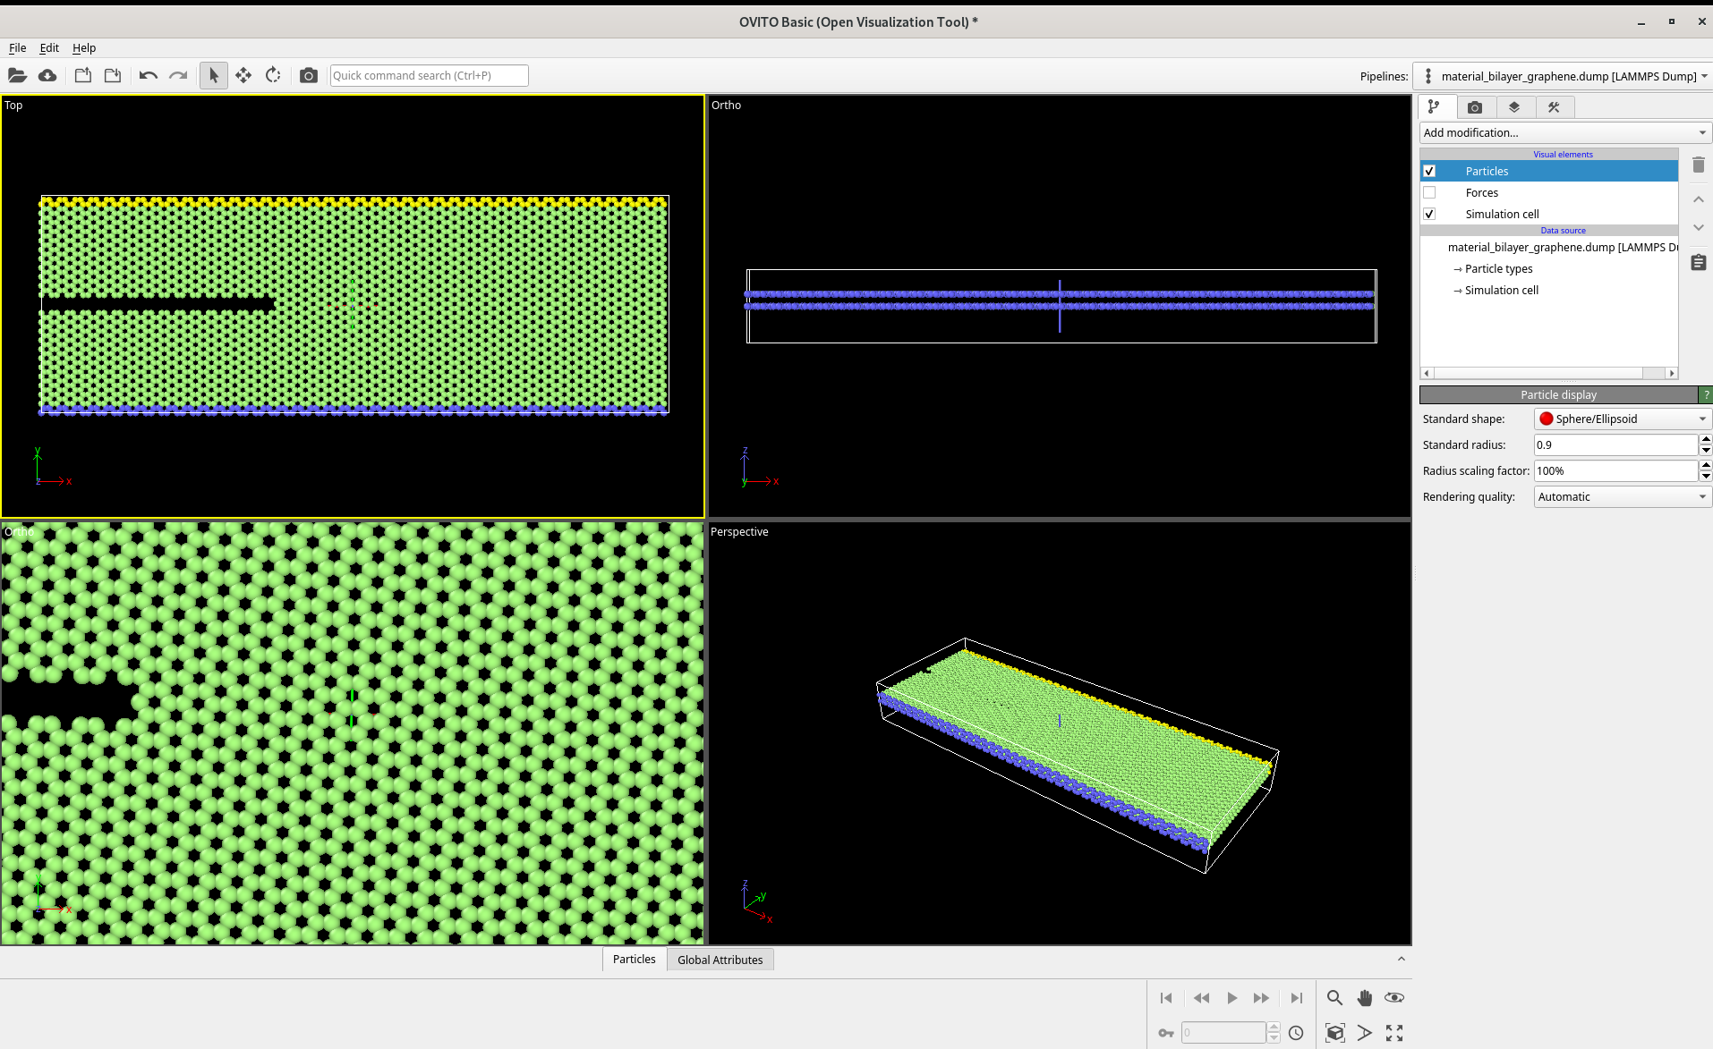
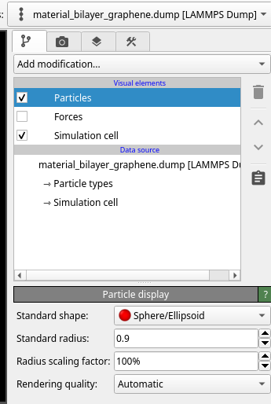
Visualization elements
Visual elements are graphical representations of data.
Particles, Bonds, Vector arrows, Simulation cell, Surface meshes, Polyhedral Trajectory lines, Dislocation lines, ...

Slide 10
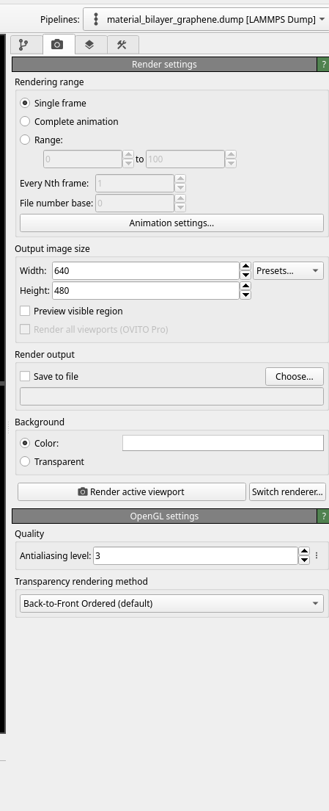
Image Export

Slide 11
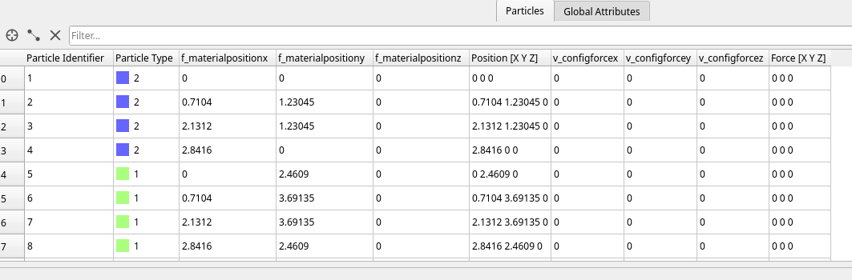
Particles menu

Slide 12
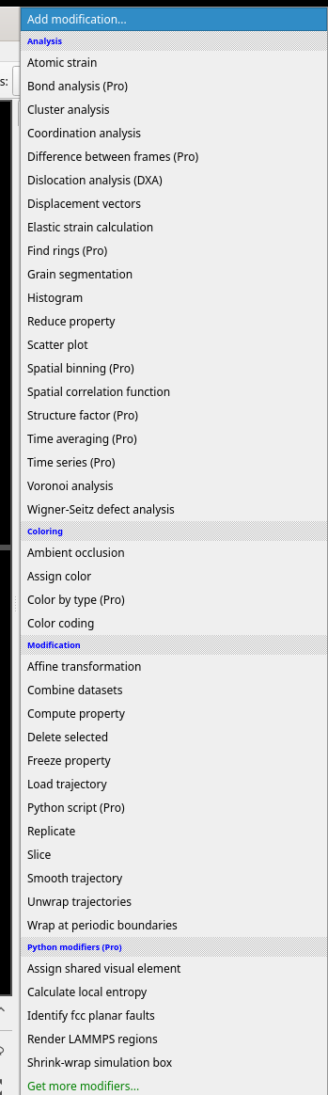
Modifier library – Post processing

Slide 13
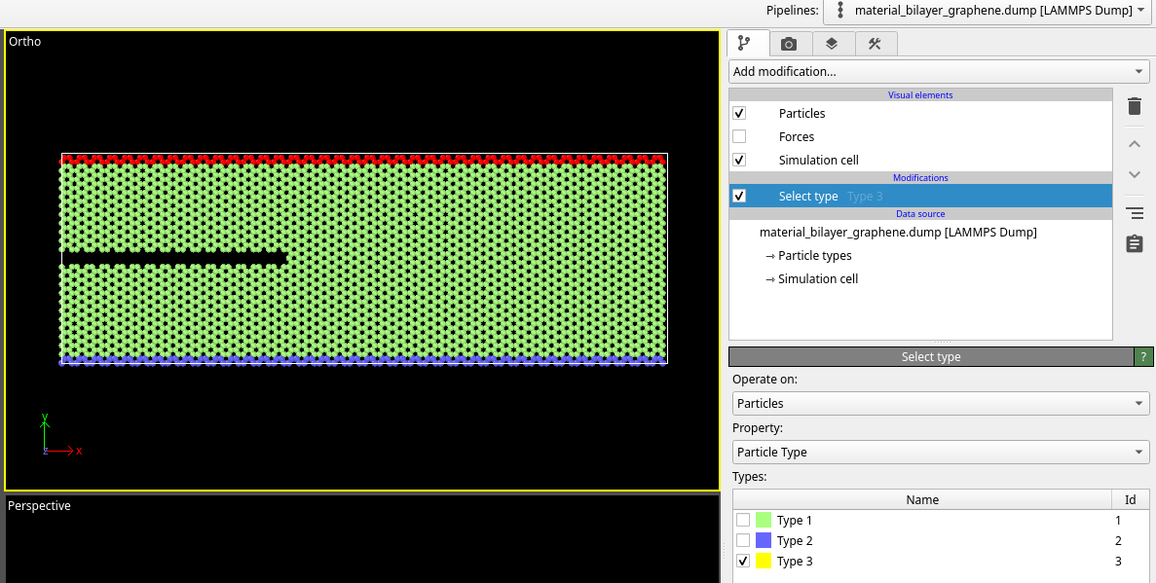
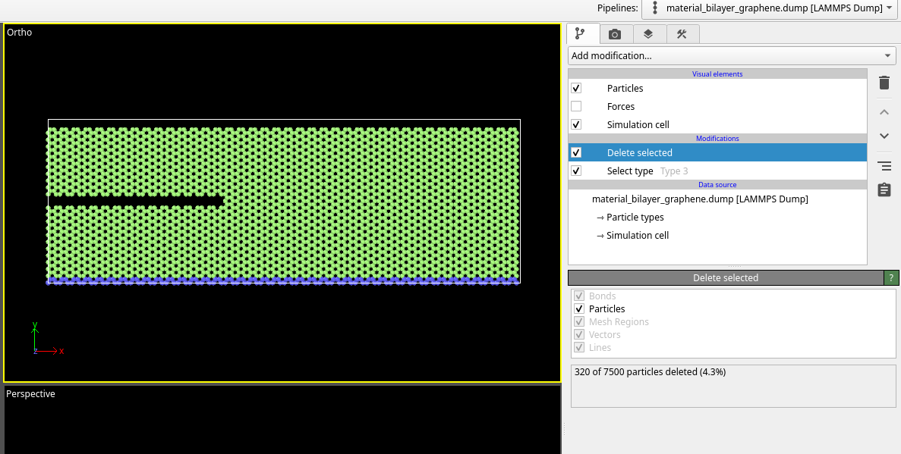
Selection and deletion

Slide 14
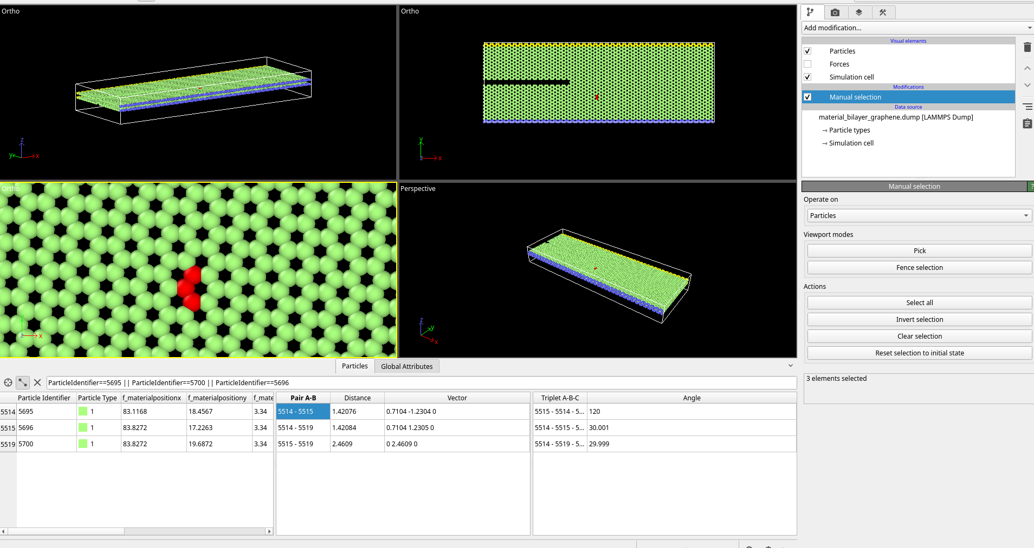
Manual selection – Topology information

Slide 15
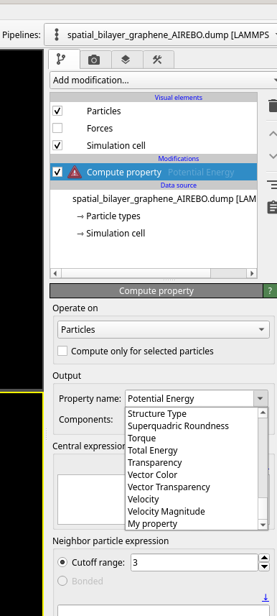
Compute Property

Slide 16
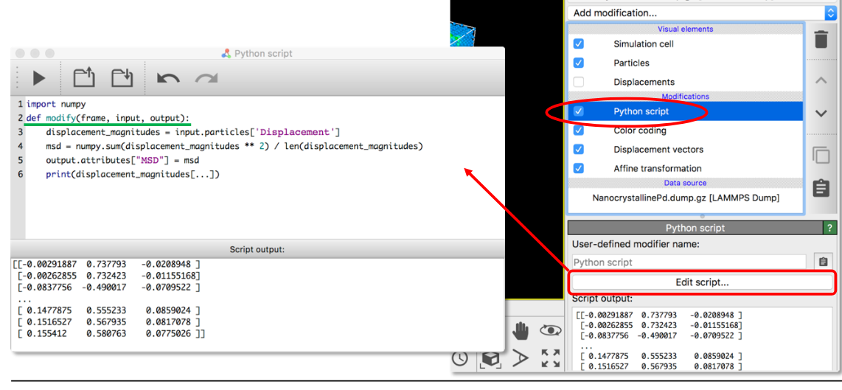
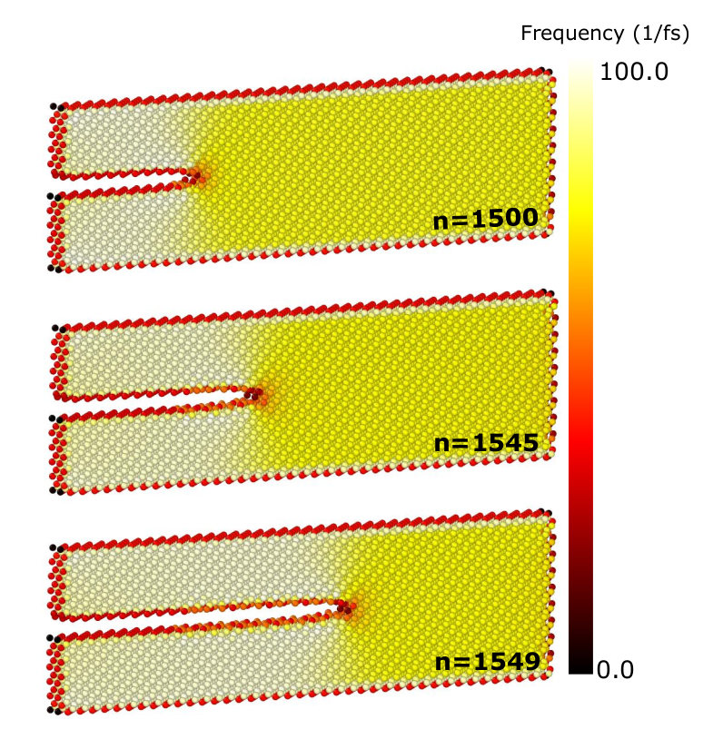
Python Script
OVITO‘s Python interface provides access to almost any program function and the data model.
Use it to automate analysis or visualization tasks.
Use it to integrate OVITO’s capabilities into custom analysis workflows.
Calculation of atomistic frequency are done using python script.

