Slide 1

Molecular Modelling Course
November 18. 2025 – 20. 2025 | Dr. Birkan Emrem, Dr. Ferdinand Jamitzky, Dr. Plamen Dobrev, Dr. Prasanth Ganta, Dr. Elmira Birang
Leibniz Supercomputing Centre

Slide 2
Outline
Motivation
Bio-molecular atomistic structures
Molecular dynamics introduction
Introduction to GROMACS
Input file parameters and topologies for molecular dynamics simulations and in GROMACS in particular

Slide 3
Outline
Motivation
Bio-molecular atomistic structures
Molecular dynamics introduction
Introduction to GROMACS
Input file parameters and topologies for molecular dynamics simulations and in GROMACS in particular

Slide 4
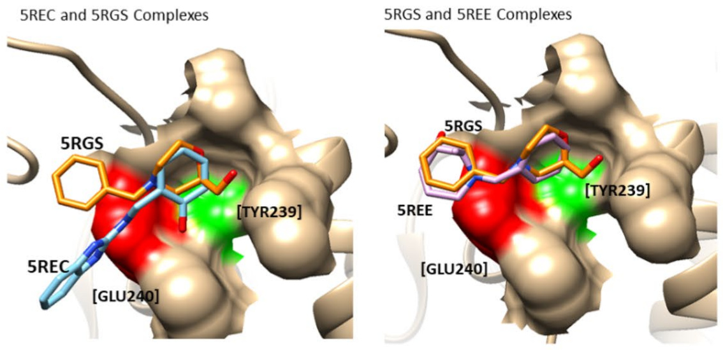
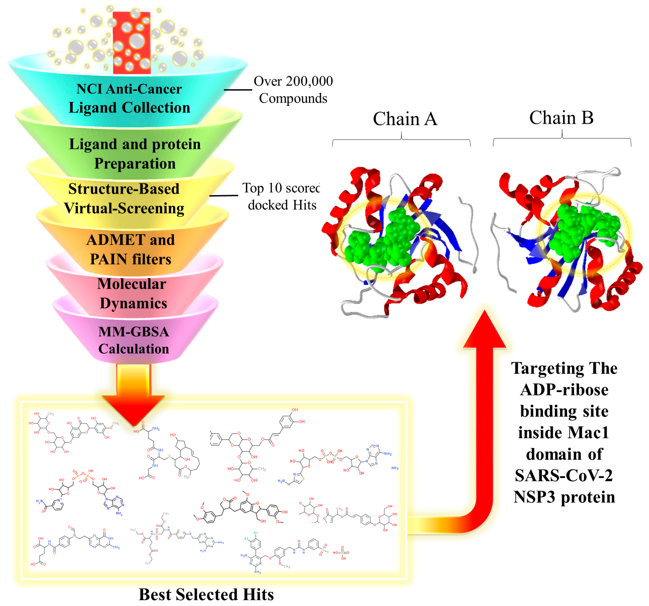
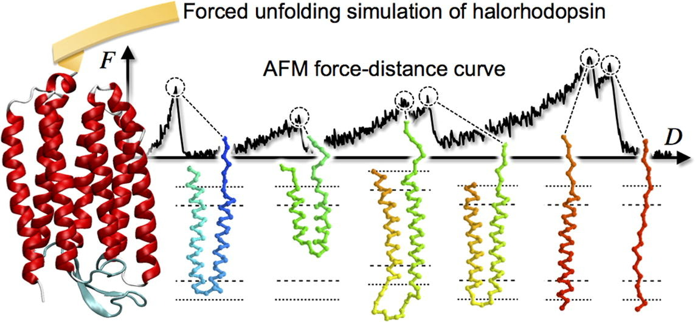
Why do simulations?
To study observables not accessible by experimental approaches
To carry out high throughput essays, studying system under multiple conditions or multiple systems simultaneously
Reproduce experiment and validate models on microscopic level
Viruses 2023, 15, 2291 https://doi.org/10.3390/v15122291
Scientific Reports 2021, 11, 7429 https://doi.org/10.1038/s41598-021-86471-0
Chemical Physics Letters 2018, 691, 276 https://doi.org/10.1016/j.cplett.2017.11.025

Slide 5
Outline
Motivation
Bio-molecular atomistic structures
Molecular dynamics introduction
Introduction to GROMACS
Input file parameters and topologies for molecular dynamics simulations and in GROMACS in particular

Slide 6
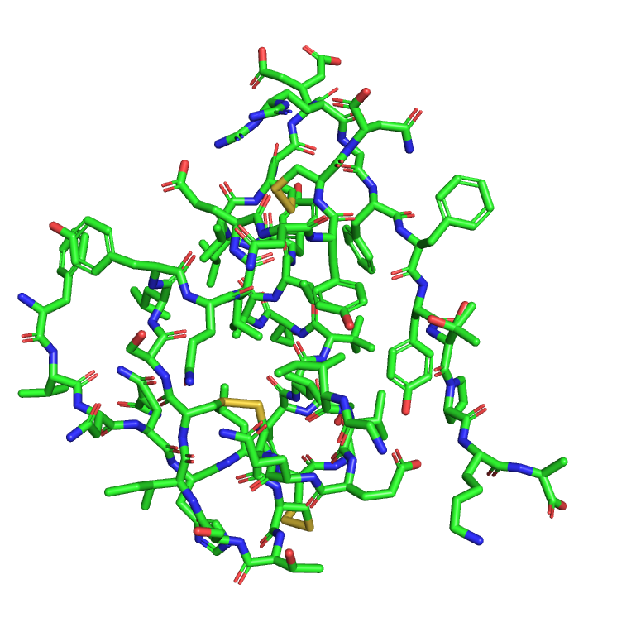
Biomolecular Structures
Structures of biological molecules are saved as a set of of atomic coordinates
They are derived experimentally either by X-ray crystallography, atomic NMR or Cryo-EM, or in silico using AI methods (e.g. AlphaFold)
Atomic resolution of a structure is crucial for obtaining physiologically relevant data during simulation

Slide 7
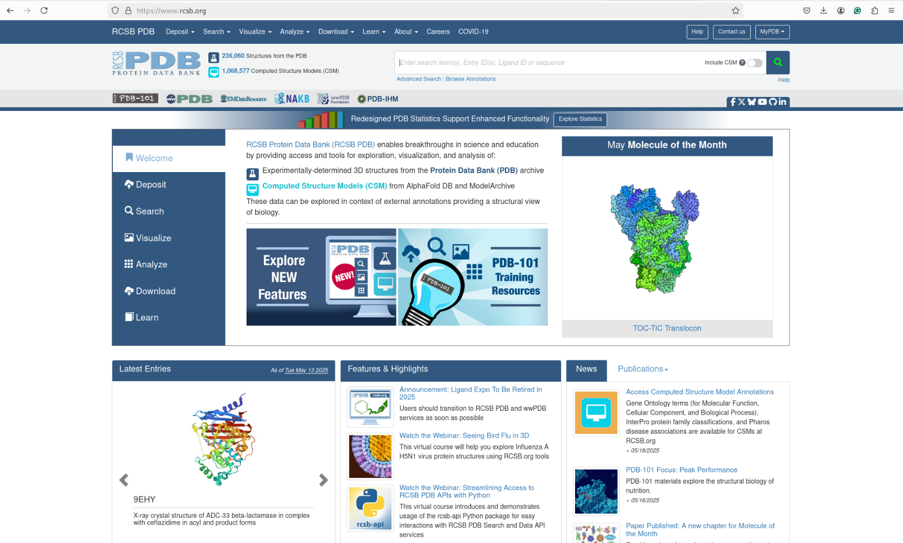

Slide 8
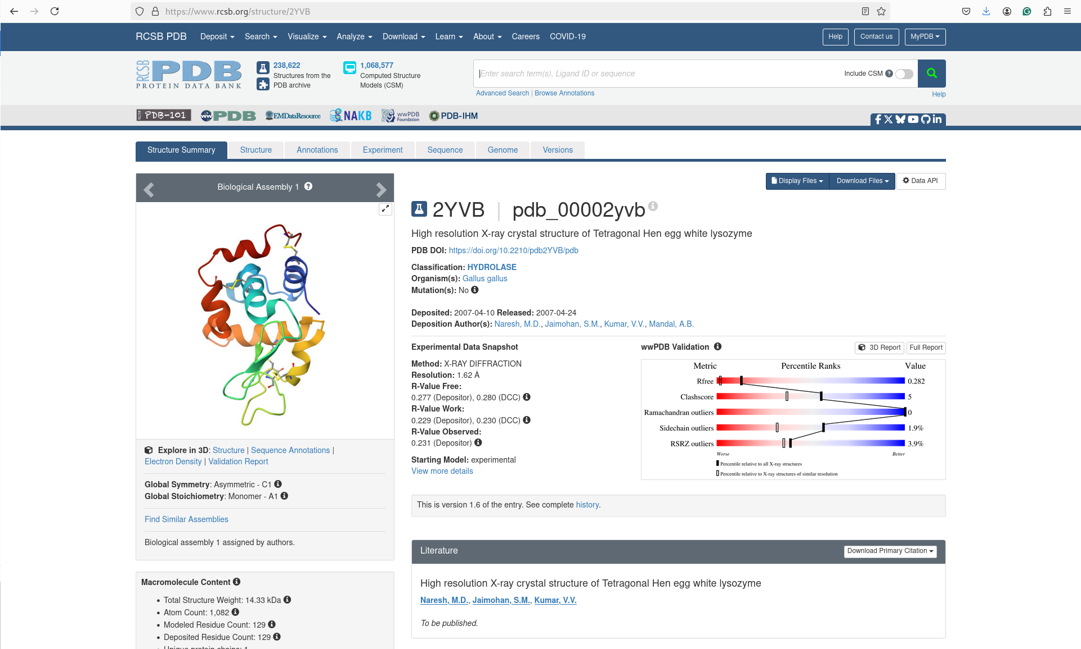

Slide 9
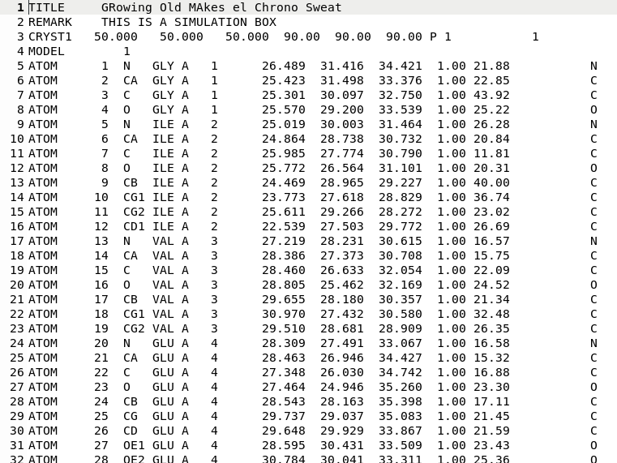
PDB file format
atom number
atom name
residue name
chain identifier
residue number
X
coordinates
Y
Z
occupancy
B-factor

Slide 10
Outline
Motivation
Bio-molecular atomistic structures
Molecular dynamics introduction
Introduction to GROMACS
Input file parameters and topologies for molecular dynamics simulations and in GROMACS in particular

Slide 11
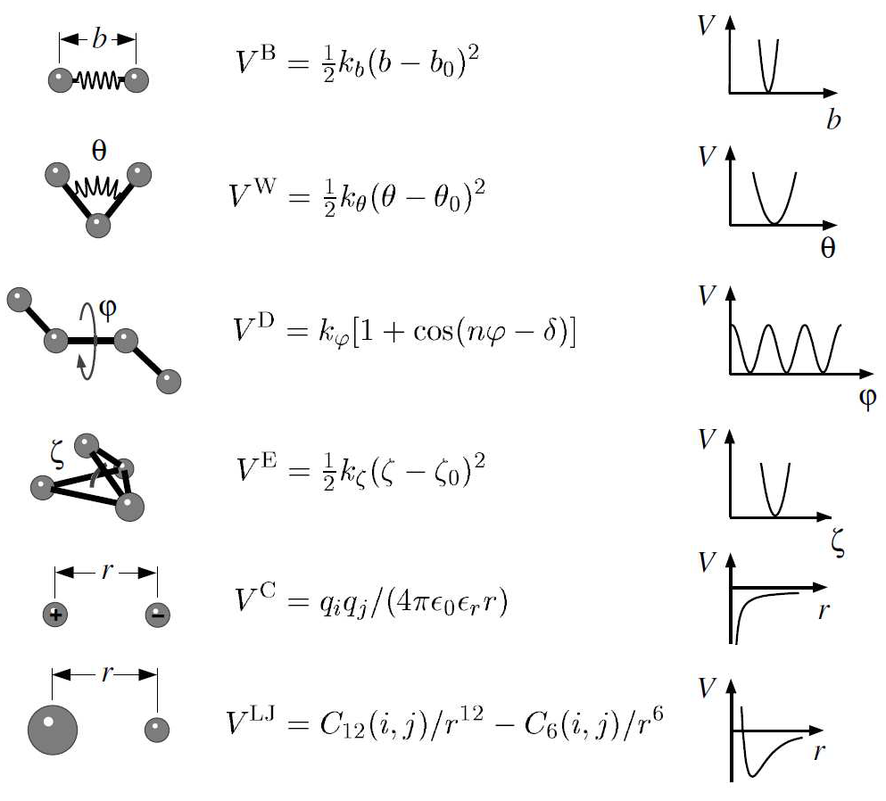
Molecular Dynamics Introduction classic potentials
From Synthetic Polymers to Proteins, NIC Series, Vol. 23, ISBN 3-00-012641-4, pp. 401-422, 2004

Slide 12
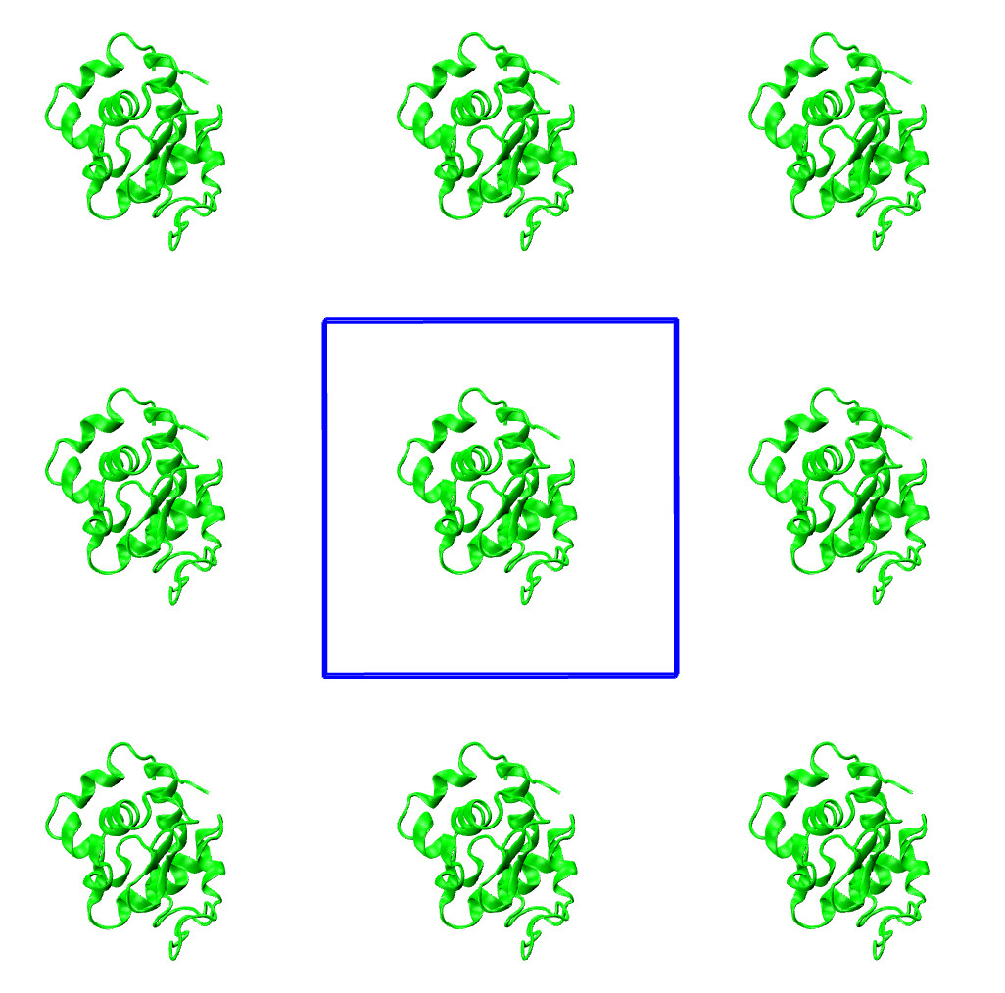
Molecular Dynamics Introduction periodic boundaries

Slide 13
Molecular Dynamics Introduction thermostats and barostats
Berendsen thermostat
Berendsen barostat

Slide 14
Molecular Dynamics Introduction trajectories

Slide 15
Outline
Motivation
Bio-molecular atomistic structures
Molecular dynamics introduction
Introduction to GROMACS
Input file parameters and topologies for molecular dynamics simulations and in GROMACS in particular

Slide 16

Introduction to GROMACS
Open Source
Highly parallel
Supports almost all modern CPUs and GPUs
Easy and straightforward to use

Slide 17
Outline
Motivation
Bio-molecular atomistic structures
Molecular dynamics introduction
Introduction to GROMACS
Input file parameters and topologies for molecular dynamics simulations and in GROMACS in particular

Slide 18
Topologies
Molecular descriptions in MD software packages are stored in topologies

Slide 19
Introduction to GROMACS topologies
; Include forcefield parameters
#include "amber99sb-ildn.ff/forcefield.itp"
[ moleculetype ]
; Name nrexcl
Protein_chain_A 3
[ atoms ]
; nr type resnr residue atom cgnr charge mass typeB chargeB massB
; residue 1 LYS rtp NLYS q +2.0
1 N3 1 LYS N 1 0.0966 14.01
2 H 1 LYS H1 2 0.2165 1.008
3 H 1 LYS H2 3 0.2165 1.008
4 H 1 LYS H3 4 0.2165 1.008
5 CT 1 LYS CA 5 -0.0015 12.01
6 HP 1 LYS HA 6 0.118 1.008
7 CT 1 LYS CB 7 0.0212 12.01
8 HC 1 LYS HB1 8 0.0283 1.008
9 HC 1 LYS HB2 9 0.0283 1.008
10 CT 1 LYS CG 10 -0.0048 12.01
11 HC 1 LYS HG1 11 0.0121 1.008
12 HC 1 LYS HG2 12 0.0121 1.008
13 CT 1 LYS CD 13 -0.0608 12.01
14 HC 1 LYS HD1 14 0.0633 1.008
15 HC 1 LYS HD2 15 0.0633 1.008
16 CT 1 LYS CE 16 -0.0181 12.01
17 HP 1 LYS HE1 17 0.1171 1.008
[ bonds ]
; ai aj funct c0 c1 c2 c3
1 2 1
1 3 1
1 4 1
1 5 1
5 6 1
5 7 1
5 23 1
7 8 1
7 9 1
7 10 1
10 11 1
10 12 1
10 13 1

Slide 20
Introduction to GROMACS topologies
[ angles ]
; ai aj ak funct c0 c1 c2 c3
2 1 3 1
2 1 4 1
2 1 5 1
3 1 4 1
3 1 5 1
4 1 5 1
1 5 6 1
1 5 7 1
1 5 23 1
6 5 7 1
[ dihedrals ]
; ai aj ak al funct c0 c1 c2 c3 c4 c5
2 1 5 6 9
2 1 5 7 9
2 1 5 23 9
3 1 5 6 9
3 1 5 7 9
3 1 5 23 9
4 1 5 6 9

Slide 21
Introduction to GROMACS topologies
; Include Position restraint file
#ifdef POSRES
#include "posre.itp"
#endif
; Include water topology
#include "amber99sb-ildn.ff/spce.itp"
#ifdef POSRES_WATER
; Position restraint for each water oxygen
[ position_restraints ]
; i funct fcx fcy fcz
1 1 1000 1000 1000
#endif
; Include topology for ions
#include "amber99sb-ildn.ff/ions.itp"
[ system ]
; Name
LYSOZYME C
[ molecules ]
; Compound #mols
Protein_chain_A 1
SOL 6628
NA 20
CL 28

Slide 22
Introduction to GROMACS topologies
; Include forcefield parameters
#include "amber99sb-ildn.ff/forcefield.itp"
; Include chain topologies
#include "topol_Protein_chain_A.itp"
#include "topol_Protein_chain_B.itp"
; Include water topology
#include "amber99sb-ildn.ff/spce.itp"
#ifdef POSRES_WATER
; Position restraint for each water oxygen
[ position_restraints ]
; i funct fcx fcy fcz
1 1 1000 1000 1000
#endif
; Include topology for ions
#include "amber99sb-ildn.ff/ions.itp"
[ system ]
; Name
INSULIN (CHAIN A); INSULIN (CHAIN B)
[ molecules ]
; Compound #mols
Protein_chain_A 1
Protein_chain_B 1
SOL 31

Slide 23
Force field organization
Force field organization
Force field organization
The potentials among all atom types inside a protein are described by set of parameters called force field

Slide 24
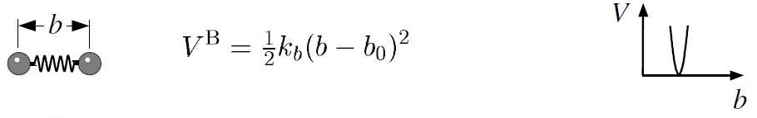
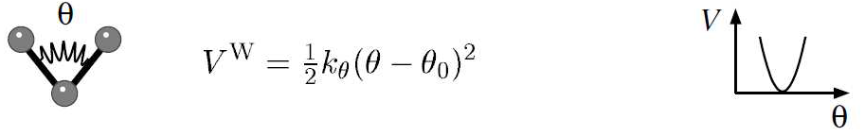
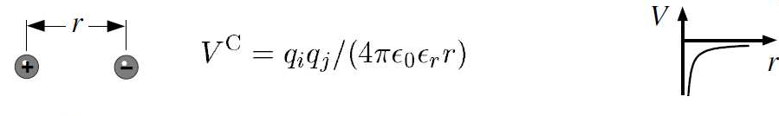
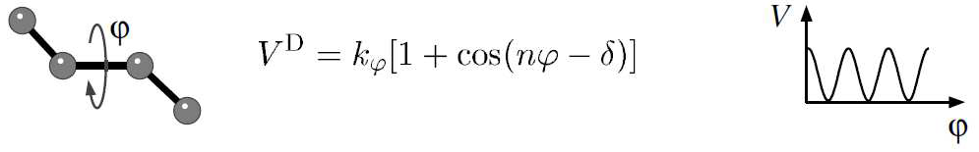
Introduction to GROMACS force fields
Molecule definition
Bonded parameters
[ ALA ]
[ atoms ]
N N -0.41570 1
H H 0.27190 2
CA CT 0.03370 3
HA H1 0.08230 4
CB CT -0.18250 5
HB1 HC 0.06030 6
HB2 HC 0.06030 7
HB3 HC 0.06030 8
C C 0.59730 9
O O -0.56790 10
[ bonds ]
N H
N CA
CA HA
CA CB
CA C
CB HB1
CB HB2
CB HB3
C O
-C N
[ impropers ]
-C CA N H
CA +N C O
[ bondtypes ]
; i j func b0 kb
C C 1 0.1525 259408.0 ; new99
C OS 1 0.1323 376560.0 ; new99
C H4 1 0.1080 307105.6 ; new99
[ angletypes ]
; i j k func th0 cth
HW OW HW 1 104.520 836.800 ; TIP3P water
HW HW OW 1 127.740 0.000 ;
C C O 1 120.000 669.440 ; new99
C C OH 1 120.000 669.440 ; new99
CT C CT 1 117.000 527.184 ; new99
[ dihedraltypes ]
;i j k l func
CT CT OS CT 9 0.0 1.60247 3 ;
CT CT OS CT 9 180.0 0.41840 2 ;
C N CT C 9 0.0 1.12968 2 ; new for 99sb
C N CT C 9 0.0 1.75728 3 ; new for 99sb

Slide 25
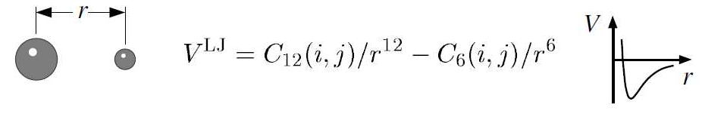
Introduction to GROMACS force fields
[ atomtypes ]
; name at.num mass charge ptype sigma epsilon
Br 35 79.90 0.0000 A 3.95559e-01 1.33888e+00 ; Converted from parm99.dat
C 6 12.01 0.0000 A 3.39967e-01 3.59824e-01
CA 6 12.01 0.0000 A 3.39967e-01 3.59824e-01
CB 6 12.01 0.0000 A 3.39967e-01 3.59824e-01
CC 6 12.01 0.0000 A 3.39967e-01 3.59824e-01
CK 6 12.01 0.0000 A 3.39967e-01 3.59824e-01
CM 6 12.01 0.0000 A 3.39967e-01 3.59824e-01
CN 6 12.01 0.0000 A 3.39967e-01 3.59824e-01
CQ 6 12.01 0.0000 A 3.39967e-01 3.59824e-01
CR 6 12.01 0.0000 A 3.39967e-01 3.59824e-01
CT 6 12.01 0.0000 A 3.39967e-01 4.57730e-01
CV 6 12.01 0.0000 A 3.39967e-01 3.59824e-01

Slide 26
Input parameters
Specifying the way the simulation would run and output data is descried by the input parameters

Slide 27
Introduction to GROMACS simulation parameters
define = -DPOSRES
;disre = simple
;disre_fc = 20
constraints = h-bonds
constraint-algorithm = Lincs
lincs-order = 6
integrator = md
dt = 0.004 ; ps !
comm_mode = Linear
nsteps = 2500000000;000000 ; total 10000 ps.
nstcomm = 1
nstxout = 100000
nstvout = 100000
nstfout = 0
nstxtcout = 5000
nstlog = 1000
nstenergy = 1000
nstlist = 5
ns_type = grid
rlist = 1
vdwtype = Cut-off
cutoff-scheme = Verlet
rvdw = 1
coulombtype = PME
fourierspacing = 0.12
pme_order = 4
rcoulomb = 1

Slide 28
Introduction to GROMACS simulation parameters
; Berendsen temperature coupling is on in two groups
Tcoupl = v-rescale
tau_t = 0.1 ; 0.5
tc-grps = System ; Protein SOL_NA+_CL-
ref_t = 300 ; 300
; Pressure coupling is not on
Pcoupl = c-rescale
pcoupltype = Isotropic
tau_p = 1
compressibility = 4.5e-5
ref_p = 1.0
; Generate velocites is on at 300 K.
gen_vel = yes
gen_temp = 300.0
gen_seed = -1

Slide 29
Introduction to GROMACS simulation parameters, energy minimization
define = -DFLEXIBLE
constraints = none
integrator = steep
nsteps = 100
;
; Energy minimizing stuff
;
emtol = 2000
emstep = 0.01
nstcomm = 1
ns_type = grid
rlist = 1
rcoulomb = 1.0
rvdw = 1.0
Tcoupl = no
Pcoupl = no
gen_vel = no

