Slide 1

What It Takes to Build a Production-Grade Risk Engine
Lakshmi Narayana Rasalay · Distinguished Engineer, Capital One
FINTECHDEVCON · TUESDAY 3:00 PM · TOWER D

Slide 2



About the Speaker
Role
Distinguished Engineer at Capital One — focused on application modernization and transformative platform engineering at enterprise fintech scale.
Expertise
AWS technologies, Artificial Intelligence, and scalable fintech architecture — building systems that process millions of transactions monthly with sub-second decisioning.
Lakshmi Narayana Rasalay
Distinguished Engineer, Capital One
This Talk
Hard lessons from designing and shipping a production-grade, multi-layer risk management engine — covering fraud detection, credit scoring, AML monitoring, and transactional risk in a single composable platform.

Slide 3

The Vision: A Modern In-House Risk Engine
Off-the-shelf risk tools work — until they don't. At scale, they become expensive black boxes. The alternative is a purpose-built, composable risk platform that gives you control, speed, and full transparency over every decision.
Full Ownership
Sub-Second Latency
No vendor lock-in — you control the model, the data, and the decision logic end-to-end.
Real-time decisioning across fraud detection, credit scoring, AML monitoring, and transactional risk.
Regulatory Transparency
Composable by Design
Explainable decisions across jurisdictions — not a black box. Audit-ready by design.
Each layer — data, rules, workflow, UI — independently deployable and upgradeable on its own cadence.
Three architectural pillars: Scalable modern architecture · Configuration-driven workflow & rules · Medallion data integration

Slide 4
Why Off-the-Shelf Risk Tools Break at Scale
The economics and operational realities of vendor risk platforms look manageable at low volume. The moment you hit the inflection point — when transaction volume, product complexity, and compliance burden all grow simultaneously — the cracks become craters.
1
Cost Explosion
Per-transaction pricing models become unsustainable as volume grows to millions of monthly transactions. What was a predictable line item becomes a budget crisis.
2
Inflexibility
Vendor update cycles lag behind your product roadmap. Customization is limited or expensive — you're adapting your risk strategy to the vendor's release schedule.
3
Opacity
Black-box models fail regulatory explainability requirements under FCRA, ECOA, and SR 11-7. You can't explain a decision you don't own.
4
Data Fragmentation
Off-the-shelf tools can't easily ingest your proprietary behavioral, transactional, and contextual signals — your competitive advantage stays siloed.
5
Integration Debt
Point-to-point integrations across fraud, credit, and AML systems create brittle, unmaintainable pipelines that break silently under load.

Slide 5
PILLAR 1 OF 3
Scalable, Forward-Looking Architecture
How to design a risk platform that scales independently, fails gracefully, and ships continuously — without becoming a distributed monolith.
1
2
Micro Frontends
Microservices
Independent UI modules per risk domain
Bounded-context services per risk function
3
4
Event-Driven Architecture
Modern Search
Async event streams decoupling producers from consumers
Sub-100ms entity resolution across billions of records

Slide 6
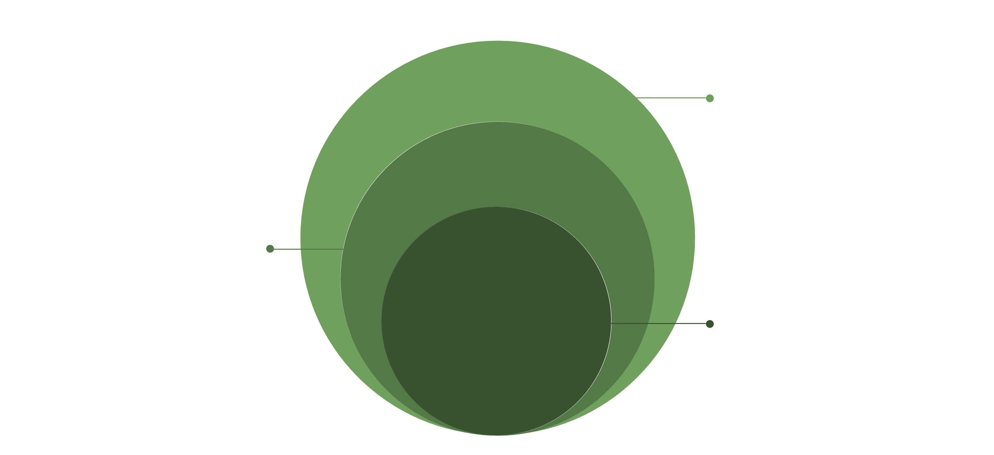
Architecture Blueprint: Four Layers of Scalability
Microservices Layer
Fraud scoring, rule eval, case mgmt, reporting
Event Bus
Kafka/Kinesis async event streams
Core: Modern Search
Elasticsearch/OpenSearch sub-100ms entity resolution
Micro Frontends
Microservices
Event-Driven Bus
Modern Search
Independent UI modules per risk domain — fraud dashboard, AML console, credit review. Teams deploy without coordination overhead using Module Federation.
Bounded-context services for each risk function — fraud scoring, rule evaluation, case management, reporting — each with its own data store and deployment lifecycle.
Async event streams (Kafka/Kinesis) decouple producers from consumers. Risk signals flow in real time without tight coupling between systems.
Elasticsearch / OpenSearch for sub-100ms entity resolution, transaction lookup, and investigator search across billions of records.

Slide 7
Micro Frontends: Decoupling the Risk UI
The Problem Solved
Operational Benefits
Monolithic risk UIs become bottlenecks — a change to the fraud dashboard blocks the AML team's release cycle. Independent deployment is the only path to team autonomy at scale.
Independent Cadences
Fraud, credit, and AML teams ship on their own schedules — no release train coordination required.
Pattern & Implementation
Module Federation (Webpack 5) or single-spa — each risk domain owns its UI bundle, deployed independently. The host application provides auth, navigation, and a shared design system. Domain teams own all feature logic.
Isolated Failures
Per-module error boundaries and performance budgets — failures are contained, not cascading across domains.
Key Tradeoff to Manage
Shared state management (Redux/Zustand) must be carefully scoped to avoid cross-module coupling. Poorly scoped shared state recreates the monolith problem in a distributed wrapper.
Observability
Per-module performance monitoring enables pinpoint diagnostics without cross-team noise.

Slide 8





Microservices: Bounded Contexts for Risk Domains
The core discipline is domain decomposition — every risk function gets its own service, its own data store, and its own deployment pipeline. This is what makes independent scaling possible.
Fraud Scoring
Rule Evaluation
Case Management
Real-time ML scoring with sub-200ms SLA. Scales horizontally during transaction spikes.
Stateless engine evaluating policy rules against enriched transaction context.
Stateful workflow service for investigator queues, escalations, and resolutions.
Alert Routing
Reporting
Priority-based routing of risk alerts to the appropriate team or automated handler.
Batch-optimized analytics service — scales for regulatory reporting without impacting transactional services.
Resilience Patterns
Deployment
Lesson Learned
Circuit breakers, bulkheads, and retry policies ensure a slow fraud model doesn't cascade into payment failures. Each service degrades gracefully in isolation.
Containerized (Docker/Kubernetes) with per-service CI/CD pipelines. Blue/green deployments enable zero-downtime rule updates during peak transaction periods.
Start with 5–7 well-defined services. Premature decomposition creates distributed monolith anti-patterns — the worst of both worlds.

Slide 9
Event-Driven Architecture: Real-Time Risk Signals
Core Pattern
<200ms
Every transaction, user action, and risk decision emits an event. Downstream consumers — fraud, AML, credit — react asynchronously without tight coupling to the source system. The event log becomes the system of record.
End-to-End Latency
Technology Stack
Transaction ingestion to risk score emission target
Apache Kafka for high-throughput event streaming. Kafka Streams or Apache Flink for stateful real-time processing — windowed aggregations, pattern detection, and session stitching at scale.
Schema Registry: Non-Negotiable
Confluent Schema Registry or AWS Glue must govern every topic. Schema drift breaks downstream consumers silently — by the time you detect it, stale data has already influenced decisions.
Event Sourcing & CQRS
Full audit trail of every risk decision — events can be replayed to reprocess historical transactions with updated models. Command (write) and Query (read) paths are separated: risk decisions write to the event log; dashboards read from materialized views.
Operational Consideration
Partition strategy directly impacts latency. Key by customer ID, not transaction ID, to preserve ordering guarantees for fraud pattern detection.

Slide 10


Modern Search: Sub-Second Entity Resolution at Scale
Investigators need to search billions of transactions, entities, and alerts in real time. SQL queries on OLTP databases don't scale to this use case — the risk platform requires a purpose-built search layer.
Core Technology
Graph-Enhanced Search
Semantic Search
OpenSearch / Elasticsearch with custom analyzers for financial entity matching — fuzzy name matching, address normalization, and account linkage across all ingested records.
Neo4j or Amazon Neptune for relationship traversal — "show all accounts linked to this device fingerprint within 30 days." Critical for network fraud and synthetic identity detection.
Vector embeddings (BERT-based) for narrative transaction description matching — catches fraud patterns that keyword search misses by understanding meaning, not just terms.
Performance Target
Compliance Value
p99 query latency under 100ms across 10B+ indexed documents — achieved through proper shard strategy, index lifecycle management, and replica configuration tuned for read-heavy workloads.
Full-text search across SAR narratives and case notes accelerates regulatory reporting by 60–70% — auditors get self-service access instead of waiting on analyst data pulls.

Slide 11
PILLAR 2 OF 3
Configuration-Driven Workflow & Rules Engine
Risk logic trapped in code is a liability — it moves at engineering speed in a domain that must move at business speed. The solution is externalizing every rule, threshold, and workflow into configuration that business and compliance teams own directly.
1
2
Rules Engine
Workflow Management
DSL-driven rule authoring, versioning, and hot reload
Configurable state machines for KYC, SAR, disputes
3
4
Governance & Auditability
Maintainability
Four-eyes approval, full decision history, conflict detection
Testing frameworks, SLA guardrails, deprecation workflows

Slide 12

The Problem: Risk Logic Trapped in Code
Status Quo Pain
The Solution
Every rule change — a new fraud threshold, a new AML typology, a new credit policy — requires a developer, a pull request, a review cycle, and a deployment pipeline. This creates three compounding problems that are individually manageable but collectively catastrophic at scale.
Externalize all risk logic into a configuration-driven rules engine. Business analysts and compliance officers change rules without touching code — and every change is versioned, tested, and approved through a governance workflow before it reaches production.
Who Changes What
Time-to-Change
A typical hardcoded rule update takes 2–4 weeks from development to production. Fraud patterns evolve in hours.
Actor
Action
Compliance Officer
Edits rule thresholds
Risk Analyst
Creates AML typologies
Compliance Risk
Credit Team
Updates policy logic
Regulatory changes (FinCEN guidance, CFPB rules) require immediate policy updates — code-driven systems structurally cannot respond fast enough.
Engineer
Maintains engine runtime only
Auditability Gap
When rules live in code, auditors cannot easily inspect what logic was active at a given decision point in time. Version control is not a compliance audit trail.

Slide 13

Configuration-Driven Rules Engine: Architecture
Author Rules
Version Control
Config Store
Rules Engine
Rule DSL
Rule Versioning
Hot Reload
YAML/JSON-based or visual rule builder. Conditions, thresholds, and actions expressed without code — accessible to compliance and business teams.
Every change is versioned and timestamped. Full history of what rule was active at any transaction decision point — essential for regulatory review.
Rules updated in DynamoDB, Redis, or Consul are picked up by the engine without service restart — zero-downtime policy updates.
A/B Testing
Governance
Shadow mode — run new rules in parallel with existing rules, compare outcomes before promoting to production. Evidence-based policy decisions.
Four-eyes approval workflow for rule changes — mandatory compliance sign-off before any rule goes live. No unilateral production changes.
Rule chaining example: if fraud_score > 0.8 AND account_age < 30d AND txn_country ≠ home_country → BLOCK — expressed declaratively, not in application code.

Slide 14
Workflow Management: Making Risk Processes Configurable
Workflow Engine
Dynamic Routing Rules
Temporal.io or Apache Airflow for orchestrating multi-step risk workflows — KYC onboarding, SAR filing, dispute resolution. Each workflow step is configurable without code changes, allowing compliance teams to adapt process logic as regulations evolve.
Case assignment is fully configurable — route high-value fraud cases to senior analysts, low-risk alerts to automated resolution queues. Routing logic updated by risk operations without engineering involvement.
State Machine Approach
Integration Hooks
Each risk case is modeled as a state machine — PENDING → UNDER_REVIEW → ESCALATED → RESOLVED. Transitions are driven by configurable rules, not hardcoded conditional logic. New states and transitions are added through configuration, not deployments.
Configurable webhooks and event triggers connect to Salesforce, Jira, or internal ticketing systems without code changes — the workflow engine acts as the integration orchestrator.
SLA Management
Hours
Configurable SLA timers per workflow type enforce regulatory deadlines automatically. SAR 30-day filing requirements trigger escalation alerts when cases approach the deadline — no manual tracking required.
vs. 3–4 Weeks
Time to deploy a risk policy change after adopting configuration-driven workflows

Slide 15





Maintainability: Keeping the Rules Engine Production-Ready
A rules engine that business teams can use freely is only an asset if it's also reliable and observable. Without engineering guardrails, a powerful authoring interface becomes a production incident waiting to happen.
Rule Testing Framework
Conflict Detection
Unit tests for individual rules, integration tests for rule chains. Automated test suite runs on every rule change before promotion — compliance teams get immediate feedback on logic errors before they reach staging.
Engine detects overlapping or contradictory rules at authoring time — prevents silent logic errors in production where two rules fire on the same transaction and produce contradictory outcomes.
Performance Guardrails
Full Observability
Rule evaluation SLA enforced at 50ms per rule. Rules that exceed the threshold are flagged at authoring time and must be optimized before promotion — prevents slow rules from impacting transaction throughput.
Every rule evaluation logged with input features, matched conditions, and output decision — complete explainability for regulatory review. Auditors can reconstruct exactly why any transaction received any decision.
Lesson learned: Invest in the rule authoring UX early. If compliance teams find the interface hard to use, they route around it — and rules end up back in code.

Slide 16



PILLAR 3 OF 3
Medallion Architecture for Real-Time Data Integration
A risk engine is only as good as the data feeding it. Fragmented, stale, or poorly governed data pipelines undermine every model and every rule — no matter how sophisticated the decisioning layer above them.
Bronze Layer
Silver Layer
Gold Layer
Raw ingestion — all source data lands as-is, full fidelity preserved
Cleansed & conformed — unified entity model across all sources
Business-ready — aggregated features, pre-computed scores, regulatory datasets

Slide 17
The Data Problem: Disparate Sources, Fragmented Risk View
Reality at Scale
Consequences
Risk data lives in 10+ systems — core banking, payment processors, KYC vendors, credit bureaus, device intelligence, behavioral analytics, and sanctions lists. Each system has its own schema, latency profile, and quality characteristics. No single system has a complete view of risk.
Missed Fraud
Reporting Impossible
Patterns that emerge between batch windows go undetected until the next run — sometimes T+24h or more after the event.
Cross-domain analysis ("fraud rate by customer segment by product") requires manual data wrangling — analysts spend more time joining data than finding insight.
Point-to-Point Integration Debt
Each new data source requires a custom ETL pipeline — brittle, hard to monitor, expensive to maintain. When a source schema changes (and it always does), downstream pipelines break silently. Data quality issues surface as model degradation weeks after the root cause.
The Latency Problem
Compliance Gaps
Batch ETL jobs mean risk decisions are made on data that's hours or days old. A fraud pattern emerging in real time is invisible to a system looking at last night's data. The detection window is the fraud window.
Regulatory reports built from fragmented sources contain inconsistencies that create examination risk during audits.

Slide 18
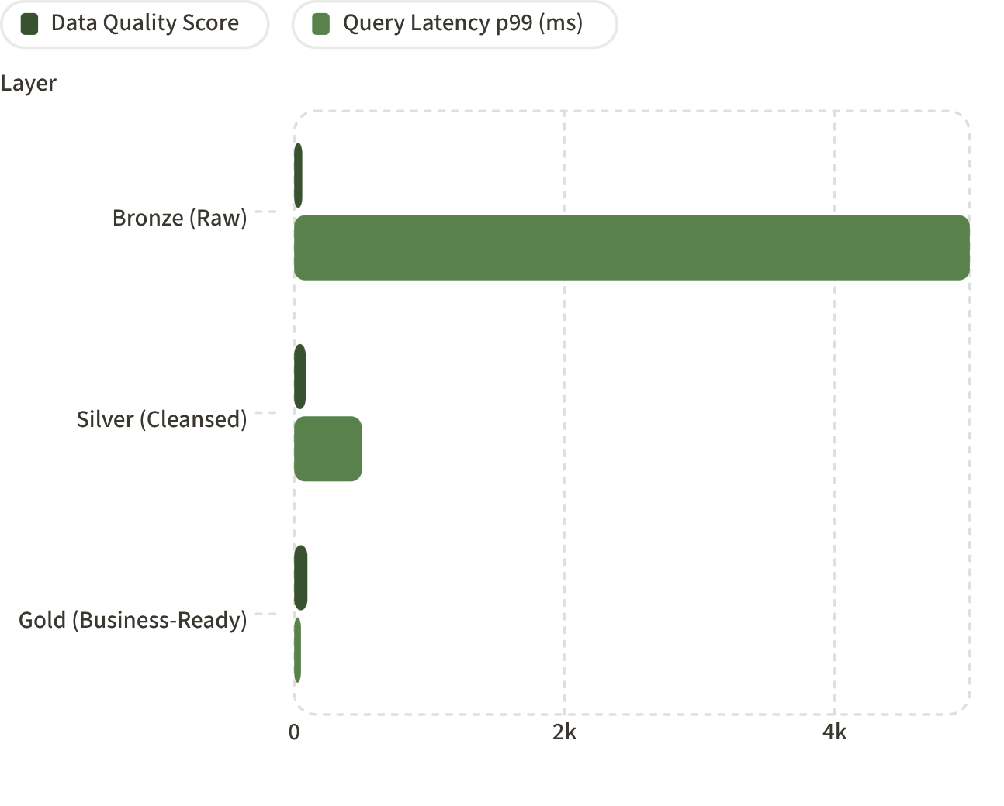
Medallion Architecture: Bronze → Silver → Gold
1
2
3
1
Bronze — Raw Ingestion
All source data lands as-is — Kafka topics per source system, no transformation, full fidelity preserved. Schema-on-read via Delta Lake or Apache Iceberg. Nothing is discarded — the bronze layer is the immutable record of truth.
2
Silver — Cleansed & Conformed
Deduplication, normalization, entity resolution. A unified customer/account/transaction entity model across all source systems. Flink or Spark Streaming transforms bronze events in near real-time (<5 min latency).
Data quality score (0–100) and p99 query latency (ms) improve dramatically across layers. Gold achieves 98/100 quality and 50ms p99 — suitable for real-time decisioning.
3
Gold — Business-Ready
Aggregated risk features, pre-computed scores, regulatory reporting datasets. Optimized for sub-second query by the rules engine, dashboards, and regulatory reporting workflows. dbt manages Silver-to-Gold transformations declaratively.

Slide 19

Centralizing Disparate Data Sources: Integration Patterns
The Medallion architecture is only as strong as the ingestion patterns feeding the Bronze layer. Each source system type requires a different integration strategy — the wrong pattern introduces latency, data loss, or silent failures.
CDC — Change Data Capture
Debezium captures row-level changes from core banking systems (Oracle, Postgres) and streams directly to Kafka — no polling, no batch windows. Every committed transaction appears in the Bronze layer within seconds of write.
API-Based Ingestion
KYC vendors, credit bureaus, and sanctions lists — event-driven pull via webhooks or scheduled micro-batch with idempotent writes. Deduplication at the Bronze layer prevents double-counting on retry.
Behavioral & Device Data
Clickstream and device signals ingested via Kinesis Data Firehose → Bronze layer, then enriched in Silver with session context — giving the fraud model behavioral signals at the moment of transaction.
External Threat Feeds
OFAC, FinCEN, industry fraud consortia — ingested as versioned reference data and joined at the Gold layer for real-time sanctions screening. Reference data versioning enables point-in-time compliance audits.
Data Contracts
Each source system publishes a schema contract. Breaking changes trigger automated alerts before they reach production pipelines — eliminating the silent schema drift that causes data quality incidents.
Outcome: Single unified risk data platform replaces 10+ point-to-point integrations — new data source onboarding reduced from 6 weeks to 3 days.

Slide 20
Real-Time Reporting: From Hours to Seconds
Before: Batch Reporting
Measured Business Impact
Risk reporting ran overnight batch jobs — fraud rates, AML alert volumes, and credit performance metrics available next morning at best. Risk operations teams were making decisions with yesterday's data. Regulatory reports required multi-day manual extraction and reconciliation across fragmented systems.
T+3min
4hrs
Fraud Detection Window
Regulatory Report Generation
Reduced from T+24h — a 480x improvement in detection speed
After: Live Gold Layer Dashboards
Reduced from 3 days — BSA/AML, CCAR, DFAST on-demand
Gold layer materialized views power live dashboards — metrics refresh every 60 seconds, regulatory reports generated on-demand. Risk ops teams see the same data the engine sees, at the same time it sees it. The information asymmetry between the system and its operators is eliminated.
60s
Technology
Dashboard Refresh Cadence
Apache Pinot or ClickHouse for OLAP queries on streaming data — sub-second aggregations across billions of transactions. Pre-built Gold layer datasets for BSA/AML, CCAR, and DFAST reporting enable auditor self-service without manual data extraction.
Live operational metrics for fraud rate, AML queue depth, credit throughput

Slide 21
Putting It All Together: The Integrated Risk Platform
Microservices & UI
Services, event bus, and micro frontends
Rules & Workflow
Decision logic and orchestrated pipelines
Medallion Data
Bronze/Silver/Gold central risk data
Data Layer — Medallion
Decision Layer — Rules Engine
All risk signals centralized, cleansed, and available in near real-time. The single source of truth for every risk decision across fraud, credit, and AML.
Configuration-driven rules consume Gold layer features. Business teams change policy without engineering involvement — hours, not weeks.
Execution Layer — Microservices + Events
Experience Layer — Micro Frontends
Bounded-context services process decisions asynchronously. Scalable, resilient, independently deployable — each domain fails and scales in isolation.
Domain-specific UIs for fraud analysts, AML investigators, and credit reviewers. Each team ships independently on their own cadence.
Cross-cutting concerns baked into every layer: Observability (OpenTelemetry) · Security (zero-trust, field-level encryption) · Compliance (full audit trail, explainability, point-in-time replay)

