Slide 1
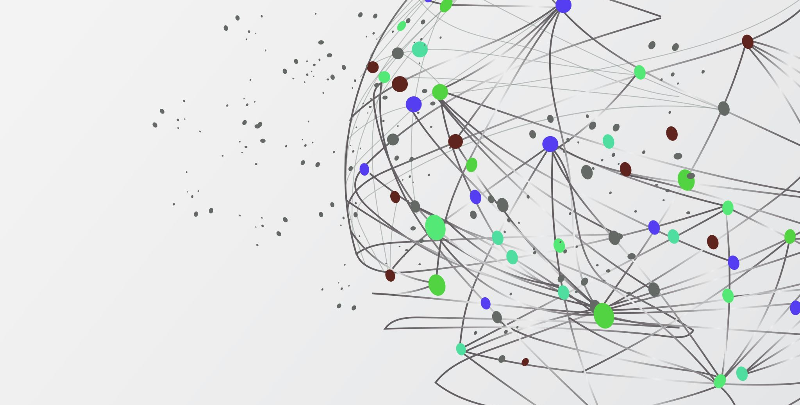
Chasing Shadows: Finding Class 1 Sites for Weather Sensors Using Hillshade
Lucas Rosen
GIS 5572

Slide 2
Overview
Introduction
Setup
Methods and Flowchart
Arc Pro
Earthpy
Results

Slide 3
Introduction
Weather Stations are useful for many applications in agriculture including finding evapotranspiration and growing degree days
Accuracy of weather stations rely on many factors including Slope, distance from buildings/water, and shading
World Meteorological Organization defines a Class 1 (best) placement for air temperature and humidity sensors as “away from all projected shade when the sun is higher than 5°”
Many urban and photovoltaic studies use hours of sun to get total radiation, but few look at specific altitudes.

Slide 4
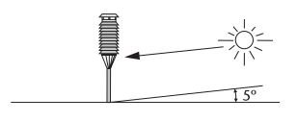
Goal
Use Hillshade Analysis to find Class 1 suitable areas for placement of air temperature and humidity sensors

Slide 5
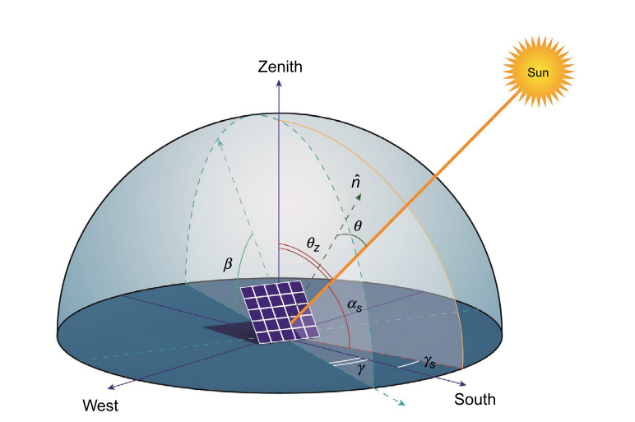
Setup: What is needed for a Hillshade
Elevation Data (DSM or DEM)
Zenith (altitude) which is 5°
Azimuth (direction) which varies based on location, date, and time

Slide 6
Setup: What is needed for a Hillshade
The sun as at 5 degrees twice a day (morning and evening)
Just need to know two dates:
Winter Solstice
Summer Solstice

Slide 7
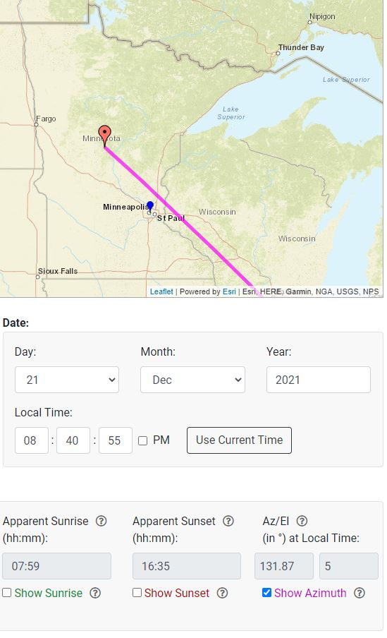
How to find Azimuth
NOAA’s Sun Calculator was used to find the Azimuth for:
Winter Solstice Morning : 131.87°
Winter Solstice Evening: 228.11°
Summer Solstice Morning: 60.66°
Summer Solstice Evening: 299.33°

Slide 8
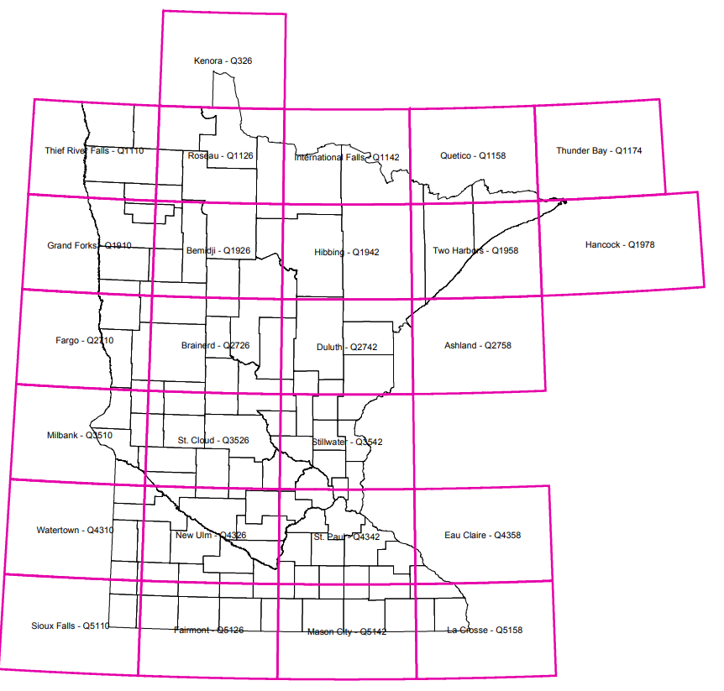
Data
DSM Data From Data Repository of University of Minnesota
Resolution: 1 meter
Year Collected: 2011
Projection: NAD 1983 UTM 15*

Slide 9
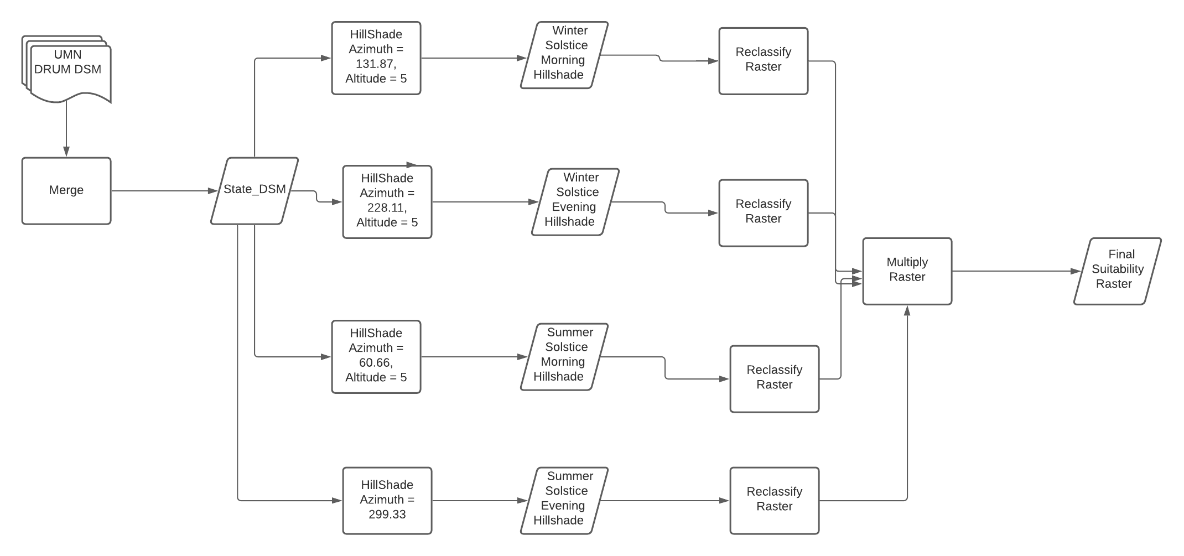
Flow Chart

Slide 10
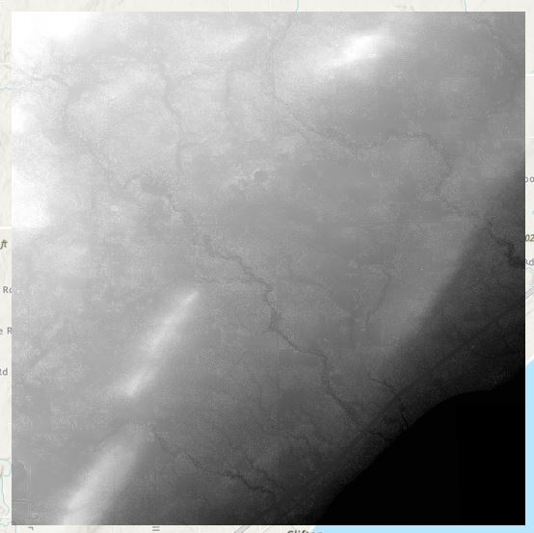
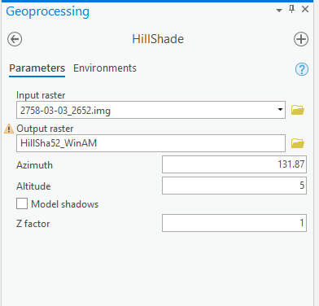
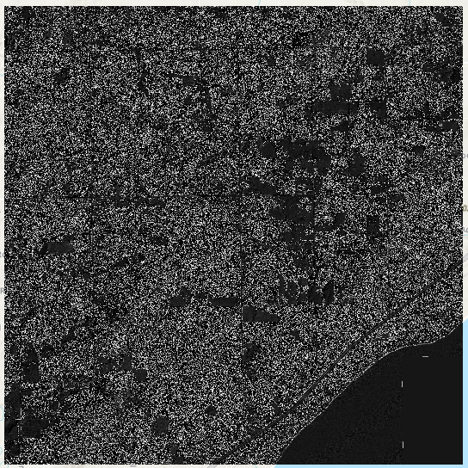
Methods: Arc Pro
DSM was put on the Map and Hillshade was used four times: Once for each date/time

Slide 11
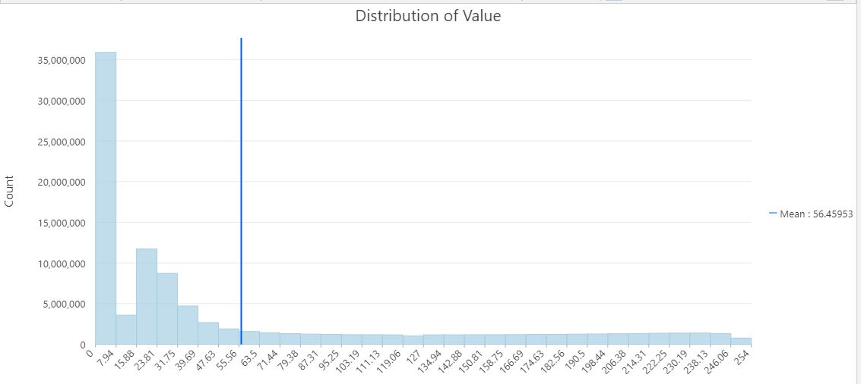
Methods Arc Pro
Histogram and Arc Pro Documentation Show that shadows are a Hillshade value of 0

Slide 12
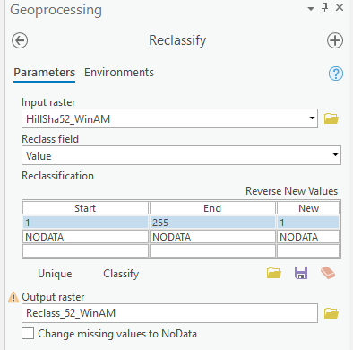
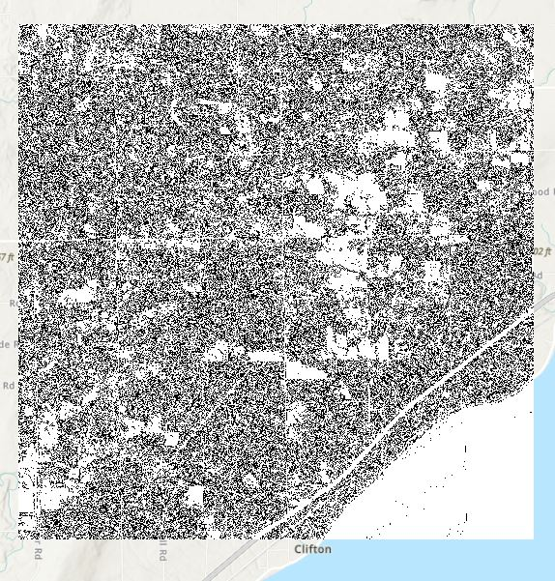
Methods: Arc Pro
Values Greater than 0 were reclassified as 1

Slide 13
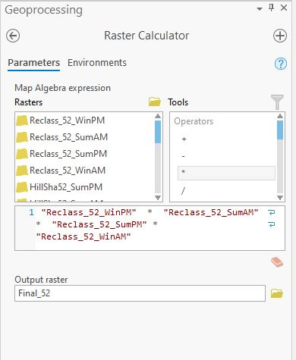
Methods: Arc Pro
All 4 Rasters were multiplied:
Values of 1 are Class 1 Suitable
Values of 0 have shadows at some point.

Slide 14
Methods: Earthpy
Earthpy.Spatial has Hillshade function that works similar to Arc Pro…
But there is a noticeable difference

Slide 15
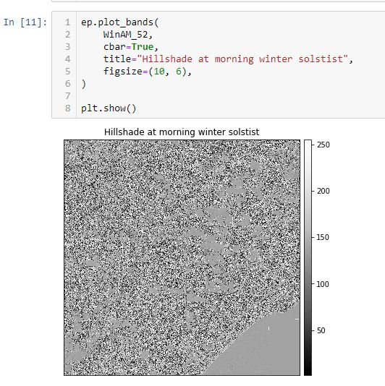
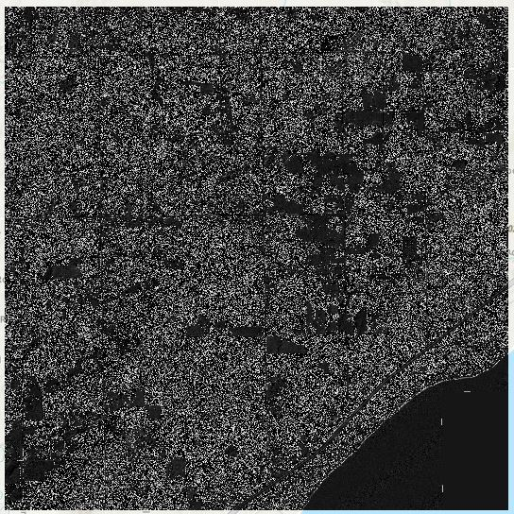
Methods: Earthpy
Output looks similar but the values are different (Left: Earthpy Right: Arc Pro)

Slide 16
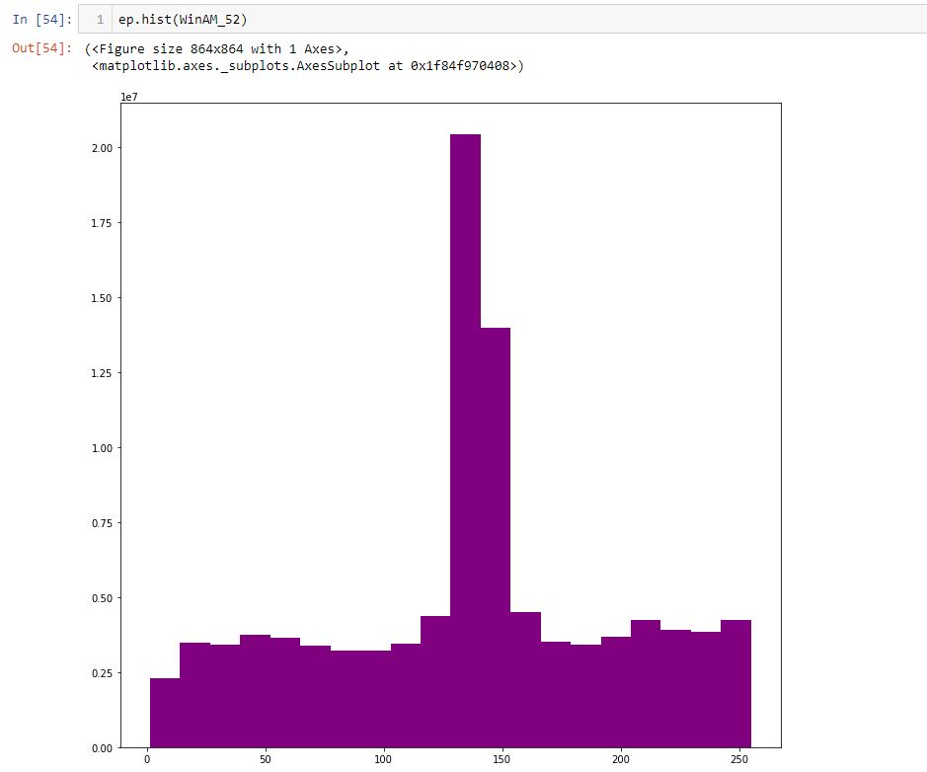
Methods: Earthpy
Comparing Histograms shows the values are different (Left: Earthpy Right: Arc Pro)

Slide 17
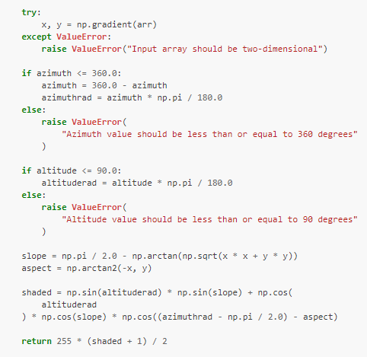
Methods: EarthPy
Looking at Earthpy’s source code led to the answer:
Shaded values are between -1 and 1 with anything less than or equal to 0 in shadow
Values + 1 are multiplied by 255 (8-bit) and divided by 2
Plug in 0 for shaded and all shadows are less than or equal to 127.5

Slide 18
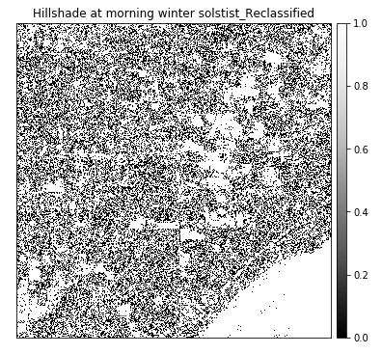

Methods: EartyPy
Once shadows were figured out, Reclassification and Multiplication worked the same way:

Slide 19
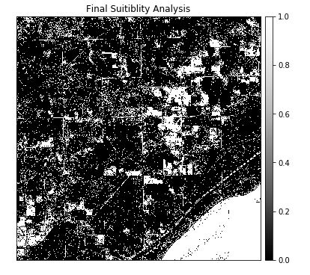
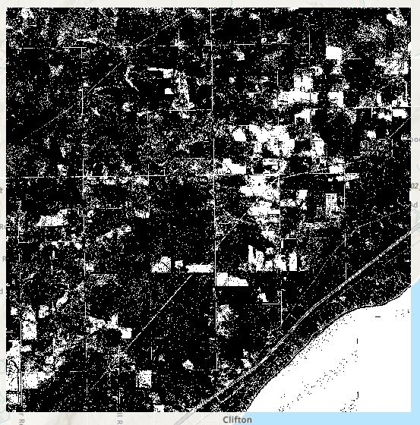
Results
White areas on the map show suitable areas for weather sensors (Left: Earthpy Right Arc Pro)

Slide 20
Results
Both are similar: slight differences could be due to significant figures used in calculations (Left: Earthpy Right Arc Pro)

Slide 21
Discussion
Earthpy is needed to do Hillshade on a larger scale because Arc Pro is not supported in MSI
Things to consider (errors):
Data is from 2011 (needs to be updated)
Azimuth was determined by the Minnesota Centroid
Place | Lat | Long | Winter AM | Winter PM | Summer AM | Summer PM
Cetroid | 46.39241 | -94.63623 | 131.87 | 228.11 | 60.66 | 299.33
Bottom | 43.452918 | -93.691406 | 129.05 | 230.95 | 61.98 | 298.01
Top | 48.632908 | -93.823242 | 134.44 | 225.57 | 59.48 | 300.52

Slide 22
Conclusion
Both Arc Pro and Earthpy can use hillshade to produce similar suitability maps
Earthpy could be used with MSI
Need to consider assumptions made in data and analysis

Slide 23
References
Fleming, D., Grimes, A., Lebreton, L., Maré, D., & Nunns, P. (2018). Valuing sunshine. Regional Science and Urban Economics, 68(November 2017), 268–276. https://doi.org/10.1016/j.regsciurbeco.2017.11.008
Joint, J. R. C. (2018). Photovoltaic Electricity. In Submerged and Floating Photovoltaic Systems (pp. 13–32). https://doi.org/10.1016/B978-0-12-812149-8.00002-8
Porter, D., Gowda, P., Marek, T., Howell, T., Moorhead, J., & Irmak, S. (2012). SENSITIVITY OF GRASS- AND ALFALFA-REFERENCE EVAPOTRANSPIRATION TO WEATHER STATION SENSOR ACCURACY. Applied Engineering in Agriculture, 28(4), 543–549.
World Meteorological Organization. (2018). Guide to Meteorological Instruments and Methods of Observation: Part I - MeasureMent of MeteorologIcal VarIaBles. In Quality Assurance. Retrieved from www.wm

