Slide 1
Organization of Data bases semester 4
Notes:
Оригинальные шаблоны для презентаций: https://presentation-creation.ru/powerpoint-templates.html
Бесплатно и без регистрации.

Slide 2
Lecture 1

Slide 3
Teacher:
Lyudmila Viktorovna Rozova
phd, associate professor
room #13
email: lyudmyla.rozova@khpi.edu.ua

Slide 4
Literature

Slide 5
Plan
1
Introduction to Databases
2
Data model
3
Stages of Database Designing
4
Subject Area and its Model
5
The Model of Subject Area “Organization”

Slide 6

Introduction to the database
At present time, the successful work of various firms, organizations and enterprises is simply not possible without a developed information system that allows automate data collection and processing.
For convenient work with data, they need to be structured, or presented in a certain way.
Typically, a database is created to store and access data containing information about a certain subject area.
Database (DB) is a collection of information about specific objects of the real world in any subject area. It reflects the state of objects and their relationships.
As for subject area, it is usually presented as a certain area of human activity or an area of the real world, subject to study for it management and automation, for example, an enterprise, a university, etc.
Historically, people collected various information from different subject areas, tried to systematize it in the form of tables, relationships between them. In real life, DB systems are mainly used to store information.

Slide 7
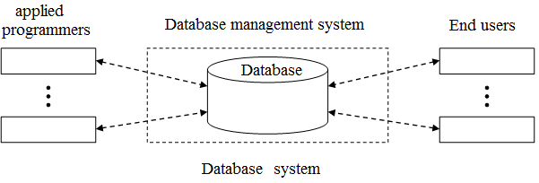
Database system (DBS)
Database system (DBS) is a computerized structured data storage system, the main purpose of which is to store information and provide it on request.
The database system includes:
Data, stored in the database;
hardware;
software;
users:
applied programmers;
database administrators.
end users;

Slide 8
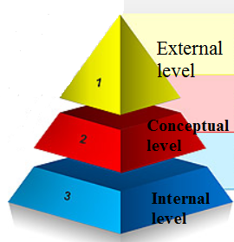
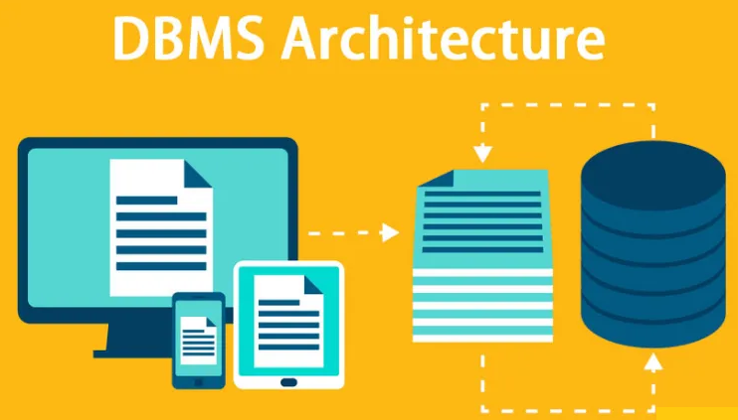
Database designing
The three-tiered database organization system proposed by the American National Standards Institute (ANSI) is most used for database designing:
1 level: External level - presentation of the database from the point of view of users.
This level describes the part of the database through which the user interacts with it. The external layer is made up of several different external views of the database.
it is a collection of external data representations and how the user sees them on the screen. It can be a table with sorted data, with a filter applied, a form, a report, or a query result.
External data representations are interconnected, so it can be obtained one from another.

Slide 9
2d level - Conceptual level - a generalized representation of the database.
This level describes what data is stored in the database (tables, their fields, properties, as well as the relationships that exist between them).
At the conceptual level, the following components are presented:
all entities, their attributes and relationships;
information about data; •
data constraints; •
information on security measures •
maintaining data integrity.
3d - Internal level - the physical representation of the database. Data located on external disks, Access to data through working with files.
This architecture allows to provide logical (between levels 1 and 2) and physical (between levels 2 and 3) data independence.
Logical independence implies the ability to change one application (program) without changing other applications (programs) that work with the same database.
Physical independence implies the ability to transfer stored information from one disk to another, maintaining working capacity of all applications (programs), which connected with this database.

Slide 10
The data in the database is integrated and public.
Integrated - means that data can be presented as a union of several, may be overlapped, separate data files.
For example, there is a file containing data about students - last name, first name, date of birth, address, etc., and another - about the sports section. The necessary data about students attending the section can be obtained by referring to the first file.
Public means that separate data areas can be used by different users, so each of these users can access the same data area, even at the same time.
For example, the same database data about students can be used simultaneously by some department and by dean's office.)
Hardware includes:
• Storage devices for storing information together with connected devices, channels, etc.
• The processor (or processors) together with the main memory that is used to support the operation of the software system. The software layer is between the data and users. Its core is the database management system (DBMS), or database manager.

Slide 11

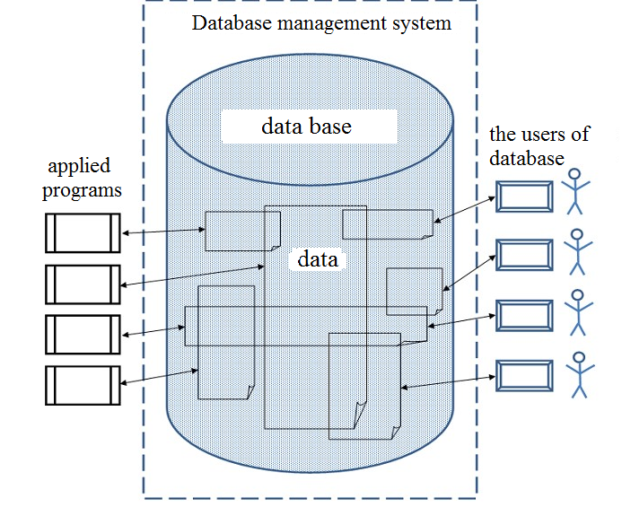
Database management system (DBMS) - a set of language and software tools, designed to create, fill, update and delete databases.
The main function of the DBMS is to provide the database user with the ability to work with it without going into details at the hardware level.
Those. all user access to the database, adding and removing data, selections, updating data - all this actions are provided by the DBMS.
In other words, the DBMS supports high-level user operations. Users work with the database by the use of special applications (applications)

Slide 12
Data model
The core of any database is the data model.
Data model (MD) is an integrated set of concepts for describing and processing data, the relationships between them and the data constraints.
The model is a representation of objects and events of the "real world", as well as the connections existing between them. A data model is some kind of abstraction that, can be applied to specific data, allows users and developers to interpret it as information, contained not only data, but also the relationship between them. It focuses on the most important and necessary aspects, and ignores all the secondary properties.
Data models are divided on three categories:
• object-based DM,
• based on records (record-based)
• physical DM.
The first two are used to describe data at the conceptual and external levels, and the last one at the internal level.

Slide 13
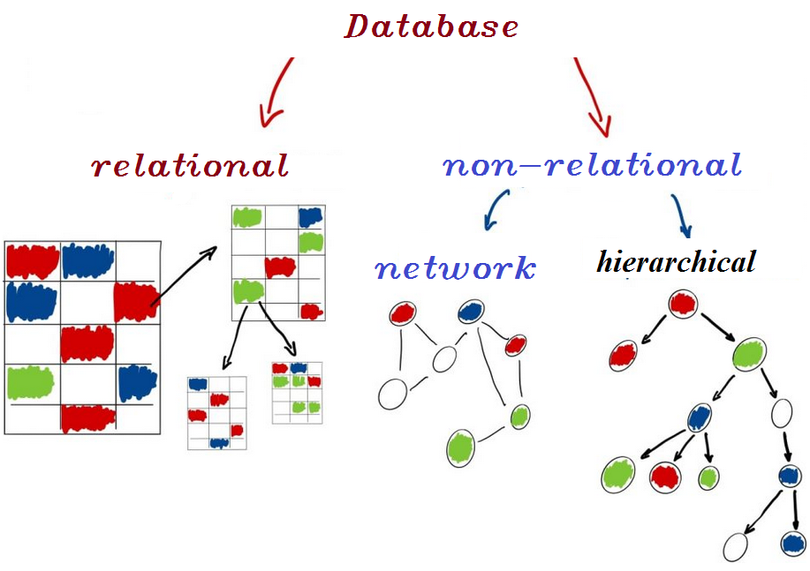
Record-based logical data models include:
1) The relational data model is based on the concept of mathematical relations.
The relational database gets its name from the English term relation. It was proposed in the 70th year by an employee of IBM Edgar Codd.
A relational database is a collection of tables connected by relationships.
The advantages of the relational data model are simplicity and flexibility of the structure. Besides, it is convenient to implement it on a computer. Most modern databases for personal computers are relational.
2) The network data model. The data is organized as a graph. The disadvantage of the network structure is the rigidity of the structure and the complexity of its organization.
3) The Hierarchical data model. Here the data is presented as a tree structure. Such database structure is convenient for working with hierarchically ordered data. When operating on data with complex logical connections, the hierarchical model turns out to be too complex.

Slide 14
Object models include:
Model of the "entity-relationship" type, or ER-model (Entity-Relationship model);
Semantic model;
Functional model;
Object-oriented model. Combine network and relational models and are used to create large databases with complex data structures.
Physical data models describe how data is stored in a computer, providing information about the records, their order, and existing access paths.
Physical data models include:
1) Generalizing model (unifying model);
2) Frame memory model.

Slide 15
STAGES OF DATABAS DESIGNING
The purpose of any database is to store and use information about any subject area.
The several levels of modeling (stages of database designing) are usually distinguished, They help to make a transition from the subject area to a specific implementation of the database by means of a specific DBMS.
The following stages of database designing can be presented
1) The subject area is a part of the real world, the data about which we want to reflect in the database (for example, department, bank, store, etc.);
2) The model subject area - is knowledge about subject are, which can be either in the form of informal knowledge in the expert's brain, or expressed formally using any subject are (for example, text descriptions of the subject area, sets of job descriptions, etc.);
3) The logical data model describes the concepts of software, their relationship, as well as the data constraints by the subject area.
For example, the concepts - "employee", "department", "project", the relationship between the concepts - "an employee can work in one department", "several employees can work on one project", restrictions - "the employee's age is not less than 16 and not more 60 years".

Slide 16
The logical data model is the initial prototype of the future database and is built in terms of information units, but without reference to a specific DBMS.
In this case, the use of relational DBMS is assumed, and therefore the logical data model will be formulated in terms of the relational data model. The criteria for assessing the quality of the logical data model should also be taken into account:
the adequacy of database of the subject area,
the easiness of designing and maintenance of database,
the speed of operations for data performing and updating (inserting, updating, deleting tuples),
the speed of operations for data selecting.
4) The physical data model describes the data by means of a specific DBMS;
5) The database, based on a specific hardware and software and their applications.

Slide 17
SUBJECT AREA AND ITS MODEL Building the model of subject area.
The subject area is infinite and contains important concepts and data, and not important no data.
Determination of data importance that will be used in the developed database depends on the choice of subject area.
It can be made at the stage of building the model.
There are a large number of techniques for describing of subject area.
The most famous of them are: the SADT structural analysis technique, Heine-Sarson data flow diagrams, the UML object-oriented analysis technique.

Slide 18
At the initial stage of database building, preliminary actions are:
1) Planning of database designing, an effective way to implement the stages of the database life cycle;
2) Determination of system requirements, determination of the range of actions and boundaries of the database application, its users and areas of application;
3) Collection and analysis of user requirements, of user views on subject area, the creation of requirements for each user view and the overall user view.
The users views are the definition of the requirements for a database application by specific user category (for example, a manager or salesperson, if the subject area is a store) or other needs (for example, the needs of othet department).
The collection and analysis of user requirements about subject area. This information is used to determine user requirements for the developed database. Requirements collection and analysis is the preliminary stage of database conceptual design, during which the user requirements specifications are analyzed in order to find out all the necessary information.

Slide 19
Typical Example. The Model of Subject Area "ORGANIZATION"
Let’s consider as a subject area for certain firm carrying out some projects.
Model of the subject area "ORGANIZATION" (described by simple text that contains information about the subject area):
1) Employees of the organization carry out projects;
2) Projects consist of several tasks;
3) Each employee can participate in one or several projects, or temporarily not participate in any projects;
4) Several employees can work on each project or the project can be temporarily suspended, then no employee is working on it;
5) Exactly one employee works on each task in the project.
6) Each employee is attached to one department;
7) Each employee has a phone number located in the employee's department.

Slide 20
Additional information (determine what data should be stored and what facts should be considered when creating a model):
1) For each employee, it is necessary to store the surname and personnel number, which is unique for each employee.
2) Each department has a unique number;
3) Each project has a number and name. The project number is unique;
4) Each work in project has a number that is unique within the project. Works in different projects can have the same numbers.
The state of the subject area (information about the current state of the subject area, which may change over time):
1) Employee Jackson, working in department 1, performs task 1 in the project "Project A" and task 1 in the second project "Project B".
2) Employee Richardson, working in department 2, performs task 3 in the first project " Project A " and task 2 in the second project "Tractor Project B".
3) Employee Halley, working in Department 1, performs task 2 in the first project " Project A ".

