Slide 1

Early Prediction of Sepsis
Team Index: 8
Team members:
鄭志權 312554017
蔡璧如 312554019

Slide 2
INTRODUCTION

Slide 3
Backgrouds
3
Sepsis is a life-threatening condition that happens when the body’s immune system has an extreme response to an infection, causing organ dysfunction.
There were 48.9 million cases and 11 million sepsis-related deaths worldwide, representing 20% of all global deaths.
Over 1 in 3 of people who die in hospitals have sepsis.
Sepsis costs U.S. hospitals more than any other health condition at $24 billion (13% of U.S. healthcare expenses) a year.
Sepsis is a major public health issue responsible for significant morbidity, mortality, and healthcare expenses.
Singer, Mervyn, et al. "The third international consensus definitions for sepsis and septic shock (Sepsis-3)." Jama 315.8 (2016): 801-810.
https://www.who.int/news-room/fact-sheets/detail/sepsis
Dellinger, R. Phillip, et al. "Surviving sepsis campaign: international guidelines for management of severe sepsis and septic shock: 2012." Critical care medicine 41.2 (2013): 580-637.

Slide 4
Motivation
4
If we predict sepsis too early such as 12 hours before the patient's sepsis onset:
Alert fatigue: Frequent and early alarms may overwhelm physicians.
Low clinical utility: Overtreatment can severely harm patients’ health conditions.
If we predict too late such as 3 hours before the patient's sepsis onset:
Less intervention time: There's less time to administer effective treatments.
Higher mortality risk: Each hour of delayed treatment has been associated with roughly an 4-8% increase in mortality.
When predicting sepsis for each patient at each time point (e.g. hourly), we may correctly predict sepsis early enough to allow intervention but not so early.
Seymour, Christopher W., et al. "Time to treatment and mortality during mandated emergency care for sepsis." New England Journal of Medicine 376.23 (2017): 2235-2244.
https://www.globalpointofcare.abbott/us/en/products-solutions/solutions/istat-healthcare-settings-us/hospital-ed-sepsis.html

Slide 5
Research Aims
5
There is high complexity in sepsis patients, making it overwhelming for physicians to for prediction.
The current definition of sepsis uses SOFA score to classify patients with infectious diseases into potentially severe outcomes. However, by the time SOFA scores change significantly, sepsis is often already in a severe stage.
This project aims to predict sepsis early before the clinical prediction of sepsis using machine learning to improve outcomes.

Slide 6
Challenges
6
Limited Raw Features: Only 40 features are in the datasets.
High Missing rates: Most of the missing rates of the features are greater than 90%.
Variable-Length Inputs: The number of records we can use is different at each hour.
Label imbalance: Only 7.26% of the patients finally have sepsis (1.8% of the records).

Slide 7
Contributions
7
Addresses issues such as imbalance datasets & variable-length time series as input.
By designing for a custom utility function rather than traditional metrics (e.g., Accuracy), the model aligns more closely with actual clinical priorities.
Construct a model that can predict sepsis within a proper time window, enabling timely intervention to improve clinical outcomes.
Provide explanations for predictions, such as which features contribute most to the sepsis risk to enhance model interpretability.

Slide 8
PROBLEM SETTING

Slide 9
Problem Description
9
Each patient contains multiple records since ICU admission.
Research Problem: For each patient at every hour, the goal is to predict whether sepsis will occur within the next 6 hours using current and past records.
For a specific patients :
Feature Engineering
HR | Temp | … | ICULOS
NaN | NaN | … | 1
78 | 35.8 | … | 2
… | … | … | …
75 | 35.8 | … | 34
Missing Value Imputation
Prediction
0
0
…
1
Down/Up Sampling
Modeling ( XGBoost )
Input : Tabular Data
Process
Output : Probability

Slide 10
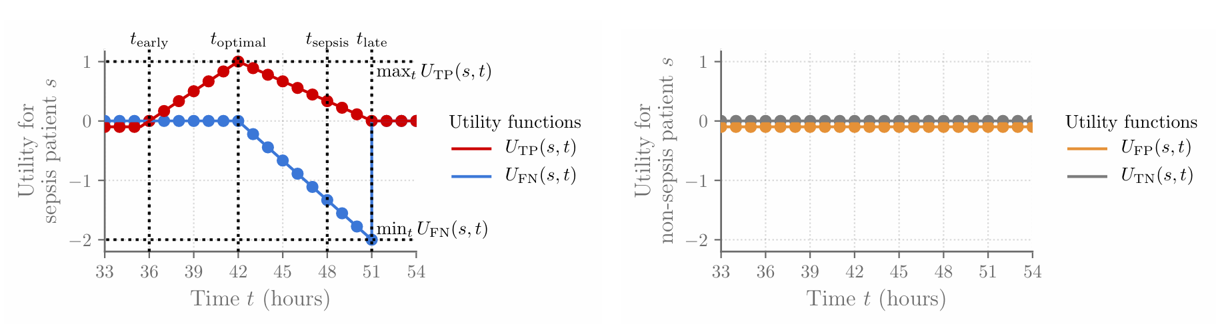
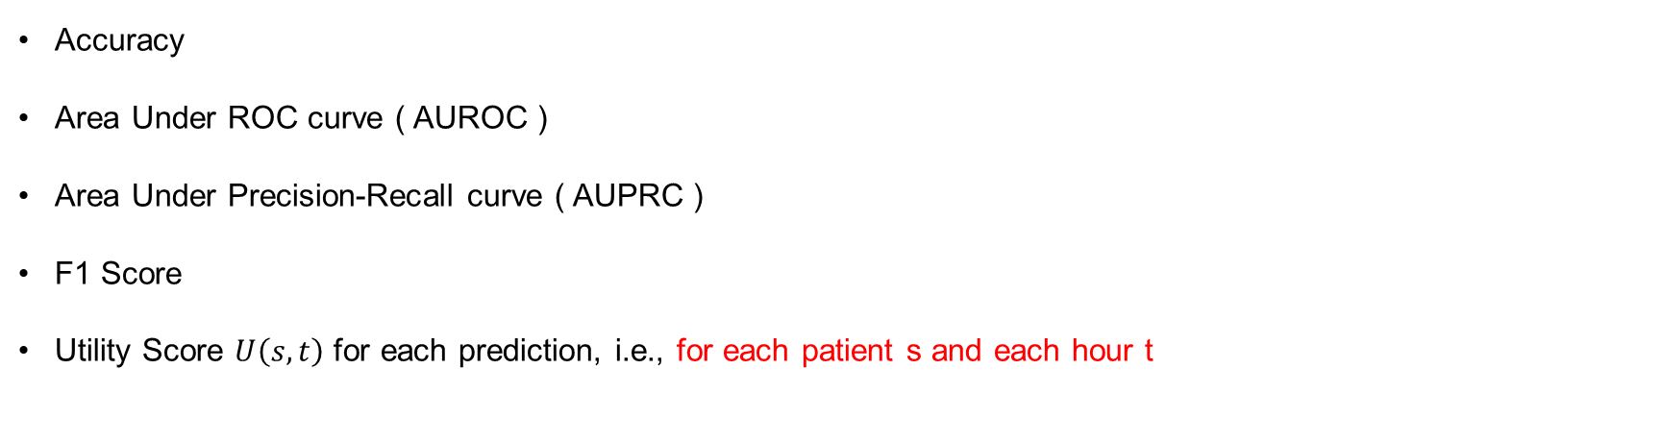
Evaluation Metrics
10
Accuracy
Area Under ROC curve ( AUROC )
Area Under Precision-Recall curve ( AUPRC )
F1 Score
Utility Score $U\left(s,t\right)$ for each prediction, i.e., for each patient s and each hour t
For sepsis patients :
For non-sepsis patients:

Slide 11

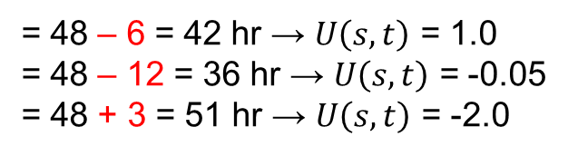
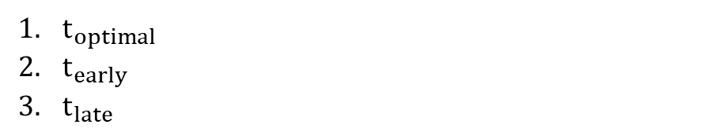


Evaluation Metrics
11
Define a score $U\left(s,t\right)$ for each prediction, i.e., for each patient s and each hour t:
For sepsis patients: Assume $t_{sepsis}$ = 48 hr
$t_{optimal}$
$t_{early}$
$t_{late}$
= 48 – 6 = 42 hr → $U\left(s,t\right)$ = 1.0
= 48 – 12 = 36 hr → $U\left(s,t\right)$ = -0.05
= 48 + 3 = 51 hr → $U\left(s,t\right)$ = -2.0
For non-sepsis patients:
$U_{FP}(s,t)=−0.05$ (False Alarm)
$$U\left(s,t\right)=$$
$U_{TN}(s,t)=0$ (Correct Rejection)

Slide 12
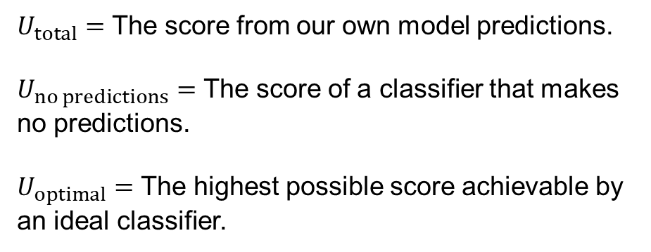
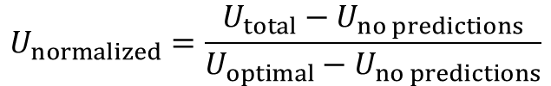
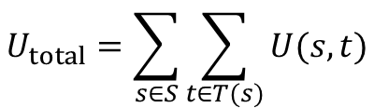
Evaluation Metrics
12
Define a score $U\left(s,t\right)$ for each prediction, i.e., for each patient s and each hour t:
$$U_{total}=\sum_{s∈S}{\sum_{t∈T(s)}{U(s, t)}}$$
$$U_{normalized}=\frac{U_{total}−U_{no predictions}}{U_{optimal}−U_{no predictions}}$$
$U_{total}=$ The score from our own model predictions.
$U_{no predictions}=$ The score of a classifier that makes no predictions.
$U_{optimal}=$ The highest possible score achievable by an ideal classifier.

Slide 13
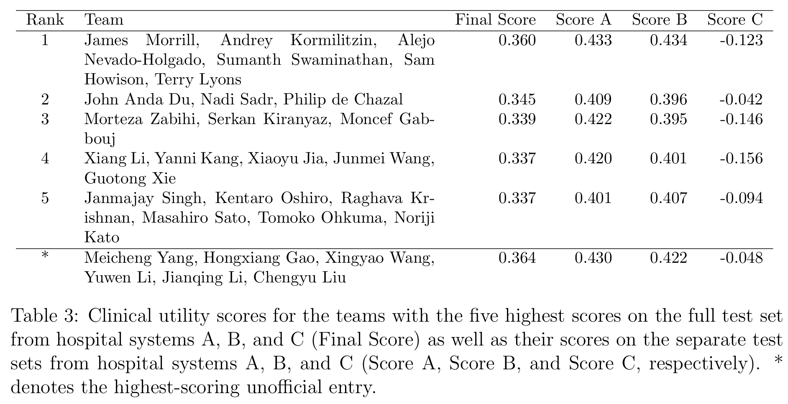
Target Performance
13
( Utility Score : ~ 0.4 )
https://physionet.org/content/challenge-2019/1.0.0/physionet_challenge_2019_ccm_manuscript.pdf

Slide 14
RELATED WORKS

Slide 15
Selected Literature List
15
No. | Paper Title | Source | Year | Authors
1 | Machine Learning Used to Compare the Diagnostic Accuracy of Risk Factors, Clinical Signs and Biomarkers and to Develop a New Prediction Model for Neonatal Early-onset Sepsis | The Pediatric Infectious Disease Journal | 2022 | Stocker, Martin, et al.
2 | Advancing Early Detection of Sepsis With Temporal Convolutional Networks Using ECG Signals | IEEE Access | 2024 | Apalak, Merve & Kamran Kiasaleh
3 | SepsisLab: Early Sepsis Prediction with Uncertainty Quantification and Active Sensing | KDD '24 | 2024 | Yin, Changchang, et al.
4 | Continuous prediction and clinical alarm management of late-onset sepsis in preterm infants using vital signs from a patient monitor | Computer Methods and Programs in Biomedicine | 2024 | Yang, Meicheng, et al.
5 | An Easy and Quick Risk-Stratified Early Forewarning Model for Septic Shock in the Intensive Care Unit:Development, Validation, and Interpretation Study | Journal of Medical Internet Research | 2025 | Liu, Guanghao, et al.
[1] M. Stocker et al., “Machine learning used to compare the diagnostic accuracy of risk factors, clinical signs and biomarkers and to develop a new prediction model for neonatal early-onset sepsis,” Pediatr. Infect. Dis. J., vol. 41, no. 3, pp. 248–254, 2022, doi: 10.1097/INF.0000000000003344.
[2] M. Apalak and K. Kiasaleh, “Advancing Early Detection of Sepsis With Temporal Convolutional Networks Using ECG Signals,” IEEE Access, vol. 12, pp. 3417–3427, 2024, doi: 10.1109/ACCESS.2023.3349242.
[3] C. Yin et al., “SepsisLab: Early sepsis prediction with uncertainty quantification and active sensing,” in Proc. 30th ACM SIGKDD Conf. Knowl. Discov. Data Min., 2024, doi: 10.1145/3637528.3671586.
[4] M. Yang et al., “Continuous prediction and clinical alarm management of late-onset sepsis in preterm infants using vital signs from a patient monitor,” Comput. Methods Programs Biomed., vol. 255, Art. no. 108335, 2024, doi: 10.1016/j.cmpb.2024.108335.
[5] G. Liu et al., “An Easy and Quick Risk-Stratified Early Forewarning Model for Septic Shock in the Intensive Care Unit: Development, Validation, and Interpretation Study,” J. Med. Internet Res., vol. 27, Art. no. e58779, 2025, doi: 10.2196/58779.

Slide 16
Application Side Summary
16
No. | Dataset | Target | #Sample | #Pos Labels | Features | Deployment
1 | 1. NeoPInS | Early-Onset Sepsis (Newborn) | 1,685 | 28 (1.7%) | 4 biomarkers 4 risk factors 6 clinical signs 14 other variables
2 | 1. MIMIC-III 2. MIMIC-Waveform | Sepsis | 715 | 65 (9.1%) | 25 HRV features
3 | 1. MIMIC-III 2. AmsterdamUMCdb 3. OSUWMC | Sepsis | 1. 21,686 2. 6,560 3. 85,181 | 1. 6,940 (32%) 2. 2,296 (35%) 3. 24,702 (29%) | 18 lab tests 8 vital signs | V
4 | Maxima Medical Center | Late-Onset Sepsis (Newborn) | 119 | 51 (42.9%) | 2 demographics 100 vital signs | V
5 | 1. eICU 2. MIMIC-IV | Septic Shock | 1. 5,125 2. 2,180 | 1. 766 (14.9%) 2. 480 (22.0%) | 8 arterial blood gases 7 vital signs | V
* public datasets
Notes:
這張表彙整了近年來幾篇關於敗血症早期預測的代表性研究，從資料集、方法、模型表現到每篇文章的優點與限制進行對照與比較：
1️⃣ 第一篇研究使用 MIMIC-IV 資料集，採用 XGBoost 與邏輯回歸模型，雖然 AUROC 高達 0.85，並針對模型進行校準，但其缺乏跨院驗證，限制了模型的泛化能力。
2️⃣ 第二篇採用 PhysioNet 2019 的資料，提出新的特徵工程策略，大幅提升模型表現（AUROC 接近 0.98），但也指出「平均處理」可能導致資訊流失，此外進一步特徵的貢獻也有限。
3️⃣ 第三篇使用 LSTM 處理時間序列資料，並基於 utility score 進行評估，強調實用性，但其泛化能力仍有不足。
4️⃣ 第四篇創新地將 ChatGPT 生成摘要與結構化資料結合，並以自注意力模型進行預測，驗證 LLM 模型的潛力，但仍使用較傳統的時間序列處理流程。
5️⃣ 第五篇強調跨院資料分析，使用 GPT + ClinicalBert + BiLSTM 架構，模型表現 AUROC 達 0.846，具國際泛化性，但資料品質差異帶來挑戰。
6️⃣ 第六篇為解釋式 AI 的代表作，透過 Grad-CAM 搭配 CNN+MLP 架構進行模型解釋，提升臨床可解釋性，但其特徵指標（如 qSOFA）仍較有限。

Slide 17
Application Side Summary
17
No. | Input | Process | Output | Result
1 | 28 variables | Modeling: Random Forest | 0: non-sepsis 1: sepsis | AUROC: 83.4% AUPRC: 28.4%
2 | ECG signals | Preprocessing: divide ECG recordings into non-overlapping 5-minute segments Feature Engineering: calculating the mean of all HRV measurements Modeling: TCN | 0: non-sepsis 1: sepsis | AUROC: 81.9% AUPRC: 71.3%
3 | 26 variables | Preprocessing: missing value imputation using LSTM Modeling: Time-Aware LSTM | 0: non-sepsis 1: sepsis | 1. AUROC: 83.7% 2. AUROC: 84.9% 3. AUROC: 93.4%
4 | 27 variables | Preprocessing: divide vital signs within the 5-minute non-overlapping window Feature Engineering: calculating the mean, min, max, SD Modeling: LR, SVM, KNN, XGBoost | 0: non-sepsis 1: sepsis | AUROC: 87.5%
5 | demos, lab tests, vital signs in the datasets | Feature Selection: according to SHAP importance ranking Modeling: Septic Shock Risk Predictor (SORP) | 0: non-septic shock 1: septic shock | AUROC: 94.6%
Notes:
這張表彙整了近年來幾篇關於敗血症早期預測的代表性研究，從資料集、方法、模型表現到每篇文章的優點與限制進行對照與比較：
1️⃣ 第一篇研究使用 MIMIC-IV 資料集，採用 XGBoost 與邏輯回歸模型，雖然 AUROC 高達 0.85，並針對模型進行校準，但其缺乏跨院驗證，限制了模型的泛化能力。
2️⃣ 第二篇採用 PhysioNet 2019 的資料，提出新的特徵工程策略，大幅提升模型表現（AUROC 接近 0.98），但也指出「平均處理」可能導致資訊流失，此外進一步特徵的貢獻也有限。
3️⃣ 第三篇使用 LSTM 處理時間序列資料，並基於 utility score 進行評估，強調實用性，但其泛化能力仍有不足。
4️⃣ 第四篇創新地將 ChatGPT 生成摘要與結構化資料結合，並以自注意力模型進行預測，驗證 LLM 模型的潛力，但仍使用較傳統的時間序列處理流程。
5️⃣ 第五篇強調跨院資料分析，使用 GPT + ClinicalBert + BiLSTM 架構，模型表現 AUROC 達 0.846，具國際泛化性，但資料品質差異帶來挑戰。
6️⃣ 第六篇為解釋式 AI 的代表作，透過 Grad-CAM 搭配 CNN+MLP 架構進行模型解釋，提升臨床可解釋性，但其特徵指標（如 qSOFA）仍較有限。

Slide 18
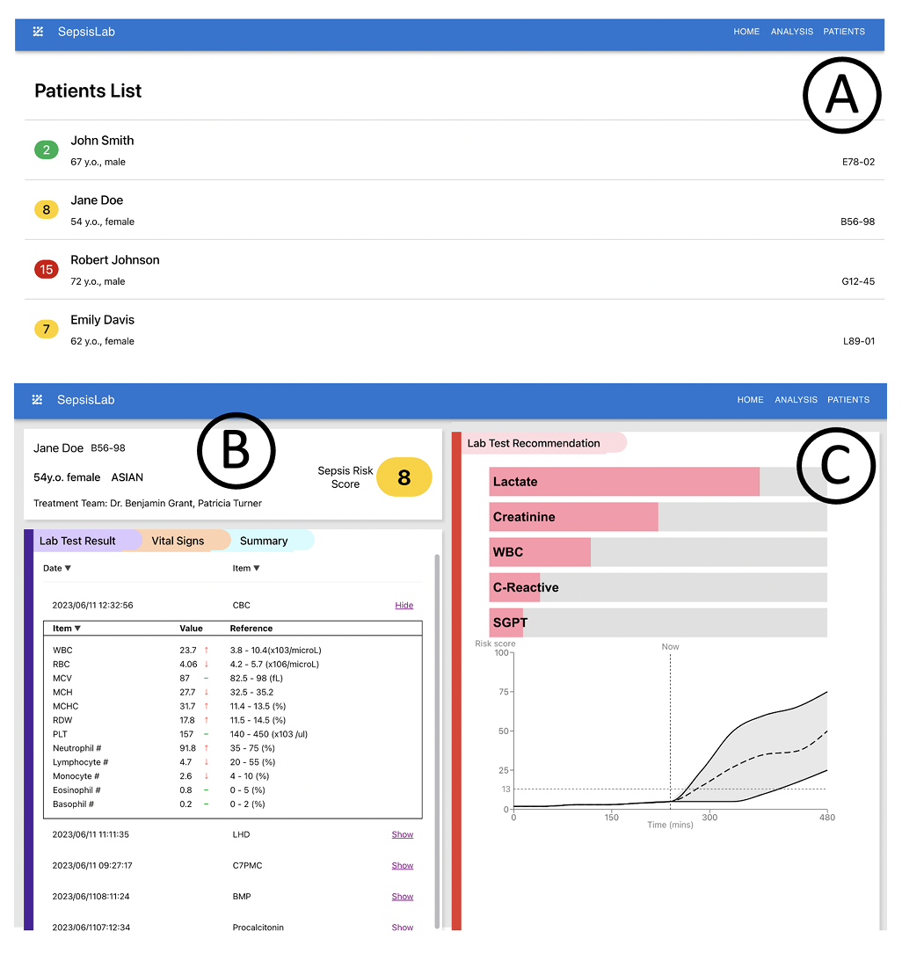
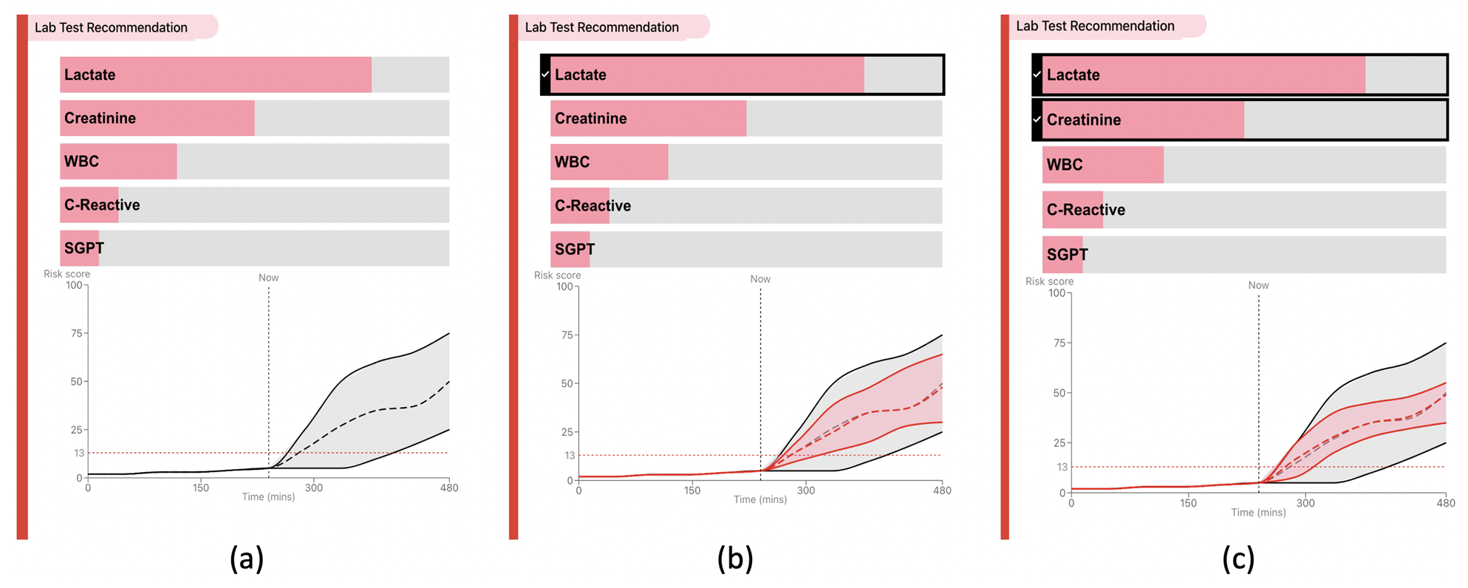
3. SepsisLab: Early Sepsis Prediction with Uncertainty Quantification and Active Sensing
18
When the missing rates are high & the health care resources are insufficient...
Risk Score
Uncertainty Quantification
Active Sensing
Notes:
這張表彙整了近年來幾篇關於敗血症早期預測的代表性研究，從資料集、方法、模型表現到每篇文章的優點與限制進行對照與比較：
1️⃣ 第一篇研究使用 MIMIC-IV 資料集，採用 XGBoost 與邏輯回歸模型，雖然 AUROC 高達 0.85，並針對模型進行校準，但其缺乏跨院驗證，限制了模型的泛化能力。
2️⃣ 第二篇採用 PhysioNet 2019 的資料，提出新的特徵工程策略，大幅提升模型表現（AUROC 接近 0.98），但也指出「平均處理」可能導致資訊流失，此外進一步特徵的貢獻也有限。
3️⃣ 第三篇使用 LSTM 處理時間序列資料，並基於 utility score 進行評估，強調實用性，但其泛化能力仍有不足。
4️⃣ 第四篇創新地將 ChatGPT 生成摘要與結構化資料結合，並以自注意力模型進行預測，驗證 LLM 模型的潛力，但仍使用較傳統的時間序列處理流程。
5️⃣ 第五篇強調跨院資料分析，使用 GPT + ClinicalBert + BiLSTM 架構，模型表現 AUROC 達 0.846，具國際泛化性，但資料品質差異帶來挑戰。
6️⃣ 第六篇為解釋式 AI 的代表作，透過 Grad-CAM 搭配 CNN+MLP 架構進行模型解釋，提升臨床可解釋性，但其特徵指標（如 qSOFA）仍較有限。

Slide 19
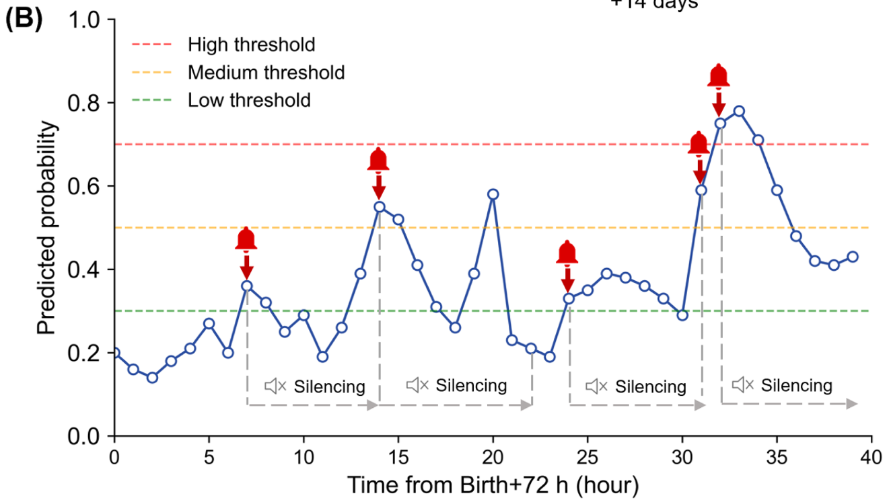
4. Continuous prediction and clinical alarm management of late-onset sepsis in preterm infants using vital signs from a patient monitor
19
Multi-Thresholds Alarm Policy
Notes:
這張表彙整了近年來幾篇關於敗血症早期預測的代表性研究，從資料集、方法、模型表現到每篇文章的優點與限制進行對照與比較：
1️⃣ 第一篇研究使用 MIMIC-IV 資料集，採用 XGBoost 與邏輯回歸模型，雖然 AUROC 高達 0.85，並針對模型進行校準，但其缺乏跨院驗證，限制了模型的泛化能力。
2️⃣ 第二篇採用 PhysioNet 2019 的資料，提出新的特徵工程策略，大幅提升模型表現（AUROC 接近 0.98），但也指出「平均處理」可能導致資訊流失，此外進一步特徵的貢獻也有限。
3️⃣ 第三篇使用 LSTM 處理時間序列資料，並基於 utility score 進行評估，強調實用性，但其泛化能力仍有不足。
4️⃣ 第四篇創新地將 ChatGPT 生成摘要與結構化資料結合，並以自注意力模型進行預測，驗證 LLM 模型的潛力，但仍使用較傳統的時間序列處理流程。
5️⃣ 第五篇強調跨院資料分析，使用 GPT + ClinicalBert + BiLSTM 架構，模型表現 AUROC 達 0.846，具國際泛化性，但資料品質差異帶來挑戰。
6️⃣ 第六篇為解釋式 AI 的代表作，透過 Grad-CAM 搭配 CNN+MLP 架構進行模型解釋，提升臨床可解釋性，但其特徵指標（如 qSOFA）仍較有限。

Slide 20
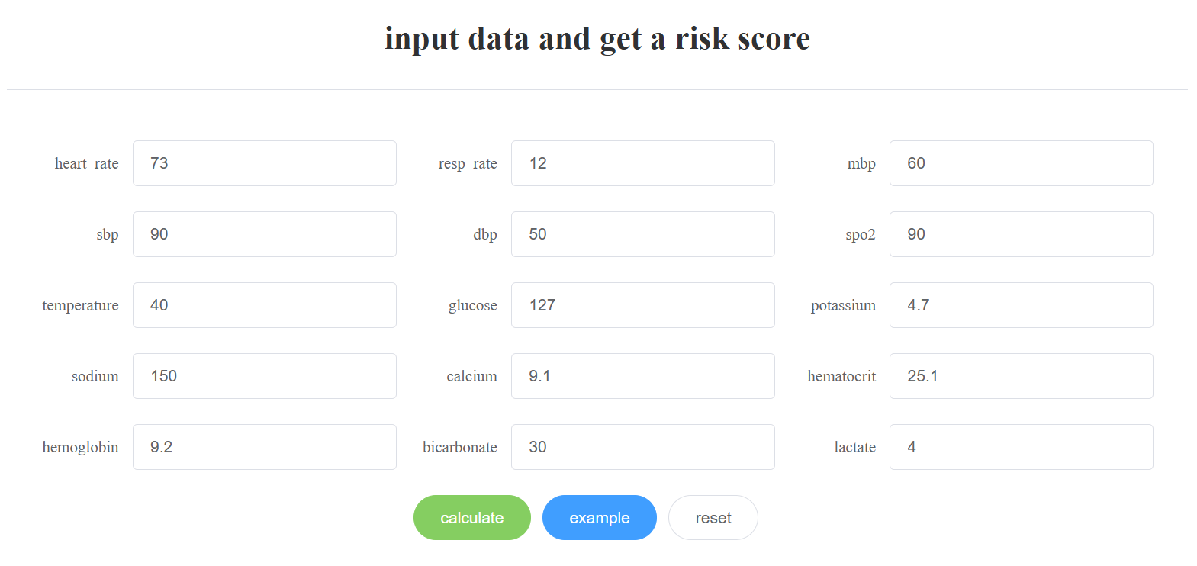
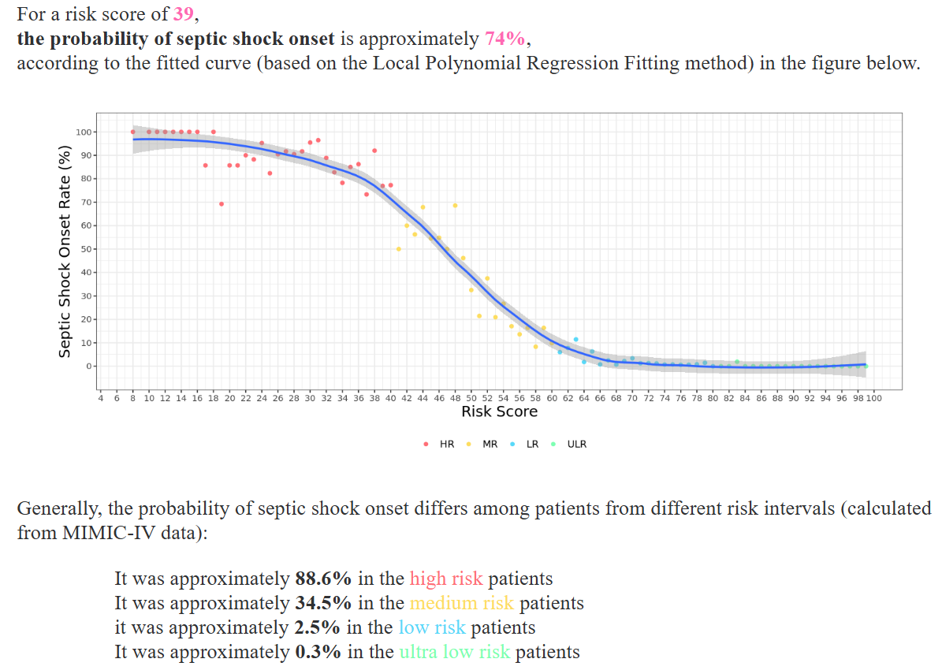
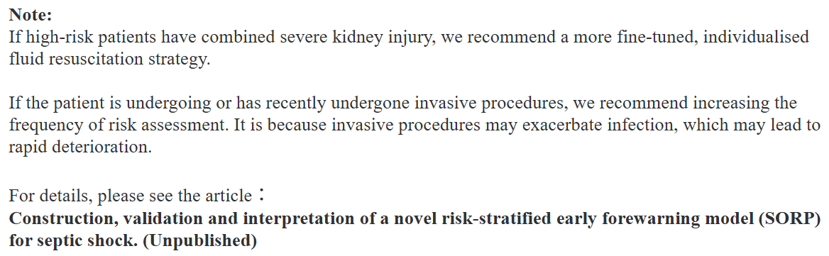
5. An Easy and Quick Risk-Stratified Early Forewarning Model for Septic Shock in the Intensive Care Unit: Development, Validation, and Interpretation Study
20
Through feature importance…
treatment suggestions according to different subgroups
Notes:
這張表彙整了近年來幾篇關於敗血症早期預測的代表性研究，從資料集、方法、模型表現到每篇文章的優點與限制進行對照與比較：
1️⃣ 第一篇研究使用 MIMIC-IV 資料集，採用 XGBoost 與邏輯回歸模型，雖然 AUROC 高達 0.85，並針對模型進行校準，但其缺乏跨院驗證，限制了模型的泛化能力。
2️⃣ 第二篇採用 PhysioNet 2019 的資料，提出新的特徵工程策略，大幅提升模型表現（AUROC 接近 0.98），但也指出「平均處理」可能導致資訊流失，此外進一步特徵的貢獻也有限。
3️⃣ 第三篇使用 LSTM 處理時間序列資料，並基於 utility score 進行評估，強調實用性，但其泛化能力仍有不足。
4️⃣ 第四篇創新地將 ChatGPT 生成摘要與結構化資料結合，並以自注意力模型進行預測，驗證 LLM 模型的潛力，但仍使用較傳統的時間序列處理流程。
5️⃣ 第五篇強調跨院資料分析，使用 GPT + ClinicalBert + BiLSTM 架構，模型表現 AUROC 達 0.846，具國際泛化性，但資料品質差異帶來挑戰。
6️⃣ 第六篇為解釋式 AI 的代表作，透過 Grad-CAM 搭配 CNN+MLP 架構進行模型解釋，提升臨床可解釋性，但其特徵指標（如 qSOFA）仍較有限。

Slide 21
Application Side Summary
21
No. | Insights | Pitfalls
1 | Considering biomarkers rarely appear in other datasets Ablation study of different types of features | Biomarkers may not be available in a short time Requiring further validation on populations from other regions
2 | Utilizing ECGs, which does not commonly appear in other datasets | Discarding other types of features available in the dataset
3 | Considering the uncertainty & test acquisition cost, reflecting real-world clinical scenarios Assisting clinicians in deciding which tests to perform | The interpretability of uncertainty estimation & active sensing is relatively low rather than simple score calculation
4 | Multi-thresholds alert strategy with model interpretability | Validating only on one private dataset, requiring further validation on public datasets
5 | High interpretability by using simple scorecards to get the risk score Evaluating the model on different datasets | The performance might degrades when variables are missing
Notes:
這張表彙整了近年來幾篇關於敗血症早期預測的代表性研究，從資料集、方法、模型表現到每篇文章的優點與限制進行對照與比較：
1️⃣ 第一篇研究使用 MIMIC-IV 資料集，採用 XGBoost 與邏輯回歸模型，雖然 AUROC 高達 0.85，並針對模型進行校準，但其缺乏跨院驗證，限制了模型的泛化能力。
2️⃣ 第二篇採用 PhysioNet 2019 的資料，提出新的特徵工程策略，大幅提升模型表現（AUROC 接近 0.98），但也指出「平均處理」可能導致資訊流失，此外進一步特徵的貢獻也有限。
3️⃣ 第三篇使用 LSTM 處理時間序列資料，並基於 utility score 進行評估，強調實用性，但其泛化能力仍有不足。
4️⃣ 第四篇創新地將 ChatGPT 生成摘要與結構化資料結合，並以自注意力模型進行預測，驗證 LLM 模型的潛力，但仍使用較傳統的時間序列處理流程。
5️⃣ 第五篇強調跨院資料分析，使用 GPT + ClinicalBert + BiLSTM 架構，模型表現 AUROC 達 0.846，具國際泛化性，但資料品質差異帶來挑戰。
6️⃣ 第六篇為解釋式 AI 的代表作，透過 Grad-CAM 搭配 CNN+MLP 架構進行模型解釋，提升臨床可解釋性，但其特徵指標（如 qSOFA）仍較有限。

Slide 22
Conclusion
22
Early prediction of sepsis may benefit from integrating diverse modalities — including demos, lab tests, vital signs, biomarkers, & ECGs.
Other datasets we can use for further evaluation.
Systems like SepsisLab actively suggest which lab tests should be chosen, balancing uncertainty reduction and acquisition cost.
Hourly prediction frameworks with multiple alert thresholds & interpretability features are more compatible with ICU settings.
By grouping patients with similar risk profiles & treatment histories, clinicians can not only see if treatment failure is due to undertreatment or overtreatment but also flag patients likely to progress to septic shock, allowing early intervention.

Slide 23
PROPOSED METHODS

Slide 24
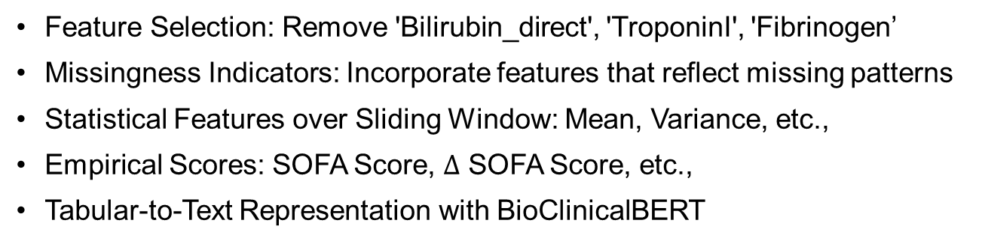
Data Preparation
24
Input
Change error values of FiO2 into NaN
Check Typos
Feature Selection: Remove 'Bilirubin_direct', 'TroponinI', 'Fibrinogen’
Missingness Indicators: Incorporate features that reflect missing patterns
Statistical Features over Sliding Window: Mean, Variance, etc.,
Empirical Scores: SOFA Score, $∆$ SOFA Score, etc.,
Tabular-to-Text Representation with BioClinicalBERT
Feature Engineering
Missing Value Imputation
Last Observation Carried Forward ( more close to the real situation )
Down/Up Sampling
Modeling ( XGBoost )

Slide 25
Feature Engineering (1/3)
25
Missingness Indicators :
Cumulative Measurements
Total number of times the variable has been measured up to the current time point.
The Time Gap (Hour) Since The Last Measurement
Time gap from the previous measurement.
First-Order Difference:
Value change between two consecutive measurements
Missing Status
Indicates if the original value is missing ( useful as imputation may distort the data ).
Yang, Meicheng, et al. "Early prediction of sepsis using multi-feature fusion based XGBoost learning and Bayesian optimization." The IEEE conference on computing in cardiology (CinC). Vol. 46. 2019.
Notes:
Clinicians often monitor patients more frequently when their condition appears unstable. These features may enhance performance by providing context rather than the raw values themselves.
臨床醫師在病患狀況看起來不穩定時，通常會更頻繁地監測病患的生理指標。 這類特徵（如監測的頻率、是否有測量等）可能會提升模型效能， 因為它們提供的是一種背景脈絡（contextual information）， 而不是僅僅依賴**原始數值本身（raw values）**來做判斷。

Slide 26
Feature Engineering (2/3)
26
Statistical Features over Sliding Window :
For vital signs (HR, O2Sat, SBP, MAP, Resp):
6 Statistics (Min, Max, Mean, Median, SD, Diff SD) in The Past 6 Hours
Empirical Scores :
For variables in the SOFA score (Platelets, Bilirubin, MAP, Creatinine):
Total SOFA Score
SOFA Score in Each System
ΔSOFA: The difference of the current SOFA score & the previous one.
Yang, Meicheng, et al. "Early prediction of sepsis using multi-feature fusion based XGBoost learning and Bayesian optimization." The IEEE conference on computing in cardiology (CinC). Vol. 46. 2019.

Slide 27
Feature Engineering (3/3)
27
Tabular-to-Text Representation with Bio_ClinicalBERT :
subject | hour | HR | O2Sat | Temp | … | ICULOS
1 | 1 | NaN | 93 | NaN | … | 1
1 | 2 | 78 | 92 | 35.8 | … | 2
1 | 3 | 82 | 91 | 36.0 | … | 3
… | … | … | … | … | … | …
1 | 34 | 75 | NaN | 35.8 | … | 34
If the value is missing at the time, then skip it (missing wouldn’t be in the text).
[column name] [value]
O2Sat 93 ... ICULOS 1
HR 78 O2Sat 92 Temp 35.8 … ICULOS 2
HR 82 O2Sat 91 Temp 36.0 … ICULOS 3 …
HR 75 Temp 35.8 … ICULOS 34
The embedding contains the information of the complete records.
Bio_ClinicalBERT
PCA
Embedding
Hegselmann, Stefan, et al. "Tabllm: Few-shot classification of tabular data with large language models." International Conference on Artificial Intelligence and Statistics. PMLR, 2023.

Slide 28
Modeling
28
Training & Validation Sets
Raw Variables |  |  | Feature Engineering |  |  | Embedding | Label
Why XGBoost ?
XGBoost
Handles skewed variables well
Supports missing values input natively
Strong performance on tabular data
Offers model explainability
Hyperparameter tuning by GridSearchCV, e.g.,
max_depths = [3, 4]
learning_rates = [0.01, 0.02, 0.04, 0.06, 0.08, 0.1, 0.15, 0.2]
subsamples = [0.5, 0.6, 0.7, 0.8, 0.9]
colsample_bytrees = [0.5, 0.6, 0.7, 0.8, 0.9]
reg_alphas = [0.0, 0.005, 0.01, 0.05, 0.1]
reg_lambdas = [0.8, 1, 1.5, 2, 4]

Slide 29
Evaluation Strategy
OS : Linux
Programming Language: Python
Libraries : xgb, scikit-learn, pytorch …
29
Raw Variables |  |  | Feature Engineering |  |  | Embedding | Label
UP or Down Sampling / Weighted Loss
Training set (64%)
Validation set (16%)
Testing set (20%)
1. Splitting by subjects
Model training & Hyperparameter tuning
To make sure the distribution of the target among the different splits to be the same.
Utility Score, AUROC, AUPRC,
F1-Score
5 Fold cross-validation
2. Stratifying by labels
Model
The same subject would not exist in training set and testing set at the same time.
Feature Importance ( Explainability )

Slide 30
Dataset Challenges
30
High Missing Rate
Challenge: Many features, especially lab values, have high missingness.
Solution: Use XGBoost, which handles missing values natively.
Limited Raw Features and Various Variable-Length Inputs:
Challenge: Only 40 raw variables, possibly insufficient for capturing complex clinical patterns.
Solution: Apply diverse feature engineering and text representation to enrich the data.
Imbalanced Dataset
Challenge: Over 1.5 million records, but fewer than 30,000 with sepsis.
Solution: Explore up-sampling, down-sampling, and weighted loss to address imbalance.

Slide 31
EXPERIMENTAL SETTING

Slide 32
Dataset – The PhysioNet/Computing in Cardiology Challenge 2019
32
Including ICU patients in two separate hospital systems.
Available patient covariates consist of demographics, vital signs, and laboratory values.
Each patient file will have the same column and each row will represent a single hour's worth of records.
Hospital system | A | B
# of patients | 20,336 | 20,000
# of records | 739,663 | 684,508
# Variables | 40 ( Cat: 3 / Num: 37 ) | 40
Avg. # Rec. / Patient | 38.48 | 38.48
# of sepsis patients | 1,790 | 1,142
Sepsis prevalence | 8.8% | 5.7%
 | Statistics
# of patients | 38,895
# of records | 1,535,282
Avg. # Rec. / Patient | 38.48
# Raw Variables | 40 ( Cat: 3 / Num: 37 )
# Features | 204
# of sepsis records | 27,679 (1.8%)
https://physionet.org/content/challenge-2019/1.0.0/

Slide 33
EXPERIMENTAL RESULTS

Slide 34
Experiment Result
34
What is the performance of our proposed model compared to our target performance ?
The model’s average performance across the 5-fold test sets.
Model | Accuracy | AUROC | AUPRC | F1-score | Utility
SailOcean | 0.8192 | 0.8334 | 0.1033 | 0.1183 | 0.3989
Our Model | 0.8259 | 0.8402 | 0.1112 | 0.1223 | 0.4118
Target Performance

Slide 35
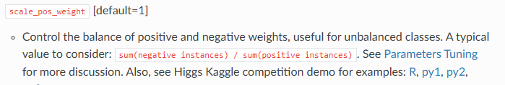
Experiment Result
35
How can we address the class imbalance problem ? ( Based on 37 raw Variables )
The model’s average performance across the 5-fold test sets.
Method | Accuracy | AUROC | AUPRC | F1-score | Utility
None | 0.9818 | 0.8061 | 0.1034 | 0.0197 | 0.0095
UP-Sampling | 0.8136 | 0.8002 | 0.0968 | 0.1093 | 0.3467
Down-Sampling | 0.8411 | 0.7709 | 0.0904 | 0.1118 | 0.3195
[1] CB Loss | 0.9817 | 0.8071 | 0.1036 | 0.0245 | 0.0119
scale_pos_weight | 0.8083 | 0.8065 | 0.1021 | 0.1091 | 0.3582
XGBoost
Official Document
[1] Y. Cui, M. Jia, T.-Y. Lin, Y. Song, and S. Belongie, “Class-Balanced Loss Based on Effective Number of Samples.” Available: https://openaccess.thecvf.com/content_CVPR_2019/papers/Cui_Class-Balanced_Loss_Based_on_Effective_Number_of_Samples_CVPR_2019_paper.pdf

Slide 36
Experiment Result
36
What is the performance of each feature engineering component?
The model’s average performance across the 5-fold test sets.
Method | Accuracy | AUROC | AUPRC | F1-score | Utility
Raw Variables | 0.8083 | 0.8065 | 0.1021 | 0.1091 | 0.3582
Raw Variables + Missing | 0.8267 | 0.8353 | 0.1069 | 0.1222 | 0.4089
Raw Variables + Sliding | 0.8170 | 0.8349 | 0.1073 | 0.1181 | 0.3997
Raw Variables + Scores | 0.8179 | 0.8297 | 0.1005 | 0.1165 | 0.3907
Raw Variables + Augmented Features | 0.8248 | 0.8387 | 0.1077 | 0.1221 | 0.4104
Different sliding window lengths (e.g., 3 or 12 hours) showed no significant impact on performance

Slide 37
Experiment Result
37
Based on XGBoost, what is the performance of text component?
The model’s average performance across the 5-fold test sets.
Method | Accuracy | AUROC | AUPRC | F1-score | Utility
Text | 0.7749 | 0.7696 | 0.0788 | 0.0903 | 0.2715
Raw Variables + Augmented Features | 0.8248 | 0.8387 | 0.1077 | 0.1221 | 0.4104
Text + Raw Variables + Augmented Features | 0.8259 | 0.8402 | 0.1112 | 0.1223 | 0.4118
Does using an MLP classifier improve performance compared to XGBoost? ( Only Text Emb )
The model’s average performance across the 5-fold test sets.
Method | Accuracy | AUROC | AUPRC | F1-score | Utility
XGBoost | 0.7749 | 0.7696 | 0.0788 | 0.0903 | 0.2715
MLP | 0.8698 | 0.7677 | 0.0760 | 0.1192 | 0.3047

Slide 38
Experiment Result
38
Why don’t we use deep learning model such as FT-Transformer? ( Based on 37 variables )
As suggested in '[1] Tabular Data: Deep Learning Is Not All You Need', the optimal method can vary depending on the dataset.
Deep learning methods were also able to achieve competitive results
The model’s average performance across the 5-fold test sets. ( Down-Sampling + Simple Imputation )
Model | Accuracy | AUROC | AUPRC | F1-score | Utility
MLP | 0.7502 | 0.8043 | 0.0808 | 0.0911 | 0.3126
Resnet | 0.8776 | 0.7741 | 0.0717 | 0.1183 | 0.2784
[2] FT-Transformer | 0.8943 | 0.7860 | 0.0698 | 0.1264 | 0.2745
XGBoost | 0.8411 | 0.7709 | 0.0904 | 0.1118 | 0.3195
[1] R. Shwartz-Ziv and A. Armon, “Tabular data: Deep learning is not all you need,” Information Fusion, vol. 81, pp. 84–90, May 2022, doi: https://doi.org/10.1016/j.inffus.2021.11.011.
[2] Y. Gorishniy, I. Rubachev, V. Khrulkov, and A. Babenko, “Revisiting Deep Learning Models for Tabular Data,” Neural Information Processing Systems, 2021. https://proceedings.neurips.cc/paper_files/paper/2021/hash/9d86d83f925f2149e9edb0ac3b49229c-Abstract.html

Slide 39
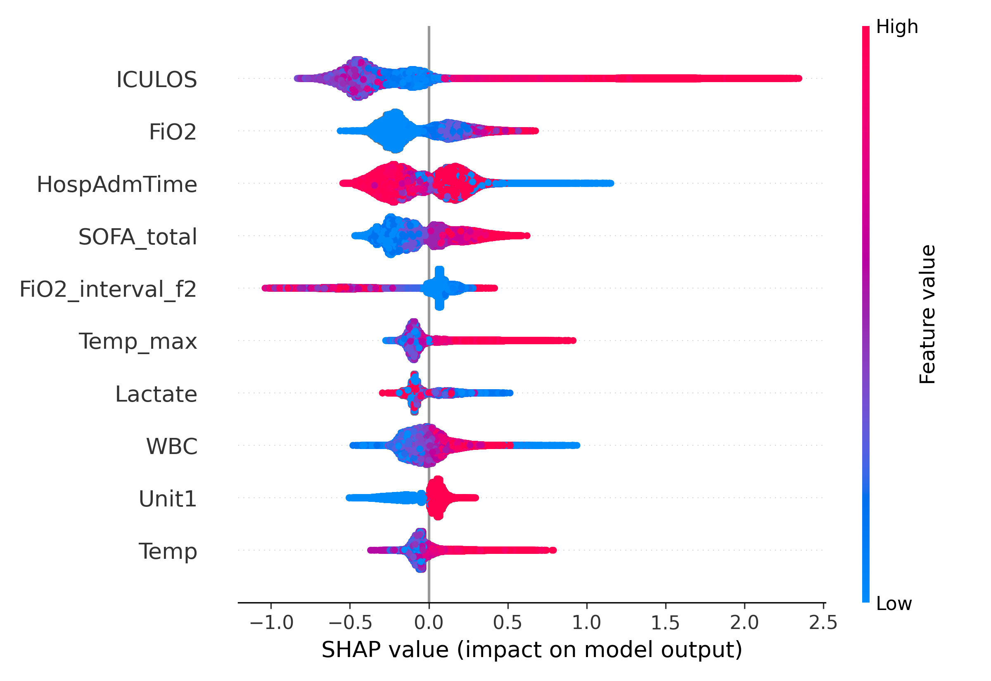
Experiment Result
39
( Raw + Augmented ) Feature Importance based on SHAP Values ( Top 10 )
Empirical Scores
Missingness Indicators
Statistical Features
over Sliding Window

Slide 40
CONCLUSION AND LIMITATION

Slide 41
Conclusion & Limitation
41
Conclusion
Effectively addresses challenges like data imbalance and variable-length time series inputs.
Enhances data representation through comprehensive feature engineering and text embeddings.
Offers interpretability by identifying key features that contribute to sepsis risk predictions.
Limitation :
XGBoost performs less competitively than deep learning models when using text embeddings as input.
ML models have limitations in addressing multi-modality.

Slide 42
Work distribution chart
42
 | 鄭志權 | 蔡璧如
Intro | V | V
Problem Settings | V | V
Review Papers | V | V
EDA |  | V
Methods | V | V
Experiment Settings | V | V
Results | V
Conclusions | V | V

Slide 43
Variable | Type | Range | %Missing | Description
HR | Cont. | (20, 280) | 9.86 (2.28) | Heart rate (beats per minute)
O2Sat | Cont. | (20, 100) | 13.05 (2.45) | Pulse oximetry (%)
Temp | Cont. | (20, 50) | 66.16 (7.41) | Temperature (Deg C)
SBP | Cont. | (20, 300) | 14.59 (3.89) | Systolic BP (mm Hg)
MAP | Cont. | (20, 300) | 12.43 (2.77) | Mean arterial pressure (mm Hg)
DBP | Cont. | (20, 300) | 31.54 (20.84) | Diastolic BP (mm Hg)
Resp | Cont. | (1, 100) | 15.30 (3.06) | Respiration rate (breaths per minute)
EtCO2 | Cont. | (10, 100) | 96.32 (91.66) | End tidal carbon dioxide (mm Hg)
BaseExcess | Cont. | (-32, 100) | 94.52 (67.79) | Measure of excess bicarbonate (mmol/L)
HCO3 | Cont. | (0, 55) | 95.77 (56.08) | Bicarbonate (mmol/L)
FiO2 | Cont. | (-50, 4000) | 91.60 (56.16) | Fraction of inspired oxygen (%)
pH | Cont. | (6.6, 7.9) | 93.02 (54.33) | N/A
PaCO2 | Cont. | (10, 100) | 94.40 (55.58) | Partial pressure of CO2 from arterial blood (mm Hg)
SaO2 | Cont. | (23, 100) | 96.53 (69.74) | Oxygen saturation from arterial blood (%)
AST | Cont. | (3, 9961) | 98.38 (69.48) | Aspartate transaminase (IU/L)
BUN | Cont. | (1, 268) | 93.12 (20.49) | Blood urea nitrogen (mg/dL)
Alkalinephos | Cont. | (7, 3833) | 98.39 (69.77) | Alkaline phosphatase (IU/L)
Calcium | Cont. | (1, 28) | 94.13 (28.51) | (mg/dL)
Chloride | Cont. | (26, 145) | 95.42 (53.17) | (mmol/L)
Creatinine | Cont. | (0.1, 46.6) | 93.90 (19.42) | (mg/dL)
Bilirubin_direct | Cont. | (0.01, 37.50) | 99.81 (95.36) | Bilirubin direct (mg/dL)
Vital
signs
After LOCF imputation
Lab
values
The missing rates of labs are extremely high; it might be because the lab test needs to take more time than vital signs.

Slide 44
Variable | Type | Range | %Missing | Description
Glucose | Cont. | (10, 988) | 82.93 (14.60) | Serum glucose (mg/dL)
Lactate | Cont. | (0.2, 31.0) | 97.32 (70.12) | Lactic acid (mg/dL)
Magnesium | Cont. | (0.2, 9.8) | 93.67 (27.82) | (mmol/dL)
Phosphate | Cont. | (0.2, 18.8) | 95.97 (42.73) | (mg/dL)
Potassium | Cont. | (1.0, 27.5) | 90.67 (18.21) | (mmol/L)
Bilirubin_total | Cont. | (0.1, 49.6) | 98.51 (69.87) | Total bilirubin (mg/dL)
TroponinI | Cont. | (0.01, 440.00) | 99.06 (85.07) | Troponin I (ng/mL)
Hct | Cont. | (5.5, 71.7) | 91.11 (19.42) | Hematocrit (%)
Hgb | Cont. | (2.2, 32.0) | 92.60 (20.96) | Hemoglobin (g/dL)
PTT | Cont. | (12.5, 250.0) | 97.03 (54.94) | partial thromboplastin time (seconds)
WBC | Cont. | (0.1, 440.0) | 93.58 (22.49) | Leukocyte count (count*10^3/µL)
Fibrinogen | Cont. | (34, 1760) | 99.34 (89.27) | (mg/dL)
Platelets | Cont. | (1, 2322) | 94.05 (22.30) | (count*10^3/µL)
Age | Cont. | (14, 100) | 0.00 | Years (100 for patients 90 or above)
Gender | Cat. | [0, 1] | 0.00 | Female (0) or Male (1)
Unit1 | Cat. | [0, 1] | 39.53 | Administrative identifier for ICU unit (MICU)
Unit2 | Cat. | [0, 1] | 39.53 | Administrative identifier for ICU unit (SICU)
HospAdmTime | Cont. | (-5366.86, 24.00) | 0.00 | Hours between hospital admit and ICU admit
ICULOS | Cont. | (1, 336) | 0.00 | ICU length-of-stay (hours since ICU admit)
SepsisLabel | Cat. | [0, 1] | 0.00 | For sepsis patients, label is 1 if t ≥ t_{sepsis}−6 and 0 if t < t_{sepsis}−6. For non-sepsis patients, label is 0.
Variable | 0 | 1
Gender | 44% | 56%
Unit1 | 50.41% | 49.59%
Unit2 | 49.59% | 50.41%
Lab
values
Demo
graphics

Slide 45
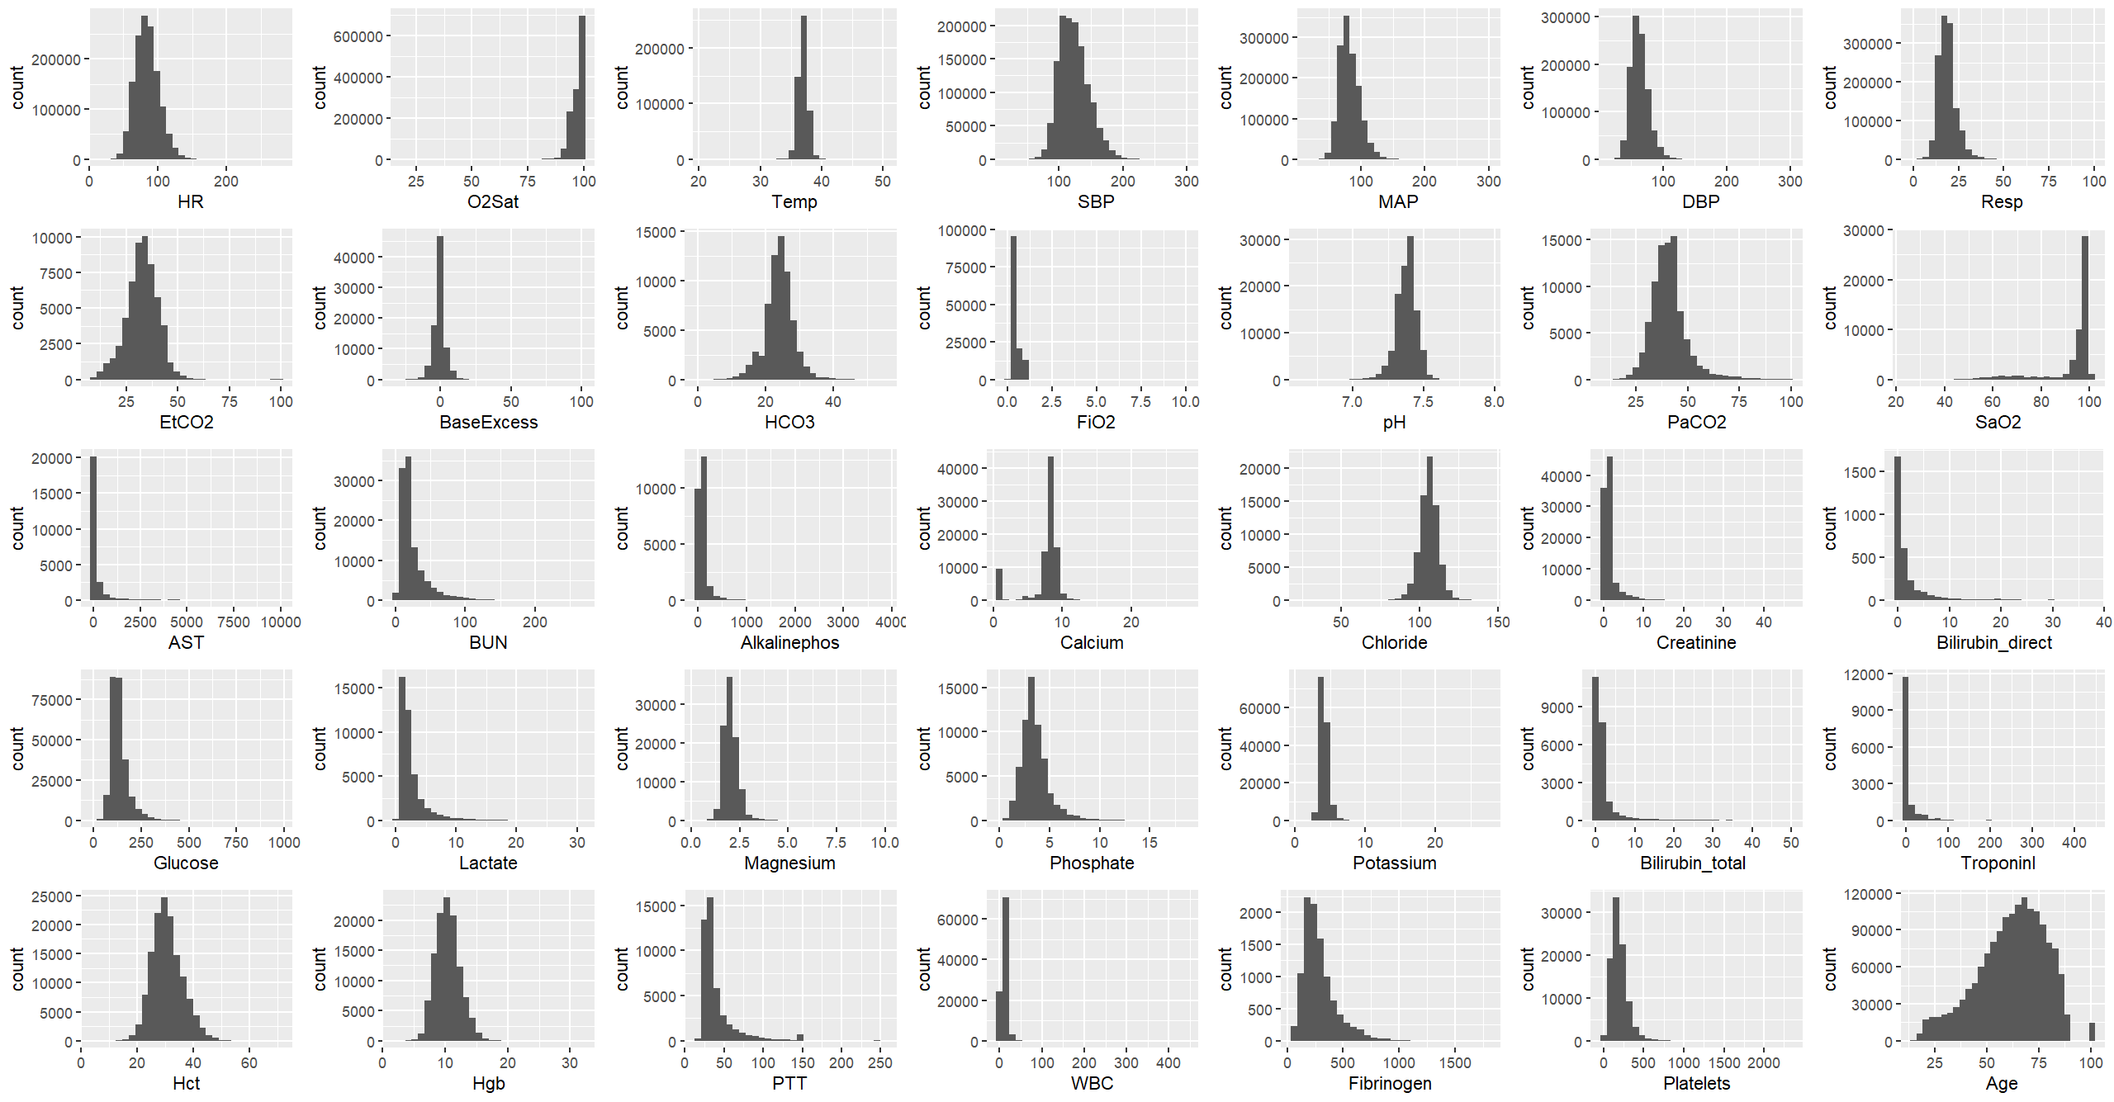
The distribution of each continuous variables.
Most of the variables are with high skewness.
The gap is because of the setting of the dataset.

Slide 46
THANK YOU

