Slide 1
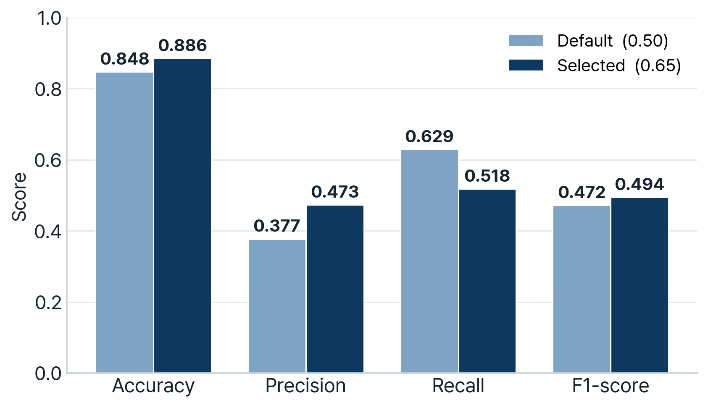
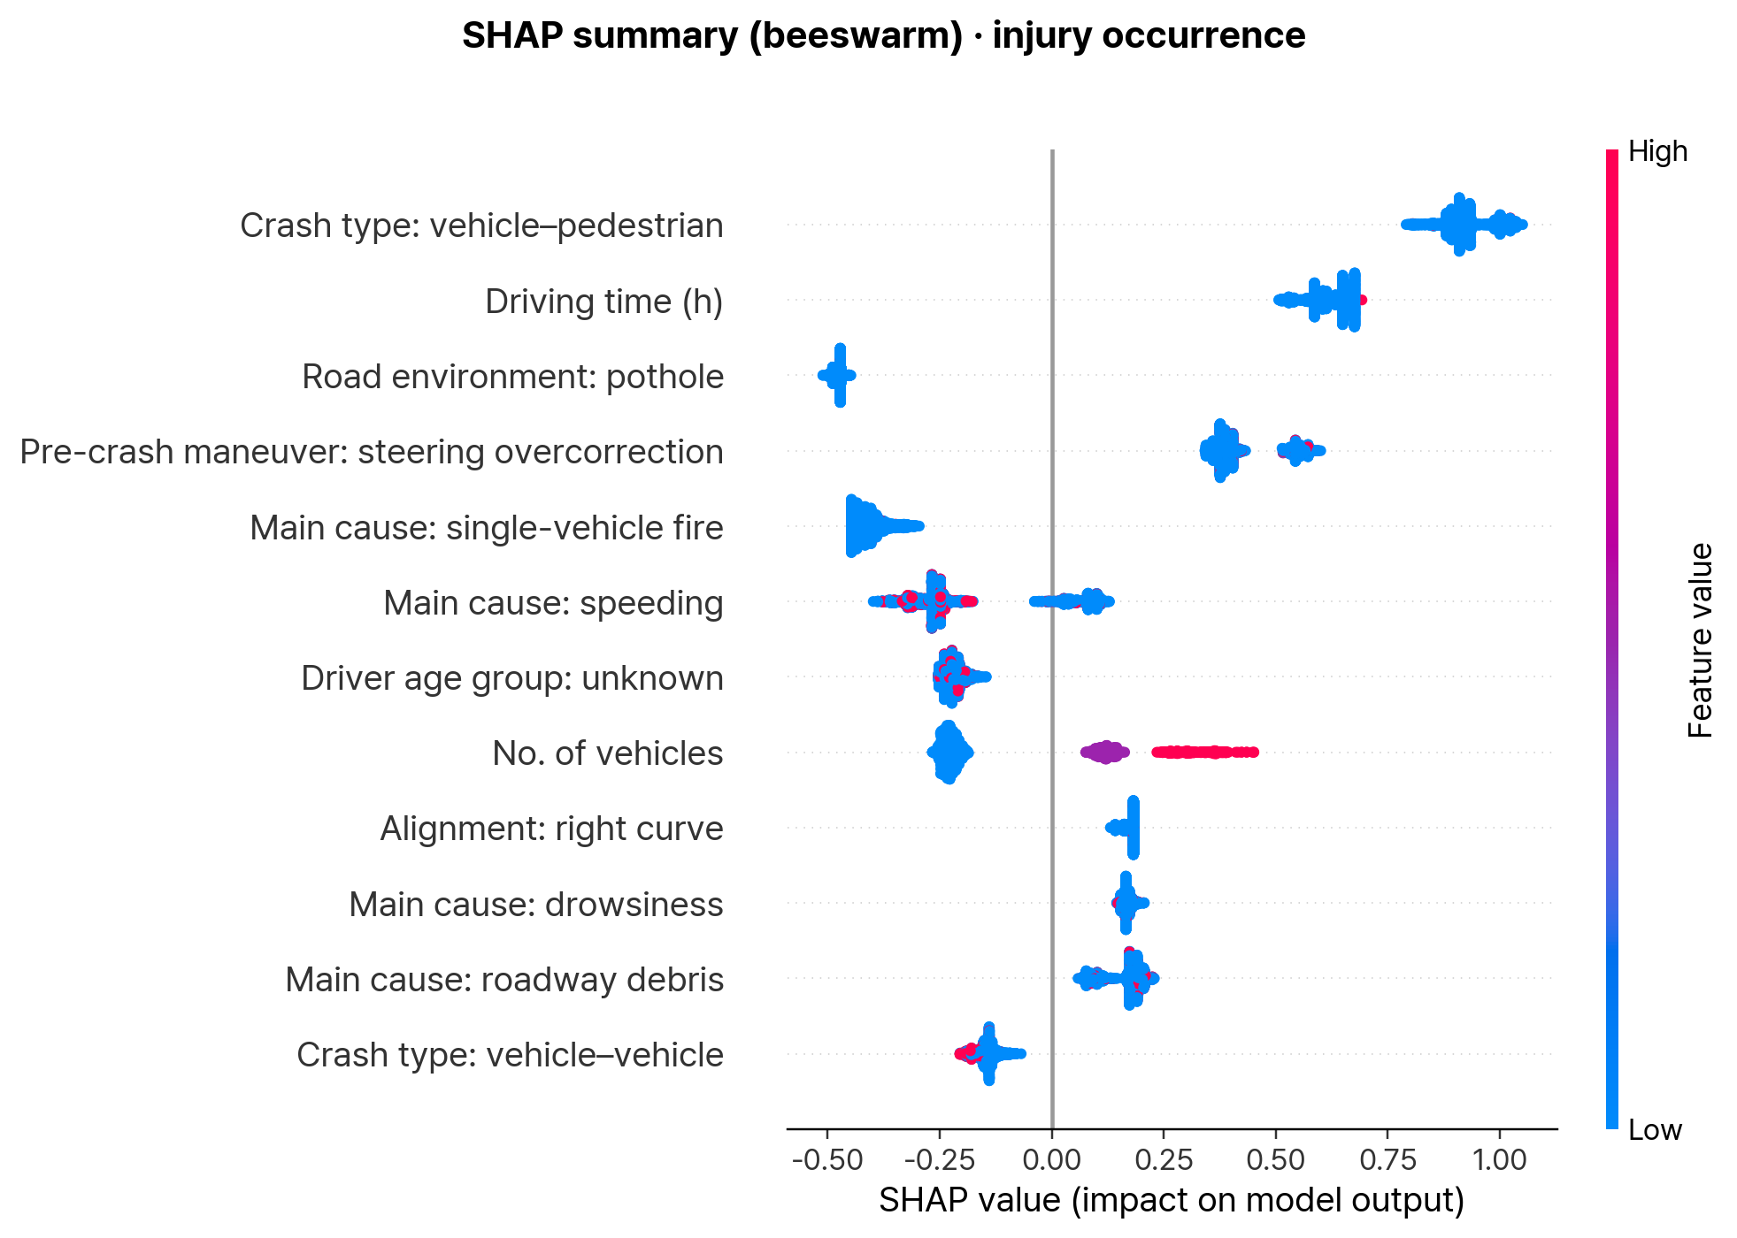
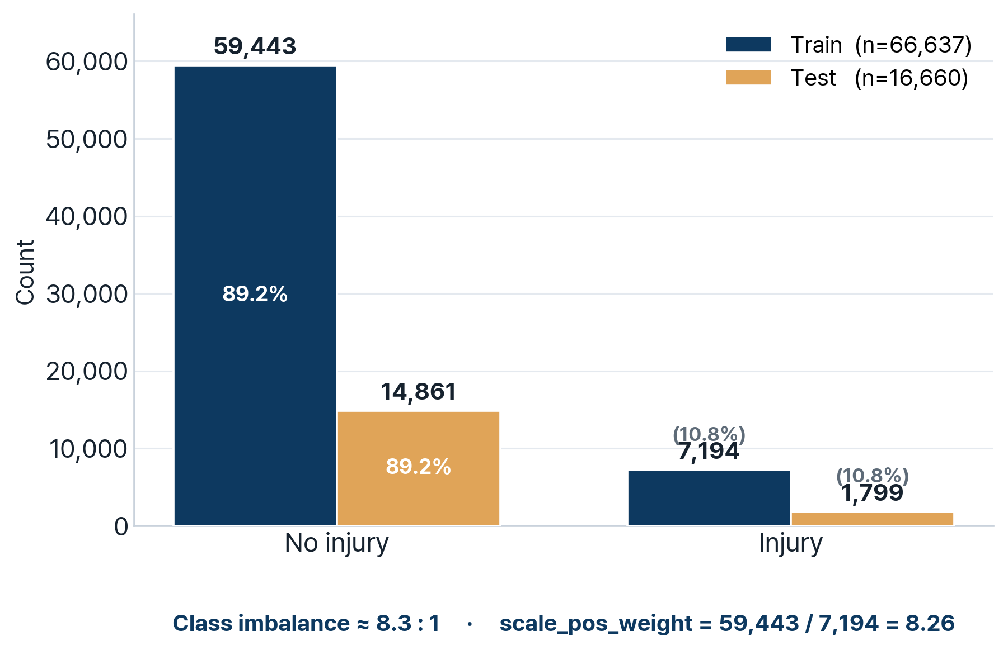
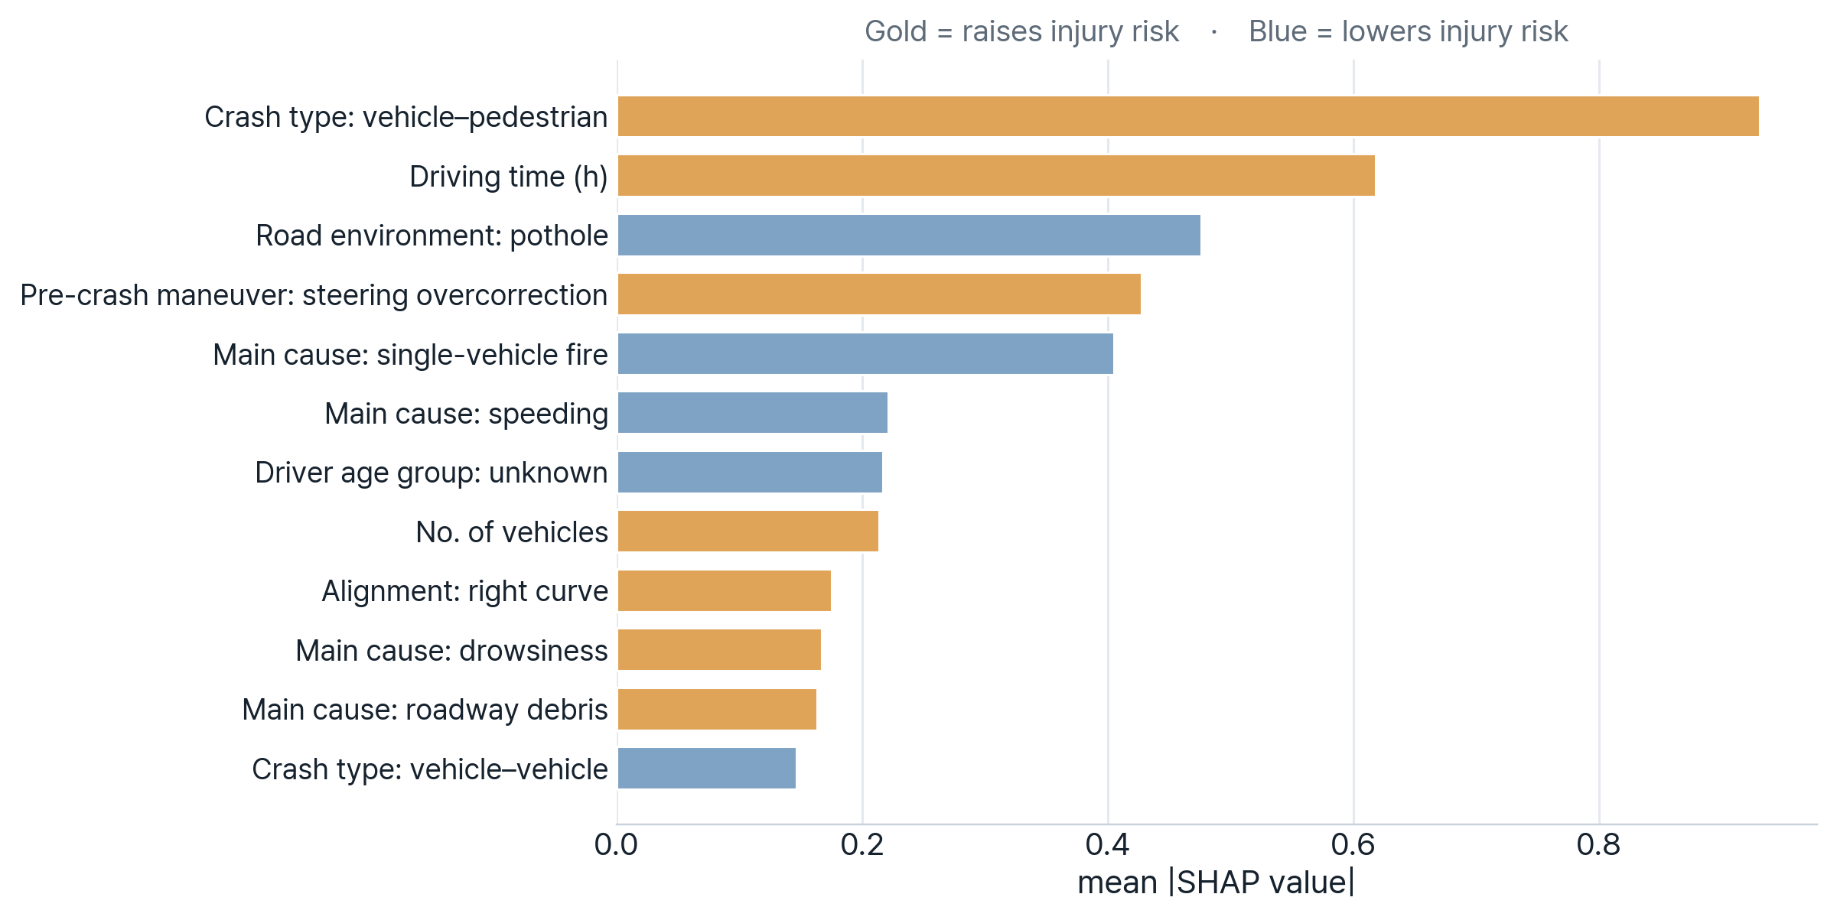

2026 APTE Conference
Factors Associated with Injury Occurrence in Expressway Crashes: An Interpretable XGBoost–SHAP Analysis
Nonlinear and interaction-based injury-risk factors in nationwide freeway crash data (2011–2019)
Seungbo Lee¹
Seonjae Lee¹
Eunjeong Ko²·*
¹Dept. of Management Information Systems, Hannam University ²Dept. of Big Data Application, Hannam University * Corresponding author: eunjeong.ko@hnu.kr
Introduction
Results
High-speed expressway crashes are more likely to cause injuries and large socioeconomic losses.
Identifying which conditions raise injury risk is difficult crash outcomes are highly context-dependent, and the same factor can act differently across situations.
Prior injury-severity studies often assume linear / additive effects → they miss nonlinear and interaction-based risk structures.
Severe class imbalance further challenges conventional models.
This study uses nationwide freeway crash data (2011–2019), with injury occurrence defined as a binary outcome derived from recorded crash-severity records.
We build an interpretable XGBoost model and use SHAP to reveal injury-occurrence risk factors.
Beyond ranking variable importance, SHAP reveals the direction of each factor's effect (risk-increasing vs. risk-decreasing) — an interpretable basis for proactive, data-driven safety management.
1. Model performance
Metric | 0.50 | 0.65
Accuracy | 0.848 | 0.886
Precision | 0.377 | 0.473
Recall | 0.629 | 0.518
F1-score | 0.472 | 0.494
ROC-AUC | 0.853 | 0.853
PR-AUC | 0.499 | 0.499
Selected threshold = 0.65 (best F1)
Objective
Accuracy is deceptive here. With only 10.8 % injury cases, a naïve "always no-injury" classifier already scores ≈ 0.89 accuracy — so the 0.85–0.89 accuracy is not the real signal. Precision, Recall, F1 and PR-AUC are the meaningful metrics.
Strong ranking ability (ROC-AUC = 0.853). The model correctly ranks a random injury case above a random non-injury case ~85 % of the time — a threshold-independent measure of discrimination.
Real signal under imbalance (PR-AUC = 0.499). This is ≈ 4.6× the 0.108 prevalence baseline, confirming the model captures genuine injury-risk structure rather than noise.
Threshold tuning is a precision–recall trade-off. Raising the cutoff 0.50 → 0.65 lifts Precision 0.377 → 0.473 and F1 0.472 → 0.494 (fewer false alarms), at the cost of Recall 0.629 → 0.518.
0.65 maximizes F1 (balanced operating point). For safety-critical early warning where missing an injury is costlier, a lower threshold (≈ 0.50–0.55) can be chosen to prioritize Recall — the model supports flexible operating points.
At threshold 0.65 (confusion matrix): 932 of 1,799 injury cases correctly flagged (51.8 % recall) with 1,039 false alarms among 14,861 non-injury cases — an acceptable alert load for a screening/early-warning use.
Identify factors associated with injury occurrence and interpret their direction via SHAP.
Support proactive expressway safety management and countermeasure prioritization.
Methodology
01
02
03
Data & preprocessing
Model training
Evaluation & SHAP
2011–2019 expressway crashes
Remove post-crash leakage cols
One-hot → 9,684 features
XGBoost binary (n=600, depth=4)
scale_pos_weight = 8.26
Stratified 80 / 20 split
Threshold opt (0.50 → 0.65)
ROC · PR-AUC · F1
SHAP global + direction
2. SHAP summary — injury-risk factors
Data
Source: 2011–2019 nationwide expressway crashes
Target: injury occurrence (binary)
83,297 records (Train 66,637 / Test 16,660)
Injury 10.8% → class imbalance ≈ 8.3 : 1
9,684 pre-accident features (one-hot)
Post-crash response / outcome vars removed (leakage)
Pre-accident variables
Crash dynamics dominate injury risk: vehicle–pedestrian collisions and pre-crash steering overcorrection are the strongest risk-raising factors.
Driver fatigue is a key driver: long driving time and drowsiness both push predictions toward injury.
Multi-vehicle & debris hazards raise risk: more vehicles involved and roadway debris increase injury likelihood.
Lower-risk contexts: pothole environments, single-vehicle fires, and vehicle–vehicle crashes tend to reduce injury probability.
Consistent with the abstract: crash-cause variables (drowsiness, roadway debris) emerge as dominant contributors to injury risk.
Category | Examples
Crash | Crash type, No. of vehicles, main cause, pre-crash maneuver
Driver / Vehicle | Driver state, sex, age group, vehicle type & size
Road geometry | Route, milepost, lane, alignment, superelevation
Environment / Location | Weather, road surface, day-night, hour, branch, mainline / tunnel / tollgate
3. Risk direction
Model setup
Model: XGBoost binary classification
Imbalance: scale_pos_weight + threshold optimization
Validation: stratified 80 / 20 train–test split
Interpretation: feature importance (gain) + SHAP
Vehicle–pedestrian crashes, long driving time, steering overcorrection, drowsiness and roadway debris raise injury risk — all identifiable before the crash.
Conclusion & future work
• Pre-accident information predicts expressway injury occurrence (Test ROC-AUC 0.853, PR-AUC 0.499).
• SHAP identifies vehicle–pedestrian crashes, long driving time, steering overcorrection, drowsiness and roadway debris as key risk-raising factors.
• Threshold optimization (0.50→0.65) improves precision and F1 under severe class imbalance.
• Findings support proactive safety management and early-warning systems; future work: SHAP interaction analysis.
Acknowledgment: :This research was supported by the Regional Innovation System & Education(RISE) program through the Daejeon RISE Center,
funded by the Ministry of Education (MOE) and the Daejeon Metropolitan City, Republic of Korea (2026-RISE-06-013)
E-mail: seungbo.kr@gmail.com

