Slide 1
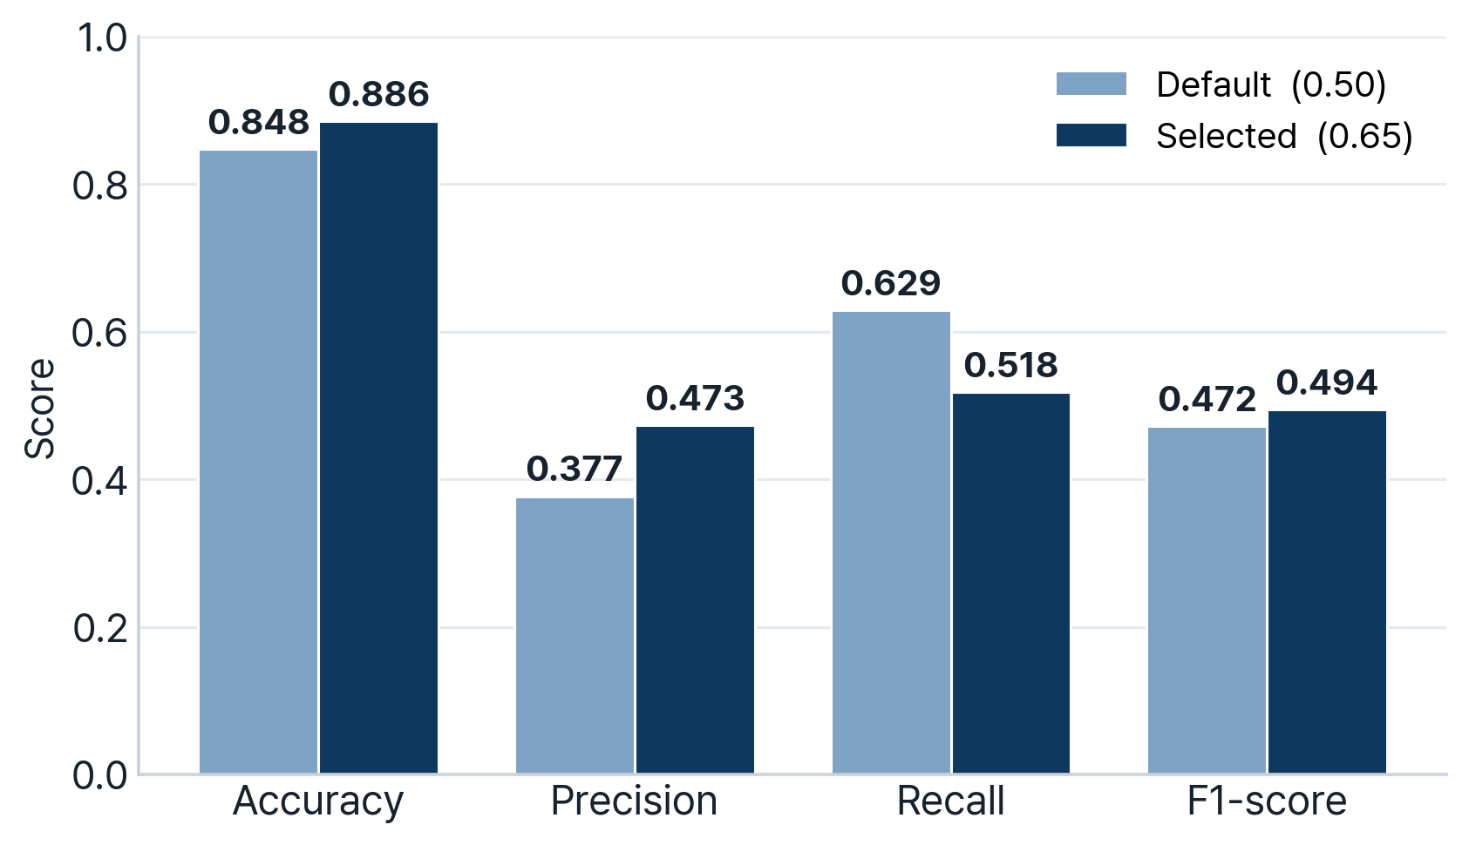
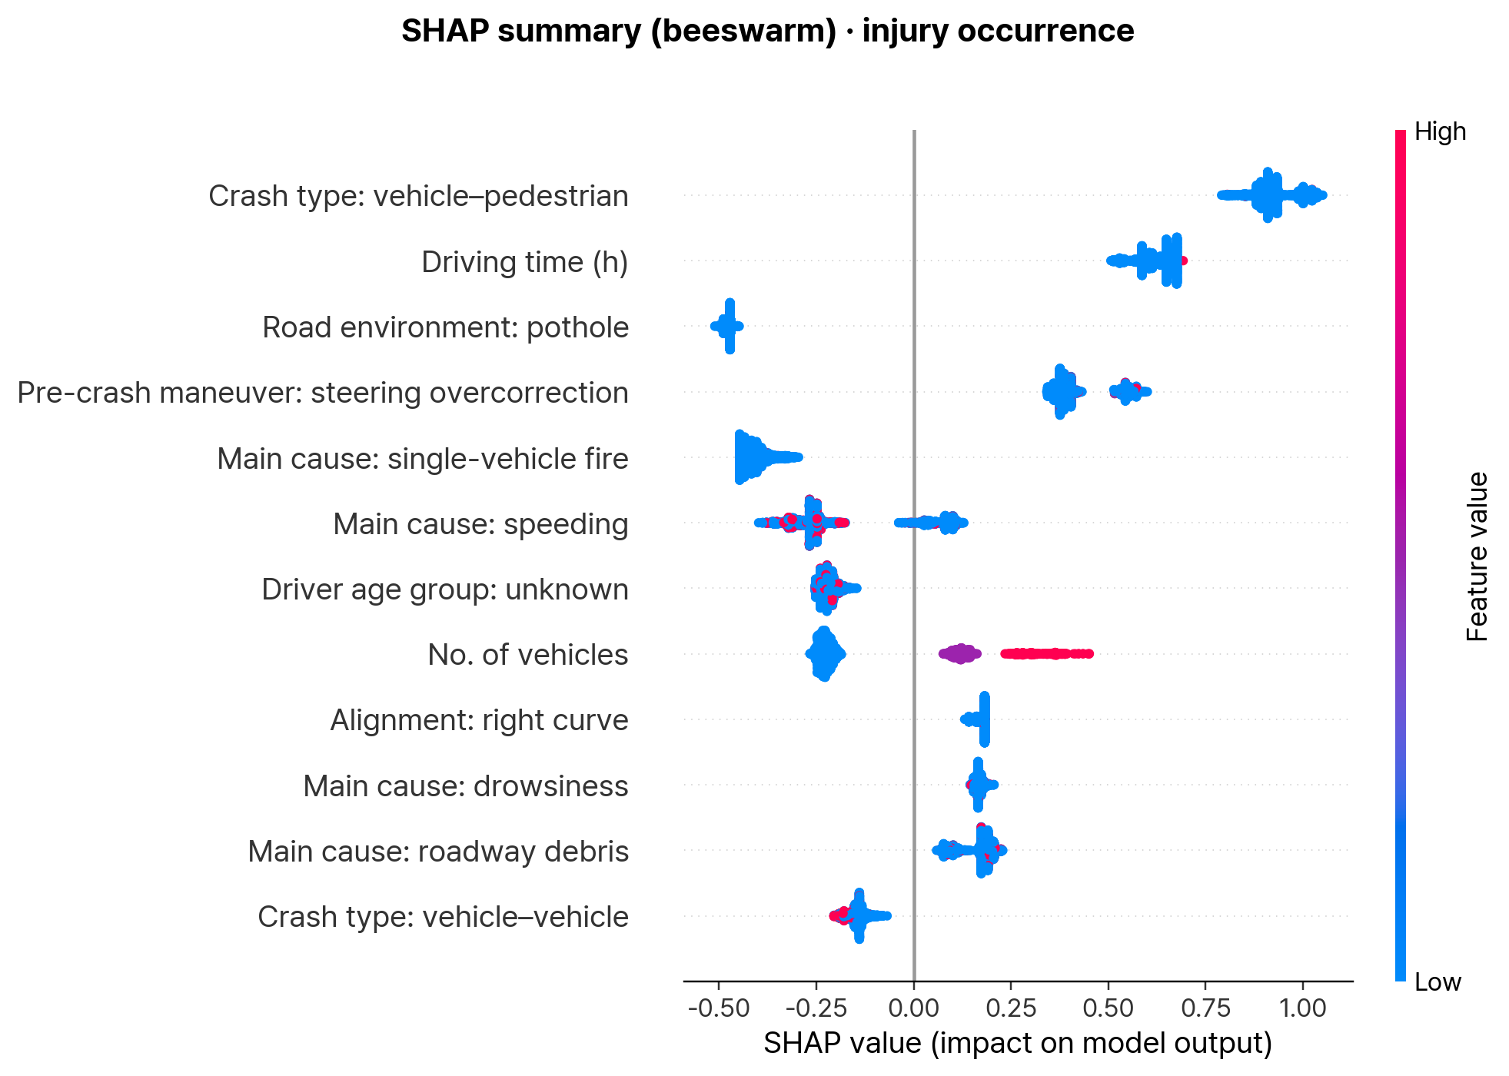
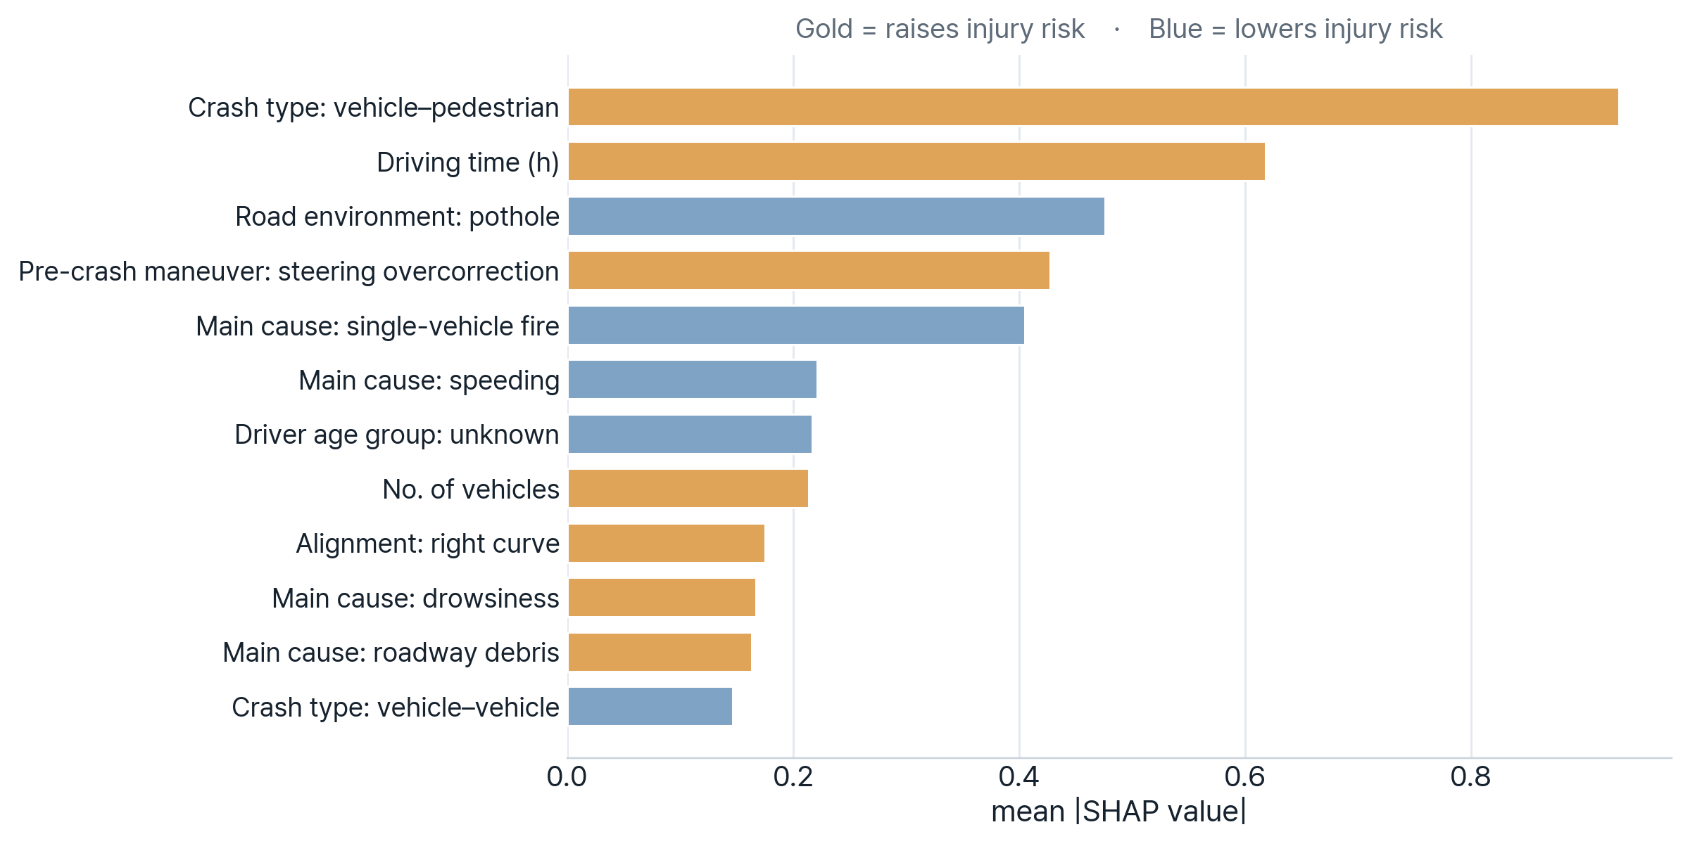


The 15th Asia-Pacific Conference on Transportation and the Environment
Analysis of factors associated with injury severity in freeway
crashes based on XGBoost–SHAP algorithm
Seungbo,Lee¹
Seongjae,Lee¹
Heejin,Jung²
Eunjeong,Ko*
¹Dept. of Management Information Systems, Hannam University
¹Dept. of Management Information Systems, Hannam University
² Senior Researcher, Korea Institute of Science and Technology Information (KISTI)
* Dept.of Big Data Application, Hannam University
Introduction
Model Evaluation and Risk Factor Interpretation
High injury risk and socioeconomic losses associated with high-speed expressway crashes
Difficulty in identifying injury-risk conditions due to context-dependent crash outcomes
Limitations of prior injury-severity studies assuming linear and additive effects
Need for nonlinear, interaction-aware modeling under severe class imbalance
Use of 2011–2019 nationwide expressway crash data with binary injury occurrence outcome
Development of an interpretable XGBoost-based injury prediction model
SHAP-based identification of key injury-risk factors and effect directions
Support for proactive, data-driven expressway safety management
1. Model performance
Metric | Default | Selcted
Accuracy | 0.848 | 0.886
Precision | 0.377 | 0.473
Recall | 0.629 | 0.518
F1-score | 0.472 | 0.494
ROC-AUC | 0.853 | 0.853
PR-AUC | 0.499 | 0.499
Selected threshold = 0.65 (best F1)
Research Objective
Limited reliability of Accuracy under severe class imbalance
Use of Precision, Recall, F1-score, ROC-AUC, and PR-AUC for balanced performance evaluation
Strong discrimination performance based on ROC-AUC = 0.853
Meaningful injury-risk signal under imbalance, with PR-AUC = 0.499 above the prevalence baseline
Improvement of Precision and F1-score through threshold optimization from 0.50 to 0.65
Precision–Recall trade-off observed after threshold adjustment
Selection of threshold 0.65 as the best F1 operating point
Identification of injury-occurrence factors in expressway crashes and interpretation of their effect directions using SHAP, providing an interpretable basis for proactive safety management and countermeasure prioritization
Methodology
01
02
03
2. SHAP summary-injury-risk factors
Data & preprocessing
Model Development
Evaluation & SHAP
Use of 2011–2019 nationwide expressway crash records
Binary definition of injury occurrence outcome
Removal of post-crash response and outcome variables
One-hot encoding of categorical variables into 9,684 predictors
XGBoost binary classifier
scale_pos_weight = 8.26 for class imbalance
F1-based threshold optimization
Evaluation metrics: Accuracy, Precision, Recall, F1-score, ROC-AUC, PR-AUC
Model interpretation using gain importance and SHAP analysis
SHAP-based identification of risk-increasing/decreasing factors
Data description and Outcome Variable
Item | Value
Source | Nationwide expressway crash data from 2011 to 2019
Target | Injury occurrence (binary classification)
Records | 83,297 records (Training: 66,637 / Test: 16,660)
Class balance | Injury cases: 10.8%; imbalance ratio: approx. 8.3:1
Predictors | 9,684 pre-accident predictors after one-hot encoding
Leakage control | Post-crash response and outcome variables removed
Dominant injury-risk contribution of crash dynamics
Strong risk increase from vehicle–pedestrian crashes and steering overcorrection
Driver fatigue effects from long driving time and drowsiness
Increased injury risk associated with multiple vehicles and roadway debris
Lower predicted injury risk in pothole environments, single-vehicle fires, and vehicle–vehicle crashes
Dominant contribution of crash-cause variables to injury-risk prediction
Pre-accident Predictor variables
Category | Examples
Crash | Crash type, No. of vehicles, main cause, pre-crash maneuver
Driver / Vehicle | Driver state, sex, age group, vehicle type & size
Road geometry | Route, milepost, lane, alignment, superelevation
Environment / Location | Weather, road surface, day-night, hour, branch, mainline / tunnel / tollgate
3. Risk direction
Model Framework
Item | Value
Model type | XGBoost binary classification model
Feature scope | Only pre-accident information was used
Imbalance handling | Class-weight adjustment to emphasize minority injury cases
Threshold optimization | The classification threshold was tuned to maximize F1-score
Data split | Stratified 80:20 train–test split
Performance evaluation | Accuracy, Precision, Recall, F1-score, ROC-AUC, and PR-AUC
Risk increase: vehicle–pedestrian crashes, long driving time, steering overcorrection, drowsiness, roadway debris
Risk decrease: potholes, single-vehicle fire, vehicle–vehicle crashes
Bar length: average impact based on mean |SHAP|
Counter-intuitive signs treated as exploratory findings
Conclusion & future work
Potential of interpretable machine learning for expressway injury occurrence prediction
Moderate but improvable predictive performance under severe class imbalance ROC-AUC = 0.853, PR-AUC = 0.499
Improvement of Precision and F1-score through threshold optimization
Identification of key injury-risk contributors using SHAP
Major risk factors: vehicle–pedestrian crashes, long driving time, steering overcorrection, drowsiness, and roadway debris
Future improvement through additional external data, refined predictors, and stronger imbalance-handling methods
Acknowledgement: This research was supported by the Regional Innovation System & Education(RISE) program through the Daejeon RISE Center, funded by the Ministry of Education (MOE) and the Daejeon Metropolitan City, Republic of Korea (2026-RISE-06-013).
E-mail: 20212007@m365.hnu.ac.kr

