Slide 1
Popup Text-Documentation

Slide 2
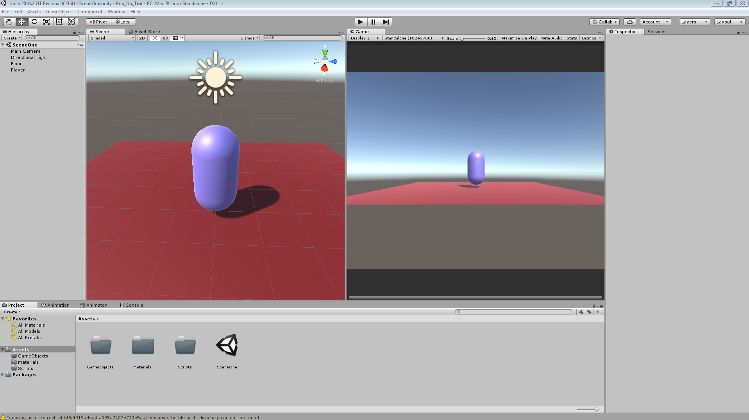
Phase one:
I first started by creating a scene to test the mechanic(as well as some file organising)
I in short created an object that I will be using for the demonstration(the capsule) as well as creating a simple plane for the player to walk on

Slide 3
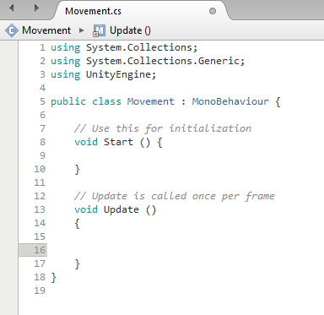
Phase two:
I then created a script that would enable the player to move around the scene and interact with certain parts of a level.

Slide 4
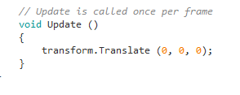
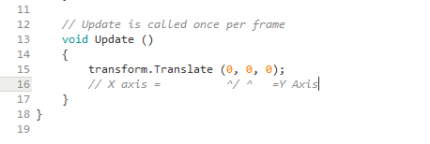
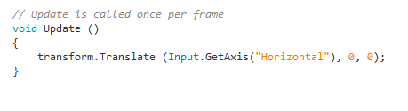
Phase three:
I then went about enabling the player to move with the “GetAxis” method
This in short makes my life a lot easier by taking advantage of the features put in place with Unity
I first started with typing inside the void Update “transform.Translate (0, 0, 0);”
Each of the three zeros are an axis within Unity, (X,Y&Z), these are the axis of which I plan to use to my advantage to enable a basic form of player movement within Unity
And finally the final stage is getting Unity to use the correct Axis, I did this by typing “(Input.GetAxis(“Horizontal”)”

Slide 5
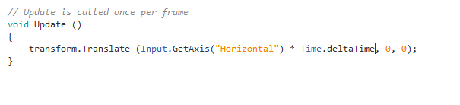
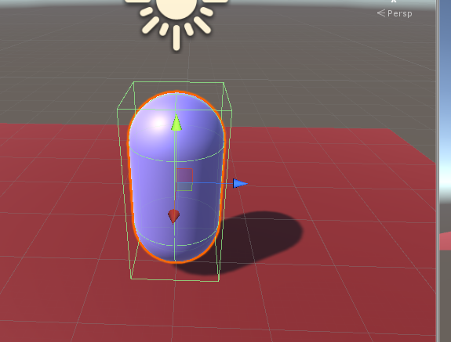
Phase four:
So I had the base of the code for the basic movement done
however it was missing a value of speed, so I timed it by real time with the following line of code “* Time.deltaTime”
I then just added a box collider to the player so that when I added a rigid body to add an element of gravity the player was not continuously falling over

Slide 6
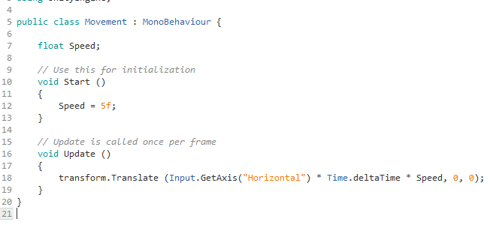
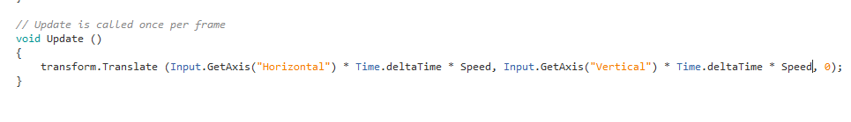
Phase five:
Even though I had the movement all figured out I was not satisfied with it being a default value of speed that the player would move at
So I added my own variable of speed so that I could control the speed that the player could move at with a value that I can change at anytime
After that I just simply did the same for the same for the z axis value, after I did the y axis first by accident which had some hilarious side affects

Slide 7
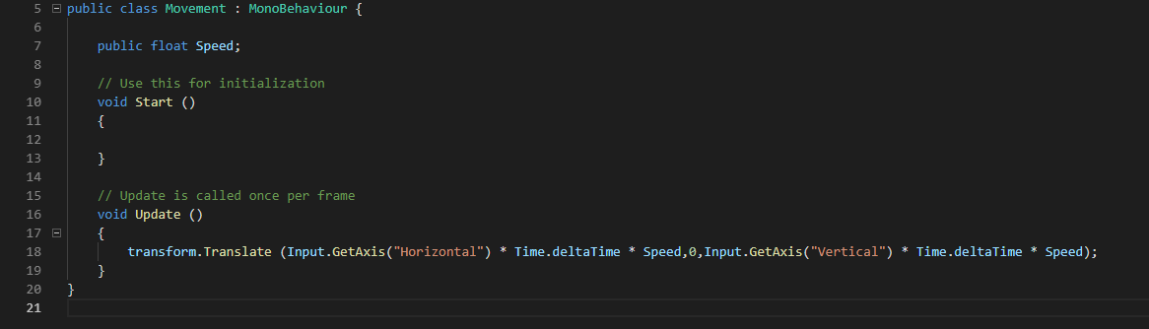
Phase six:
After confirming that the new speed variable that I added worked I made it public so I could edit it form within unity, I also took away its default speed as I would decide that when in unity

Slide 8
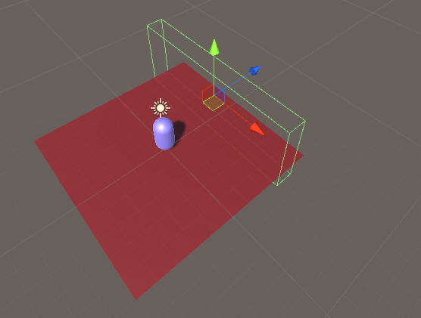
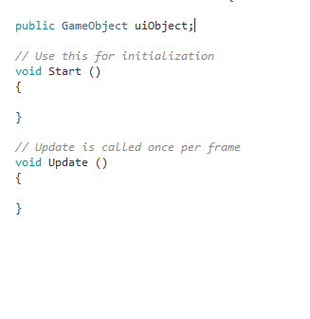
Phase six:
Now that had the movement sorted out it was time to add in the ability to activate a line of text through movement
I first started with creating a cube, which I changed the shape of, and turned its mesh off as well as the collision.
I then created a script called “uiObject” and attached it to the cube

Slide 9
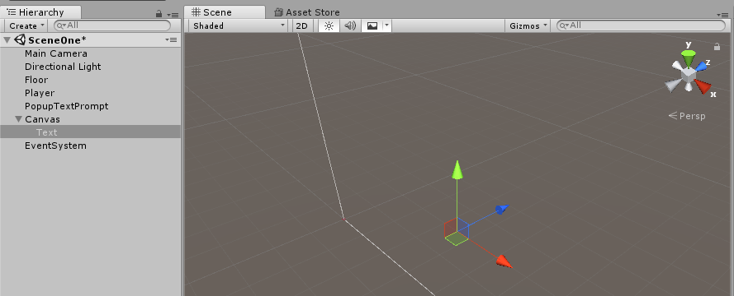
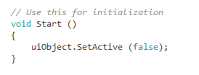
Phase seven:
I then added text into the scene simply saying “Hi” and planned to have it only appear when the player interacted with it
Within the code I first put in “unobject.SetActive (false);” this would make it so that when the scene starts the text would be out of view before the player would interact with the cube

Slide 10
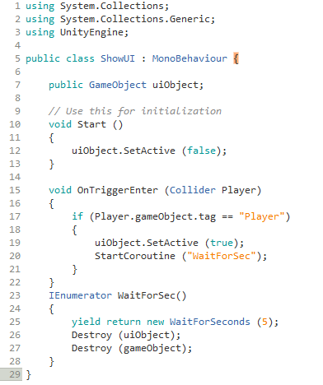
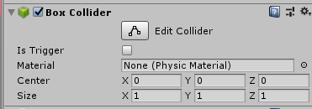
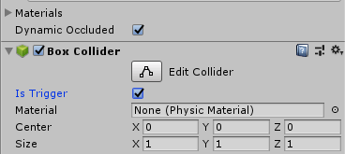
Phase eight:
I then added a void function that I would use as a base for the text to pop up mechanic
I then created an “if” statement and set the object to activate the text upon interaction and set up my next line of code
In the end I added the function that would make it so that the text, after activation, would disappear after five seconds by setting up a destroy function for both it and the box that the player had collided with
I made the box a trigger as the final touch as without it the box’s script “ShowUI” would not work

