Slide 1
TEAM TREASURE HUNT - 2
Each team will Solve a set of 6 challenges
Once solved…each team will go as a team to each treasure location and retrieve a letter
Once back here…unscramble the letters to form a “Gencyber concept” related word
Once you think you have the word…Say
“TREASURE FOUND!”

Slide 2
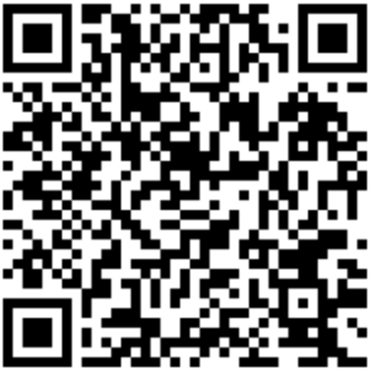
Cyberchef.io—useful site
1) 46.78452948967024, -92.14568905050777
2) This GenCyber concept deals with ensuring data isn't tampered with in transit. (tell Anup if you know)
3) VGhlIHRyZWFzdXJlIHlvdSBzZWVrIGlzIG5lYXIgdGhlIGJhc2Ugb2YgdGhlIHdlc3Qgc3RhaXJzIGluIE0xODA=
4)

Slide 3
Cyberchef.io—useful site
5) What is the most recent version of Python? (answer in X.XX format) (and tell Micah)
6) Unscramble this Linux command line term and tell Matt: ihnt asblarme

