Slide 1

Physical Hacking Devices

Slide 2
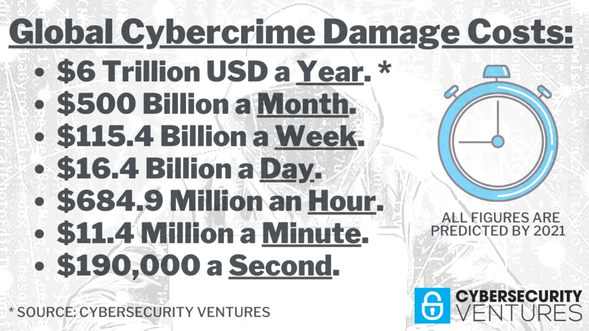
First Some Laws…
Phishing/Identify Theft/Credit Card Fraud
5 to 30years depending on if tried as bank fraud
$250,000+
Unlawful Access
5-15yrs depending on state
Cyberstalking
5yrs and $250,000

Slide 3
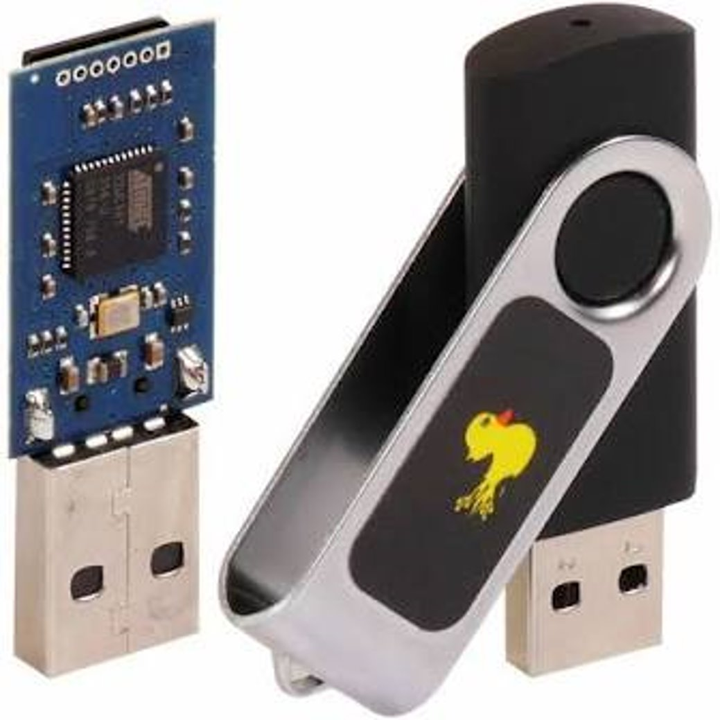
Hak 5 – Rubber Ducky
Acts like a keyboard
Injects keystrokes at rapid speed

Slide 4
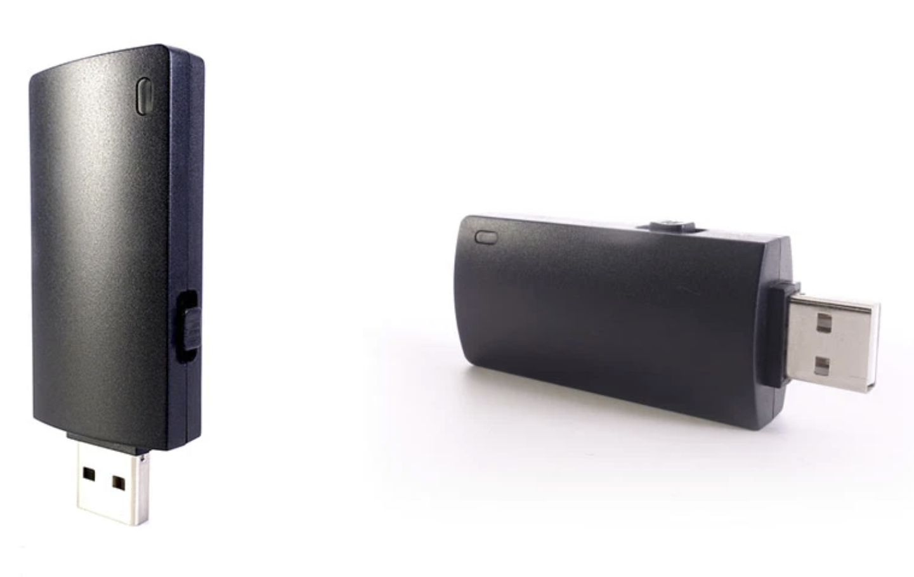
Hak 5 – Bash Bunny
Can select device type
Can store multiple payloads
Onboard storage to extract data

Slide 5

Hak 5 – Wifi Pineapple
Mimics wireless access points
Performs man-in-the-middle attacks
Extremely portable

Slide 6

Drone-Fi

Slide 7
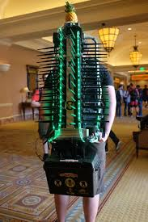
Why are these available?
Help white hat hackers test business security
Black hat hackers were using similar tools previously
Educate people about the potential dangers of physical hacking devices

Slide 8

Questions/Lab

