Slide 1
Password Cracking

Slide 2
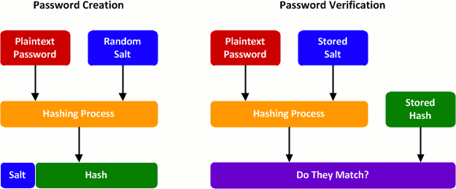
How computers see passwords

Slide 3
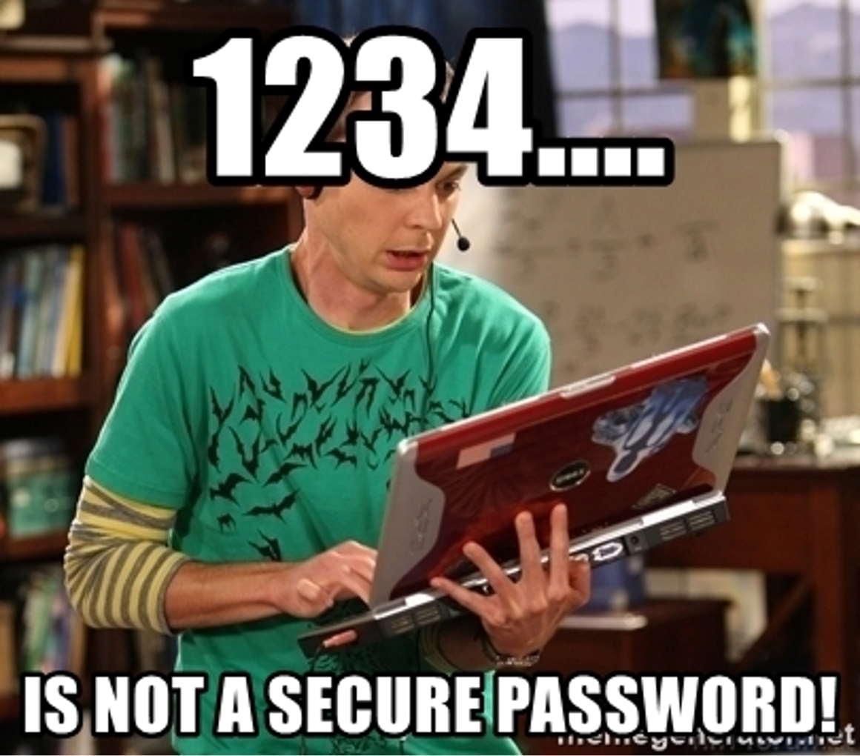
Demo of Password Lab
Hash type used?
0223b799d526b596fe4ba5628b9e65068227e68e:f6d45822728ddb2c
Create MD5 hash
GenCyber2020
Crack a hashed password
85ce57158fe94a36d6ca4028d8125378

Slide 4


Slide 5
Resources
How Stuff Works, http://computer.howstuffworks.com/workplace-surveillance2.htm
Fundamentals of Information Systems Security, David Kim and Michael Solomon, 2014.
https://hackernoon.com/20-hours-18-and-11-million-passwords-cracked-c4513f61fdb1

