Slide 1
Push
Message Queue
CFS File Source
File Information
Cloud
Provider
File Information
File Information
Criteria
Poll
User
Application
Pop
Decrypt
CFS Service
File Information

Slide 2
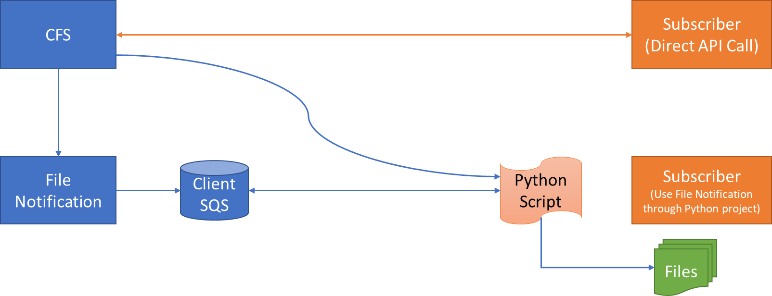

Slide 3
