Slide 1




Systematic Technical Analysis and Strategy Backtesting using Python
Technicals to Trading Systems
Conference 2023
Trevor Neil MCSI MSTA – BETA Group
Jason Ramchandani – LSEG/Refinitiv

Slide 2

Trust me, I’m a Techincal Analyst!
This session is educational to help you to learn how to develop strategies for yourself. Let no one kid you that you can listen to a few talks and be given the holy grail. There is no holy grail. Just education, discipline, skill and hard work.

Slide 3
Todays Agenda
Todays Agenda
Systematic Trading Process
Using Eikon/Workspace APIs
Using TA Indicators in your program
Creating & backtesting a simple SMA XOver strategy
Creating & testing an AI strategy using lagged data patterns
In sample, then out of sample testing
Q&A

Slide 4
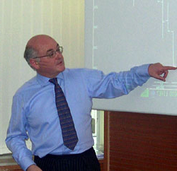
Trevor Neil MCSI FSTA – BETA Group
Trevor Neil MCSI FSTA – BETA Group
Trevor has been a professional trader and technical analyst for over 40 years..
He was on the board which created the STA and served under its first four chairman. He was made a Fellow in 2022. He is an International Goodwill Ambassador for IFTA.
He started his long career at 18 as a floor trader on the London Coffee Exchange for Merryll Lynch and has worked as broker, fund manager and technical analyst ever since. His only break from trading was when he was Global Head of Technical Analysis at Blomberg over 20 years ago.
Today, he is retained technical analyst for EnBW, CMC Markets and other major firms and is a director of RRG Research BV and BETA Group. He helps dealing desks and analysts use technical analysis in their work process. He has presented the popular Trevor Neil’s Technical Analysis Surgery webinar hosted by Refinitiv for over 15 years.

Slide 5
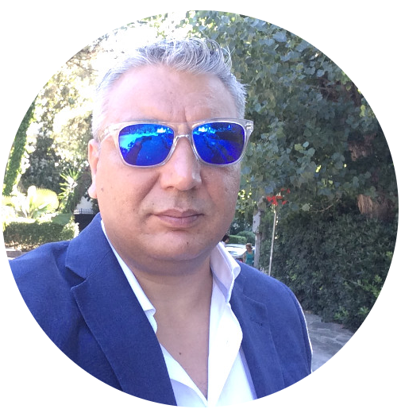
Jason Ramchandani - Lead Developer Advocate
Jason Ramchandani - Lead Developer Advocate
Jason has worked at LSEG/Refinitiv for 10 years as Lead Developer Advocate helping to build the Developer Community.
Previously he has worked in financial markets for over 15 years with a quant background in the equity/equity-linked space at Okasan Securities, Sakura Finance and Jefferies LLC in Research, Broking, Market-Making and Derivatives / Synthetics structuring roles.
Alma Mater: University College London

Slide 6
The Process
The Process
Your Idea
The Data
Think About It
Platform & language
Define and code rules
Bad results
Bad results
Evaluate Results
Out-of-sample Test
Evaluate Results
In-sample Test
Now you can trade

Slide 7
Over to Jason
Over to Jason
Code Demo

Slide 8
Resources
Resources
BETA Group Academy
Refinitiv Developer Community: Articles Q&A APIs UC
Jason’s Sample Notebook
Python Quants Video Training Series w/notebooks
Books:
Python for Finance, Python for Algorithmic Trading, Artificial Intelligence in Finance
The Python Quants
Python for Quant Finance Meetup Group (Virtual/Live)

Slide 9
Want More?
Want More?
www.betagroup.co.uk/courses
In-house courses in technical analysis in 2023? All levels but always tailored to you and your markets and work process. Book a call HERE
For recordings of past Surgeries BETA Group Academy
A course in your City – ask me
Consultancy & Mentoring. Book a call HERE

