Slide 1
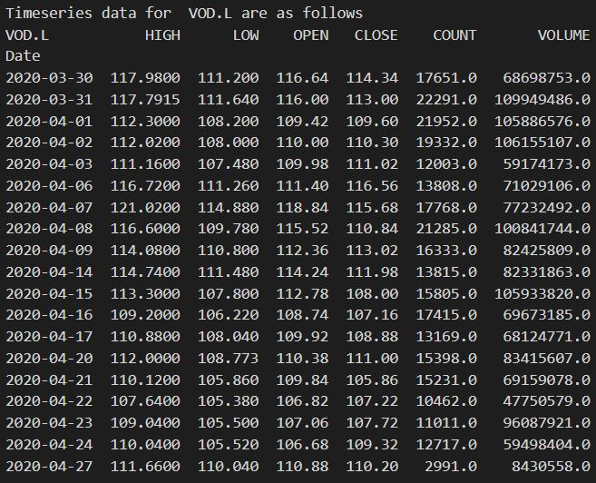
Can you help me retrieve data?
1
Do you need timeseries or snapshot price?
context_set:[gettimeseries,getsnapshot]
Other context
I need timeseries
context:gettimeseries
context_link:ric_confirmed
I want to get price
context:getsnapshot
context_link:ric_confirmed
2
Please provide RIC name
Please provide RIC name
3
VOD.L
tag:ricconfirm
context_action:gettimeseries
MSFT.O
tag:ricconfirm
context_action:getsnapshot
The latest data for MSFT.O are as follows
Instrument Price Open Price Close Volume Price Low0
MSFT.O 172.06 174.55 34305320 170.71
4
Ok, Let me check.

