Slide 1
1. The core content data is UTF-8 JSON string
3. Split it to numbers of fragments
4. Each fragment if in to a single update message
2. compressed it with gzip
fragnum = 1
{“analytics”:{“analyticsScores:[{“assetClass”: “CMPNY”,” sentimentNegative”:”0.81”, “sentimentNeutral”:”0.12”,” sentimentPositive”:”0.056”}]}}
fragment
OMM Update message
gzip message
fragnum = 2
fragment
OMM Update message
fragnum = 3
fragment
OMM Update message

Slide 2
frag_num = 1
fragnum = 1
decoded
fragment
length = 200
OMM Update message
fragment
tot_size= 500
frag_num = 2
fragnum = 2
gzip completed fragment
OMM Update message
decoded
fragment
length = 150
fragment
unzip
frag_num = 3
fragnum = 3
decoded
fragment
length = 150
{“analytics”:{“analyticsScores:[{“assetClass”: “CMPNY”,” sentimentNegative”:”0.81”, “sentimentNeutral”:”0.12”,” sentimentPositive”:”0.056”}]}}
OMM Update message
fragment
The core content data is UTF-8 JSON string

Slide 3
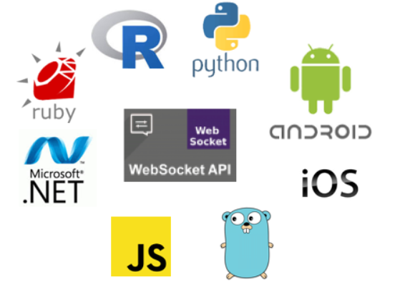
Elektron
MRN Data
RSSL connection
TREP
MRN Data
WebSocket connection

