Slide 1
1. The core content data is UTF-8 JSON string
3. Split it to numbers of fragments
4. Each fragment if in to a single update message
2. compressed it with gzip
fragnum = 1
{"altId": "1234", "body": "This is MRN News Data body", "headline " : " This is a headline", "language": "en"}
fragment
OMM Update message
gzip message
fragnum = 2
fragment
OMM Update message
fragnum = 3
fragment
OMM Update message

Slide 2
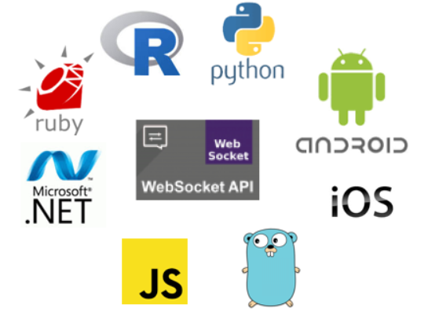
Elektron
MRN Data
RSSL connection
TREP
MRN Data
WebSocket connection

Slide 3
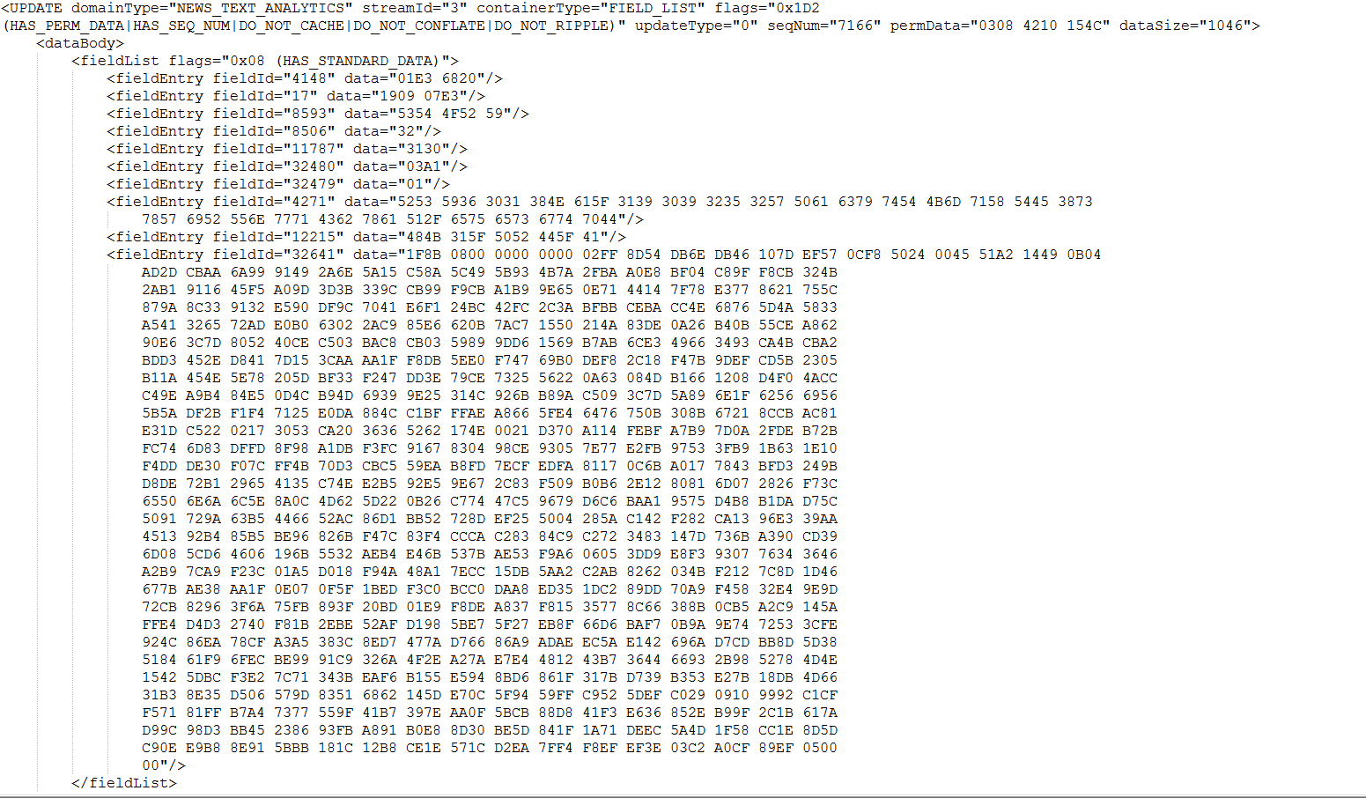
RSSL

Slide 4
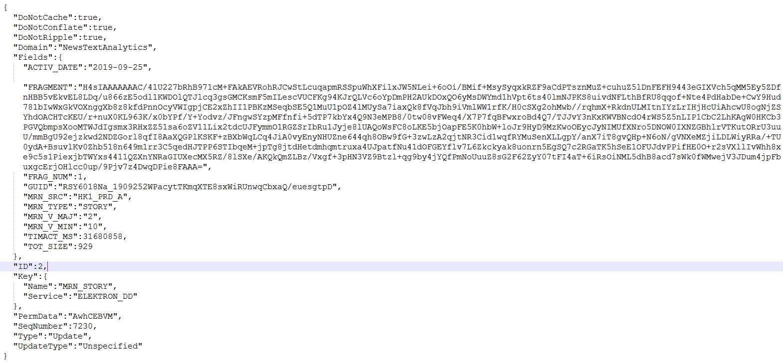
WebSocket

Slide 5
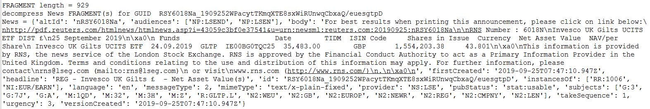
Result

